Slide 1
FY 2022 – BRIC and FMA NOI
How to Successfully Complete a Notice of Interest (NOI)
August 31, 2022
www.caloes.gov

Slide 2




Webinar Overview
Place yourself on mute
This presentation is being recorded, and will be posted to the Cal OES website
During the presentation, use the chat feature to ask questions
Q and A will occur at the end

Slide 3
Administrative Slide for UEI and SAM
Effective April 4, 2022, the Federal Government transitioned from using the Data Universal Numbering System or DUNS number, to a new, non-proprietary identifier known as a Unique Entity Identifier or UEI.
For entities that had an active registration in the System for Award Management (SAM) prior to this date, the UEI has automatically been assigned and no action is necessary.
For all entities filing a new registration in SAM.gov on or after April 4, 2022, the UEI will be assigned to that entity as part of the SAM.gov registration process.
UEI registration information is available on GSA.gov at: https://www.gsa.gov/about-us/organization/federal-acquisition-service/office-of-systems-management/integrated-award-environment-iae/iae-systems-information-kit/unique-entity-identifier-update
Grants.gov registration information can be found at: https://www.grants.gov/web/grants/register.html.
Detailed information regarding UEI and SAM is also provided in Section D of the FEMA BRIC NOFO
Detailed information regarding UEI and SAM is also provided in Section D of the FEMA FMA NOFO

Slide 4
Goals Review
General Information
Subapplication Information
Project Information
Problem and Solution
Benefit-Cost Analysis
Activity Costs & Prepare California Match
Local Hazard Mitigation Plan Information
Contact Information
FMA Differences
Eligibility and Follow-Up

Slide 5
Hazard Mitigation Assistance (HMA) Grants
BRIC and FMA funding:
FLOOD MITIGATION ASSISTANCE (FMA)
Purpose: FEMA funded, State administered program and not directly tied to a disaster declaration; reduce NFIP claims Cycle: Annual Local Match: 0%, 10%, or 25% FY 2022 Funding*: $800M - nationally competitive program
BUILDING RESILIENT INFRASTRUCTURE AND COMMUNITIES (BRIC)
Purpose: FEMA funded, State administered program and not directly tied to a disaster declaration; high-impact, neighborhood scale projects Cycle: Annual Local Match: At least 25% or 10% for economically disadvantaged rural communities (EDRC) FY 2022 Funding*: ~$2.3B - nationally competitive program
HAZARD MITIGATION GRANT PROGRAM (HMGP)
Purpose: FEMA funded, State administered program and directly tied to a disaster declaration; break cycle of repetitive losses Cycle: Post-Disaster Local Match: 25% FY 2022 Funding*: Varies year to year - competitive within each state
* Federal Share

Slide 6
Goals of NOI Submission
  Time and resource management
  Quick screening tool for eligibility and competitiveness
  Early intervention to flag potential issues
  Determine if potential projects are aligned with FEMA and State funding priorities for mitigation
  Steps 1 and 2 are in Salesforce
  Steps 3 and 4 are in FEMA GO
1
2
3
4
NOI Submission | NOI Approval | Subapplication Development | Subapplication Submission

Slide 7


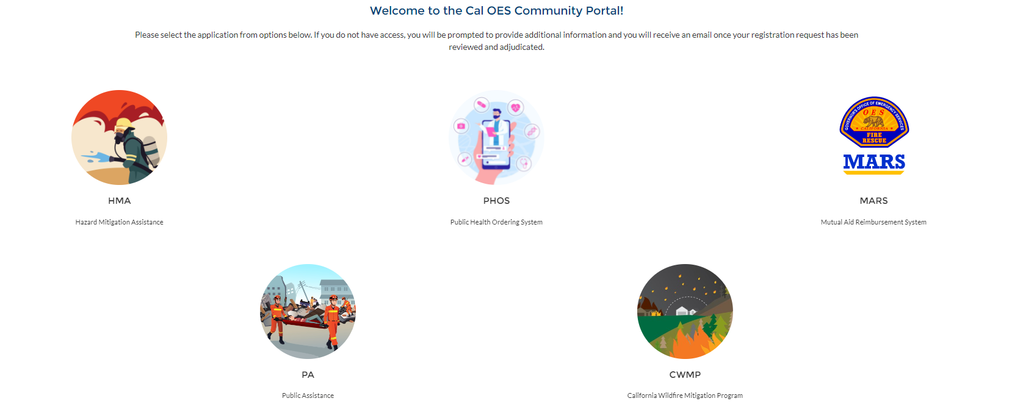
Notice of Interest (NOI)
Click HMA

Slide 8
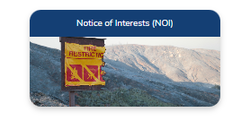

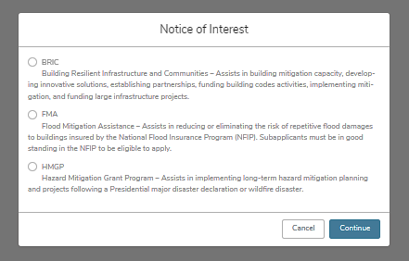
Notice of Interest (NOI): 3 Steps
1
2
3
Submit NOI | Upper Left Corner, click submit NOI | Notice of Interest

Slide 9
Goals Review
General Information
Subapplication Information
Project Information
Problem and Solution
Benefit-Cost Analysis
Activity Costs & Prepare California Match
Local Hazard Mitigation Plan Information
Contact Information
FMA Differences
Eligibility and Follow-Up

Slide 10
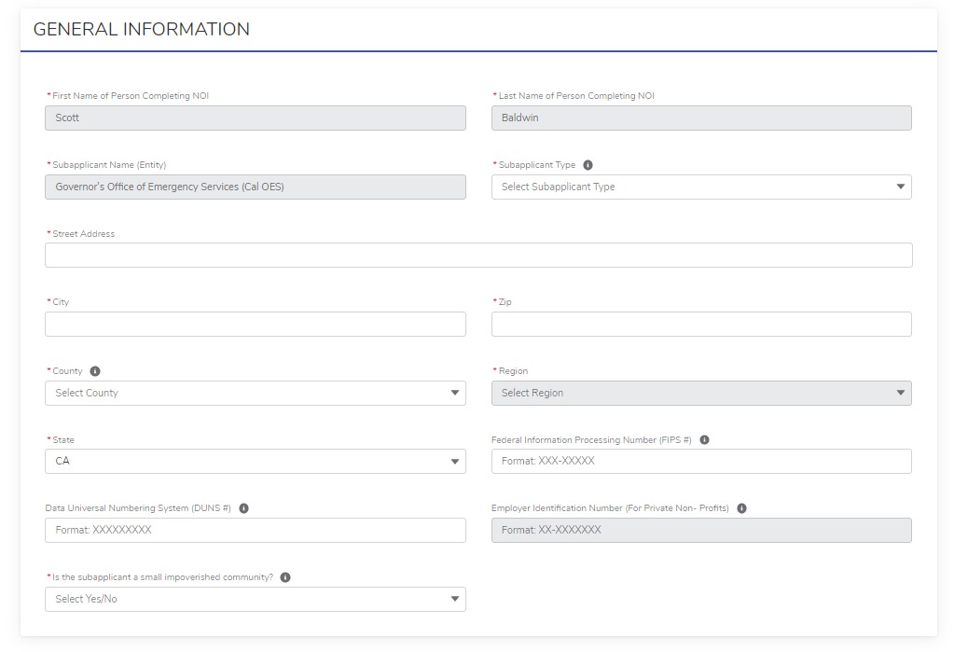
General Information Section

Slide 11
General Information Section
Field | Hover Tip? | Mandatory or Optional | Tips for Subapplicant
Name of person completing the NOI | No | Mandatory
Subapplicant name | No | Mandatory
Subapplicant type | Yes | Mandatory | City, County, State, PNP, Special District, and Tribal
Address with County and Region | Yes | Mandatory | Instruction for use of multi-county
Federal Information Processing (FIPS) Number | Yes | Optional | Email Cal OES to get FIPS
Data Universal Numbering System (DUNS) Number | Yes | Optional | Information for how to obtain DUNS is provided (not needed since UEI has replaced this)
Employer Identification Number (EIN) used for Private Non-Profits | Yes | Optional | Information on what an EIN is
Small Impoverished Community (Economically Disadvantaged Rural Community) | Yes | Mandatory | - Must meet the definition - If applying on behalf of an EDRC, this will need to be stated in the brief summary section (letter from EDRC is needed) - If yes is checked, the local match is 10%. The SA can overmatch at 12%

Slide 12
Goals Review
General Information
Subapplication Information
Project Information
Problem and Solution
Benefit-Cost Analysis
Activity Costs & Prepare California Match
Local Hazard Mitigation Plan Information
Contact Information
FMA Differences
Eligibility and Follow-Up

Slide 13
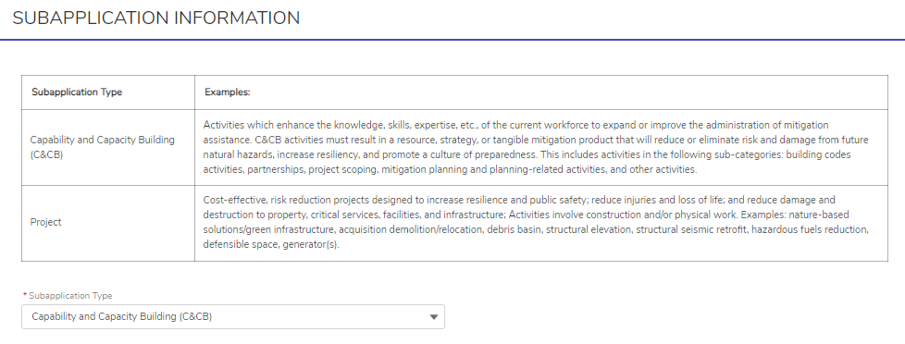
BRIC Subapplication Information Section

Slide 14
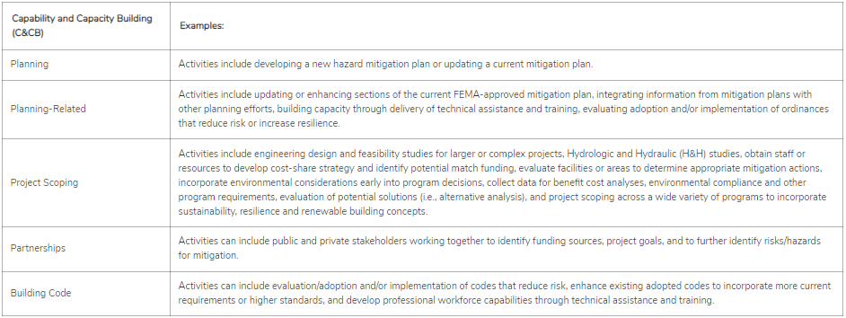
BRIC Subapplication Information: C&CB
Keep In Mind
Cal OES is prioritizing project scoping activities to fulfill their $2M allocation cap

Slide 15
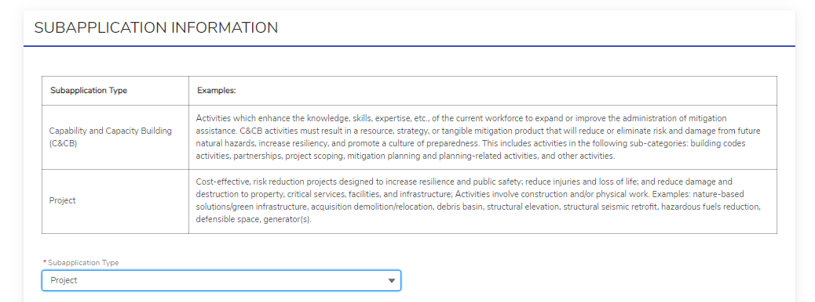
BRIC Subapplication Information: Project

Slide 16
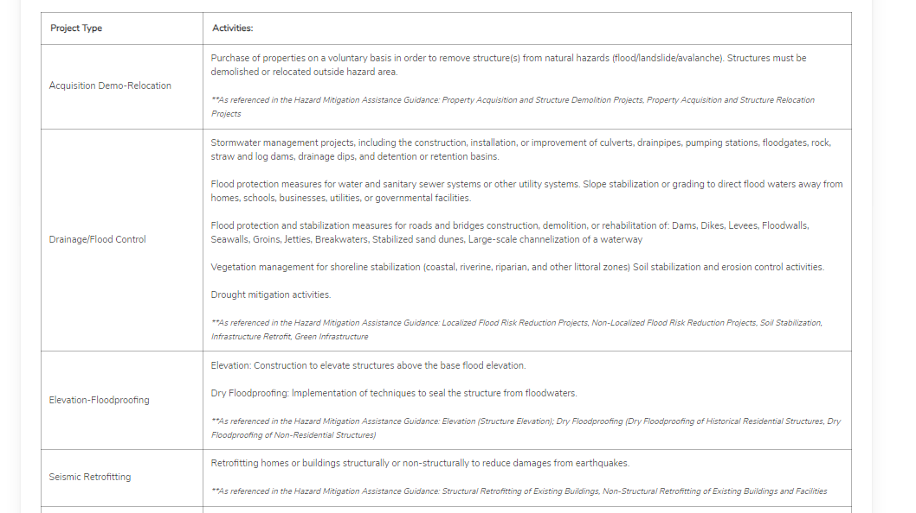
BRIC Subapplication Information: Project Types

Slide 17
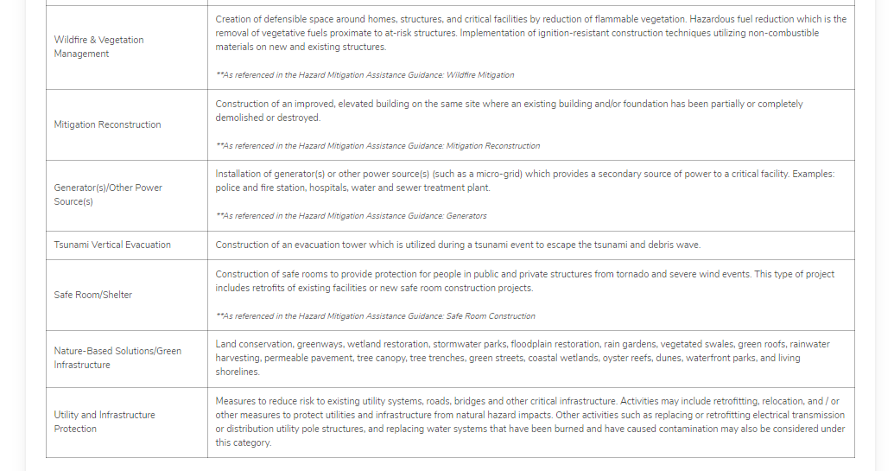
BRIC Subapplication Information: Project Types

Slide 18


BRIC Subapplication Information Section
First critical action needed here!
  Must determine the correct subapplication type
BRIC Project | C&CB
Construction will occur; can be phased project or shovel ready project | No construction will occur; activity that will get to a HMA project in the future

Slide 19
Subapplication Type Should Match the Hazard
For example, if drainage/flood control is selected, the hazard is more likely flood than tornado.

Slide 20
Goals Review
General Information
Subapplication Information
Project Information
Problem and Solution
Benefit-Cost Analysis
Activity Costs & Prepare California Match
Local Hazard Mitigation Plan Information
Contact Information
FMA Differences
Eligibility and Follow-Up

Slide 21
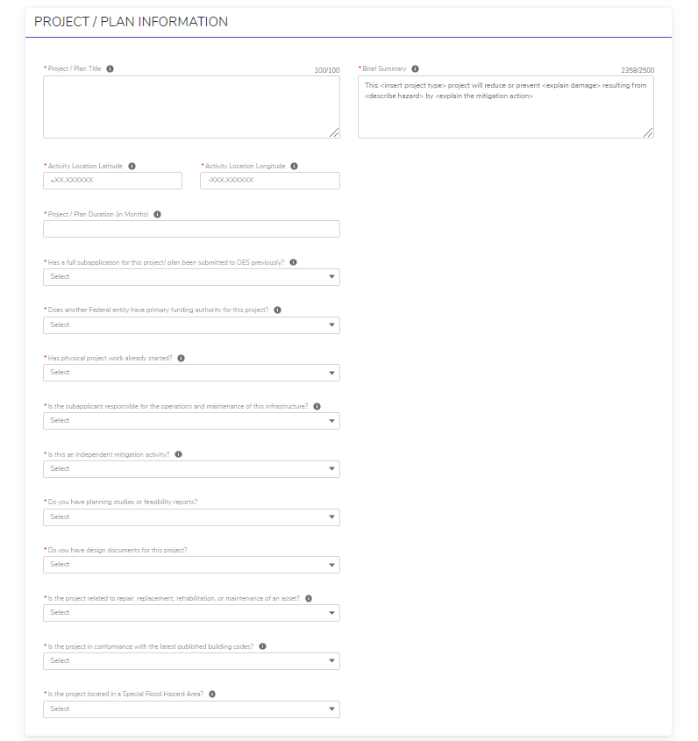
BRIC Project Information Section

Slide 22
BRIC Project and C&CB Information
Field | Hover Tip? | Mandatory or Optional | Tips for Subapplicant
Project Title | Yes | Mandatory | Explains how to name the project Too often, titles are vague or include ineligible information Start with BRIC / FMA 2022 Subapplicant name and brief description of mitigation activity
Brief Summary | Yes | Mandatory | Formatted to assist SA to answer the Q and provide a brief overview
Activity location | Yes | Mandatory | Describes the lat/long format of the location and project benefitting area
Project Duration (in months) | Yes | Mandatory | Explains the period of performance; BRIC projects can be longer than 36 months with a reasonable explanation; should include 3 months for grant closeout

Slide 23
BRIC Project and C&CB Information
Field | Hover Tip? | Mandatory or Optional | Tips for Subapplicant
Has the project been submitted previously? | Yes | Mandatory | Lists other potential sources of funding If yes, the SA should provide the program and project number (example, HMGP DR 4482) Question seeks to reduce duplication and/or to help track duplicated projects
Duplication of Programs (DOP) | Yes | Mandatory | If another agency has primary authority (yes answer), the project may not be eligible … more information is needed If the SA answers yes, SA should provide the program A yes response will likely trigger the need for a follow-up call, email, or RFI
Has work begun? | Yes | Mandatory | If work has started (yes answer), the project may not be eligible … more information is needed If the SA answers yes, SA should describe the work that has already begun A yes response will likely trigger the need for a follow-up call, email, or RFI

Slide 24
BRIC Project Only Information Section
Field | Hover Tip? | Mandatory or Optional | Tips for Subapplicant
Is SA responsible for O&M? | Yes | Mandatory | If SA is not responsible (no answer), the project may not be eligible … more information is needed If no, who is responsible for the O+M A no response will likely trigger the need for a follow-up call, email, or RFI
Independent mitigation solution | Yes | Mandatory | If not an independent mitigation solution (no answer), the project may not be eligible … more information is needed If no, what is it dependent on? A no response will likely trigger the need for a follow-up call, email, or RFI

Slide 25
BRIC Project Information Section
Field | Hover Tip? | Mandatory or Optional | Tips for Subapplicant
Planning studies/feasibility reports | No | Mandatory | SA lists documents available Helps to determine if the project should be phased
Design documents | No | Mandatory | SA lists documents available Helps to determine if the project should be phased
Is the project repair, replacement, or maintenance? | Yes | Mandatory | If the project is any of the above (yes answer), the project may not be eligible … more information is needed If the project does not have a level of protection increase, it is not an eligible mitigation project
Is the project in conformance with the latest published building codes? (Project + C&CB)? | Yes | Mandatory | Ensures that the project is feasible in that it meets current code and is not in violation of current code A no answer may trigger the need for follow-up as the project may be ineligible If SA answers no, they should explain why the project is not in conformance with current codes
Is the project in the Special Flood Hazard Area (Project + C&CB)? | Yes | Mandatory | If the project is in the SFHA (yes answer), the project may need further evaluation Good floodplain management discourages new building in the SFHA Flood insurance and code requirements may need to be met (EO 11988 and 500-year construction requirement) See new FEMA policy, FEMA Policy FP-206-21-0003

Slide 26
Goals Review
General Information
Subapplication Information
Project Information
Problem and Solution
Benefit-Cost Analysis
Activity Costs & Prepare California Match
Local Hazard Mitigation Plan Information
Contact Information
FMA Differences
Eligibility and Follow-Up

Slide 27
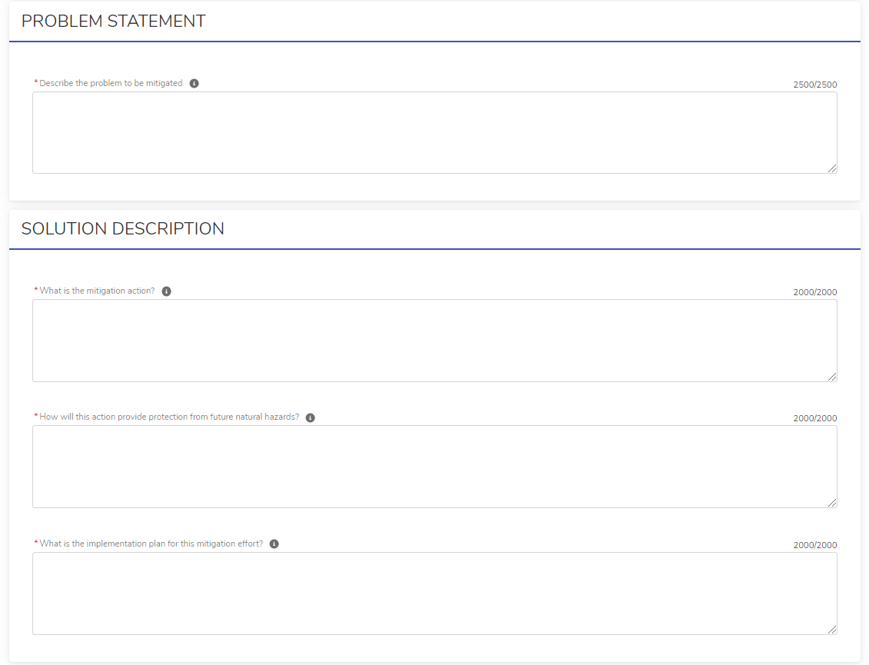
BRIC Problem Statement & Solution Description Section: Project and C&CB

Slide 28
BRIC Problem Statement Section
Field | Hover Tip? | Mandatory or Optional | Tips for Subapplicant
Describe the problem to be mitigated | Yes | Mandatory | Damages must be caused by a natural hazard Detailed description of the problem Location and extent of the problem What is the frequency of the damages and how long has the problem been going on? Dates of events (history of the hazard) Looking for quantitative and qualitative description of hazard impacts Types of damage (loss of function/service and physical damage) Is the problem causing death, injury, and property damage? Cost of damages or service/function disruption or loss Are critical assets/infrastructure being damaged? What studies / analysis have been completed to determine extent of hazard?

Slide 29
BRIC Solution Description Section
  What is the mitigation solution?
  What is being protected by the mitigation solution?
  Does it include a level of protection increase?
  Does the mitigation solution seem to address the mitigation problem?
  Level of details for the mitigation solution (is it designed?)
  What happens if the mitigation action (project) is not constructed?
  Does the scope include any ineligible activities?
Field | Hover Tip? | Mandatory or Optional
What is the mitigation action? | Yes | Mandatory
How does the action protect against natural hazards? | Yes | Mandatory

Slide 30
BRIC Solution Description Section
  Who is managing the project (in house or consultants)? Is procurement addressed?
  Are they seeking management costs to help to implement the grant?
  Does the implementation plan seem reasonable given the scope of the proposed mitigation solution (right sized)?
Field | Hover Tip? | Mandatory or Optional
What is the implementation plan for the mitigation action? | Yes | Mandatory

Slide 31
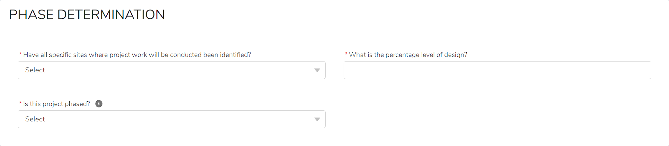
Phase Determination (Only Applicable for Projects – C&CB Write No)
Field | Hover Tip? | Mandatory or Optional | Tips for Subapplicant
Have all specific sites where project work will be conducted been identified? | No | Mandatory | Yes or No Helps to determine if the project should be phased
What is the percentage level of design? | No | Mandatory | 0%, 10%, 30%, 60%, 90%, and/or 100% If under 60%, the project needs to be phased
Is this project phased? | Yes | Mandatory | Yes or No If all sites are not known and/or project is under 60% design, the project must be phased

Slide 32
Goals Review
General Information
Subapplication Information
Project Information
Problem and Solution
Benefit-Cost Analysis
Activity Costs & Prepare California Match
Local Hazard Mitigation Plan Information
Contact Information
FMA Differences
Eligibility and Follow-Up

Slide 33
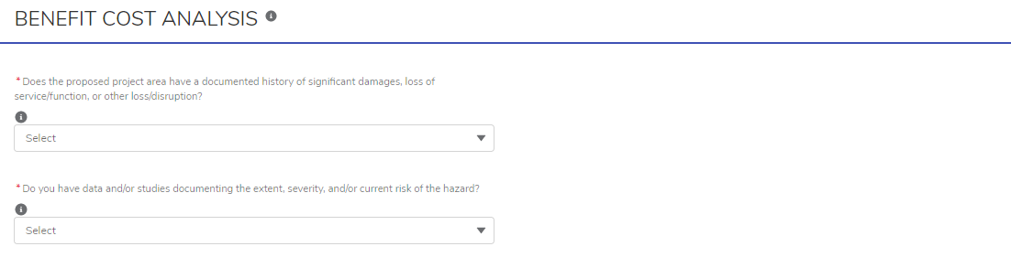
BRIC Benefit Cost Analysis Section: Project Only

Slide 34
BRIC Benefit Cost Analysis Section: Project Only
  These two questions are to help get better visibility into how well documented and quantified the risk/hazard is
  Since cost-effectiveness is mandatory and time intensive, we ask these questions to gleam a bit more information into the potential BCA
  Subapplicants should list what information is available
  If a SA does not seem to have any documentation, the project may struggle to be cost-effective as credible documentation is the foundation for “good” BCAs
Field | Hover Tip? | Mandatory or Optional
Documented history of hazards | Yes | Mandatory
Studies documenting the severity and impact | Yes | Mandatory

Slide 35
Goals Review
General Information
Subapplication Information
Project Information
Problem and Solution
Benefit-Cost Analysis
Activity Costs & Prepare California Match
Local Hazard Mitigation Plan Information
Contact Information
FMA Differences
Eligibility and Follow-Up

Slide 36
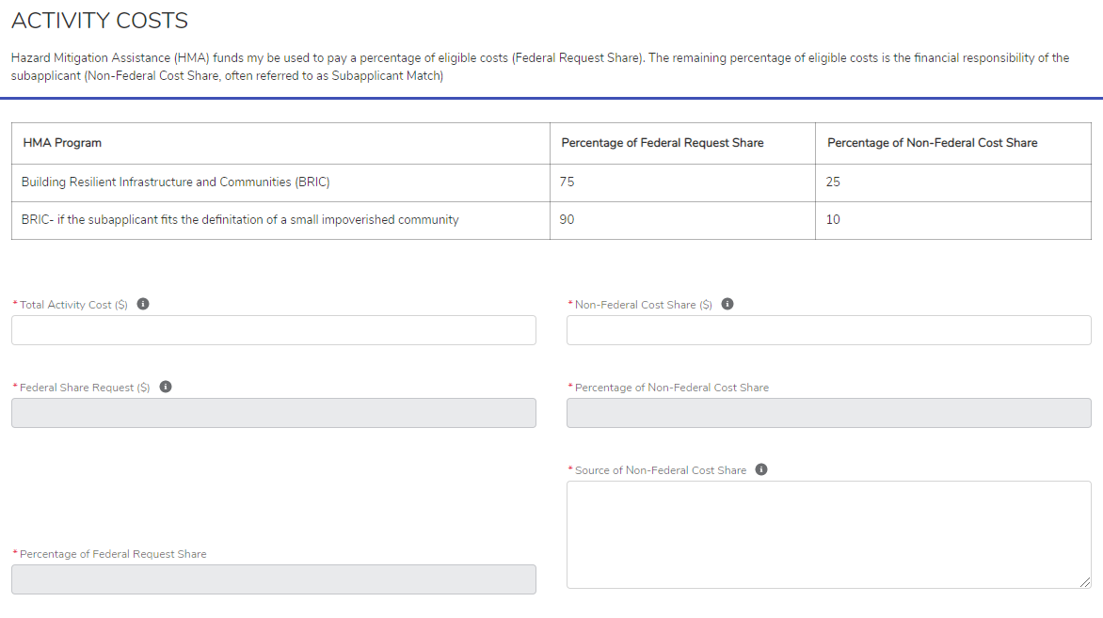
BRIC Activity Costs Section: Project and C&CB

Slide 37
BRIC Activity Costs Section: Project and C&CB
Field | Hover Tip? | Mandatory or Optional | Tips for Subapplicant
Total activity “project” cost | Yes | Mandatory | When the SA enters the cost, the remaining fields are auto-populated (minus source Q)
Non-Federal share “local match” | Yes | Mandatory | Must be at least 25%
Federal share | Yes | Mandatory | What FEMA provides
Percent of non-federal share | No | Mandatory | What the SA provides (overmatch for BRIC is 30% or 12%)
Source of non-federal share | Yes | Mandatory | Asked to ensure the non-federal share is an eligible source (local, State, in-kind, donation, etc.) If a federal source, it needs to be a federal source that loses its federal identify like HUD CDBG-DR Must be available at time of subapplication submission

Slide 38
Prepare California Match Initiative Eligibility
Eligibility:
State agencies, counties, cities, special districts and tribal governments
Must protect a community considered socially vulnerable and at high hazard risk using Cal OES Hazard Exposure and Social Vulnerability Heat Map
Subapplicants may be eligible to receive Prepare California Match, which provides local match (25% , 10% non-federal cost share) to qualified entities for competitive projects and project scoping activities
Scoping activities need to include:
  Nature-based solutions and provide flood risk reduction for NFIP structures
    Other C&CB activities will not be prioritized for Match funding (ex: plan development and/or partnership development)
Competitive projects must:
  Be aligned with the prioritization scoring criteria
  Demonstrate effective risk reduction and resiliency, community wide
  Incorporate nature-based solutions, ancillary benefits, and future conditions
  Well-defined implementation plan
  Project will directly benefit / protect a socially vulnerable community
Keep In Mind:
Subapplicants that do not meet the criteria for Prepare California Match, are still able to apply for BRIC and FMA, but will be responsible for the non-federal cost share

Slide 39
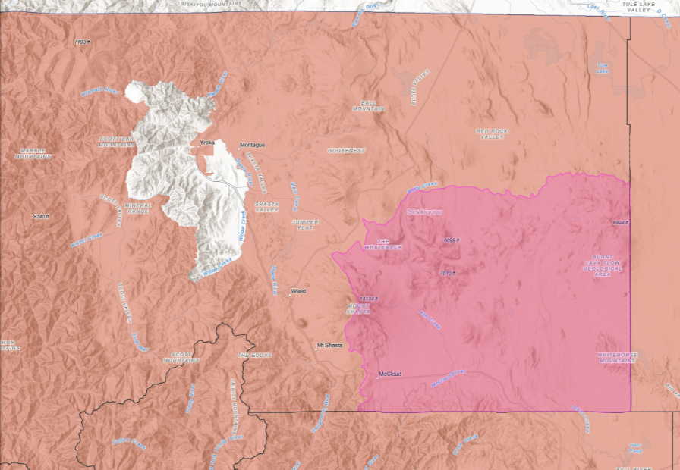
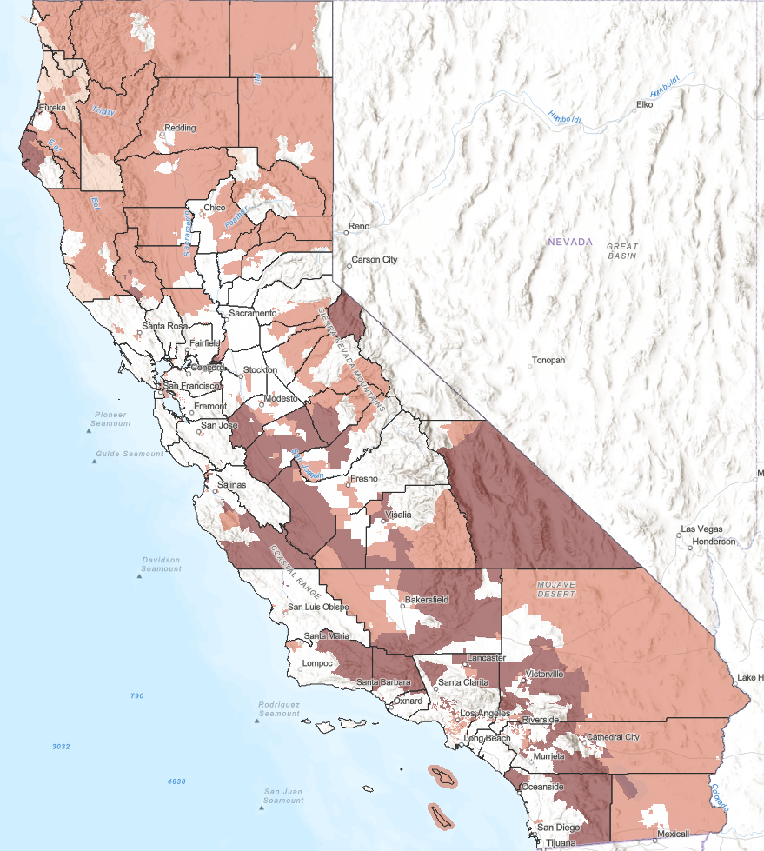
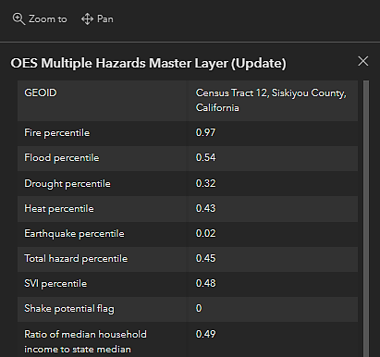
Prepare California Match Map
Eligibility Criteria
Above 0.70 in the SVI percentile
– or –
Less than 0.80 in the “ratio of median household income to state median”
– and –
Above 0.85 in any of the five hazard categories,
– or –
Above 0.70 in overall hazard exposure,
– or –
Have 1g or higher in the shake potential flag category
Cal OES Hazard Exposure and Social Vulnerability Heat Map

Slide 40
Prepare California Match Considerations
To be most competitive, the hazard and project should align – meaning, if the high hazard is flooding (70th percentile or above), that the project submitted for Prepare California consideration should be a flood project.
The project’s benefiting area must be eligible – this can sometimes differ from the project’s location.
Only subapplicants eligible for BRIC / FMA (FEMA’s criteria) are eligible for the Prepare California Match.
    Per FEMA, PNPs, businesses, and individuals are not eligible.
    Must apply as a subapplicant through Cal OES to be eligible for the Prepare California Match.
The eligible subapplicant MUST have a hazard mitigation plan approved and adopted by 12/2/22. There are no exceptions.

Slide 41
Prepare California Match Notice of Interest (NOI)
Title your NOI as follows, Prepare California Match: BRIC or FMA 2022 - Subapplicant name and activity. Example – Prepare California Match BRIC 2022 Muccio County Floodplain Restoration & Levee Resiliency Project
In the brief summary, note the area that will benefit from the project. Include the census tract number(s) for the project benefiting area in this summary
For the lat / long, note the project’s benefiting area. This will be checked against the Prepare California Match map to verify eligibility for the Match program
For the NOI’s source of non-federal cost share, write in “State Funding through Prepare California Match”
Include Prepare California Match criteria and priorities from the NOFO in the NOI (SRL/RL, BCEGS, NBS, climate adaptive, infrastructure, high-impact, community wide scale, etc.) – utilize the what is the mitigation action field
If the NOI is approved, Cal OES will give further instructions on how / where to include the Prepare California Match information in the FEMA GO subapplication

Slide 42
Goals Review
General Information
Subapplication Information
Project Information
Problem and Solution
Benefit-Cost Analysis
Activity Costs & Prepare California Match
Local Hazard Mitigation Plan Information
Contact Information
FMA Differences
Eligibility and Follow-Up

Slide 43
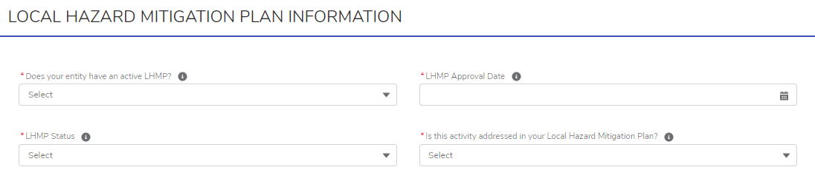
BRIC Local Hazard Mitigation Plan Information Section: Project and C&CB

Slide 44
BRIC Local Hazard Mitigation Plan Information Section: Project and C&CB
Field | Hover Tip? | Mandatory or Optional | Tips for Subapplicant
Does SA have an active LHMP? | Yes | Mandatory | If SA answers no, the project may not be eligible The LHMP needs to be approved and adopted at time of application submission and grant award for BRIC / FMA
LHMP approval date | Yes | Mandatory | If the date is not within the last 5 years, the project may not be eligible If the date is approaching 5 years, this will be flagged in the NOI review and clarified with the subapplicant
LHMP status | Yes | Mandatory | Answers include not started, in dev, OES review, FEMA review, pending adoption, and adopted
Is project addressed in your LHMP? | Yes | Mandatory | While OES likes to see a link between the HM plan and the project, this is not a requirement. A no answer does not make the project ineligible

Slide 45
Goals Review
General Information
Subapplication Information
Project Information
Problem and Solution
Benefit-Cost Analysis
Activity Costs & Prepare California Match
Local Hazard Mitigation Plan Information
Contact Information
FMA Differences
Eligibility and Follow-Up

Slide 46
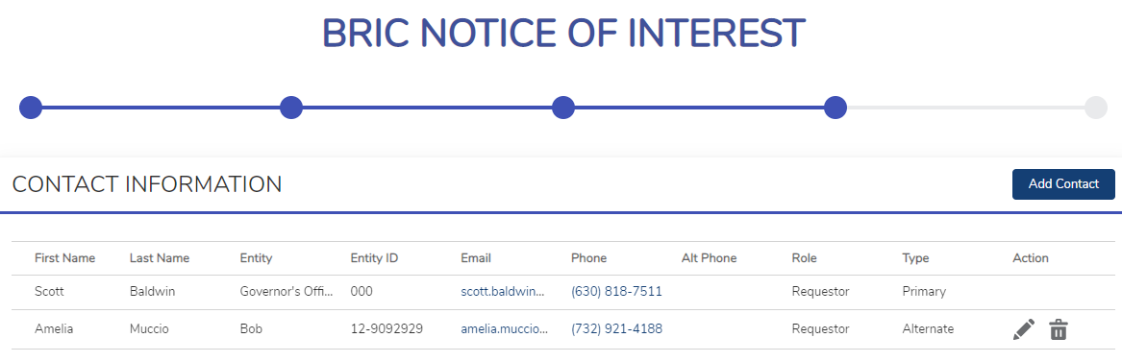
BRIC Contact Information Section: Project and C&CB
  Need to add second Point of Contact
  Must be at least two POCs on the NOI (one should be the responsible rep)

Slide 47
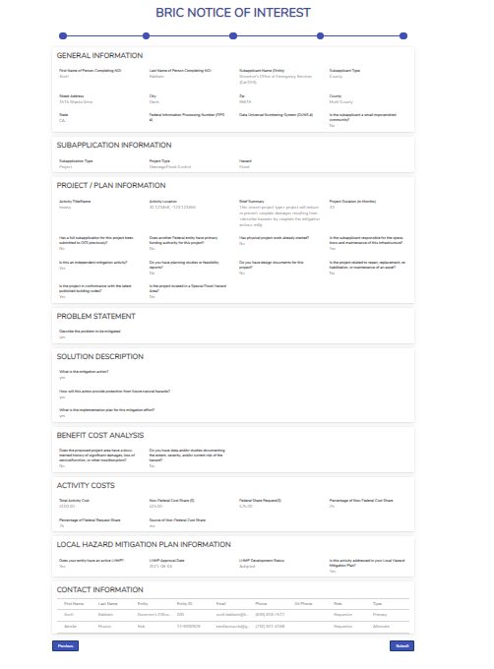
BRIC NOI Form

Slide 48
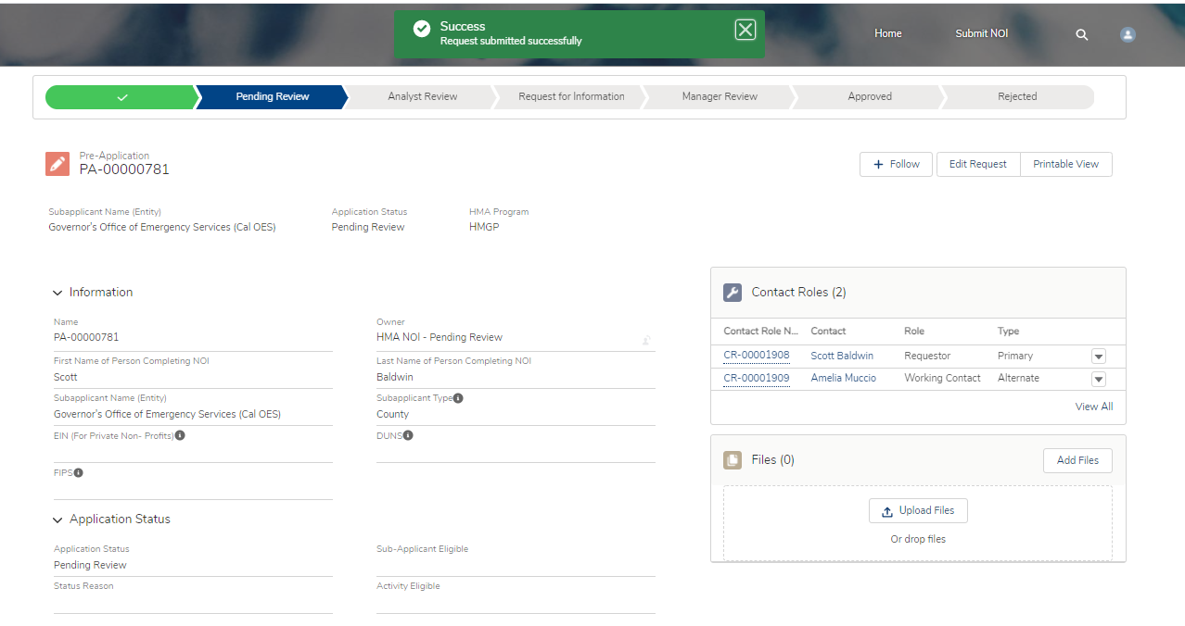
Click Submit, and…

Slide 49
Goals Review
General Information
Subapplication Information
Project Information
Problem and Solution
Benefit-Cost Analysis
Activity Costs & Prepare California Match
Local Hazard Mitigation Plan Information
Contact Information
FMA Differences
Eligibility and Follow-Up

Slide 50
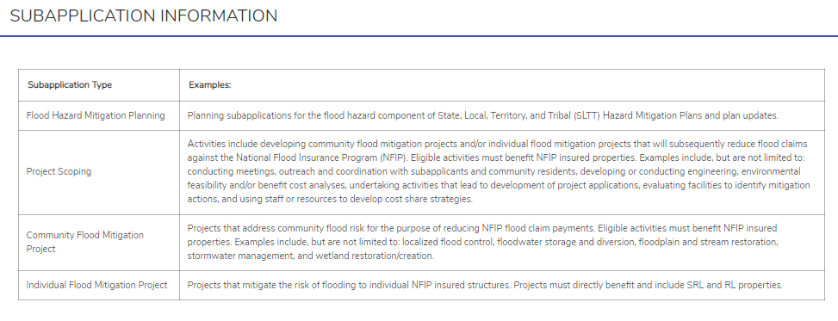
Changes for the FMA NOI
  The FY 2022 FMA program had many new changes including new eligible project types
  Cal OES is updating the FMA NOI form and subapplicants should be able to log on to complete a FMA NOI by 9/2 or early next week
  Community flood mitigation project is now localized flood risk reduction project
  Flood hazard mitigation planning is now multi-hazard mitigation plans ($25K fed share)
  Other activities should select project scoping (SRL /RL strategy plan, partnership, etc.)
  Project scoping (C&CB) and individual flood mitigation project
  NOI will not ask about small impoverished community / EDRC status
  Depending on the subapplication information selected, the project types will differ

Slide 51
Differences for FMA
  Project information will have a few different questions
Field | Hover Tip? | Mandatory or Optional | Tips for Subapplicant
Good standing with NFIP | Yes | Mandatory | If SA answers no, the project may not be eligible
NFIP community number | Yes | Mandatory | Hover tips explains what the six digit NFIP number is
Are structures insured under NFIP? | Yes | Mandatory | If SA answers no, the project may not be eligible
Does project mitigate SRL and RL? | Yes | Mandatory | Answers are RL, SRL, both, or no If a no answer, the project is likely not competitive in FMA

Slide 52
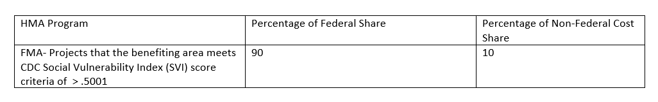
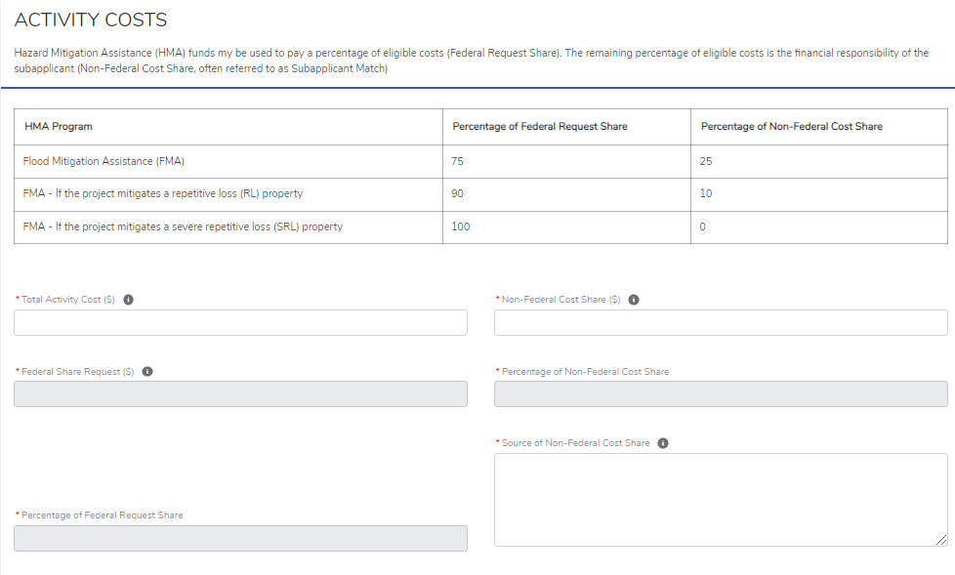
Differences for FMA
  The activity costs will differ
  Select RL if applying as a disadvantaged community (CDC SVI 0.5001 or above)

Slide 53
Goals Review
General Information
Subapplication Information
Project Information
Problem and Solution
Benefit-Cost Analysis
Activity Costs & Prepare California Match
Local Hazard Mitigation Plan Information
Contact Information
FMA Differences
Eligibility and Follow-Up

Slide 54
Eligibility and Common Reasons for Follow-Up
  Subapplication type is incorrect
  Project and hazard do not match
  Project title is ineligible
  POP is missing grant closeout
  There is a DOP
  Work has started
  SA is not responsible for O & M
  Not an independent mitigation solution
  Based on information in the NOI, the project needs to be phased
  Lacks a level of protection increase
  Does not mitigate a natural hazard
  Project is not compliant with code
  Project is in the SFHA
  The problem and mitigation solution are not aligned
  The mitigation scope is vague or missing
  NOI contains ineligible HMA language or ineligible activities
  Local match amount is incorrect or local match source is not eligible
  LHMP is expired or near expiring

Slide 55
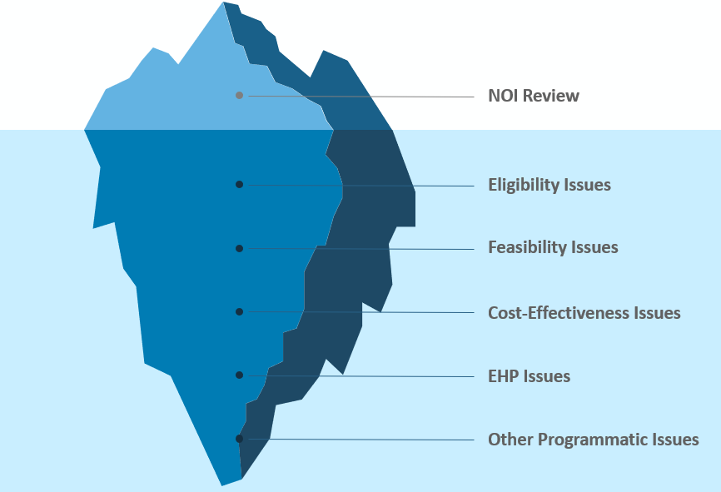
NOIs are Triaging Tools
Not meant to be full eligibility, feasibility, and cost-effectiveness screening but meant to help the subapplicant determine if the project meets the minimum eligibility criteria and raise potential issues EARLY in the process (rather than after subapplication development and subapplication submission)

Slide 56
BRIC and FMA Timeline 2022-2023
2022
2023
AUGUST | SEPTEMBER | OCTOBER -DECEMBER | JANUARY | MARCH - MAY | AUGUST
FY 2021 competitive project selections are announced FEMA NOFOs 8/12/2022 Issue 2 CFR 200 compliant RFPs for subapplication support if needed | Cal OES NOI period opens from 9/1/2022 to 9/16/2022 FEMA GO opens 9/30/2022 | Cal OES provides technical assistance and webinars to subapplicants with approved NOIs Develop subapplications (due to OES on December 2, 2022) Respond to Cal OES RFIs as needed | Cal OES finalizes subapplications to be submitted to FEMA by January 25, 2023 | C&CB Rd I announced FEMA reviews subapplications for eligibility / technical scoring criteria National Technical Review (NTR) reviews competitive subapplications Qualitative review panels are convened | 2022 competitive projects adjudicated, and selections are announced FEMA NOFO for BRIC and FMA 2023 expected in mid-August

Slide 57
Q & A
Send all additional project scoping, TA, and other questions to Cal OES Hazard Mitigation Assistance at: HMA@caloes.ca.gov
www.caloes.gov

