Slide 1

Law Enforcement Mutual Aid (LEMA)
Assistance Fund
Mutual Aid Expense Workbook Training
Nancy Ward, Director
California Governor’s Office of Emergency Services
Don O’Keefe, Chief, Law Enforcement Branch
California Governor’s Office of Emergency Services

Slide 2

Introduction/Housekeeping:
Introductions
Presentation Duration: 30 minutes
Questions: Please hold your questions until the Q&A session immediately following the presentation. During Q&A, we will unmute participants to ask questions directly. Please state your name and agency before your question. You may also submit questions anytime via the chat box.
Training Access: This training PowerPoint will be available for review on the LEMA website after today’s session.
Materials: A mutual aid workbook has been shared in the chat box for your reference.

Slide 3
LEMA FUND AGENDA/OBJECTIVES:
Equip Responding Agencies
Provide essential tools and information to efficiently prepare and submit required documentation when assisting in disasters or emergencies outside their jurisdiction.
Clarify Mutual Aid Workbook Tabs
Explain the purpose and functionality of each tab within the Mutual Aid workbook to streamline documentation processes.
Highlight LEMA Online Portal Benefits
Discuss the advantages of registering with the online portal, including improved accessibility and efficiency.
Facilitate Further Support
Provide easy access to our website and contact information for additional resources or inquiries.

Slide 4


WHO’S ELIGIBLE?
Eligible Agencies
Sworn members of CA:
City Police Departments
Sheriff’s Offices
Probation
District Attorney’s
Coroner/Medical Examiners
Non-Eligible Agencies
State Law Enforcement
Federal Law Enforcement
Requesting Agency

Slide 5
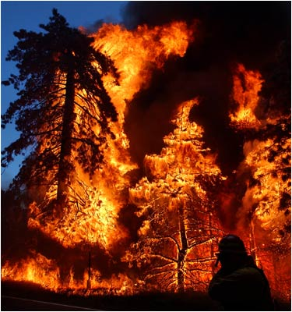
ELIGIBLE EXPENSES
Responding officer overtime
Backfill for responding officers
Mileage - to & from the incident
Lodging (case by case, requires approved justification)
Per Diem (case by case, requires approved justification)
Fuel (case by case, requires approved justification)
Extraordinary Equipment (Case by Case i.e. ISU vehicles, Rapid DNA, etc.)
Overtime, backfill, and fuel will be reimbursed at the actual costs.
Lodging, per diem, and mileage will be reimbursed at the STATE rate.
Providing Agencies can’t request reimbursement for expenses provided by the Requesting Agency.

Slide 6
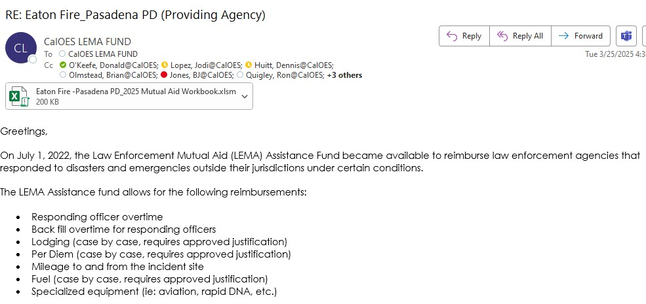
LEMA FUND REIMBURSEMENT PROCESS
Cal OES will contact the PROVIDING AGENCIES
Eligible Providing Agencies will receive the email below with all the information needed for the reimbursement packet.
Includes Mutual Aid Expense Workbook to fill out.
LEMA Fund Analysts will assist providing agencies with the reimbursement packet process.
Notes:
Supporting Documents:
Timecards
Payroll Breakdowns
MOU if applicable
214’s
Google Map
Post Event Summary Agreement

Slide 7
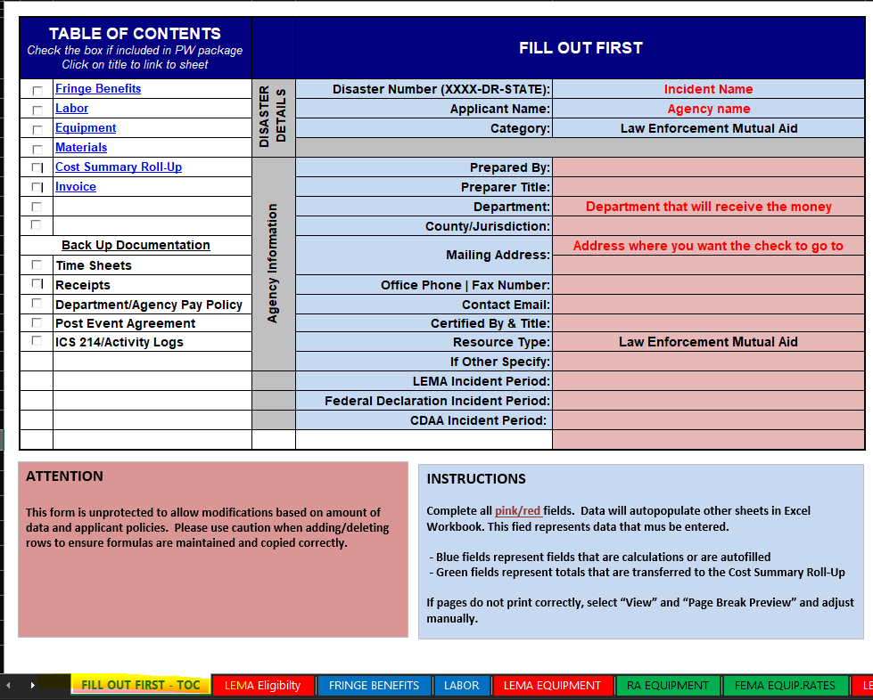
SUPPORTING/BACK UP DOCUMENTS
Mutual Aid Expense Workbook
TAB 1-FILL OUT FIRST_TOC
Fill out table with your department information
Name and Address of the department you want the invoice check to be received.

Slide 8
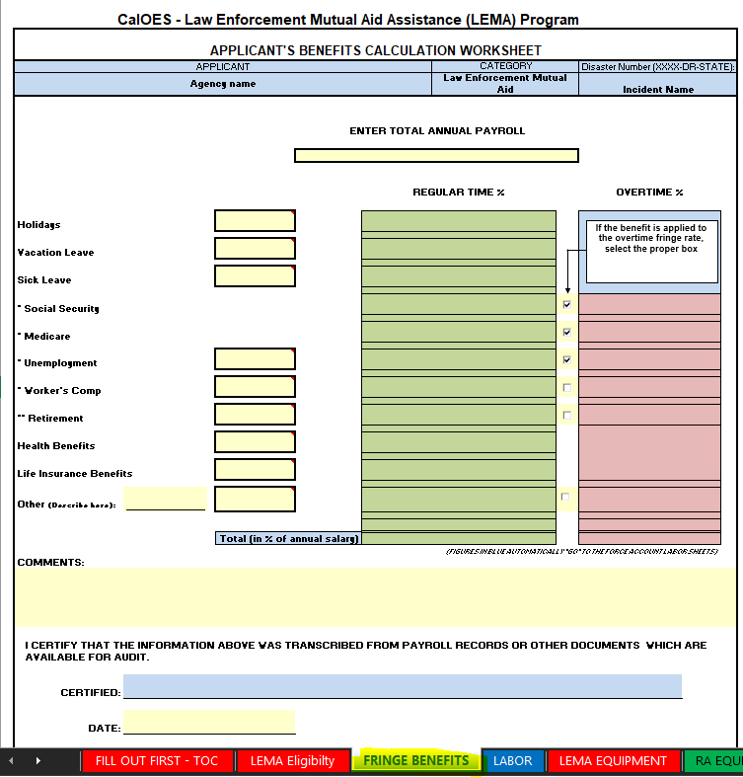
SUPPORTING/BACK UP DOCUMENTS
Mutual Aid Expense Workbook
TAB 3-FRINGE BENEFITS
Fill out table with your department’s fringe benefits
Fill out table with amounts of your departments annual budget.
If your department wants to NOT claim fringe benefits, please let us know in email response for back up documentation.
OR provide pay roll breakdown with fringe benefits included into pay rates.

Slide 9
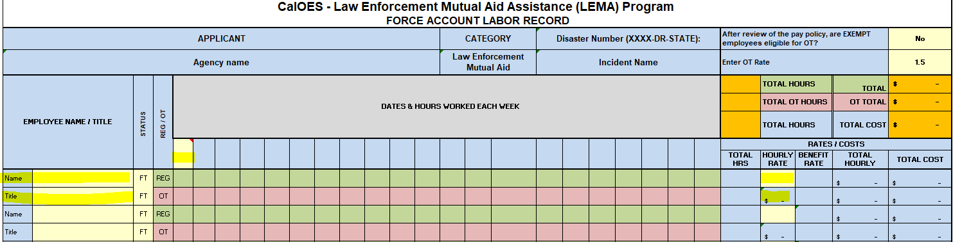
SUPPORTING/BACK UP DOCUMENTS
Mutual Aid Expense Workbook
TAB 4-LABOR
Fill out table with your department information during the incident time period
Name/Title of personnel
Date of hours worked during the Incident period
Total hours worked (REG-green row/OT-pink row)
Regular pay rate/ Overtime pay rate
DATE
HOURS

Slide 10
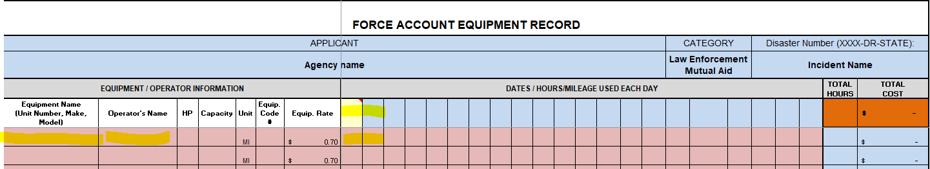
SUPPORTING/BACK UP DOCUMENTS
Mutual Aid Expense Workbook
TAB 5- LEMA EQUIPMENT
Fill out table with your department mileage information during the incident time period from the
Google map to and from your department's headquarters to the incident command post.
Names of personnel
Vehicle information
Date
Google map mileage (only round trip mileage – to and from )
*Equipment Rates are reimbursed at the STATE rate
Equipment Rate includes: Fuel, Maintenance, Depreciation, & Insurance
DATE
Google Map Miles

Slide 11
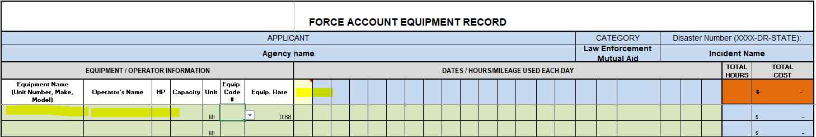
SUPPORTING/BACK UP DOCUMENTS
Mutual Aid Expense Workbook
TAB 6-RA EQUIPMENT
Fill out table with your department mileage information during the incident time period that is noted on
ICS 214 form.
Names of personnel
Vehicle information
Date
ICS 214 mileage
CAL OES LEMA Mileage and RA Vehicle Equipment Rate can't both be claimed; it must be one or the other.
*Equipment Rates are reimbursed at the FEMA rates
Equipment Rate includes: Fuel, Maintenance, Depreciation, & Insurance
DATE
214

Slide 12
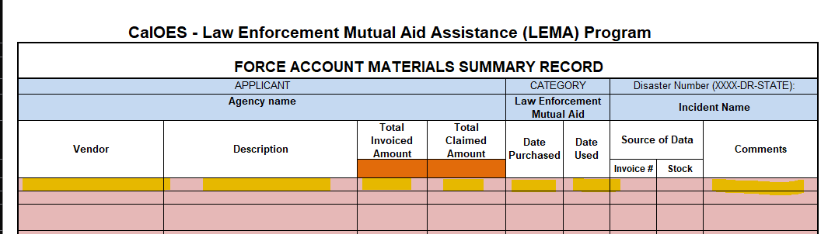
SUPPORTING/BACK UP DOCUMENTS
Mutual Aid Expense Workbook
TAB 9-LEMA MATERIALS
Fill out table with your department material information during the incident time period.
FOOD, FUEL, LODGING, ETC (case by case, requires approved justification)
Names of personnel
Vendor information
Description
Date
Amount of costs
Reasonable justification of use of materials during incident
*Please use the provided resources that
the Requesting Agency provided at incident
*Material Rates are reimbursed at the STATE rate
If requesting, provide receipts & bank statements.

Slide 13
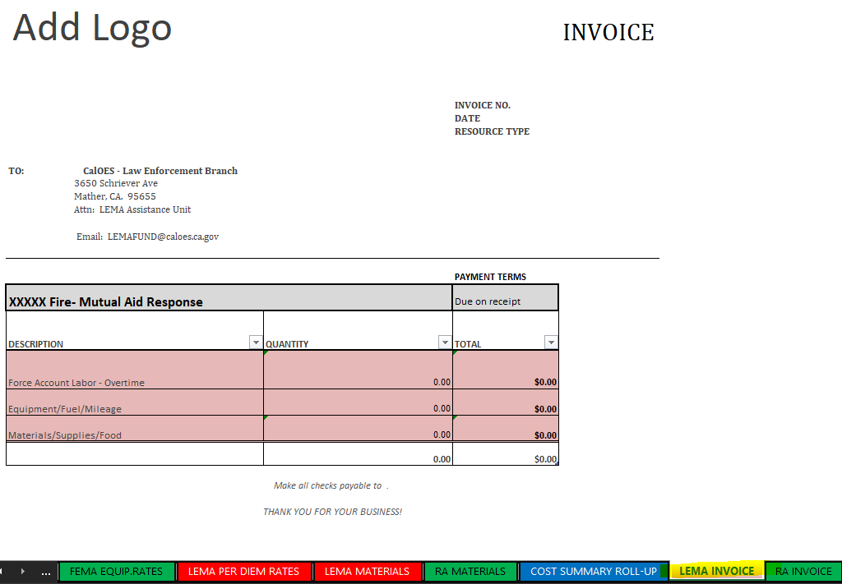
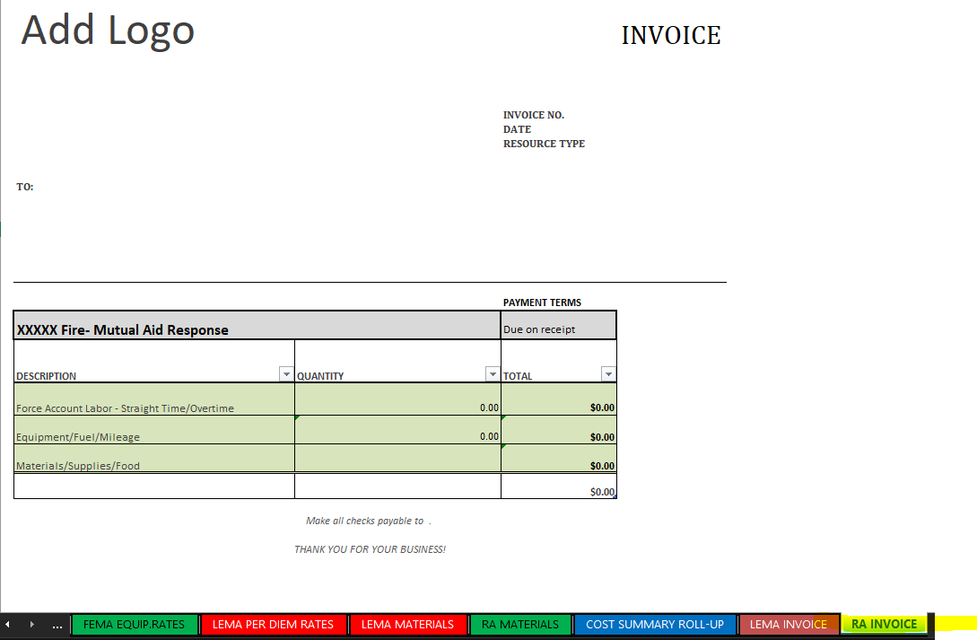
LEMA Fund Invoice vs Requesting Agency Invoice
Mutual Aid Expense Workbook has TWO invoices at the very end on the spreadsheet.
The first invoice the TAB is RED is the LEMA invoice. (TAB 12)
Eligible expenses through the LEMA Fund will be processed and amounts will be on the LEMA invoice on workbook.
Overtime expenses, mileage to and from, and LEMA Fund approved materials.
The second invoice the TAB is GREEN is the RA invoice. (TAB 13)
Non-Eligible expenses through the LEMA Fund will be processed and amounts will be on the RA invoice on workbook.
Straight time expenses, 214 mileage, and other Requesting Agency approved materials.
TAB 12
TAB 13

Slide 14
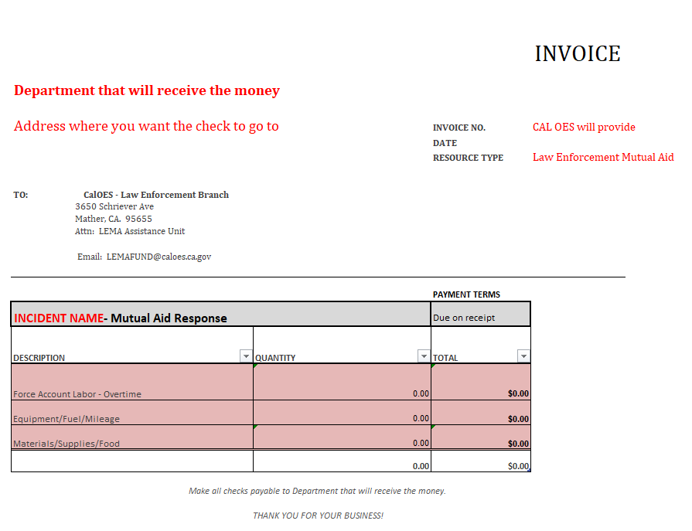
SUPPORTING/BACK UP DOCUMENTS
Mutual Aid Expense Workbook
TAB 12-LEMA INVOICE
This tab will auto fill from the first TAB.
This is the invoice amount Cal OES LEMA Fund will reimburse your agency.
Cal OES LEMA Fund will provide you an invoice number for your claim.
Double check this is the department and address you want the invoice check to go to.

Slide 15
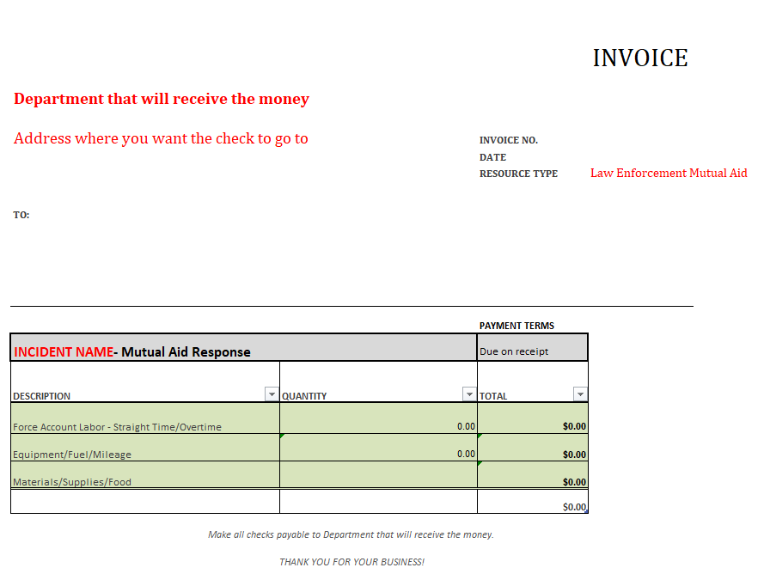
SUPPORTING/BACK UP DOCUMENTS
Mutual Aid Expense Workbook
TAB 13-RA INVOICE
This tab will auto fill from the first TAB.
This is the invoice amount Requesting Agency will reimburse your agency.
Double check this is the department and address you want the invoice check to go to.

Slide 16
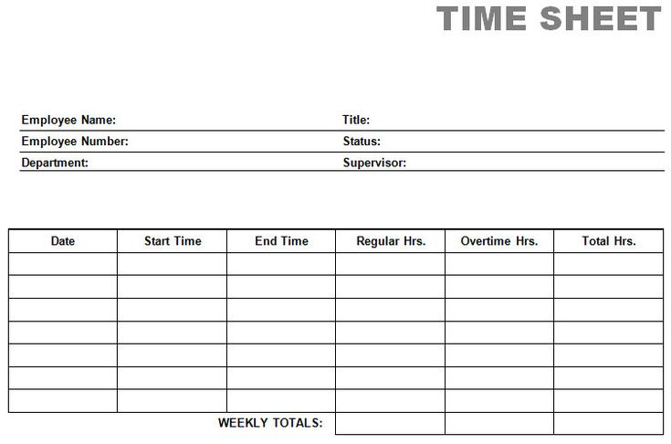
SUPPORTING/BACK UP DOCUMENTS
TIME CARDS
Name
Dates
Need timecards for every personnel worked at incident/backfill
Hours worked (Regular/ Overtime)

Slide 17
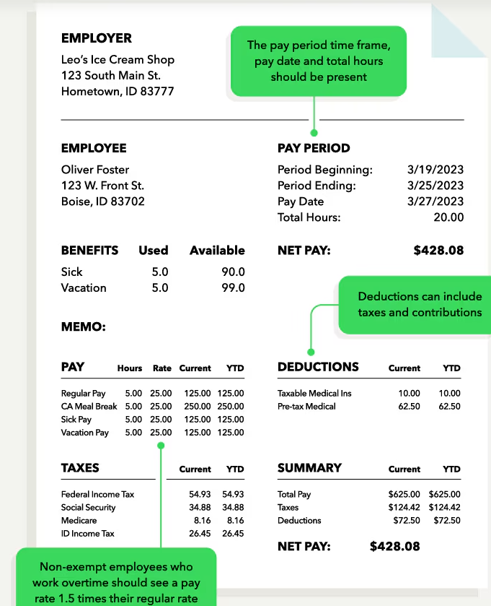
SUPPORTING/BACK UP DOCUMENTS
Pay Roll Document
Name
Dates
Need pay roll stub for every personnel worked at incident/backfill
Base pay(Regular/ Overtime)
Please note any incentives/special pays/benefits included into pay rates (Must be in department’s Pay Policy MOU)
No Worker’s Comp is included in OT pay
Can provide excel spreadsheet of pay roll breakdown

Slide 18
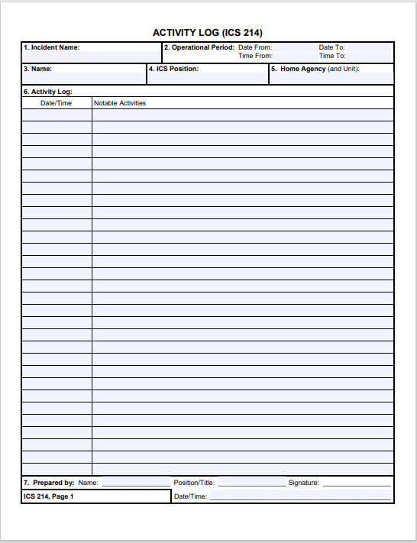
SUPPORTING/BACK UP DOCUMENTS
ICS 214 Form
Please fill out properly!
Name
Dates
Hours worked (Please include travel time)
Vehicle information/mileage
Activity (Patrolling/evacuations/etc..)
Don’t forget me!

Slide 19
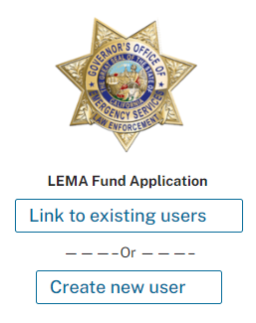
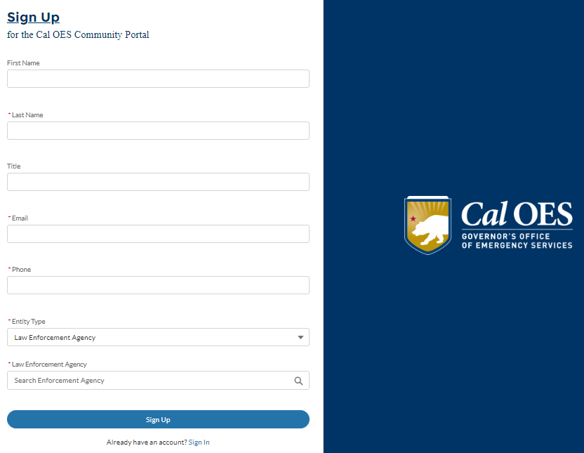
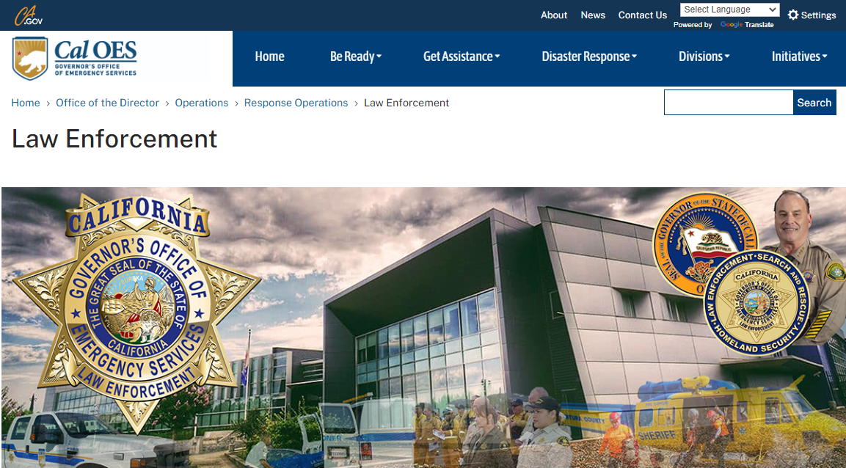
SUBMITTING DOCUMENTATION THROUGH THE ONLINE PORTAL
Providing Agencies can register on the Cal OES Online Portal and submit final reimbursement documents and invoices online.
  https://www.caloes.ca.gov/office-of-the-director/operations/response-operations/law-enforcement/law-enforcement-mutual-aid-fund/
Agencies will have access to all their invoices and be able to track payment status.

Slide 20
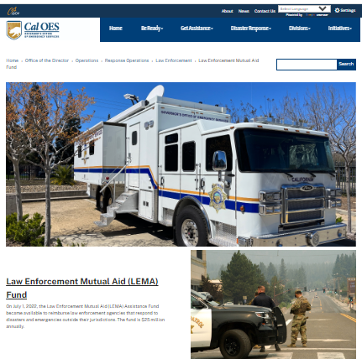
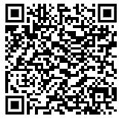
LEMA FUND WEBPAGE
LEMA Fund Information
Eligible Incidents & Fact Sheets
Access to the LEMA Fund On-Line Portal
Training Webinars
LEMA Team Contact Information

Slide 21
Q & A
FREQUENTLY ASKED QUESTIONS
1. In the case we don’t have a portal account, can we submit the workbook along with the supporting documents by email?
Answer: YES: lemafund@caloes.ca.gov, but we encourage you to make an account and track your reimbursement and records of the incidents you responded to.
2. If we cannot claim the regular hours for LEMA Fund, why do you ask for regular gross base pay?
Answer: We ask for a regular base pay rate to compare the Overtime pay rate. We make sure that the rates follow your MOU/pay policy, and if there are specialty/incentive pay or benefits included in those rates, they need to be broken down for us. LEMA Fund only reimburses overtime hours. The regular hours you can include, but it would be reimbursed by the Requesting agency.

Slide 22
Q & A
FREQUENTLY ASKED QUESTIONS
Can we claim patrol mileage and LEMA round-trip mileage?
Answer:
  CAL OES LEMA Mileage and RA Vehicle Equipment Rate can't both be claimed; it must be one or the other.
  CAL OES LEMA only covers Mileage to and from the incident on the LEMA Equipment Tab w/google map mileage
  NO PATROLING mileage OR the agency could request the Vehicle Equipment Rate if approved by RA for all mileage. This should be noted on the RA Equipment Tab.
  Agencies usually request our CAL OES LEMA FUND mileage because it is a guaranteed/quicker payout for mileage.
  While waiting for an incident to be declared and processed for CDAA/FEMA funds.

Slide 23
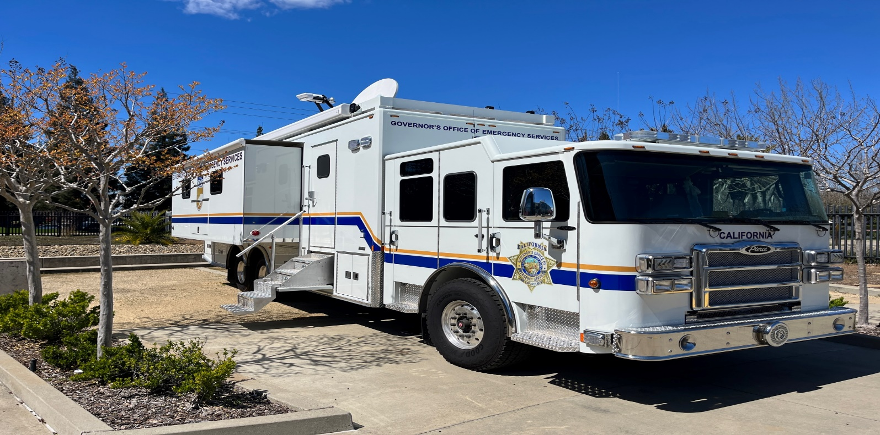
CONTACT US
LemaFund@caloes.ca.gov
Jodi Lopez
Staff Services Manager II
Law Enforcement Branch
(916) 845-8307
Taryn Renowden
AGPA LEMA Program
Law Enforcement Branch
(916) 845-8705
Pooja Randhawa Staff Services Manager I Law Enforcement Branch
(916) 845-8743
Nancy Talley
AGPA LEMA Program
Law Enforcement Branch
(916) 845-8706

