Slide 1
Office of Intergovernmental Tribal Affairs
Office established in response to the unique political status of tribal governments
Advisor to Director Mark Ghilarducci and Executive staff on emergency management matters of tribal significance
Provide Tribal Leaders with an opportunity to collaborate with the Cal OES on emergency preparedness, response and recovery and mitigation
Act as conduit to effective working relationships between Cal OES, Local governments and Tribes

Slide 2
Design of Office of Tribal Affairs
Functions as an open-door to all tribal matters pertaining to emergency management
      Serves as the primary channel of communication between tribal governments and Cal OES
Collaboration → Cooperation → Coordination
      Create collaborative policies between Tribes and Cal OES
      Strengthens tribal partnerships with Cal OES
      Coordinate with tribal governments on a broad range of issues to help integrate tribes into emergency response and recovery
Address matters related to
      Grant Information
      Emergency Planning, Preparedness & Prevention
      Training and Exercises
      Identifying resources
      Disaster Declaration Process

Slide 3
Collaboration Goals
Mission statement for the office:
To enhance emergency management capabilities of California Tribal Nations and promote access to resources through effective, supportive, and sustained partnerships with Local, State, Federal, and Non- profit agencies.
Promote a Proactive vs. Reactive environment
Improve understanding of cultural differences
Provide emergency preparedness information and training
IMPORTANT:
    Relationships must be built with Tribal Leadership & staff in order to build any kind of effective and trusting relationship with the tribal communities

Slide 4
Benefits
Creates opportunities to deal with sovereignty and jurisdictional issues in a government-to-government manner
Establishes agency-tribal relationships
  Builds bridges and creates trust
  Promotes partnerships
Promotes a better understanding and familiarity of tribal governments
Focus on building capacity and capability of all participating Federally-Recognized Tribes.

Slide 5
Contact information
Denise M. Shemenski
Tribal Advisor
Office of Intergovernmental Tribal Affairs
California Governor’s
Office of Emergency Service
Email denise.shemenski@caloes.ca.gov
(916) 845-8163 Office
(916) 616-8499 Mobile

Slide 6

California Specialized Training Institute
CSTI is a statewide enterprise responsible for supporting Training, Exercises and Education in a wide variety of areas including, but not limited to; emergency management, public safety, homeland security, hazardous materials, disaster recovery and crisis communications.
Type of Training & Providers:
CSTI & Other State Agencies: Emergency Management, Hazardous Materials, Criminal Justice Terrorism, All Hazards Training
National Domestic Preparedness Consortium: Emergency Management,
Hazardous Materials, Terrorism, All Hazards Training
Federal Emergency Management Agency: Emergency Management, All Hazards Training

Slide 7
California Specialized Training Institute
  Training Coordinated for Tribal Government:
HazMat Training for First Responders
ICS 100, 200, 300 & 400
Hazardous Materials Emergency Response Workshop
Officer Safety & Field Tactics
Emergency Management Framework for Tribal Governments
Emergency Management Operations for Tribal Governments
CERT Ham Radio Operator/Technician Licensing Training
CBRNE Radiation Detection Device Usage
CBRNE for 1St Responders
Continuity of Operations for Tribal Governments

Slide 8
California Specialized Training Institute
  Training Coordinated for Tribal Government (cont):
Tribal Law & Archaeological Field School
All Hazards Preparedness and Response
Crisis Response Team
Archeological Law Enforcement
Anti-Terrorism for Tribal Law Enforcement
Threat and Hazard Identification and Risk Assessment (THIRA)
Basic Tribal Teen CERT
All Hazard Mitigation Planning
Equine & Livestock Rescue, Large Animal Rescue
Archaeological Crime Investigation course
CPR/First Aid/AED

Slide 9
California Specialized Training Institute
  Exercise Support for Tribal Government:
Homeland Security Exercise and Evaluation Program training course to train exercise planners, controllers and evaluators and program managers.
Discussion based exercises
  Seminar
  Workshop
  Tabletop
Operations Based Exercises
  Drill
  Functional
  Full Scale

Slide 10
California Specialized Training Institute
  How to request training for State & Federal Courses:
Tribal Government wishing to attend residential training or schedule a delivery of a mobile class can request training using one of the points of contact below:
  Richard Rodriguez
    California Specialized Training Institute
    Office: (916) 845-8961
    Richard.Rodriguez@caloes.ca.gov
  Tomas Kaselionis
    DHS-FEMA Region IX
    Office: (510) 627-7298
    Tomas.Kaselionis@fema.dhs.gov

Slide 11
CSTI Contact Information
Website: http://www.calema.ca.gov/csti/pages/csti.aspx
Main Line: (805) 549-3535
James Ayre: james.ayre@caloes.ca.gov (916) 417-3841

Slide 12
Cal OES Grants Management
Tribal Programs
Grants Management, within the California Governor’s
Office of Emergency Services (Cal OES), strives to enhance
and continually improve customer service to our grant
recipients.
Of Grants Management’s 77 programs, eight
programs fund tribes in the following Divisions:
Homeland Security and Prop 1B Division
Victim Services Division
Criminal Justice and Emergency Management Division

Slide 13
Homeland Security and Prop 1B Division
The mission of the Homeland Security and Prop 1B Division is to enhance and improve overall customer service to our subgrantees while ensuring all grant expenditures are in compliance with state and federal requirements. The Division manages four federal preparedness grant programs, of which two allocate tribal funding:
  Homeland Security Grant Program (HSGP): The Cal OES HSGP supports the building, sustainment and delivery of core capabilities to enable Tribes to strengthen their capacity to prevent, protect against, mitigate, respond to, and recover from potential terrorist attacks and other hazards.
  Tribal Equipment Assistance Program (TEA): This program builds on the prevention, protection, response, and recovery capabilities within California Tribal Nations by providing needed equipment.

Slide 14
Victims Services Division
The Victims Services Division provides federal and state financial assistance to victim services agencies in California that provide a wide range of services for victims and their families in the areas of Domestic Violence, Sexual Assault, Child Abuse, and other victimizations. Currently there are 42 programs, of which 5 focus primarily on serving the tribal communities.
American Indian Child Abuse Treatment – Provides therapeutic clinical services to child victims and their non-offending families.
American Indian Domestic Violence and Sexual Assault Program – Provides advocacy services to victims of domestic violence and sexual assault.
Tribal Crisis Response – Trains Tribal communities on how to best respond to the emotional needs of victims following a crisis.
Native American Children Training Forum – Provides technology to Tribes and Tribal service providers to enable child abuse training via webinar.
Court Education and Training – The Administrative Office of the Courts administers a training program that must use 40% of funds to train Tribal Court Judges on violence against women issues.

Slide 15
Criminal Justice and Emergency Management Division
The Emergency Management Performance Grant (EMPG) Unit assists
EMPG sub-grantees with all federal, state, and programmatic
requirements, as well as provide grant support to the subgrantees in
their efforts to improve their emergency management and
preparedness capabilities. Of the two programs in the EMPG Unit, one
focuses primarily on tribes.
Tribal Emergency Management Performance Grant (EMPG) Program—The purpose is to assist federally-recognized tribes, located in California, in enhancing and sustaining all-hazards emergency management capabilities.
Tribal EMPG eligible activities and expenses include emergency management-related: Planning; Staffing & Operating Costs; Equipment; Training and Exercises.

Slide 16
Program Contacts
Grants Management:
Gina Buccieri-Harrington, Assistant Director
(916) 845-8513, Gina.Buccieri-harrington@caloes.ca.gov
Homeland Security, Prop 1B Division:
Kris Whitty, Division Chief
(916) 845-8251, Kris.Whitty@caloes.ca.gov
Victim Services Division:
Sonia Banales, Division Chief
(916) 845-8249, Sonia.Banales@caloes.ca.gov
Criminal Justice/Emergency Management Division:
John Isaacson, Division Chief
(916) 845-8644, John.Isaacson@caloes.ca.gov

Slide 17
Planning, Preparedness and Prevention
Tina Curry, Deputy Director
The Planning, Preparedness and Prevention Directorate develops and maintains emergency plans, conducts training and exercises, and maintains mitigation, prevention, and protection programs.
Programs include:
Preparedness Branch – Moustafa Abou-Taleb, Branch Chief
Phone (916) 845-8791
  Develops and Maintains the State Emergency Plan and Catastrophic Plans.
  Administers the Standardized Emergency Management System Maintenance System.
  Coordinates the Radiological/Nuclear Preparedness Program.
  Assists agencies in developing their own emergency preparedness, response and continuity plans.

Slide 18
Planning, Preparedness and Prevention
California Specialized Training Institute – David Fukutomi, Assistant Director and Superintendent
Phone (805) 549-3535
  Supports statewide training, exercises, and education in emergency management, public safety, homeland security, hazardous materials, disaster recovery, and crisis communications for local, state, and tribal governments, emergency management personnel and private-sector customers.
  Conducts the annual Capstone Exercise series on a statewide or regional basis for catastrophic disaster scenarios.

Slide 19
Planning, Preparedness and Prevention
Earthquake and Tsunami Program – Mark R. Johnson, Branch Chief Phone (916) 845-8132
  Fosters and supports statewide earthquake and tsunami readiness.
  Raises awareness of earthquake and tsunami hazards and enhances collaboration among the scientific and academic communities, emergency managers, professional associations, the public and media.
  Helps to builds and maintains earthquake and tsunami-ready communities.
  Coordinates the annual Great ShakeOut Drill.
  Lead for implementation of the CA Earthquake Early Warning System.

Slide 20
Planning, Preparedness and Prevention
Mitigation Planning – Jose Lara, Manager
Phone (916) 845-8883
  Identifies local policies and actions that can be implemented over the long term to reduce risk and future disaster-related losses.
  Develops and maintains the State Hazard Mitigation Plan (SHMP); and assists agencies in implementing state priorities by training, reviewing and providing technical assistance with Local Hazard Mitigation Plans.
  Maintains the Statewide Dam Inundation Program.
  Participates in the development and implementation of the State’s Climate Adaptation initiatives and strategies.

Slide 21
Public Safety Communications
Beginning of FirstNet
Middle Class Tax Relief and Job Creation Act of 2012
Provisions to fund a national public safety broadband network
Reallocate the 20 MHz portion of 700 MHz D Block spectrum to public safety
Authorize the FCC to conduct incentive auctions to raise $7 billion for building and managing the new network
Network specifications, network coverage, and subscription costs are unknown at this time
FirstNet currently working on specifications of the network as well as future applications

Slide 22
Public Safety Communications
FirstNet by the Numbers
5.4 Million potential FirstNet public safety users nationwide
  200,000 Potential California Public Safety Users
3,800,000 Square Miles Nationwide
  5% Dense Urban, 68% Rural, 27% Wilderness
  In California: 5% Dense Urban, 81% Rural, 14% Wilderness
60,000 Public Safety Agencies
  In California: 2,136 Public Safety Agencies
3,250 Counties
  In California: 58 Counties, 478 Incorporated Cities, 3,400 Special Districts
566 Tribes
  In California: 111 Tribes

Slide 23
Public Safety Communications
FirstNet and the State’s Role
California State Point of Contact – Karen Wong
Each Governor will have a FirstNet Network Design specific for the State to opt in to the network or opt out
Opt out - 90 days to have the RFP approved by FirstNet & the FCC
State and Local Implementation Grant Program (SLIGP)
August 19, 2013 California Received Phase 1 Grant Funding
  California’s total grant award is $7,095,983
  Science Application International Corporation (SAIC) was awarded the outreach contract

Slide 24
Public Safety Communications
California’s Plan
FirstNet efforts toward the Nationwide Public Safety Broadband Network in California must serve all counties and tribal lands equally
Partnering with Western States – WestNet
Los Angeles Regional Interoperable Communications System Authority (LA-RICS)
Partnering with CPUC and the Department of Technology on efforts to bring Broadband to underserved communities
Leveraging efforts with the Next Generation of 9-1-1
California First Responder Network (CalFRN) Advisory Committees:
  Technical Advisory Committee
  Tribal Advisory Committee
  9-1-1 Advisory Committee
  Mutual Aid Regional Advisory Committee
  California Statewide Interoperability Executive Committee

Slide 25
Public Safety Communications
Next Steps: What Can You Do To Prepare
Engage with the State’s Outreach Opportunities
CalFRN Board Meetings can be viewed on the OES Website
Look for FirstNet in California updates at APCO meetings,
9-1-1 Board meetings, or online at www.caloes.ca.gov, or www.firstnet.gov
Convergence of Technology
State is looking to leverage assets, funding and shared infrastructure including the NG 9-1-1 network
Other potential opportunities
Contact: Karen Wong 916-657-9482
Karen.Wong@caloes.ca.gov

Slide 26
Operations
Maintain a constant situational awareness of developing emergencies and provide response to the immediate needs of the Operational Areas or Tribes through the Standardized Emergency Management System (SEMS). Simultaneously, assess disaster impacts and begin the recovery process to bring the communities back to as close to the pre-disaster level as possible.
CalOES Regions: Inland, Coastal, and Southern
Fire & Rescue Branch
Law Enforcement Branch
California State Warning Center (CSWC)
State Terrorism Assessment Center (STAC)

Slide 27
Regions
The Regions support the administration of all emergency management and homeland security functions within their respective areas of responsibility. This includes the coordination of training, planning and exercises, sharing and gathering of information and deployment of emergency resources before, during and after incidents.
Operate regional emergency operations centers (REOCs) to support field operations during emergencies
Chair quarterly Mutual Aid Regional Advisory Committee (MARAC) in each Region
Assess drought impacts and attend drought meetings
Response to local jurisdictions to assist with planning and resource needs
Coordinate State Agency assistance to affected areas

Slide 28
Inland Region- Eric Lamoureux, Region Administrator
The Inland Region is comprised of 31 counties located within Mutual Aid Regions III, IV, and V.
Mutual Aid Region III – Butte, Colusa, Glenn, Lassen, Modoc, Plumas, Shasta, Sierra, Siskiyou, Sutter, Tehama, Trinity, and Yuba
Mutual Aid Region IV – Alpine, Amador, Calaveras, El Dorado, Nevada, Placer, Sacramento, San Joaquin, Stanislaus, Tuolumne, and Yolo
Mutual Aid Region V – Fresno, Kern, Kings, Madera, Mariposa, Merced, Tulare
Region Tribal Contact: Kyle Noderer (916) 709-5492
Kyle.Noderer@caloes.ca.gov

Slide 29
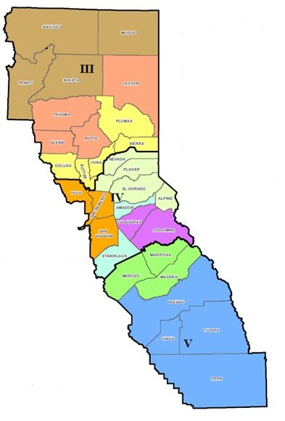
Inland Region

Slide 30
Coastal Region- Jodi Traversaro, Region Administrator
The Coastal Region is comprised of 16 counties located within Mutual Aid Region II.
Mutual Aid Region II – Del Norte, Humboldt, Mendocino, Lake, Sonoma, Napa, Marin, Solano, San Francisco, San Mateo, Contra Costa, Alameda, Santa Clara, Santa Cruz, San Benito and Monterey
Region Tribal Contact: Roger Sigtermans (415) 298-3550
Roger.Sigtermans@caloes.ca.gov

Slide 31
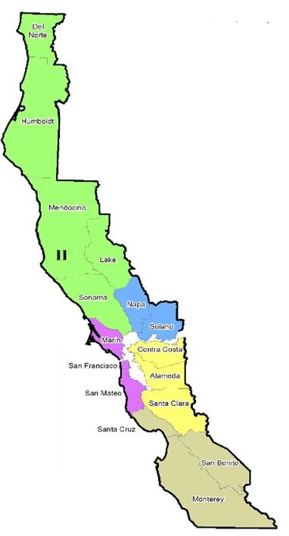
Coastal Region
31

Slide 32
Southern Region- Mona Bontty, Region Administrator
The Southern Region is comprised of 11 counties located within Mutual Aid Regions I and VI.
Mutual Aid Region I –San Luis Obispo, Santa Barbara, Ventura, Los Angeles, and Orange
Mutual Aid Region VI –San Diego, Imperial, Riverside, San Bernardino, Inyo, and Mono
Region Tribal Contact: Bill Martinez (562) 795-2957 Bill.Martinez@caloes.ca.gov

Slide 33
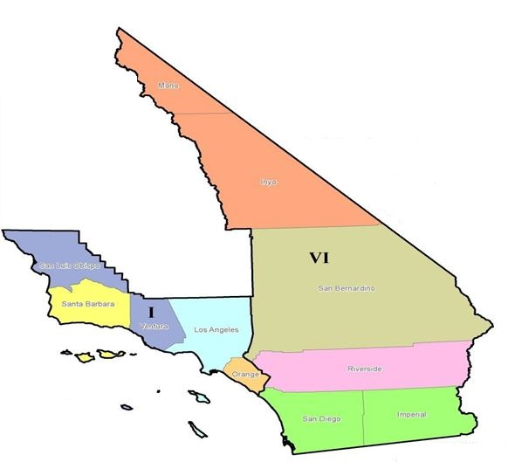
Southern Region

Slide 34
Fire, Rescue and Hazardous Material Branch: Kim Zagaris, Chief
Responsible for the development, implementation and coordination of the California Fire Service and Rescue Emergency Mutual Aid Plan.
Plan is developed under the guidance and approval of the Fire and Rescue Services Advisory Committee Board of Directors (FIRESCOPE)
Systematic mobilization, organization and operations of the State’s fire and rescue resources on a local, area, regional, statewide, national and international basis.

Slide 35
Fire, Rescue and Hazardous Material Branch: Kim Zagaris, Chief
Manages the Urban Search and Rescue (USAR) Program
Maintains a fleet of 139 initial response all-risk fire engines and 12 tactical water tenders assigned to local government fire agencies throughout the state.
Coordinates the statewide implementation of the hazardous materials accident prevention and emergency response programs
Contact: Headquarters Office (916) 845-8711

Slide 36
Law Enforcement- Mark Pazin, Chief
Coordinates statewide response for law enforcement mutual aid. Deploys law enforcement assets to disaster scenes and incidents.
Law Enforcement Mutual Aid Program
Search and Rescue Program
Coroners and Mass Fatality Program
Contact: Headquarters Office (916) 845-8700

Slide 37
State Warning Center- Randy Schulley, State Warning Officer
Responsible for informing, communicating, alerting and notifying local governments, operational areas, state officials and the federal government of natural or human caused emergencies
Maintain 24/7/365 situation status unit
Hazardous weather warnings
Tsunami alerts
Nuclear Power Plant alerts
Hazardous materials spill reporting
Contact: CSWC (916) 845-8911

Slide 38
State Terrorism Threat Assessment Center- Greg Ferraro, Commander
The STAC is California’s primary fusion center, operated by California Office of Emergency Services, California Highway Patrol and the California Department of Justice
Statewide information clearinghouse to aid in the prevention, preparation and response to strategic threats while preserving individual privacy and constitutional rights.
Contact: STAC Headquarters (916) 874-1100

Slide 39
Recovery Section
Recovery Section maximizes disaster recovery by:
State and federal disaster assistance programs.
Comprehensive grant management system.
Individuals, businesses, and the agricultural community.
Disaster recovery planning.
Disaster recovery educational activities.
Technical assistance, including Environmental and historic preservation
Trained cadre of disaster recovery staff.
California Disaster Recovery Framework.
Notes:
The Recovery Section is responsible for promoting and managing disaster recovery activities that restore vital life-support systems to operating standards and return infrastructure systems to their pre-disaster design, function and capacity. The Section performs extensive liaison activities with local, state and federal agencies, legislators, private-sector entities, various volunteer and nonprofit organizations, as well as the general public. The Recovery Section develops and provides training on recovery programs to promote recovery readiness.
Recovery Section is developing a system to provide a trained cadre of disaster recovery staff available to coordinate disaster recovery operational activities and be available to supplement current staffing for future disaster recovery efforts.
The Recovery Section is also in the process of developing the California Disaster Recovery Framework (CDRF) specifically designed to integrate with the National Disaster Recovery Framework (NDRF). The CDRF is intended to:
Provide structure to community disaster recovery.
Define roles and responsibilities for all stakeholders.
Promote a strategic planning approach to disaster recovery.
Lead the stakeholders toward a sustainable community through sustainable operational recovery efforts.

Slide 40
Individual Assistance Division (IA)
Coordinates disaster recovery information, services, referrals, and assistance for:
  Individuals and households
  Businesses
  Farmers, Ranchers, and Aquaculturists
Provides guidance and coordination for:
  Damage Assessments
  Local Assistance Centers
  Voluntary agency coordination
  Donations management for in-kind donations
Contact: Karma Hackney
(916) 845-8141
karma.hackney@caloes.ca.gov

Slide 41
Public Assistance Division (PA)
Provides guidance and coordination for:
  The federal Public Assistance (PA) program
  The Fire Management Assistance Grant (FMAG) Program
Directly administers the California Disaster Assistance Act (CDAA) program for:
  Local Governments
  Private Non-Profit Organizations
  Contact: Stacy Mason-Vegna
(916) 845-8250
stacy.mason-vegna@caloes.ca.gov
Notes:
PA and FMAG programs are authorized by the Robert T. Stafford Disaster Relief and Emergency Assistance Act. These federal programs are administered in accordance with the approved State Administrative Plans and applicable federal plans. These plans specify the state and federal roles and responsibilities and requirements for program implementation.
California Tribes eligibility for disaster recovery assistance under the Stafford Act may be processed through Cal OES PA as a subgrantee or maybe processed through FEMA or Bureau of Indian Affairs as a grantee. California Tribes are not eligible for CDAA funds. If a local government were to assist with emergency measures (not permanent restoration) on behalf of the tribe, the local government could apply for CDAA assistance as the eligible applicant for associated costs.

Slide 42
Technical Assistance Division
Provides technical expertise internally within Cal OES, and externally (other state agencies, local government, and when appropriate the private sector) for:
  Safety Assessment Program (SAP)
  Environmental/Historical Assessment
  Debris Management
  Levees, Delta, Floodplain
Contact: Marcia Sully
(916) 845-8170
marcia.sully@caloes.ca.gov

