Slide 1


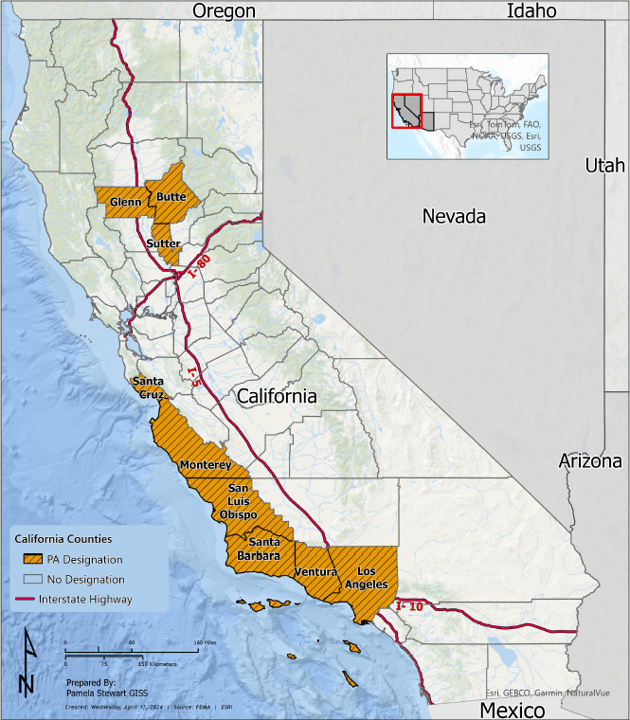
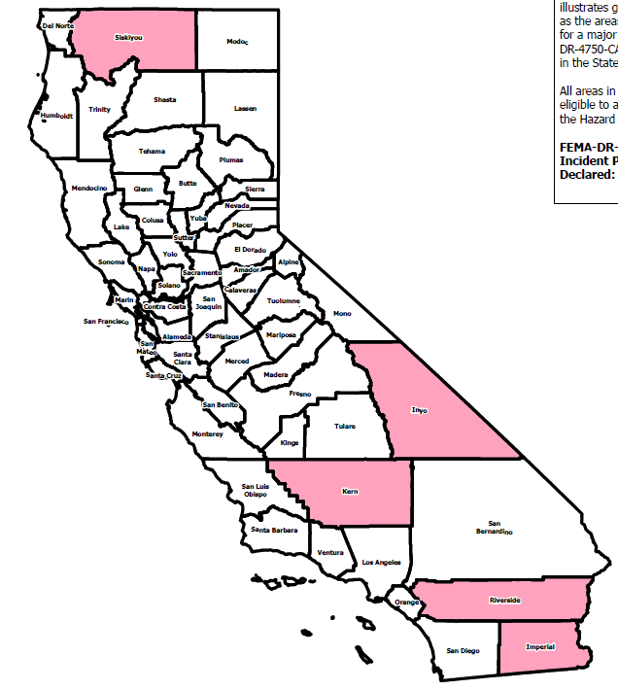
Recovery Planning Unit
DR-4750 2023 Tropical Storm Hilary
DR-4769 2024 Severe Winter Storms
Joint Incident Action Plans Completed
32
Joint Incident Action Plans Completed
26
Situation Status Reports Completed
Situation Status Reports Completed
49
32
AS OF 11/01/2024

