Slide 1


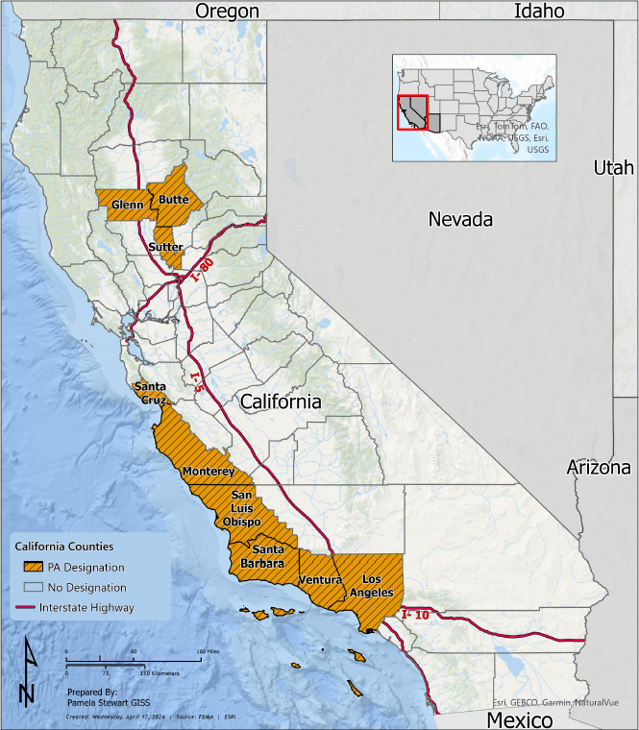
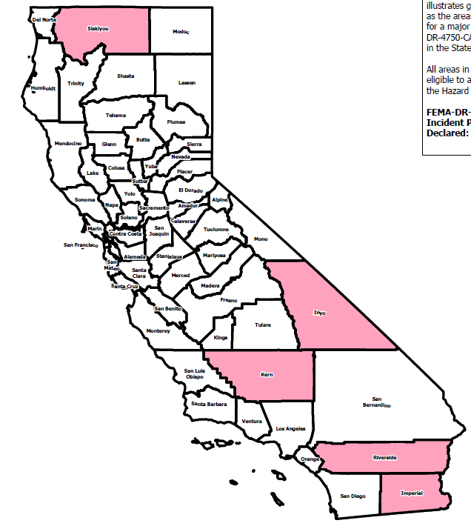
Recovery Planning Unit
DR-4750 2023 Tropical Storm Hilary
DR-4769 2024 Severe Winter Storms
Joint Incident Action Plans Completed
18
Joint Incident Action Plans Completed
19
Situation Status Reports Completed
Situation Status Reports Completed
35
18
as of July 31, 2024

