Slide 1
Hazard Mitigation Grant Program
Subapplication Development
&
Benefit Cost Analysis Workshop

Slide 2


Welcome

Slide 3
Agenda
  9:00am to 10:30am - Subapplication Development
  10:30am to 10:45am - Break
  10:45am to 12:00pm - Subapplication Development
  12:00pm to 1:00pm - Lunch
  1:00pm to 3:00pm - Benefit Cost Analysis (BCA)

Slide 4
Ground Rules
Please mute your microphone
Please wait until question break slides before asking your questions
Hold all project-specific questions until your scheduled appointment
You may email additional questions to the HMA Inbox HMA@caloes.ca.gov

Slide 5
Workshop Objectives
Provide a clear overview of the program
Provide subapplication development guidance
Outline expectations of subapplication process
Discuss criteria for scoring and ranking
Brief overview of compliance and monitoring
Provide overview of the FEMA BCA process

Slide 6
Webinar Purpose
Provide an overview of the Hazard Mitigation Grant Program (HMGP) subapplication timelines for DR-4569
Outline subapplication and BCA considerations, programmatic requirements, and best practices with the goal of making you successful in obtaining FEMA grant funding for your mitigation projects

Slide 7
Present State
Presidential Major Disaster Declarations:
    DR-4569: September 2020 Wildfires
      Declared October 16, 2020
Notices of Interest (NOI) were due to Cal OES December 30, 2020
Communities were notified of NOI eligibility and invited to attend this webinar

Slide 8
What’s Next Part 1
Subapplications due to Cal OES by May 1, 2021
    Cal OES will review submitted subapplications and may issue additional Requests for Information (RFI)
Cal OES must submit complete subapplications to FEMA no later than October 12, 2021
    Cal OES will notify you with the status of your subapplication
        Only the most complete and competitive subapplications will be recommended to FEMA
    FEMA may issue additional RFIs

Slide 9
What’s Next Part 2
Once NEPA/EHP review is completed, FEMA may award funding to Cal OES if approved
Cal OES will contact you to provide updates

Slide 10
Current Federal Disasters
DR-4569 September 2020 Wildfires
Notices of Interest (NOI) Received: 68
Total Federal Share of All NOIs Received: approximately $440,372,457 million
Total Funding Available: $45 million
*Projects submitted under this disaster may be recommended to FEMA for funding or placed on a waitlist to be considered for future funding opportunities

Slide 11
Declaration Dates
DR-4344: October 10, 2017
DR-4353: January 2, 2018
DR-4382: August 4, 2018
FM-5278: November 8, 2018
DR-4407: November 12, 2018
DR-4431: May 1, 2019
DR-4434: May 18, 2019
FM-5293: October 11, 2019
DR-4558: August 22, 2020
DR-4569: October 16, 2020

Slide 12
Declared Counties
Del Norte
Fresno
Los Angeles
Madera
Mendocino
Napa
San Bernardino
San Diego
Shasta
Siskiyou
Sonoma
Yuba

Slide 13
Funding Priorities, part 1
Jurisdictions seeking funding for the following project types:
Local Hazard Mitigation Plans (LHMP) updates that will expire within 24 months
All other LHMP updates
Shovel ready projects with a high level of design that can begin construction within 90 days of FEMA approval, in declared counties
Shovel ready projects with a high level of design that can begin constructions within 90 days of FEMA approval, in all other counties
Whole community risk reduction/large critical infrastructure wildfire projects

Slide 14
Funding Priorities, part 2
  Whole community risk reduction/large critical infrastructure projects for other hazard types
  Wildfire projects in declared counties
  All hazard type projects in declared counties
  Wildfire projects in any county
  All Hazard type projects in any county
  Planning related activities
  Five percent (5%) Initiative projects

Slide 15
DR-4569
Due Date for Subapplications
Subapplication CDs or DVDs must be postmarked by May 1, 2021
Subapplication CDs or DVDs may also be hand delivered to Cal OES no later than 4:00pm on Friday May 1, 2021

Slide 16

Hazard Mitigation
Hazard mitigation is defined as any sustained action taken to reduce or eliminate long-term risk to life and property from natural hazard events.
This is an on-going process that occurs before, during, and after disasters and serves to break the cycle of damage in hazard-prone areas.

Slide 17
Hazard Mitigation Grant
Program Part 1
HMGP funding becomes available after a Presidential Major Disaster Declaration
California is currently an Enhanced State:
    Must meet enhanced plan requirements:
        Integrated planning with agencies and stakeholders
        State mitigation capabilities – reduce exposure to risk
        Hazard Mitigation Assistance (HMA) grants performance – have the capabilities to manage grant performance

Slide 18
Hazard Mitigation Grant Program Part 2
20% of the total value of eligible damages is made available for HMGP
Projects, 7% Plans, and 5% Initiative

Slide 19
404 and 406 Mitigation
404 and 406 refer to the applicable section of the Robert T. Stafford Act
406 Mitigation (PA): Provides funding through the Public Assistance program for the repair, restoration, and replacement of damaged facilities, and for related mitigation measures
404 Mitigation (HMGP): A competitive grant program focused on mitigating risks from future disasters through the implementation of long-term independent solutions to increase protection and/or capacity

Slide 20

Previous Federal Disaster Stats
Subapplications Received:
  79 total
  63 projects and 16 plans
Subapplications to FEMA:
  46 total
  31 projects and 15 plans
  $60.5 million
Grants Funded:
  24 projects
  15 plans
  7 pending FEMA Approval
DR-4240:
  Valley and Butte
Year:
  2015
Type of Disaster:
  Fire
HMGP Funding :
  $61,933,203Available
NOIs Received: 162
NOIs Eligible:106

Slide 21
Applicant vs Subapplicant, part 1
State, territories, and Federally recognized tribes are eligible applicants for HMA programs, including HMGP
Applicant: Cal OES
Subapplicant: State agencies, local governments, special districts, PNPs, and Federally-recognized tribes
  Eligible PNPs must be eligible under 501(c), (d), or (e) of the Internal Revenue Code of 1954 and operating a facility that provides an essential government service, or provide State certification, under State law, of nonprofit status

Slide 22
Applicant vs Subapplicant, part 2
Cal OES is responsible for soliciting subapplications from eligible subapplicants and assisting in the preparation, review, and submittal of eligible and complete subapplications to FEMA

Slide 23
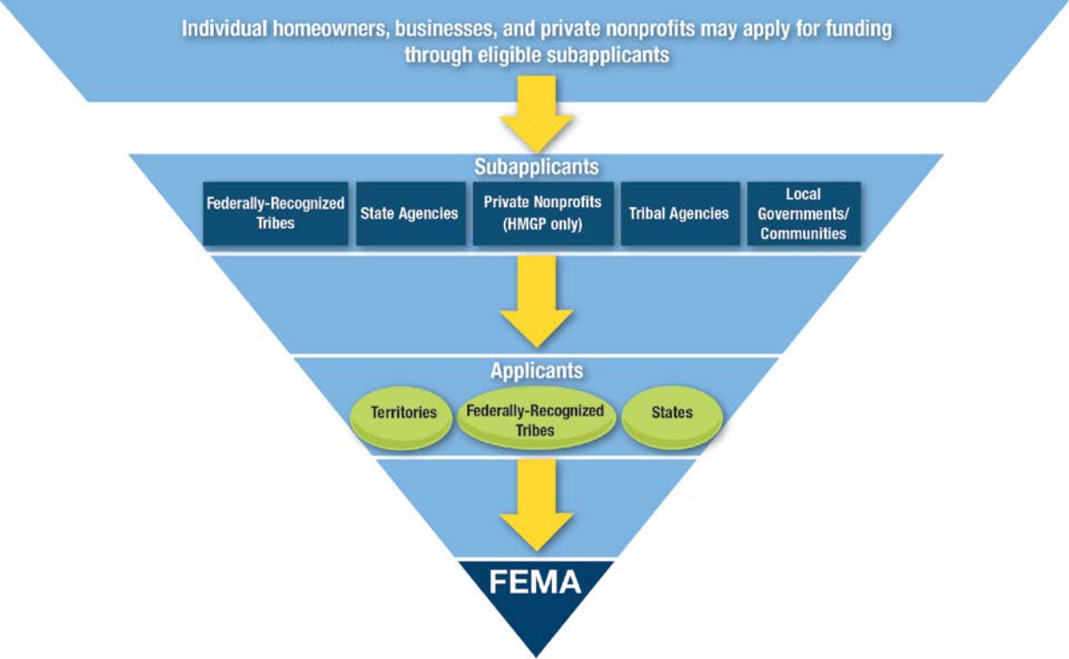
The Process, part 1
You
Cal OES

Slide 24

The Process, part 2
Tier 1: Individual homeowners, businesses, and private nonprofits may apply for funding through eligible subapplicants
Tier 2: Subapplicants- Federally-Recognized Tribes, State Agencies, Private Nonprofits (HMGP only), Tribal Agencies, Local Governments/Communities (You)
Tier 3: Applicants-Territories, Federally-Recognized Tribes, States (Cal OES)
Tier 4: FEMA
You
Cal OES

Slide 25
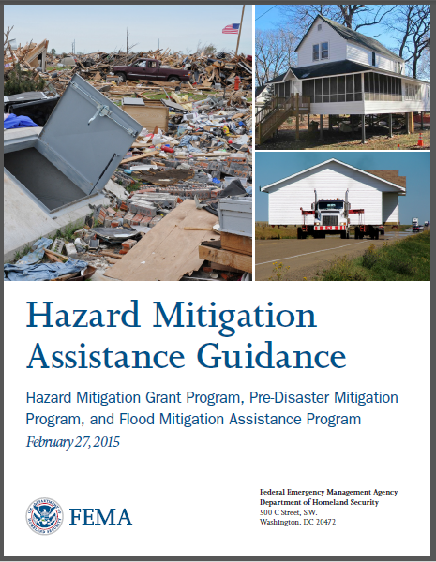
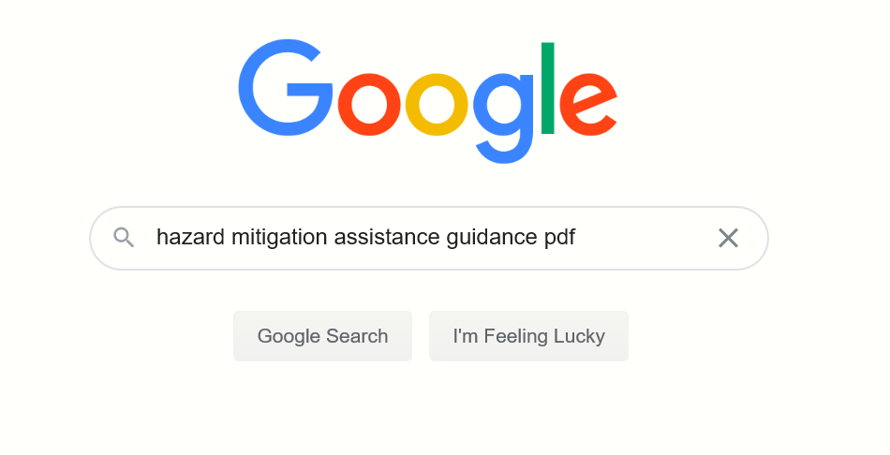
FEMA Hazard Mitigation Assistance Guidance
Click here for the HMA Guidance

Slide 26
HMGP Eligibility Requirements
Must have a FEMA-approved and locally adopted LHMP or MJHMP
  PNPs are exempt from this requirement
25% local cost share match required
36-month Period of Performance (POP)
Must obtain environmental clearances (CEQA)
NO CONSTRUCTION prior to FEMA approval

Slide 27
Eligible Activity Types, part 1
Eligible Activities, part 1 | HMGP
Property Acquisition and Structure Demolition | Yes
Property Acquisition and Structure Relocation | Yes
Structure Elevation | Yes
Mitigation Reconstruction | Yes
Dry Flood Proofing of Historic Residential Structures | Yes
Dry Flood Proofing of Non-Residential Structures | Yes
Generators | Yes
Localized Flood Risk Reduction Projects | Yes
Non-Localized Flood Risk Reduction Projects | Yes

Slide 28
Eligible Activity Types, part 2
Eligible Activities, part 2 | HMGP
Structural Retrofitting of Existing Buildings | Yes
Non-Structural Retrofitting of Existing Buildings and Facilities | Yes
Safe Room Construction | Yes
Wind Retrofit for One and Two Family Residences | Yes
Infrastructure Retrofit | Yes
Soil Stabilization | Yes
Wildfire Mitigation | Yes

Slide 29
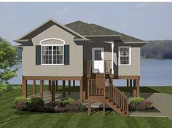
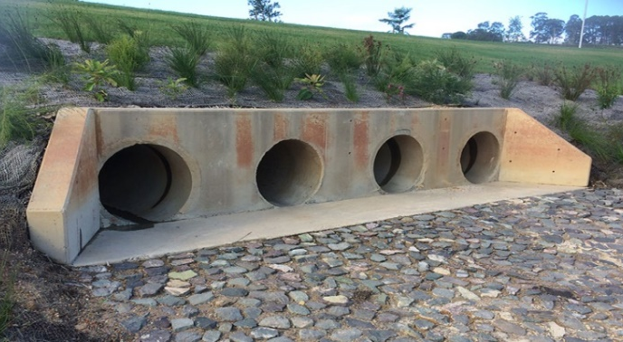
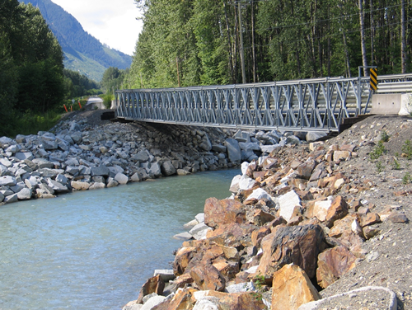
Eligible Activity Types, part 3
Eligible Activities, part 3 | HMGP
Post-Disaster Code Enforcement | Yes
Advance Assistance | Yes
5 Percent Initiative Projects | Yes
Miscellaneous/Other | Yes
Planning-Related Activities | Yes
Technical Assistance | No
Management Costs | Yes

Slide 30
Planning Eligibility Requirements
Federal share for a LHMP or for other planning activity is capped at $150,000
Federal share for a MJHMP is capped at $250,000
Federal cost share requested is limited to 75% of the total activity cost
Overmatching by a jurisdiction is acceptable (more than 25%)

Slide 31
Eligible Planning Activities
New plans or updates to plans
  Local, Multi-Jurisdictional, or Tribal
Other planning-related activities
  Safety Element
  Community Wildfire and Flood Protection Plan
  General Plan
  Plan annex for climate adaptation
*A list of eligible planning-related activities is found on page 39 of the HMA Guidance

Slide 32
The 5% Initiative
Project types that cannot be evaluated using traditional cost effectiveness methodologies
5% relates to percentage of total HMGP funding made available for these project types
Must be consistent with goals and objectives of State and local hazard mitigation plans
Must meet all HMGP eligibility requirements
BCA not required
    BUT a narrative of cost effectiveness is required
    Projects that can be evaluated with the FEMA BCA Tool, but do not meet the 1.00 threshold are not eligible under the 5% Initiative

Slide 33
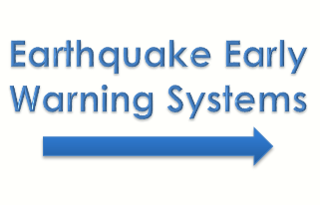
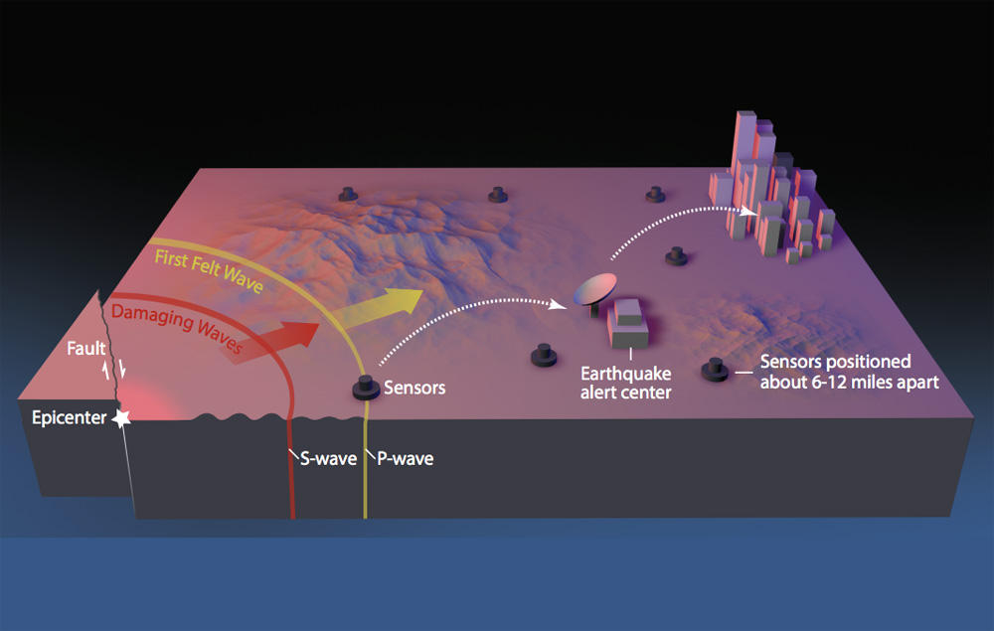
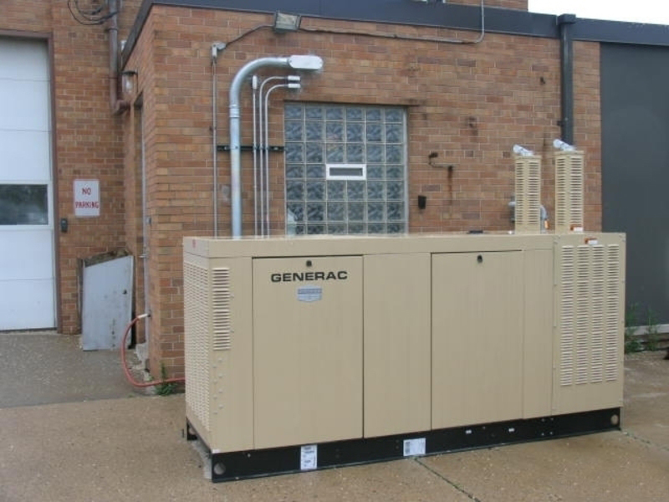
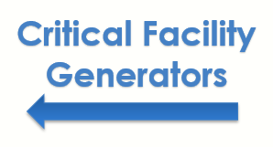
Common 5% Initiative Projects

Slide 34
Generator Clarification
Must be used to protect a critical facility from a loss of function
    Critical facilities must be identified in a jurisdiction’s hazard mitigation plan
Generators must produce an independent solution to a problem
    The necessity of human interaction would make it a dependent action and therefore not an independent, stand-alone, and effective hazard mitigation solution

Slide 35
Ineligible Activities, part 1
Projects for which actual physical work has occurred prior to approval (groundbreaking, demolition, construction, etc.)
Projects that do not reduce risk to human life, structures, or improved infrastructure
Projects that are dependent on a contingent action in order to be effective (reliant on some other project)

Slide 36
Ineligible Activities, part 2
Property acquisition projects that are not compatible with open space guidelines and do not maintain open space
    Must be deed-restricted in perpetuity to open space uses and restore/conserve natural floodplain functions
Preparedness activities or temporary measures - Response
Hazardous fuels reduction beyond 2 miles of at-risk structures

Slide 37
Ineligible Activities, part 3
Studies that are not directly related to the design and implementation of a proposed hazard mitigation project
Projects that address the operation, deferred/future maintenance, rehabilitation, restoration, or replacement of existing structures, facilities, and/or infrastructure without increasing the level of protection
*A list of ineligible activities can be found on pages 42-43 of HMA Guidance

Slide 38
Common Eligibility Issues, part 1
No plan or recently expired plan
Physical construction activities have already started
Projects that are strictly capital improvements (i.e. something has reached the end of its useful life and needs to be replaced)
Projects that only consist of repairs
    HMGP does not repair/replace; Public Assistance pays to fix disaster-induced damages

Slide 39
Common Eligibility Issues, part 2
Projects that are not cost effective upon review
    Adequate supporting documentation not provided
    Inflated data inputs

Slide 40

Any Questions?

Slide 41
Subapplication Development
Notes:
Example:
Flood Control NOI vs. Structural Retrofit Subapplication

Slide 42
Notice of Interest (NOI)
An approved Notice of Interest may represent an eligible activity
An approved NOI does not necessarily guarantee an approved subapplication
Consistency between the NOI and subapplication is very important

Slide 43
Knowledge Check #1
Is this scenario acceptable?
Notice of Interest
The City will replace an existing and failing culvert with a larger capacity culvert
The culvert will be constructed at 18th Ave and D St.
Subapplication
The City will replace an existing and failing culvert with a similar capacity culvert
The culvert will be constructed at 18th Ave and N St.

Slide 44
Project Subapplication Documents, part 1
Click Here for the Cal OES HMGP Webpage
Including, but not limited to:
Project Subapplication
Scope of Work
Designs and Studies
Maps and Photos
Cost Estimate Spreadsheet
Cost Estimate Narrative
Work Schedule

Slide 45
Project Subapplication Documents, part 2
Click Here for the Cal OES HMGP Webpage
Including, but not limited to:
Match Commitment Letter
Maintenance Agreement
FEMA EHP Checklist
Designation of Applicant’s Agent Resolution
Grant Management Cost Subapplication

Slide 46
Planning
Subapplication Documents
Click Here for the Cal OES HMGP Webpage
Including, but not limited to:
Planning Subapplication (Specific to plans)
Scope of Work
Cost Estimate Spreadsheet
Cost Estimate Narrative
Work Schedule
Match Commitment Letter
Letter(s) of Commitment from participating jurisdictions (multi-jurisdictional plans only)
Designation of Applicant’s Agent Resolution
Grant Management Cost Subapplication

Slide 47
Standardized Subapplication CD/DVD File Format, part 1
Binders and printed subapplication documents are no longer required
Submit subapplication files on two CDs or DVDs in the folder format shown on the right
Please do not lock or encrypt the CDs or DVDs that are submitted to Cal OES
Test for functionality!

Slide 48
Standardized Subapplication CD/DVD File Format, part 2
Table of Contents
Subapplication
Scope of Work
Designs
Studies
Maps
Photos
Schedule
Budget
Match
Benefit-Cost Analysis
Maintenance
Environmental
Supporting Documents
Management Cost Subapplication

Slide 49
Organization of the Subapplication
First Section:
Introduction, Public Assistance, Time Extensions
Regulations
Eligibility Checklist – VERY IMPORTANT
Format Instructions – Very specific, follow closely

Slide 50
Subapplication Form Layout
Subapplicant Information
Local Hazard Mitigation Plan Information (LHMP)
Community Information
Project Information
Work Schedule Information
Cost Estimate Information
Benefit Cost Effectiveness Information
Maintenance Assurance Information
National Flood Insurance Information (NFIP)
Environmental Information
Project Conditions
Authorization

Slide 51
Subapplicant Information
Type
FIPS Number
DUNS Number Lookup on the System for Award Management Website
    FEMA'S SAM.gov
Political Districts – Numbers only
Primary and Alternate Contacts

Slide 52
Local Hazard
Mitigation Plan Information
Must have a FEMA-approved and locally adopted LHMP or MJHMP at time of award
LHMPs are valid for 5 years (check expiration)
The proposed project must be in conformance and consistent with the LHMP
Private Non-Profits (PNPs) do not require an LHMP
Specify exactly where the activity is referenced in the plan (chapter, part, section, page)

Slide 53
Community Information
Describe the programs that the community participates in.
    Community Wildfire Protection Plan, Community Rating System, Unreinforced Masonry Participation, Shakeout Drill Participation, etc.
Was there a requirement to provide public notice regarding the project?
    If so, describe how it was done

Slide 54
Project Information, part 1
Project Location: Provide county where activity will occur and include latitudes and longitudes
Coordinates: For each individual structure
Staging Area: Describe and include the coordinates, map must be included in map file
Mapping Requirements: Clearly depict entire project location, work site(s), staging area(s), and include North indicator. FIRM must also be included
    Color maps only
Photos: Minimum of 3 per work site, include in file
Describe PA funding and possible deed restrictions

Slide 55
Site Photos Requirements
Site photos must clearly show all work areas and exactly where work will be conducted for the project
Projects that include work inside of a structure must include interior photos (i.e. structural or non-structural retrofitting)
Projects that include multiple site locations must have pictures of all locations
Minimum of 3 photos per site

Slide 56
Project Information, part 2
Application Type: Project or 5% Activity
Project Type: Check all that apply
Describe Problem/Hazards/Risks:
    What problem will the project solve?
    What are the expected outcomes?
    Describe the hazards and risks to life, safety, and improved property over the last 25 years
Recent Events: What facilitated the need?
High Quality Scope of Work: Effectively describing the entire project that is easy to understand

Slide 57

Scope of Work, part 1
Attention to detail is a MUST
  Anyone should be able to read and understand exactly what the project entails
  Describe project from A-Z
  Who, What, Where, Why and How?
  When? (Work Schedule)
  How Much? (Budget)
  Attach in SOW file

Slide 58
Scope of Work, part 2
Describe and discuss:
Environmental setting, adjacent land uses, staging area(s)
Any necessary land acquisition activities
Right-of-way or access easements required
If the project is a structural mitigation activity, discuss how the structure will be constructed or retrofitted
Any demolition activities that may need to occur

Slide 59
Scope of Work, part 3
Describe and discuss:
Identify waste resulting from demolition (construction debris, dirt/sediment, hazardous materials, etc.) and exact location where the materials will be disposed
Materials, equipment, techniques, and methodologies that will be used

Slide 60
Planning Scope of Work
Unique to planning subapplications:
Planning Area
Planning Process
Previous Mitigation Planning
Available Data and Risk Assessment Process
Development of a Mitigation Strategy
Plan Adoption

Slide 61
Planning Subapplication Considerations
Is this a new plan or an update?
If you have ever had a FEMA-approved plan, your plan is considered an update (even if it expired)
Are substantial revisions required?
How many jurisdictions will participate?
How many meetings do you want to hold?
Is there new information to collect or analyze?

Slide 62

Elements of a Plan
Planning Process
Identification of Natural Hazards
Vulnerability Assessment
Assessment of Mitigation Capabilities
Strategies to Reduce Risk
Implementation Information
Additional Planning resources can be found at the Cal OES Local Hazard Mitigation Program website.
Notes:
The Local Hazard Mitigation Plan contains several planning elements that must be addressed according to the FEMA Plan Review Tool. Additional information can be found on the Cal OES website under Hazard Mitigation/Local Mitigation Planning

Slide 63
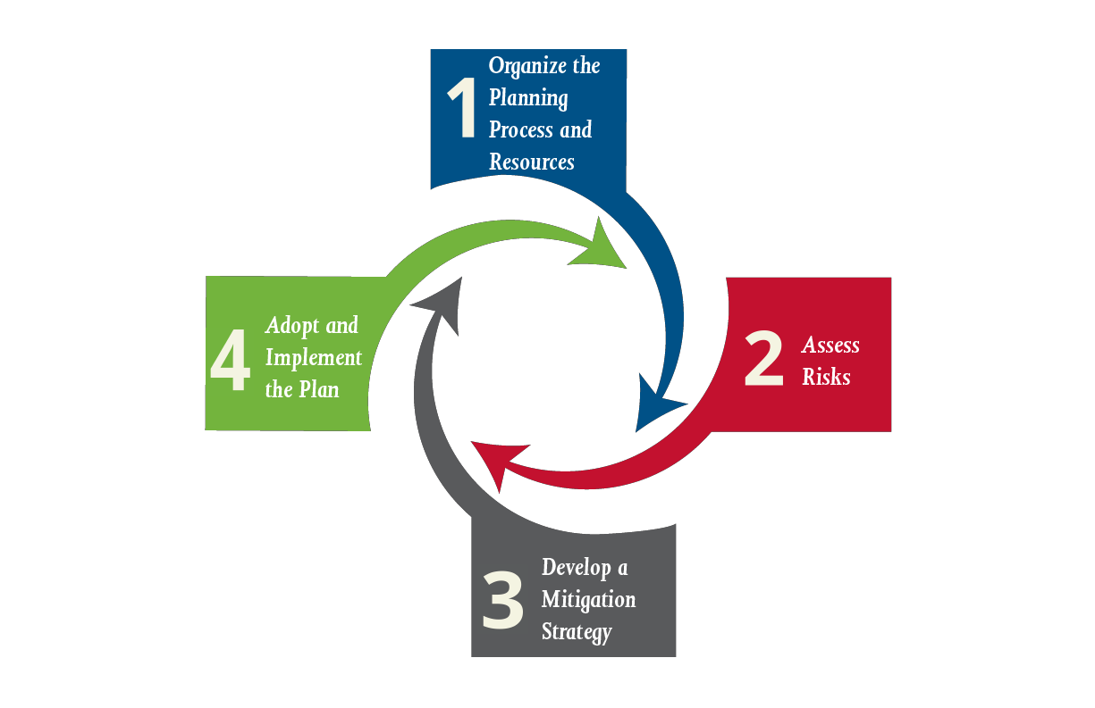
Planning Cycle
Organize the Planning Process and Resources
Assess Risks
Develop a Mitigation Strategy
Adopt and Implement the Plan
Notes:
Keep in mind when estimating your time frame for completion of your plan thqat the process takes anywhere from 16-18 months and time for Cal OES and FEMA review as well as adoption through your governing board also needs to be accounted for. Once your plan expires, it expires. However, you can get a time extension for the grant, if needed, to complete your plan

Slide 64

Opportunities for Plan Integration
LHMP CRS
LHMP Land use Planning
LHMP General Plan/Safety Element Update
LHMP Coastal Hazard Resilience Planning
LHMP Emergency Operations Planning
LHMP Emergency Action Planning
Notes:
The LHMP can assist in completing other planning requirements for your jurisdiction by integrating elements to ensure consistency and maximize the planning resources available through the LHMP planning process.

Slide 65

Question and Answers Time

Slide 66
Project Information
Previous HMGP funding received
Other potentially related funding:
    Federal, State, and private sources must be disclosed
Related projects:
    We need to know about anything that may be directly or indirectly related to the project or project area
    FEMA needs to see the whole picture
Hazard Analysis Type: Select all that apply

Slide 67
Design Plans, part 1
All designs go into the file
Provide latitudes and longitudes
Drawn to scale (e.g., 1” to 100’ or 1” to 200’)
Include a legend to describe any symbols used
Show property lines and dimensions
Grading/Topographical information
Roads/Easements
Utilities
Drainage
Parking
Identify all existing structures and proposed structures
Cross Sections (Geometry of a streambed at a specific location)

Slide 68
Design Plans, part 2
Be prepared to provide supplemental documentation to support the SOW:
Studies and preliminary engineering data
  Hydrologic and Hydraulic (H&H) Studies
  Geotechnical Analyses
Copies of drawings or blueprints
Stamped engineering analysis that validates risk and effectiveness
Scan all design documents and place in the file

Slide 69
Alternatives
You must identify the following 3 alternatives:
No Action Alternative: What consequences will the community face if nothing is done to address the problem?
Proposed Action: The action you propose to solve the problem and how it achieves the goal. Why was it chosen? How is it the best solution? Why is this the most environmentally or economically acceptable approach?
Second Action Alternative: Must also solve the problem but using different methods. Explain why it was not chosen. It must be a viable option in the event that the proposed action becomes no longer feasible.

Slide 70
Alternatives Example
Proposed Project:
Property Acquisition and Structure Relocation
Rejected Alternative:
Structure Elevation
Rationale:
While both methods would provide flood protection, the home is located in a floodway, and elevating it would be technically too difficult to achieve.
Notes:
Include examples

Slide 71
Unacceptable Alternatives
Second action alternative that states there is no other option to solving the problem
Second action alternative that states the same solution as the proposed action, but in a higher level of capacity
Not including the required minimum of three alternative options

Slide 72
Work Schedule, part 1
Use the spreadsheet within the subapplication
Describe all project tasks, milestones, and durations stated in months/weeks. Examples include:
  Construction
  Architectural Design
  Engineering
  Permitting
Must not exceed 36 months – ELIMINATION CRITERIA
3 months dedicated to project closeout (Standard Value)

Slide 73
Work Schedule, part 2
Maximize your Period of Performance (POP)
POP begins when project is approved and awarded
Must be consistent with the Cost Estimate and SOW
GANTT charts should be included to support the work schedule

Slide 74
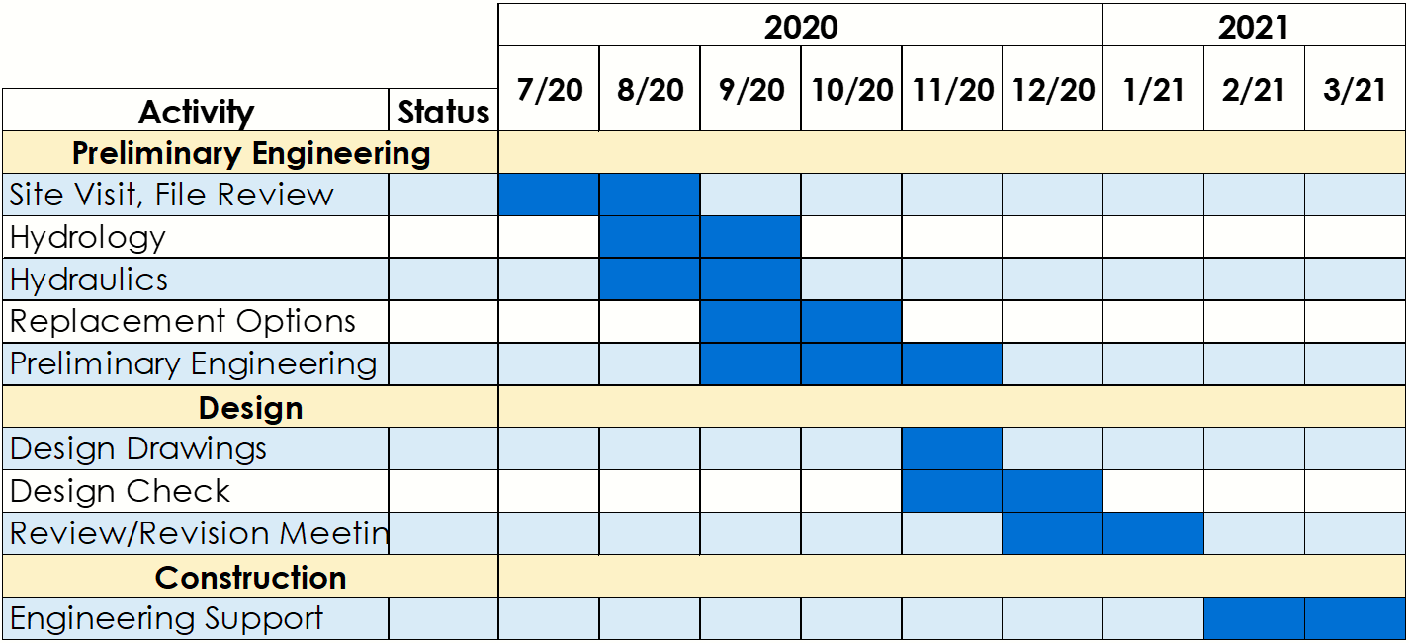
GANTT Chart Example

Slide 75
Work Schedule Attachments
Detailed narrative that explains:
Task durations that may require explanation
Key milestones anticipated for the project
Potential circumstances that could cause delays, such as weather or wildlife

Slide 76
What is an example of a scenario in which wildlife could cause project delays?

Slide 77


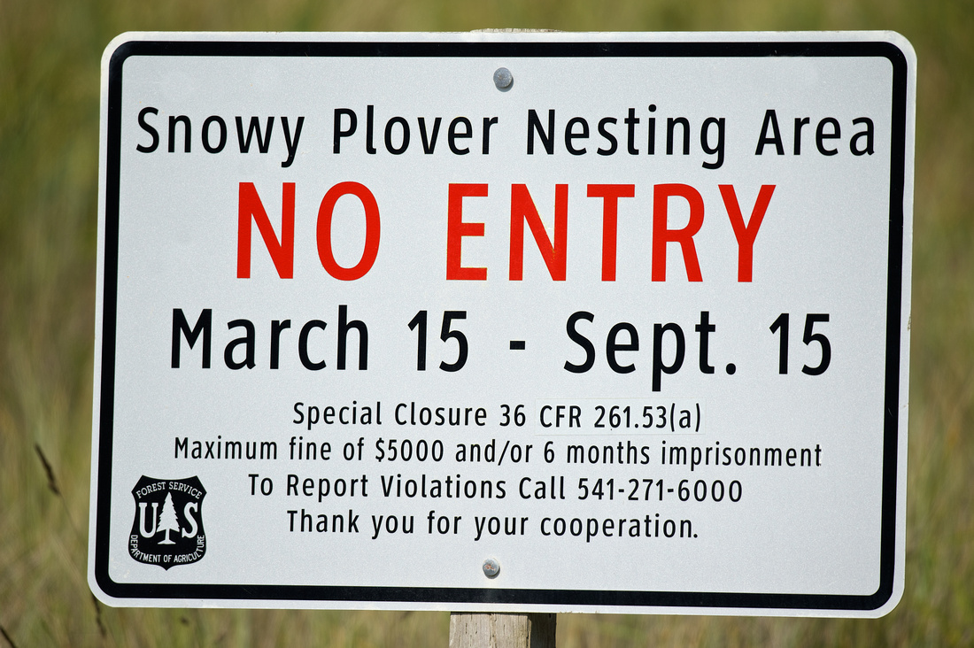

Animal Logos, Signs, and Images

Slide 78

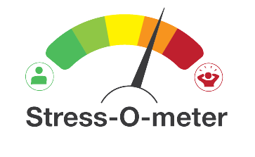

Questions and answers slide 3

Slide 79
Disaster Recovery
Reform Act of 2018
(DRRA)

Slide 80
Grant Management Costs, part 1
Per the HMGP section in the DRRA, subrecipients are now eligible to receive an amount up to 5% of the total subaward amount (no cost share, paid at 100%) for subrecipient grant management costs
Grant management costs are defined as:
  “Any indirect cost, any direct administrative cost, and any other administrative expense associated with a specific project under a major disaster, emergency or disaster preparedness or mitigation activity or measure.”

Slide 81
Grant Management Costs, part 2
Do not include grant management costs on the project cost estimate spreadsheet
A separate grant management cost subapplication will be provided
Subapplicants will be required to complete the grant management cost subapplication
Subapplicants are strongly encouraged to pursue grant management costs, as this funding provides a resource to fund staff to oversee the grant management functions of the project

Slide 82
Grant Management Costs, part 3
The following are examples of grant management costs:
Subapplication Development
Staff time to prepare reimbursement requests, quarterly reports, technical assistance, and closeout process
Travel costs related to the implementation of the project
Supply costs may include printer materials
Indirect costs may include depreciation or use allowances on buildings or equipment, cost of operating facilities, and general administration

Slide 83
Cost Estimate Information, part 1
No funding cap for Federal share request
The Federal share may not exceed 75% of the total project cost
Jurisdiction must guarantee the 25% local match
Provide detailed breakdown of every project cost
    Main cost categories preferred, not down to nuts and bolts

Slide 84
Cost Estimate Information, part 2
List all DIRECT project costs, examples include:
    Project management (not to be confused with grant management)
    Engineering, architectural, and design
    Site prep, staging, permits, disposal
    Identify contract work, in-house staff hours, or donations
    Environmental & Historic Preservation (EHP)

Slide 85
Knowledge Check #2
$1,000,000 project → $750,000 Fed share
$4,000,000 project → $3,000,000 Fed share
$10,000,000 project → What is the Fed share?

Slide 86
Ineligible Costs
Miscellaneous, other, or any generic cost categories that cannot be justified
Project maintenance
    Cannot be included in Cost Estimate but MUST be included in the Benefit Cost Analysis (BCA)
Non-Project Specific Costs

Slide 87
Cost Estimate Categories
Click Here for the Cost-Estimate Spreadsheet template
Categories include but are not limited to:
  Project Management
  Engineering and Design
  Site Acquisition
  Personnel costs
  Contracts
  Construction
  CEQA
  Pre-Award project costs
*Additional examples are provided on pages 14 and 11 of the Project Subapplication Template and the Planning Subapplication Template, respectively.

Slide 88
Pre-Award Management Costs
Costs incurred after the date of declaration but prior to approval of the grant may be considered eligible pre-award management costs. This may include:
    Development of the subapplication
    Community outreach or meetings related to the development of the subapplication
Pre-award are only reimbursable after FEMA award of funds
Include pre-award grant management costs in the management cost subapplication (reference pre-award in the line item)

Slide 89
Pre-Award Project Costs
Costs incurred after the date of declaration but prior to approval of the grant may be considered eligible pre-award project costs. This may include:
    Development of the BCA
    Collection of EHP data
    Preparation of design specifications
Pre-award costs are only reimbursable after FEMA award of funds
Include in your project budget (reference pre-award in the line item)

Slide 90



Knowledge Check #3
What type of pre-award cost is this training?

Slide 91

Cost Estimate Narrative
Provide a detailed description of each individual line item on the Cost Estimate spreadsheet
Methodology used to estimate each cost
Personnel costs should be hourly wage with fringe benefits for total hourly cost
Place the Cost Estimate spreadsheet and Cost Estimate Narrative in Cost Estimate/Budget file

Slide 92
Knowledge Check #4
Is this methodology acceptable?
Three failing culverts need to be changed to larger capacity culverts that can convey a 100-year flood event…
24” culvert cost is $10,000
36” culvert cost is $10,000 + 10% = $11,000
48” culvert cost is $10,000 + 20% = $12,000

Slide 93
Cost Estimate Attachments
Cost Estimate Narrative (required)
Source references for estimated costs
Worksheets/payroll info for personnel costs
    Position title or classification
    Hourly wage plus fringe benefits
    Number of staff utilized and project role

Slide 94
Match Commitment Letter
Requirements:
  Must be on the jurisdiction’s letterhead
      Utilize Cal OES Match Commitment Letter Template
  Guarantee the full 25% local match requirement
  Identify the source(s) of matching funds
      If there are multiple sources, identify each source and the amount of match funds provided by that source
  Provide exact date(s) funds will be available
  Signed by Authorized Agent on file with Cal OES
  Non-federal funding source

Slide 95

Consistency is Key
The Scope of Work, Cost Estimate, and Work Schedule, are compared for consistency, credibility, and mathematical accuracy
These three components must be consistent throughout the subapplication

Slide 96
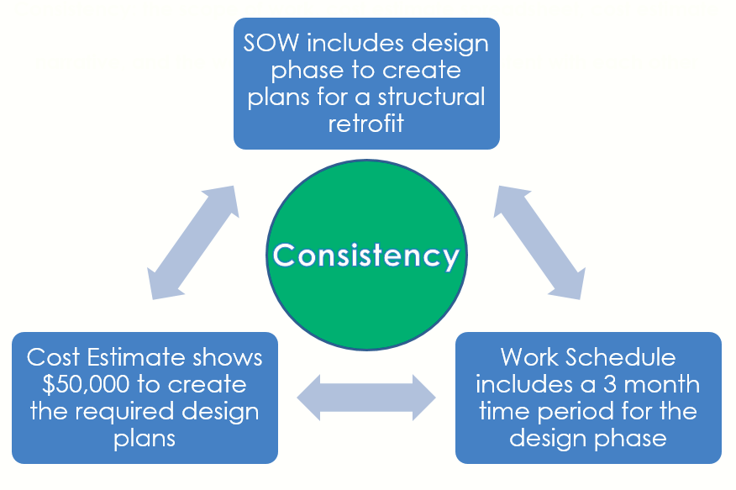
Consistency: the scope of work, cost estimate spreadsheet, cost estimate narrative, and the work schedule, must be consistent with each other

Slide 97

Quality subapplication documents are required.

Slide 98

Questions and answers slide 4

Slide 99
Benefit Cost Analysis
Must be completed using FEMA-approved software and guidelines (BCA Toolkit 6.0)
  Link to FEMA website for Benefit-Cost Analysis
Must result in a Benefit Cost Ratio (BCR) of 1.00 or greater – ELIMINATION CRITERIA
All data inputs that are not FEMA standard values must have supporting documentation
Must include maintenance costs

Slide 100
Maintenance Assurance Requirements
Include written assurance that the project activity will be maintained once the project is completed
Provide a letter on jurisdiction’s letterhead that describes the maintenance schedule, costs, and the responsible agency
Maintenance must be guaranteed for the useful life of the project

Slide 101
Authorization
Required under the Robert T. Stafford Disaster Relief and Emergency Assistance Act:
Subapplication must be signed by the jurisdiction’s designated Authorized Agent
Designation of Applicant’s Agent Resolution
    Use the Agent Resolution Form (Cal OES Form 130)
    Update every 3 years and/or when an Authorized Agent changes
    Resolutions should be universal

Slide 102
Authorization to Work With
Contractors or Consultants, part 1
Cal OES will not discuss project information with anyone who is not an Authorized Agent or listed contact on the Notice of Interest (NOI) or subapplication
If a subapplicant/subrecipient is utilizing a contractor or consultant, Cal OES must receive authorization from the Authorized Agent to interact with and share information with a contractor/consultant

Slide 103
Authorization to Work With
Contractors or Consultants, part 2
Example:
    The City of Smallville authorizes the California Governor’s Office of Emergency Services (Cal OES) Hazard Mitigation Assistance Branch to discuss any details pertaining to project DR-XXXX-PJ0001 with representatives from the ABC Consulting Firm, LLC. Specifically, John Smith, Jane Doe, and Mike Jones are assisting the City with its Hazard Mitigation Grant Program project.

Slide 104
Complete Subapplication Package, part 1
A complete subapplication package (at minimum) includes:
Two subapplication CDs or DVDs with all applicable subapplication documents in the correct labeled file folders
Scope of Work
Cost Estimate Spreadsheet
Cost Estimate Narrative
Work Schedule
Match Commitment Letter
Maintenance Letter

Slide 105
Complete Subapplication Package, part 2
A complete subapplication package (at minimum) includes:
FEMA EHP Checklist
BCA .zip file or BCA Narrative (N/A to Planning grants)
Designation of Applicant’s Agent Resolution (Form 130)
Grant Management Cost Subapplication

Slide 106
Subapplication Submission
Cal OES must receive two (2) CDs or DVDs that include all of the exact same information, data, subapplication documents, BCA .zip file, and attachments
Please DO NOT include full LHMPs, contracts, procurement manuals, etc.
Check for functionality prior to submittal

Slide 107
Send Your Subapplication to…
California Governor’s Office of Emergency Services
Hazard Mitigation Assistance Branch
Attention: Building D, 1st Floor
3650 Schriever Avenue
Mather, CA 95655

Slide 108

Questions?

Slide 109
Environmental
Information

Slide 110
Environmental Information, part 1
FEMA Environmental Checklist:
  Must be included – ELIMINATION CRITERIA
  Provide necessary information for the FEMA Environmental & Historic Preservation (EHP) unit to evaluate projects for conformance with all applicable Federal regulations to avoid delays in the review process

Slide 111
Environmental Information, part 2
Federal – National Environmental Policy Act (NEPA) Title 40, Code of Federal Regulations (CFR) Parts 1500 -1508:
  Requires investigation of the potential environmental impacts of proposed federal action, such as HMGP projects
  Completion of the Cal OES EHP Checklist assists FEMA with the NEPA review process
  Approval of EHP submittals is by FEMA following preliminary Cal OES review

Slide 112
Environmental Information, part 3
California Environmental Quality Act (CEQA)- California Code of Regulations (CCR), Title 14, Division 6, Chapter 3, Sections 15000 -15387:
  Subapplicant is responsible for complying with all CEQA Regulations
  FEMA does not review projects for CEQA compliance, that is the responsibility of the CEQA “Lead Agency”
  CEQA process: 1) Exemption or Initial Study 2) ND, MND, or EIR. Mitigation for environmental impacts is required

Slide 113
Environmental Information, part 4
California Environmental Quality Act (CEQA)- California Code of Regulations (CCR), Title 14, Division 6, Chapter 3, Sections 15000 -15387:
  Cal OES checks projects for CEQA compliance certification
  Several HMGP project types can be exempt from CEQA; documentation of exemption must be provided

Slide 114
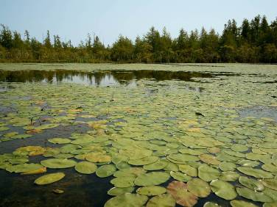
EHP Compliance – Natural Resources
Biological Resources:
  Threatened/Endangered Species
  Critical Habitat
  Migratory Birds
Air Quality
Floodplains
Wetlands & Water Quality:
  Sole-Source Aquifers
  Wild & Scenic Rivers
Coastal Zones
Geology:
  Soils
  Geologic Hazards

Slide 115
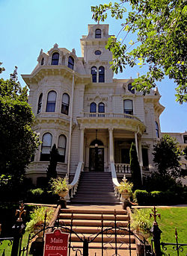
EHP Compliance – Cultural Resources & Socioeconomics
Cultural Resources:
  Historic Properties & Districts
  Archaeological Sites
Environmental Justice
Land Use:
  Agricultural Lands
Hazardous Materials
Traffic & Transportation
Energy & Utilities
Public Services
Noise
Construction Activities
Population Growth/Displacement

Slide 116
National Flood Insurance Program (NFIP) Requirements
Obtain information from the floodplain manager in the jurisdiction/community where the proposed project is located
Identify projects located within or impacted by a regulatory floodplain on a FEMA Flood Insurance Rate Map (FIRM)
Include a FEMA FIRM showing project boundaries, work sites, and staging area locations and include in map file

Slide 117
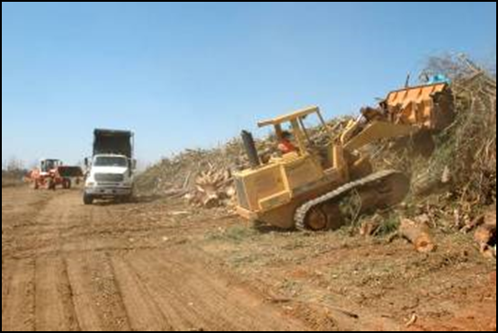
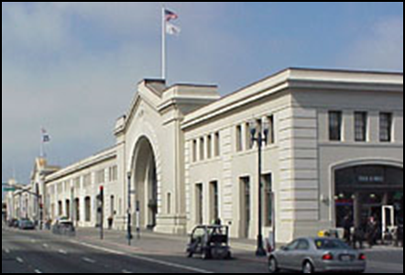
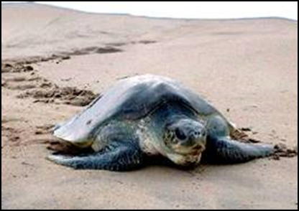
Potential
Environmental Impacts
New ground disturbance activities
    New construction
Air/water pollution
Habitat destruction
Impacts to breeding & feeding areas or patterns
Alteration of historic properties & districts
    Modification of buildings and structures 45+ years old

Slide 118
Projects with Higher
Potential Impacts
New Construction and Structure Relocation
Mitigating Flood & Drought Conditions
Wildfire Mitigation (fuels reduction, vegetation management, and defensible space)
Dry Flood-Proofing of Historic Structures

Slide 119
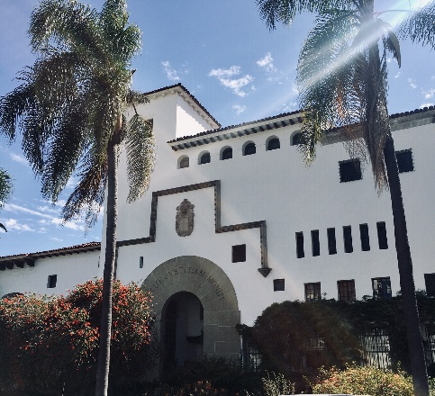

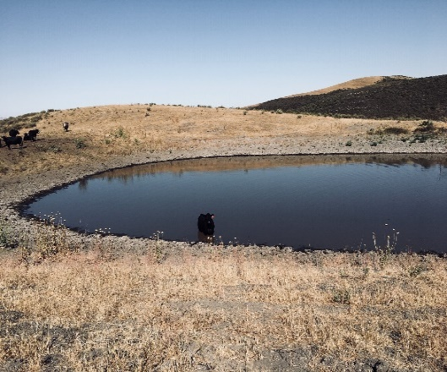
Projects with Lower
Potential Impacts
Seismic Retrofits and Structure Elevation within existing footprint
Hazard Mitigation Planning
Post-Disaster Code Enforcement

Slide 120
Federal Laws
Included in EHP Review, part 1
FEMA’s Office of Environmental Planning and Historic Preservation (OEHP) engages in a review process to ensure that FEMA-funded projects and activities comply with various Federal laws to include:
  National Environmental Policy Act (NEPA)
  National Historic Preservation Act (NHPA)
  Endangered Species Act (ESA)
  Clean Water Act (CWA)
  Clean Air Act (CAA)
  Coastal Zone Management Act (CZMA)
  Coastal Barrier Resources Act (CBRA)
  Migratory Bird Treaty Act (MBTA)

Slide 121
Federal Laws
Included in EHP Review, part 2
FEMA’s Office of Environmental Planning and Historic Preservation (OEHP) engages in a review process to ensure that FEMA-funded projects and activities comply with various Federal laws to include:
  Magnuson-Stevens Fishery Conservation and Management Act (MSA)
  Executive Order 11988 – Floodplains Management
  Executive Order 11990 – Wetland Protection
  Executive Order 12898 – Environmental Justice
  Executive Order 13690 – Federal Flood Risk Management Standards

Slide 122
Project Condition Requirements, part 1
The following conditions must be guaranteed, work ceased, and Cal OES must be notified if:
Any new ground-disturbing activities occur or human remains are uncovered. Cal OES will notify the State Historic Preservation Officer (SHPO) to obtain further guidance
Any deviations from the original SOW result in design changes, new ground disturbance, additional vegetation removal, or any other unanticipated changes to the physical environment

Slide 123
Project Condition Requirements, part 2
The following conditions must be guaranteed, work ceased, and Cal OES must be notified if:
Any wetlands or waters of the U.S. are encountered during project implementation, that were not previously identified (United States Coast Guard jurisdiction)
No construction will occur prior to the completion of the EHP review

Slide 124
EHP Checklist
Complete for all project subapplications regardless of potential environmental impacts
Provide supporting documentation and previous environmental studies if applicable
May require retention of an environmental or historic preservation consultant

Slide 125

Title Slide for
Any Questions?

Slide 126
Title Slide for
Subapplication Review

Slide 127
Subapplication Review
Subapplication files, BCA, and supporting documentation are reviewed for feasibility, accuracy, and cost effectiveness
Subapplications will be based on priority
It is not uncommon for the Cal OES specialist managing the project to change throughout the life-cycle of the project

Slide 128
Elimination Criteria, part 1
Remember this is a competitive process
  The NOI submitted for this subapplication was determined to be ineligible/denied
  The subapplication was not received by the deadline
  The subapplicant does not have a FEMA-approved LHMP or have one in progress that is close to approval/adoption
  The proposed project was not consistent with the LHMP

Slide 129
Elimination Criteria, part 2
Remember this is a competitive process
  The SOW in the subapplication was not consistent with NOI
  The POP was not within 36 months
The project does not have a BCR greater than or equal to 1.00

Slide 130
Mitigating Flood and Drought Conditions Under HMA
Formerly known as Climate Resiliency Mitigation Actions (CRMA)
Projects that mitigate risk through restoration of the natural environment

Slide 131
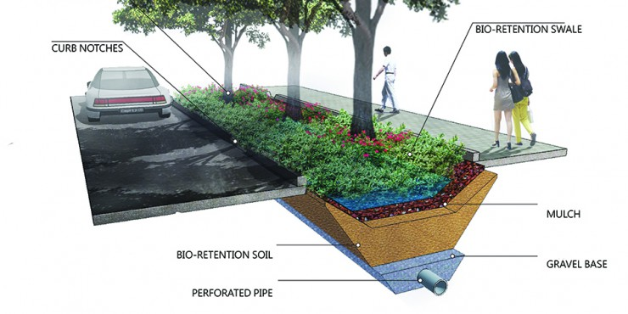
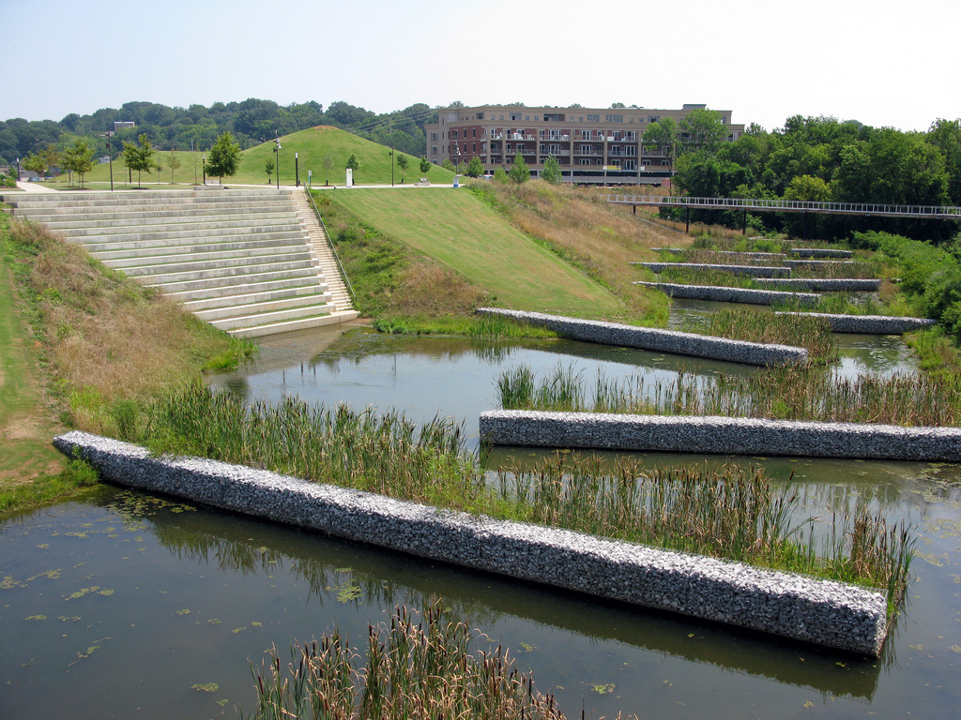
Mitigating Flood and Drought Conditions
Under HMA Activity Types
Floodplain and stream restoration
Flood diversion and storage
Green infrastructure
Aquifer storage and recovery
Constructed Wetlands
Bioswales

Slide 132
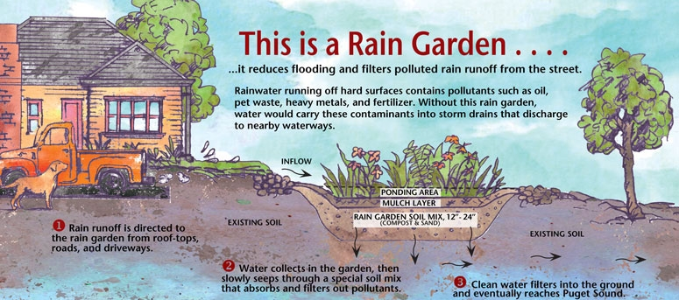
Mitigating Flood and Drought Conditions
Example of Green Infrastructure

Slide 133
Multiple Eligible NOIs
Some jurisdictions submit multiple NOIs
Jurisdictions do not compete against other jurisdictions
Conduct a self-assessment for capabilities to manage multiple projects
Prioritize your projects

Slide 134
Next Steps
Cal OES will review subapplications for completeness and reach out to subapplicants for any additional outstanding information as needed
Cal OES to notify subapplicants of project status
FEMA Region IX Review
FEMA NEPA/EHP Review
Project obligation or denial notice
Project Kick-Off (first site visit)

Slide 135

Are we experts yet?

Slide 136
Compliance and
Monitoring

Slide 137
Monitoring, part 1
Subapplicant vs. Subrecipient
After obligation, both Cal OES and the subrecipient are required to monitor and evaluate the progress of the mitigation activity in accordance with the:
    Scope of Work
    Cost Estimate
    Administrative requirements of 2 CFR Part 200
    Programmatic requirements of 44 CFR Part 206
    Applicable State and Federal regulations
Project monitoring helps to ensure that the subaward is used for authorized purposes and performance goals are achieved

Slide 138
Monitoring, part 2
Maintain constant communication between subrecipient and HMA Grants Specialist
Address concerns sooner rather than later
Evaluation of quarterly reports and reimbursement requests. Quarterly Reports are due to Cal OES:
    (Jan, Feb, Mar) Due April 15
    (Apr, May, Jun) Due July 15
    (Jul, Aug, Sep) Due October 15
    (Oct, Nov, Dec) Due January 15

Slide 139
Site Visits
Three (3) site visits may be conducted during the life-cycle of the project, and will include:
Project kick-off after award
    Provide further guidance
    Verify project site, staging areas, etc.
In-progress site visit
    Visit the project site
    Review work status and percent completed
    Discuss programmatic functions
    Identify non-compliance and offer further guidance
Project Closeout
    Verify final expense documentation
    Ensure project completion

Slide 140
Compliance-Procurement, part 1
Improper Procurement is the #1 cause for de-obligation and fund recoupment

Slide 141
Compliance-Procurement, part 2
Improper Procurement is the #1 cause for de-obligation and fund recoupment
  FEMA / Office of Inspector General(OIG)
    Every year, the OIG audit reports reveal significant procurement issues representing millions of dollars of federal funds
2 CFR §200.317-.327 apply to all FEMA awards
  The subrecipient must follow their local procurement policies and State procurement as well
  The more stringent standard applies
  Must have documented procurement procedures and document each procurement transaction

Slide 142
Compliance-Procurement, part 3
Federal Procurement Thresholds:
  Micro Purchases (contracts < $10,000)
  Small Purchases (contracts < $250,000)
  Simplified Acquisition (contracts > $250,000)
    Must be publicly advertised
    Sealed Bids
    Competitive Proposals
Additional required provisions apply based on the dollar value of the contract – 2 CFR Appendix II to Part 200
Non-Competitive Proposal (conditions apply VERY rare circumstances)

Slide 143
Common Procurement Mistakes, part 1
Award contracts to disbarred or suspended contractors (SAM.GOV)
Award contracts to contractors/consultants that assist in the subapplication development, design requirements or plans for the project
  If you have a consultant assist you with your subapplication, the same consultant cannot bid on the project or assist in developing your plan (Conflict of Interest)
Award cost plus percentage of costs contracts

Slide 144
Common Procurement Mistakes, part 2
Awarding contract without full and open competition (Sole Source)
Give preference based on geographic location (may be a selection criterion when procuring architectural and engineering services if certain requirements are met)
Enter into contracts conditional on federal funding

Slide 145
Common Procurement Mistakes, part 3
Award “Time-and- Material” contracts without a ceiling price and without documenting why no other contract type is suitable
  Contractor exceeds ceiling at own risk
  High degree of oversight required
Specifying only a “brand name” product instead of allowing for “an equal” product(restricts competition)
Note: Pre-award costs and match costs are required to follow the procurement requirements.

Slide 146
Compliance-Procurement Additional Requirements, part 1
Other Requirements
  Document a Cost/Price analysis justifying the reasonability of the contract’s price for work performed, and the selection of the contractor
  Include required contract clauses and provisions in each contract
  Take all necessary affirmative steps to assure minority businesses, women’s businesses, and labor surplus area firms are used

Slide 147
Compliance-Procurement Additional Requirements, part 2
Other Requirements (Continued)
  Avoid piggybacking off existing contracts (retainer contracts)
  Prequalified list – If used, must be current, ensure maximum open and free competition, and must not preclude potential bidders from qualifying during solicitation period
  Ensure compliance with Record of Environmental Consideration(REC) and historical protection laws
  Planning grants: Identify “FEMA-Approved LHMP” as a contract deliverable

Slide 148
Consequences of Noncompliance, part 1
Title 2 CFR §200.207
FEMA or Cal OES may:
Withhold authority to proceed to the next phase until receipt of evidence of compliance
Require additional or more detailed financial reports and/or project monitoring
Require Subrecipient to obtain technical or management assistance

Slide 149
Consequences of Noncompliance, part 2
Title 2 CFR §200.338
If a Subrecipient fails to comply with Federal rules and regulations or the terms and conditions of the subaward, additional conditions may be imposed:
Temporarily withhold reimbursements pending correction
Disallow all or part of the cost of the activity or action that is not in compliance
Partly suspend or terminate the entire subaward
Initiate suspension or debarment proceedings
Withhold future subawards to the Subrecipient

Slide 150
Resources
Link to HMA Guidance
Link to HMA Guidance Addendum
Link to 2 CFR 200
Link to 44 CFR - Emergency Management and Assistance
FEMA help guides:
  Link to FEMA Procurement Guidance
  Link to FEMA Procurement Checklist
  Link to FEMA Required Contract Provisions
BCA Technical Assistance:
  Click here to email FEMA's BCA Helpline
  (855) 540-6744

Slide 151
Contact Us!
Click here to email
HMA@caloes.ca.gov

Slide 152

Questions?

Slide 153

Be back in 1 hour

