Slide 1
Hazard Mitigation Grant Program
Planning Grants and
Local Hazard Mitigation Plan Requirements

Slide 2
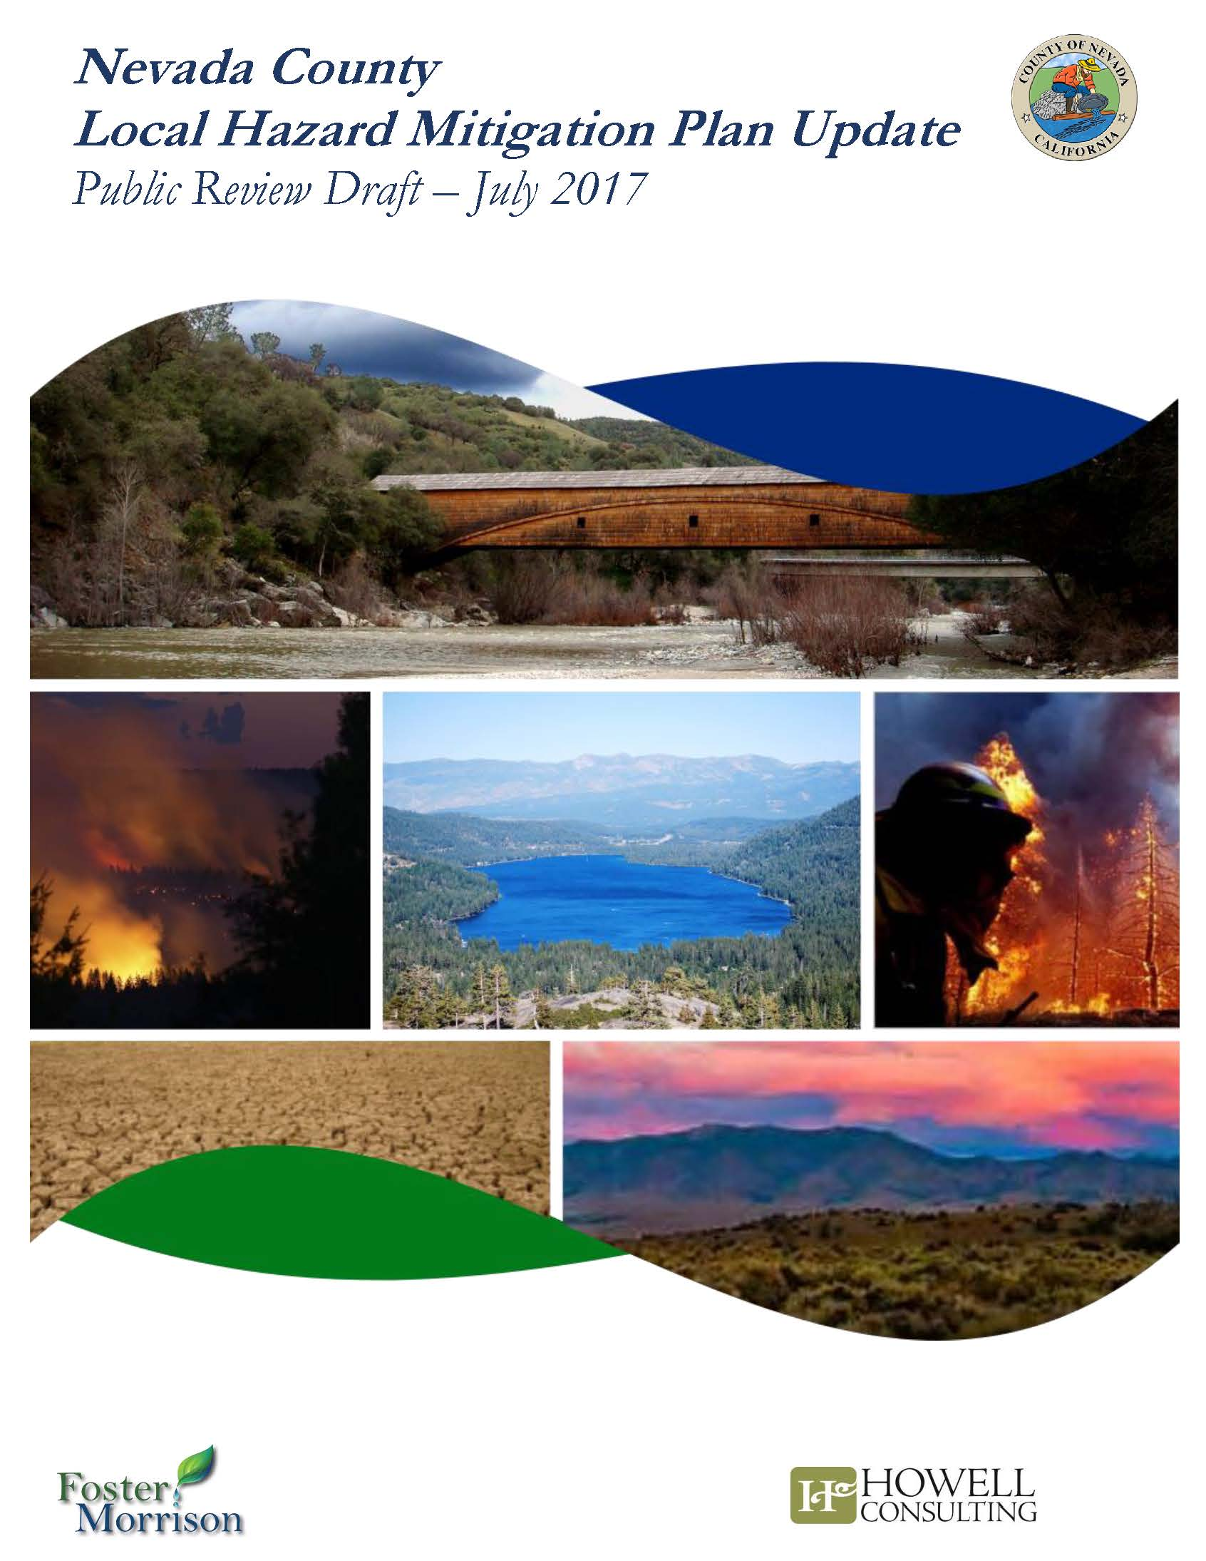
Agenda
Introduction
Planning Subapplication Development
Local Hazard Mitigation Planning
Questions
Notes:
PLANNING OR GRANTS: contextualize the presentation… approved plans are a precursor to funding projects. There is also a pool of funding to write your plan a “planning subapplication”… these are similar to project subapplications, but simpler to complete and understand. Because approved plans are so high priority to the state and to FEMA, these grants are less competitive than project grants. In this presentation we will discuss the components of a planning subapplication, and our planning staff will also give you a quick introduction to loca hazard mitigation planning and the resources your community might use to develop the plan.

Slide 3
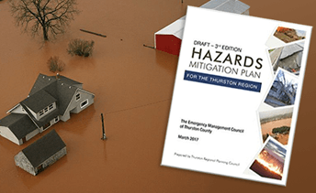
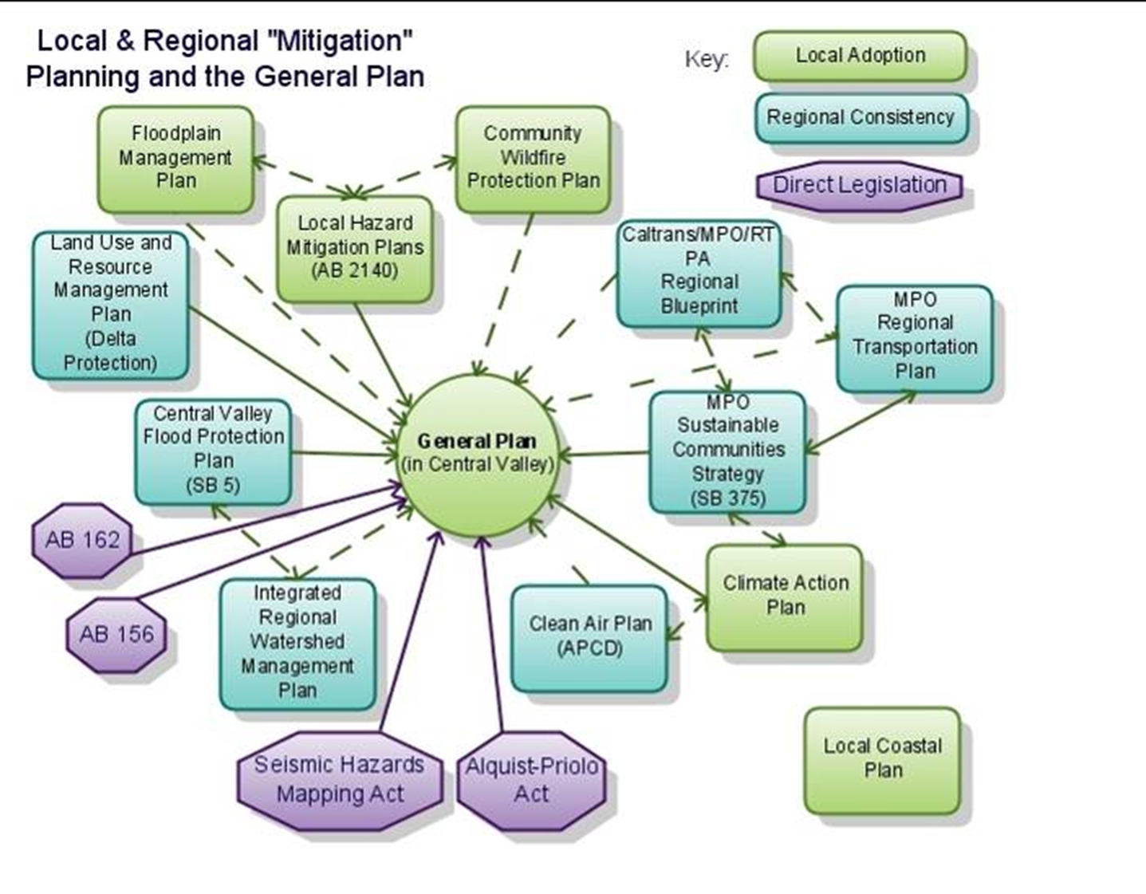


Why do Hazard Mitigation Plans Matter?
Notes:
PLANNING:
LHMPs provide a format to:
Formalize the Planning Process
Determine the risks that face your community;
Analyze ways to mitigate risks;
Prioritize your mitigation activities.
Develop your mitigation strategy
Document the plan maintenance process
Integrate related plans and strategies
Meet DMA 2000 Compliance (and thus qualify for a significant and growing pool of funding to finance mitigation projects)
Involve the public and neighboring communities in reducing risks; evaluating things that are threatening your communities; can be aspirational
Opportunity to integrate many community plans and priorities into a framework that ties directly to funding (think about linkages to your climate adaptation plan, your general plan, your water management plan… gets those folks to the table and find out how you can tie those strategies together
Required to receive federal funding to implement these projects

Slide 4
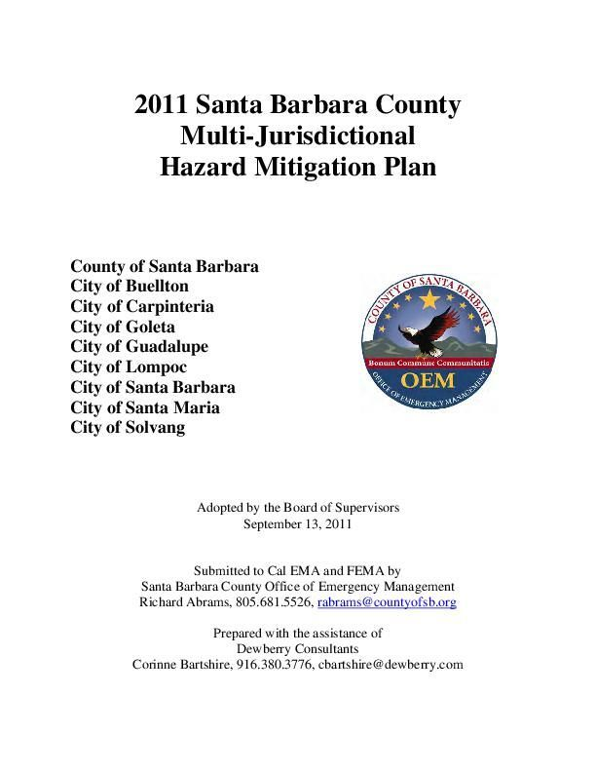
LHMP Basics
LHMPs have a five year lifespan
Types of Plans:
  Single Jurisidction
  Multi-Jurisdictional Plan
New Plans vs Updated Plans
LHMP requirements found in:
  DMA 2000
  44 CFR 201.6
Notes:
PLANNING: if you do not have an approved plan, FEMA will not obligate funding for your HMGP projects
If you have ever had a FEMA-approved plan (even if it expired, even if no one has seen it in five years etc..) your subapplication and your plan are considered an “update” not a new plan
LHMP requirements were defined in legislation called the Disaster Mitigation Act of 2000. that legislation amended the Stafford Act and changed the federal regulations (44 CFR 201.6), spelling out very specific requirements for a FEMA-approved LHMP plan (as a precursor or requirement to receiving funding for mitigation projects)

Slide 5
Level of Involvement
LHMP Participants
Planning Team
Stakeholders
Public
Neighboring communities
County (if applicable)
Special districts
Non-profits, Non-Government Organizations (NGOs).
Includes, but not limited to: Emergency Management, public works, code enforcement, utility providers, regional planning, finance/admin
Must be given opportunity to participate in plan development in addition to the review of the draft plan
Notes:
PLANNING: This is YOUR plan… every plan is different, just like every community is different. These are the different types of participants that will often be involved when you develop an LHMP, per the regulations. All these groups must be invited to the table (given an opportunity to participate)… sometimes of course you throw a party and no one shows up, but there is a requirement that you invite them and give them the opportunity nonetheless
Your planning team must actually meet. Planning team composition and size will vary. This is your core team and hopefully you engage them in the subapplication development as well.
Stakeholders depend on how you define stakeholders in your community.. That is not prescribed.
There are many different ways to engage the public in the planning process. [Provide examples] A lot of communities engage the public in hazard identification and prioritization through various exercises

Slide 6
Plan Review Process
Plan Development
State Review
FEMA Review
About 1-2 years before plan expires
Plan is approved and sent to FEMA or sent back for revisions
Plan is approved or sent back for revisions
Approved Pending Adoption
First review of the plan completed within 45 days
First review is completed within 45 days
Final Approval
5-year lifespan
Up to 12 months to adopt
DO NOT adopt the plan prior to FEMA notice of APA
Notes:
PLANNING: recommend that you apply for a planning grant three years before plan expires. Re: approved pending adoption, despite what the review tool may indicate, do not adopt the plan before you submit. You should only adopt the plan once you receive that APA letter from FEMA

Slide 7
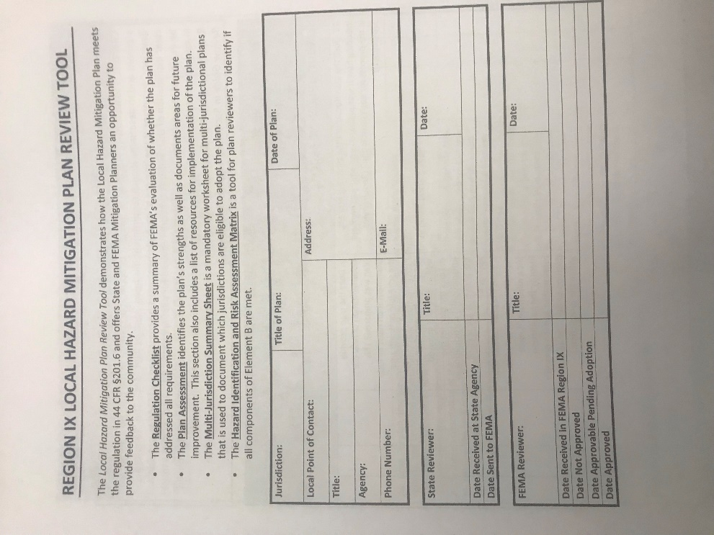
LHMP Review Tool addresses plan requirements…
Includes a compliance crosswalk used by state and FEMA plan reviewers
Each element is tied to federal regulations (44 CFR 201.6)
Region IX breaks requirements into sub-elements
Notes:
If you want to know how your plan is being “graded” this is the tool you want to use. We have brought the actual review tool for you to flip through. This is the crosswalk that Cal OES and FEMA plan reviewers actually use to assess whether or not your plan met federal requirements governing LHMPs. Specific instructions on the requirements are contained in the FEMA Local Mitigation Plan Review Guide.

Slide 8
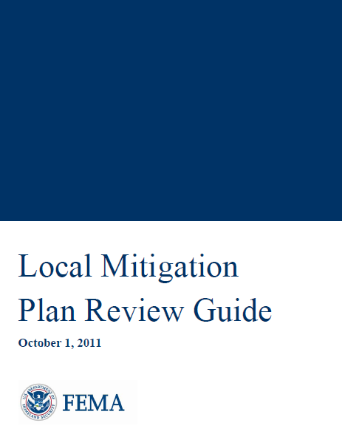
“Local Mitigation Plan Review Guide” clarifies requirements…
Follows the review tool components and provides additional explanations for each element
https://www.caloes.ca.gov/cal-oes-divisions/hazard-mitigation/hazard-mitigation-planning/local-hazard-mitigation-program
Notes:
PLANNING If you want to know how your plan is being “graded” this is the tool you want to use. We have brought the actual review tool for you to flip through. This is the crosswalk that Cal OES and FEMA plan reviewers actually use to assess whether or not your plan met federal requirements governing LHMPs.
Because some of the content in the review tool can be a little cryptic, we also rely on this plan review guide which follows the review tool element by element and lends additional clarity to each point.

Slide 9
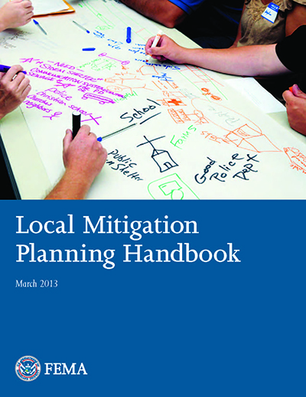
“Local Mitigation Planning Handbook” guides the process…
FEMA’s official handbook for local hazard mitigation planning
Offers comprehensive planning guidance as a companion to the Review Tool Guide
https://www.caloes.ca.gov/cal-oes-divisions/hazard-mitigation/hazard-mitigation-planning/local-hazard-mitigation-program
Notes:
PLANNING

Slide 10
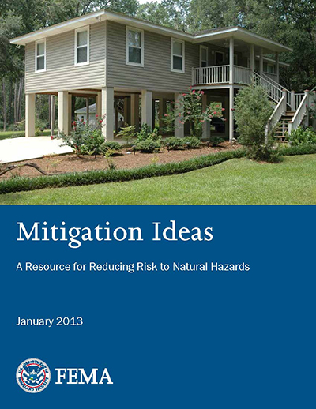
“Mitigation Ideas” helps jurisdictions brainstorm strategies and projects…
Includes HMA-eligible mitigation actions organized by hazard
These are ideas, not required strategies
https://www.caloes.ca.gov/cal-oes-divisions/hazard-mitigation/hazard-mitigation-planning/local-hazard-mitigation-program
Notes:
PLANNING

Slide 11

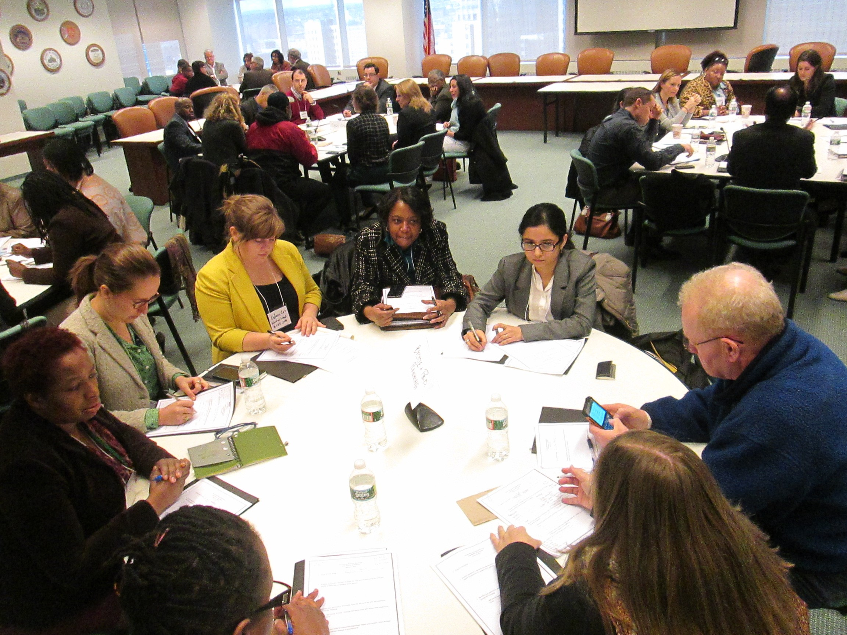

Cal OES Technical Assistance and Resources
Cal OES Hazard Mitigation Planning:
(916) 845-8531
mitigationplanning@caloes.ca.gov
Notes:
PLANNING:
We’re here to help too. We are always available by phone and email… We want to make sure you have the tools and resources you need to develop a great plan and we want to get your plan ready to be approved by FEMA. We have GIS resources to support your mapping, we can provide additional explanation on the requirements and FEMA guidance etc
Transition to next slide, which is that state also has developed great tools to assess risk:

Slide 12
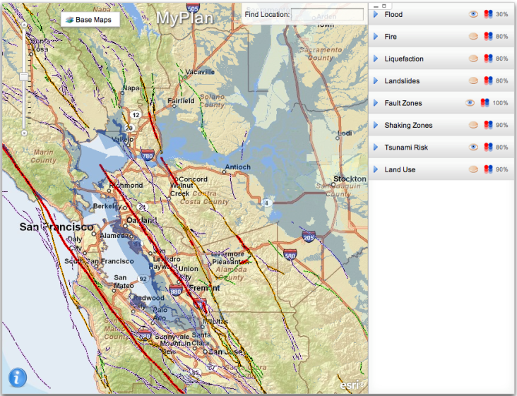
Cal OES MyPlan Tool
MyPlan assists cities, counties, and special districts in assembling and assessing GIS information on natural hazards in California (hazard identification and risk assessment section of LHMP)
www.myplan.caloes.ca.gov
Drainage Improvement
Elevation
Erosion Control
Notes:
PLANNING
The My Plan tool provides an easy-to-use interface where planners can specify views, opacity, and layering order to create a map for their Hazard Mitigation Plan area. These maps can be used in applying for federal grants or in development of mitigation plans. The tool is exportable for use by other websites, such as those of local government, and is being adopted by the states of Arizona and Nevada.
My Plan facilitates city, county, special district, and state user access to federal and state produced GIS data for use in creating maps suitable for preparing, upgrading and reviewing Local Hazard Mitigation Plans, General Plan Safety Elements, Local Coastal Plans and other hazard mitigation planning efforts.
Benefits of MyPlan:
Provides a single point of access for GIS hazard, risk, and vulnerability information to create enhanced quality GIS-based hazard maps.
Reduces the financial burden for local GIS resources and eliminates the need to own dedicated GIS software.
Improves decision-making capability for writing more effective hazard mitigation grant project proposals, and support grant reviews.
Presently, GIS datasets created by federal and state agencies exist online at multiple websites developed by sponsoring agencies. My Plan consolidates, on a single site, specialized user access to many separate GIS datasets describing natural hazards, risk, and vulnerability allowing site users to create quality GIS-based hazard maps for their local area without the need to own dedicated GIS software.

Slide 13
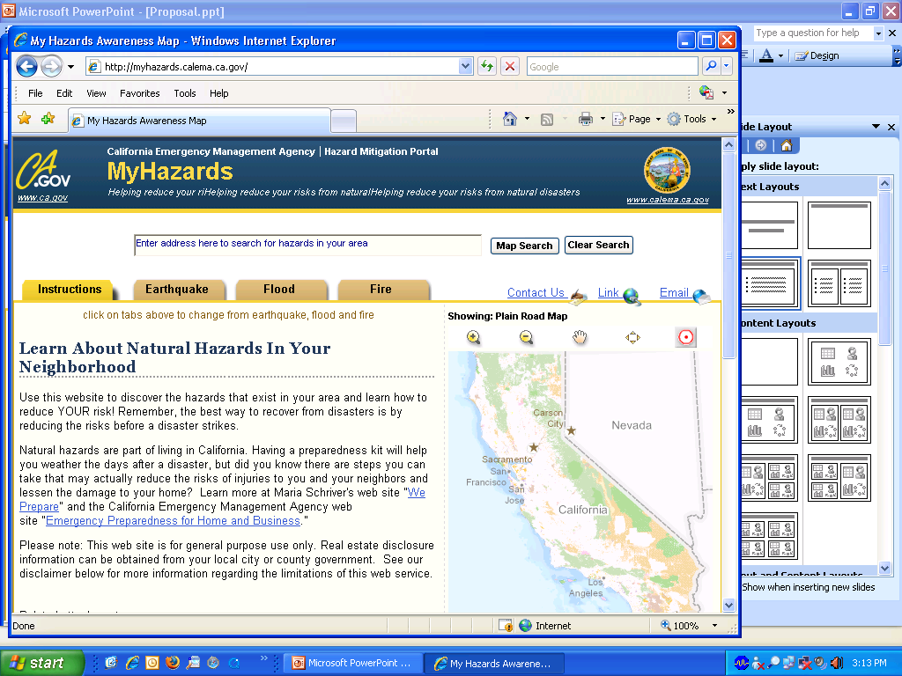
Cal OES MyHazards Tool
MyHazards is a tool for the general public to discover hazards in their area (earthquake, flood, fire, and tsunami) and learn steps to reduce personal risk
www.myhazards.caloes.ca.gov
Notes:
PLANNING
Great public engagement tool… share this with the public and it’s a great way to build support and interest around your plan.
Find out if your home, school or business is at risk to fires, floods or earthquakes.
Just type in your address to get a vulnerability assessment and then receive recommended actions you should take for each hazard.
Once you click on the individual recommended actions, you will receive step-by-step instructions on how to reduce your vulnerability
You can access the My Hazards interactive Website directly at www.myhazards.calema.ca.gov; or:
the Cal EMA home page at www.calema.ca.gov
The Hazard Mitigation Web Portal at www.hazardmitigation.calema.ca.gov

Slide 14
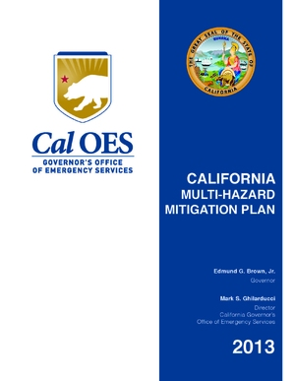
2018 State Hazard Mitigation Plan
LHMP-SHMP linkage: establish consistency between state and local goals and objectives
Resource for LHMPs for plan alignment and risk assessment information and data
2018 plan recently approved by FEMA
Notes:
PLANNING

Slide 15
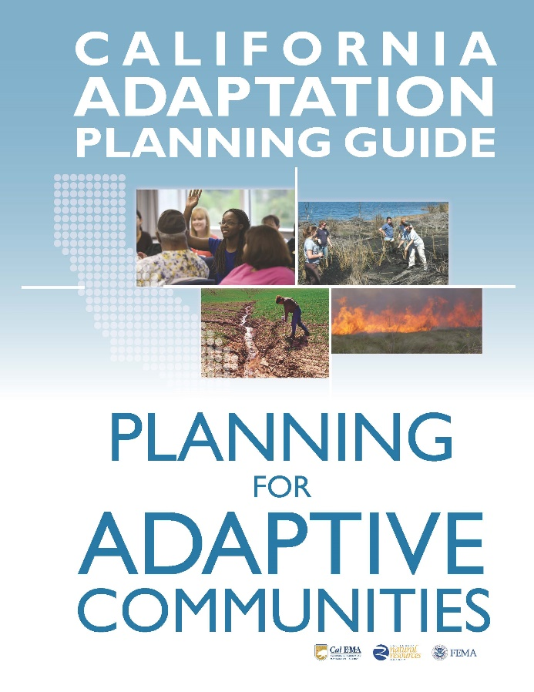
Climate Adaptation Planning
Taking on increasing importance in California (SB 379)
State’s APG Toolkit currently being updated
ICARP Adaptation Clearinghouse: selection of decision-support tools, datasets, and other research products relevant for California planners and decision-makers.
  https://resilientca.org/
Notes:
PLANNING

Slide 16

Questions?

Slide 17
Cal OES Plan Reviewers
Victoria LaMar-Haas, Senior ESC (Lead)
916-845-8531
victoria.lamar-haas@caloes.ca.gov
Karen McCready-Hoover, ESC
916-845-8177
karen.mccready-hoover@caloes.ca.gov
Carly Landry, ESC
916-845-8769
carly.landry@caloes.ca.gov
Kelly Riley, ESC
916-845-8236
kelly.riley@caloes.ca.gov
Derek Lambeth, ESC
916-845-8493
derek.lambeth@caloes.ca.gov

Slide 18
FEMA Region IX Plan Reviewers
Xing Liu, Sr. Community Planner
510-627-7267
Xing.liu@fema.dhs.gov
JoAnn Scordino, Community Planner
510-627-7225
joann.scordino@fema.dhs.gov
Emma Reed, Community Planner
510-627-7202
emma.reed@fema.dhs.gov
Jesse Carpentier
510-627-7742
jesse.carpentier@fema.dhs.gov

