Slide 1
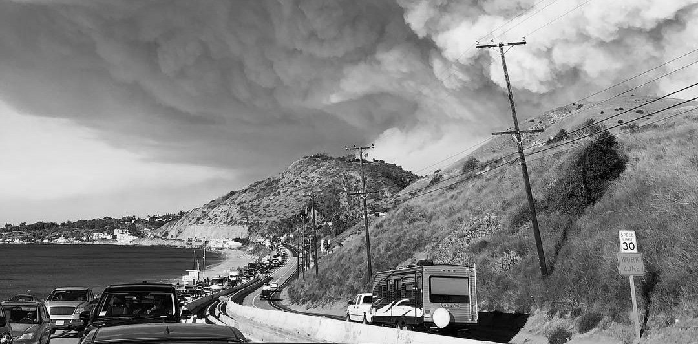

Benefit Cost Analysis (BCA) Overview
Cal OES
January 8, 2019

Slide 2
Training Introduction
Welcome
Purpose of training
Instructor introductions
Survey of attendees – BCA experience and expectations for the training
Format of training sessions

Slide 3
Agenda
BCA resources
General concept of a BCA
Determining benefits for a hazard mitigation project
Components of a BCA
Documenting the BCA
Using the FEMA BCA tool

Slide 4
BCA Resources

Slide 5
BCA Resources
Hazard Mitigation Assistance (HMA) Guidance and Addendum
BCA Reference Guide
Supplement to the BCA Reference Guide
HMA Job Aids
FEMA Building Science publications
FEMA BCA helpline (email and phone)
OES/Hagerty post-training consultation
Linked on Cal OES HMGP web page under “Benefit Cost Analysis Overview Cover Sheet”
Many other subject matter-specific resources

Slide 6
General Concept of a BCA

Slide 7
General Concept of a BCA
A BCA is the method by which the future benefits of a hazard mitigation project are determined and compared to its costs
The end result is a Benefit-Cost Ratio (BCR), which is calculated by a project’s total benefits divided by its total costs
A project is considered to be cost effective when the BCR is 1.0 or greater, indicating the benefits of a prospective hazard mitigation project are sufficient to justify the costs
The benefits are the net present value of the reduction in damages and losses over the useful lifetime of the project, using FEMA’s 7% discount rate
The present value calculation is done automatically in the BCA software

Slide 8
General Concept of a BCA
FEMA requires a BCA to validate cost effectiveness of proposed hazard mitigation projects prior to funding. There are two drivers behind this requirement:
The Office of Management and Budget’s (OMB) Circular A-94 Revised, “Guidelines and Discount Rates for Benefit-Cost Analysis of Federal Programs”
  The goal of Circular A-94 is to promote efficient resource allocation through well-informed decision-making by the Federal Government
  FEMA’s BCA Toolkit has been developed to meet the guidelines published in Circular A-94
The Stafford Act
  The Stafford Act authorizes the President to establish a program to provide technical and financial assistance to state and local governments to assist in the implementation of hazard mitigation measures that are cost effective and designed to substantially reduce injuries, loss of life, hardship, or the risk of future damage and destruction of property

Slide 9
General Concept of a BCA
Most of the focus of a BCA is on the benefits side
Costs are usually relatively easy, though they must come from a good source AND they must be more or less accurate, because they are used by States and FEMA in budgeting for the grant programs

Slide 10
Calculating Benefit Cost Ratio (BCR)
Benefits
Costs
Benefit-Cost Ratio (BCR)

Slide 11
General BCA Example
Your mechanic recommends replacing a part on your car to reduce problems in the future.
  The replacement part with labor will cost $2,500
  The mechanic estimates the old part will need service twice a year that will cost $300 each
  The mechanic estimates the new part will only need service once a year for a $150 service
  You only plan to use the car for 7 more years
Would you pay for the replacement part?

Slide 12
General BCA Example
Your mechanic recommends replacing a part on your car to reduce problems in the future.
  The replacement part with labor will cost $2,500
  The mechanic estimates the old part will need service twice a year that will cost $300 each
  The mechanic estimates the new part will only need service once a year for a $150 service
  You only plan to use the car for 7 more years
Would you pay for the replacement part?
  Without replacement, expect to pay $600 per year in services
  With replacement, expect to pay $150 per year in services
  Savings in service costs is $450/year, or $450*7 = $3,150 over 7 years
  BCR = 1.26

Slide 13
Example of a Hazard Mitigation Project
Before Mitigation (Pre-Mitigation)
First Floor Elevation
(FFE) = 500’

Slide 14
Example of a Hazard Mitigation Project
Before Mitigation (Pre-Mitigation)
100-year flood = 504’
10-year flood = 502’
5-year flood = 500’
(FFE = 500’)

Slide 15
Damages to Structure
Pre-Mitigation
Flood Depth (feet) | Annual Probability of Flooding | Scenario Damages and Losses | Expected Annual Damages and Losses
0 | 0.20 (5-year flood) | $6,400 | $1,280
2 | 0.10 (10-year flood) | $24,500 | $2,450
4 | 0.01 (100-year flood) | $32,100 | $321
Total Expected Annual Damages and Losses: |  |  | $4,051

Slide 16
Example of a Hazard Mitigation Project
After Mitigation (Post-Mitigation)
(NEW FFE = 503’)
100-year flood = 504’
10-year flood = 502’
5-year flood = 500’
Hazard doesn’t change, but
its effect on structure does!

Slide 17
Damages to Structure
Post-Mitigation
Flood Depth (feet) | Annual Probability of Flooding | Scenario Damages and Losses | Expected Annual Damages and Losses
0 | 0.20 (5-year flood) | $0 | $0
2 | 0.10 (10-year flood) | $0 | $0
4 | 0.01 (100-year flood) | $6,400 | $64
Total Expected Annual Damages and Losses: |  |  | $64

Slide 18
Calculation of the BCR
Assume we expect elevated house to last the next 30 years…
Flood Depth (feet) | Expected Annual Damages Before Mitigation | Expected Annual Damages After Mitigation | Expected Annual Avoided Damages and Losses
0 | $1,280 | $ 0 | $1,280
2 | $2,450 | $ 0 | $2,450
4 | $321 | $63 | $258
Totals | $4,051 | $63 | $3,988
PVC (7% Discount Rate, 30 years) |  |  | x 12.41
Net Present Future Value of Future Benefits |  |  | $49,491
Costs |  |  | $35,000
Benefit-Cost Ratio |  |  | 1.41

Slide 19

General Concept of a BCA
Questions?

Slide 20
Determining Benefits for a Hazard Mitigation Project

Slide 21







Determining Benefits For A Hazard Mitigation Project
What types of benefits can you claim for your project?
Avoided Physical Damages
Avoided Emergency Response Costs
Avoided Loss-of-Function Impacts
CLOSED
Avoided Injuries and Casualties
Societal and Environmental Benefits

Slide 22
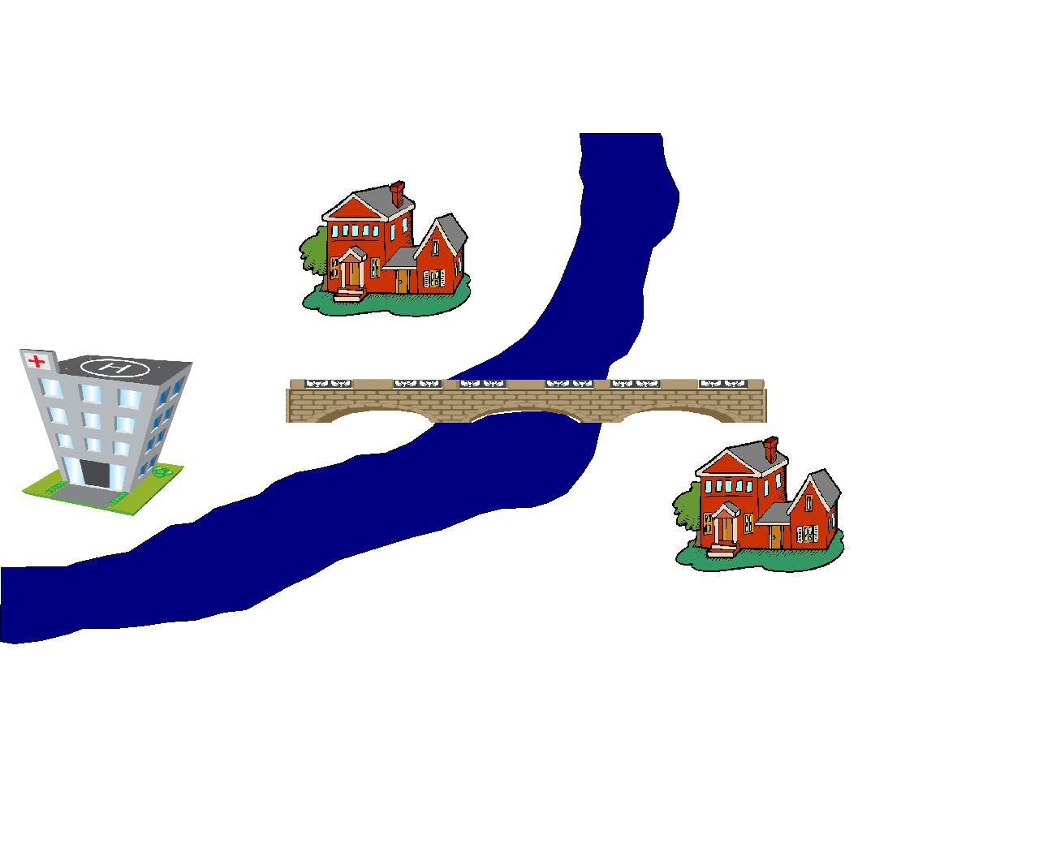
Determining Benefits For A Hazard Mitigation Project
Notes:
Physical: houses, contents, bridge, pipes, hospital building, hospital equipment
Emergency Response: sandbagging, set up detour, barricades, evacuation
LOF: road, utilities, residential, hospital
Injuries and Casualties? (no)
Social: mental stress/anxiety, lost worker productivity, environmental?

Slide 23
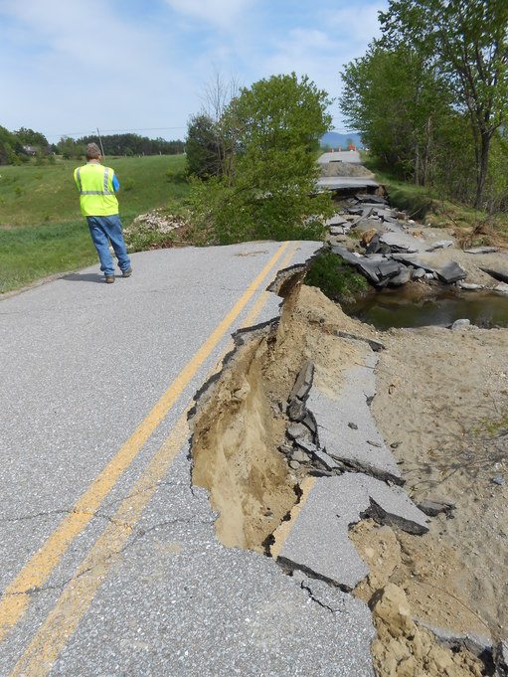
Benefits - Avoided Physical Damages
Damages to facilities requiring repair or replacement:
  Structures
  Contents
Roads
Bridges
Utilities

Slide 24
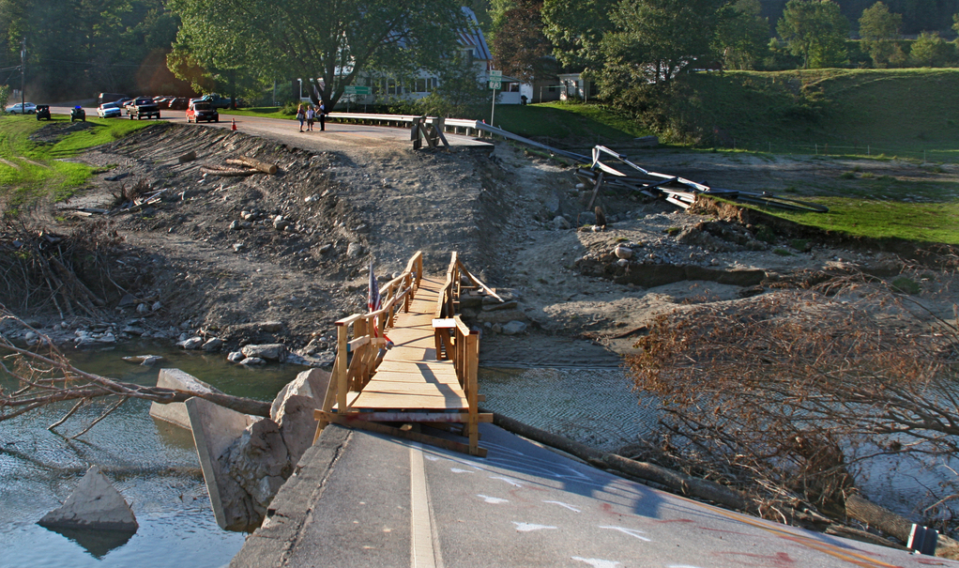
Benefits - Avoided Response Cost
Costs include labor, equipment, and materials to perform emergency work, for example:
  Sandbagging before the event
  Costs to evacuate residents
  Costs to close roads
  Costs to provide a temporary by-pass

Slide 25
Benefits - Avoided Loss-of-Function (LOF)
Loss of function is an interruption to:
  Utilities
  Roads
  Businesses
  Residences
  Critical services
Benefits depend on:
  Value of the function
  Length of interruption

Slide 26
Benefits - Avoided Loss-of-Function (LOF)
Examples include:
  Mechanical equipment for a hospital damaged in a flood
  Road bridge collapses during an earthquake
  Electric lines down after a wildfire

Slide 27
Loss-of-Function Data
Roads:
You
  # of one-way traffic trips per day
  # of additional miles and minutes per trip
  Downtime length (days)
FEMA
  Standard value for $/car/hour
Utilities (potable water, wastewater and electrical):
You
  # of customers that will be protected by mitigation project
  Downtime length (days)
FEMA
  Standard value for $/person/day

Slide 28
Loss-of-Function Data
Ordinary Public Buildings:
You
  Annual operating budget for that building
  Downtime length (days)
FEMA
  No standard values!
Critical Services (police, fire, and medical):
You
  # of people served by facility and type of area (urban vs. rural)
  Distance to closest similar facility
  # served at closest similar facility
  Downtime length (days)
FEMA
  Economic values on a per-day basis

Slide 29
Loss-of-Function Data
Residential Displacement:
You
  # occupants
  Building type
  Building Replacement Value (BRV)
  Per diem values for your area
FEMA
  Depth-damage curve
Non-residential:
You
  Monthly rental costs for comparable building
  Downtime length (days)
FEMA
  One time disruption cost

Slide 30
Benefits – Avoided Injuries and Casualties
In CA, only counted for seismic retrofit projects:
You
  average # of occupants in building over a typical 24-hour period
FEMA
  $ value/death or injury

Slide 31



Injury and Casualty Data
Based on academic research by Department of Homeland Security, the Value of Statistical Life:
Minor Injuries
$14,000
Major Injuries
$1,800,000
Dead - Fatal
$6,900,000
Typically only counted for tornado and earthquake projects due to insufficient warning times

Slide 32
Societal Benefits
Mental Stress (residential Only)
  $2,443 per person
  BCR must be >0.75 without these benefits for them to kick in
Lost Productivity (residential Only)
  $8,736 per worker
  BCR must be >0.75 without these benefits for them to kick in
Street maintenance
Volunteer time
Loss of rent

Slide 33
BCAs for Generator Projects
Generators most often funded through the HMGP 5% initiative
For the "regular" HMGP they must have a BCA
No dedicated path in the BCA software
Most often done via DFA methodology

Slide 34
BCAs for Generator Projects
Power loss frequency is often difficult to determine accurately
Various sources in FEMA guidance; good to have local records if possible
Generally power losses by themselves are not frequent or long enough to generate sufficient benefits to support a project (meaning simply counting the value of lost power) - need to be related to a service like fire department, water/sewer pumps, EOC, etc.

Slide 35
BCAs for Generator Projects
Loss of service calculations are generally based on the same inputs as other BCAs for public operations and facilities - #served, distance to nearest analogous facility, etc., along with time of interruption
As with all BCAs, documentation is important, especially true of generators, where the burden of proof is on the analyst - not much default data to work with
"Standard Economic Values" guidance has some useful metrics
Work with your local utility provider to determine dates and duration of power loss events
If three or more power loss events, utilize unknown frequency calculator in DFA module to determine recurrence intervals

Slide 36
Climate Resilient Mitigation Activities (CRMA) Guidance
CRMA projects use nature-based design in their implementation
Green infrastructure or nature based design encourages communities to use more sustainable methods
In September 2015, FEMA released three new activities eligible for the Hazard Mitigation Assistance programs:
  Aquifer Storage and Recovery
  Floodplain and Stream Restoration
  Flood Diversion and Storage

Slide 37
Climate Resilient Mitigation Activities (CRMA) Benefits
In May 2016, FEMA developed specific tools to evaluate the ecosystem services and how they would fit with the rest of the benefit cost analysis toolkit:
  Drought mitigation
  Ecosystem service
  Pre-calculated benefits for cost effectiveness evaluation of soil stabilization, flood diversion, and reforestation projects in wildfire impacted areas to support expedient implementation of post-wildfire mitigation actions

Slide 38
Pre-Calculated Benefits
To streamline the HMA grant application process, FEMA has released several benefit-cost efficiencies to provide pre-determined cost effectiveness values
Using pre-calculated benefits eliminates the requirement for applicants to conduct a separate BCA for eligible projects:
  Acquisitions and elevations in the Special Flood Hazard Area (SFHA)
  Residential Hurricane Wind Retrofits
  Non-Residential Hurricane Wind Retrofits
  Individual Tornado Safe Rooms
  Post-Wildfire Mitigation

Slide 39
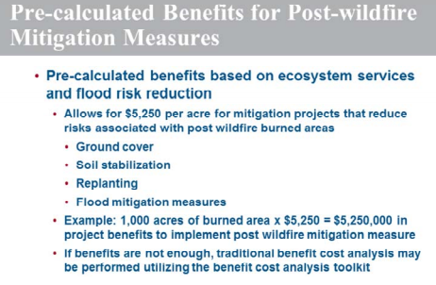
Post-Wildfire Mitigation Benefits
FEMA developed pre-calculated benefits to streamline implementation of mitigation actions in wildfire impacted areas to reduce risk from related hazards such as flood
Soil stabilization, flood diversion, and reforestation projects under the cost of $5,250 per acre are determined cost effective and no further BCA is required

Slide 40
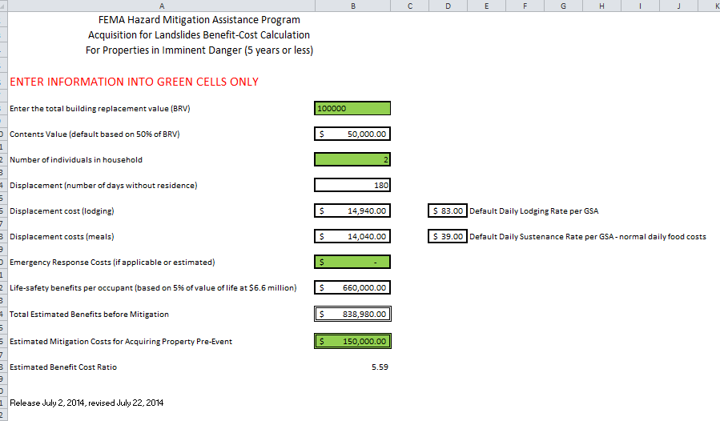
Landslide Pre-Calculated Benefits

Slide 41
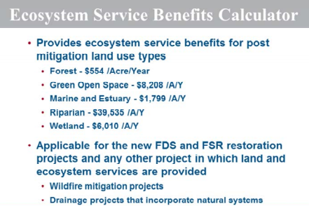
Environmental and Ecosystem Benefits
Environmental and ecosystem service benefits cannot be included with the project until 0.75 is demonstrated by the benefit cost analysis
Essentially what this means is when we have done these projects, you have to have enough benefits to cover 0.75 of the project cost

Slide 42
Using Sea Level Rise in BCAs
FEMA guidance allows/encourages the use of sea level rise (SLR) in BCAs
Applies to flood analyses
Specific data entry cell for expected SLR in ”full flood” module
Can be used in DFA by incorporating side calculation – adjusting historic or expected frequencies or damages
MUST cite a valid source of sea level rise
FEMA has developed an XL-based calculator that we can provide

Slide 43
Determining Benefits For Your Hazard Mitigation Project
Questions?

Slide 44
Components of a BCA

Slide 45





Components Of A BCA
What kind of information do you need for a BCA?
What natural hazard is your project addressing?
How often does that hazard happen?
How long will your project be effective for?
What damages does this hazard cause to the community?
How much of this damage does your project prevent?

Slide 46
Components Of A BCA
What natural hazard(s) is your project addressing?
  Floods
  Earthquakes
  Wildfires
  Landslides
  Droughts
  Hurricanes
  Tornados
  Tsunamis

Slide 47
Components Of A BCA
How often does that hazard occur?
  We can’t predict exactly when it will happen
  But can estimate how often events of various severities occur it based on:
    Historic events
    FEMA flood insurance studies
    FEMA wildland/urban interface fire return periods (included in the fire BCA software by zip code)
    USGS National Seismic Hazard Data (included in the earthquake BCA software)

Slide 48
Components Of A BCA
How often does that hazard occur?
  Another name for these estimates are recurrence intervals (RI)
    The recurrence interval represents the average period of time between two occurrences of a specific magnitude hazard event
    It is the inverse of the annual probability of an event

Slide 49
Components Of A BCA
How long will your project be effective for?
  Improvements to the built environment do not last forever
    The retrofit itself may become less effective overtime, even with maintenance
    Or the structure the retrofit is improving becomes too old and needs to be replaced
  This affects how far in the future the BCA evaluates. This time period is known as the project useful life (PUL)
    This affects how much total damage and benefits the BCA will include
  FEMA has standard values for most project types

Slide 50
Components Of A BCA
What damages does this hazard cause to the community?
  Physical Damages
  Loss of Life
  Loss of Function
  Mental Stress and Anxiety*
  Environmental*
* These benefits can be used only when the underlying BC ratio exceeds 0.75

Slide 51
Components Of A BCA
How does a BCA calculate damage?
  It calculates how much damage occurs for each level of event
    Ex. $24,500 for a 10-year event, $32,100 for a 100-year event
  It takes the recurrence interval (RI) and calculates the annual probability
    Ex. A 100-year event has a 1/100=0.01 or 1% annual probability of occurring
  It multiples the expected damage and the annual probability to calculate expected annual damages

Slide 52
Components Of A BCA
How much of this damage does your project prevent?
  Reduce physical damages
  Reduce loss of life
  Reduce loss of function/service
  Reduce mental stress
Most projects do not eliminate all risk
  Have to calculate residual damages that may occur after your project is implemented

Slide 53
Components Of A BCA
BCA is conceptually:
Compare before-mitigation and after-mitigation damages
If damages are reduced after mitigation, then there are benefits to count
If the benefits are greater than costs, the project is cost-effective
Notes:
COME BACK TO THIS SLIDE AFTER EXCEL

Slide 54
Components Of A BCA
Questions?

Slide 55
Documenting the BCA

Slide 56
Documenting The BCA
What things should you include to compile your BCA?
  Damage Frequency Assessment (DFA)
    Most generic module
    Can be used for any hazard type
  Flood
  Wildfire
  Seismic
  Drought (Aquifer Recharge)
  Landslide Acquisition (outside of BCA tool)
  Generators/Early Warning Systems

Slide 57

Documenting The BCA
For all projects:
  Use data from credible and reliable sources (Federal, state, local agencies)
  Provide complete technical support data – copy of the FIS data (FIRM, discharge data, flood profiles) or reports from other agencies
  Explain and provide justification for data that supersedes FIS or standard FEMA data
  Organize the data via a list of attachments
  Cite the location of BCA relevant data within the support data (i.e., report name, page no., etc.)
  Do not assume that, during review, FEMA has access to the same data that the user does

Slide 58
Documenting The BCA
For all projects:
  Technical documentation showing level of protection
  Documentation supporting project useful life (PUL) if FEMA standard value not used
  Detailed cost estimate and source of estimate
  Maintenance costs
  Documentation supporting value of service if FEMA standard value is not used
  Documentation of value of building function (annual budget)

Slide 59


Documenting The BCA
For projects using DFA Module:
  Technical documentation supporting recurrence intervals
    Precipitation data, stream gage data
    Fault rupture data
    Utility outage data (weather related)
  Analysis of expected damages for each level of hazard
    Pre-mitigation AND post-mitigation
  Documentation of historic damages with dates

Slide 60

Documenting The BCA
For projects using Flood Module:
  Documentation of first floor elevation
    Elevation certificate
    LIDAR + offset based on foundation
  Documentation of flood hazard
    H&H Analysis (flood elevations, discharge rates, RIs)
      Flood Insurance Study (FIS) is an H&H analysis!
  Justification for any revisions to the FEMA depth-damage curves – its almost always best to use the FEMA values

Slide 61
Documenting The BCA
For projects done in Wildfire Module:
  Defined project area (see notes on your fire summary)
  Justification for mean fire return period if FEMA data per zip code is revised
  Documented population of project area
  Documented number of structures in project area
  Documented building replacement values in project area
    Professional construction estimate
    Reputable construction estimation data (RS Means, etc.)

Slide 62

Documenting The BCA
For projects done in Seismic Module:
  Justification of soil type
    Geotechnical report or USGS soil/rock data (VS 30, etc.)
    Soil type D may be used if soil/rock type is unknown
  Documentation of building replacement value
  Documentation of the average occupancy on a 24/7/365 basis
    Averaged over a typical year
    Show activities or programs with duration and # of participants
  Justification for pre- and post- mitigation design levels
  Analysis for any non-default seismic building parameters

Slide 63


Documenting The BCA
For projects done in Drought (ASR) Module:
  # of people served by aquifer
  Total demand of aquifer (mgd)
  Drought RIs
  Analysis of pre-mitigation reduced supply
  Analysis of post-mitigation reduced supply

Slide 64
Documenting The BCA
Quick discussion of 2015 Climate-Resilient Mitigation Activities (CRMA)
Guidance at:
  http://www.fema.gov/climate-resilient-mitigation-activities-hazard-mitigation-assistance

Slide 65
Using The FEMA BCA Tool

Slide 66
Using The FEMA BCA Tool
Walkthrough of example projects

Slide 67
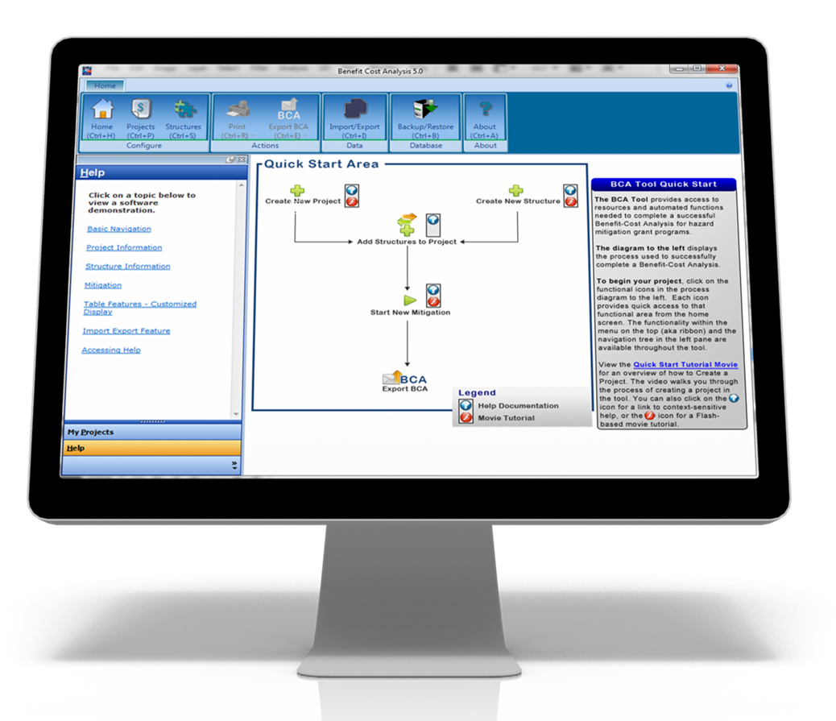
DFA EXAMPLE

Slide 68
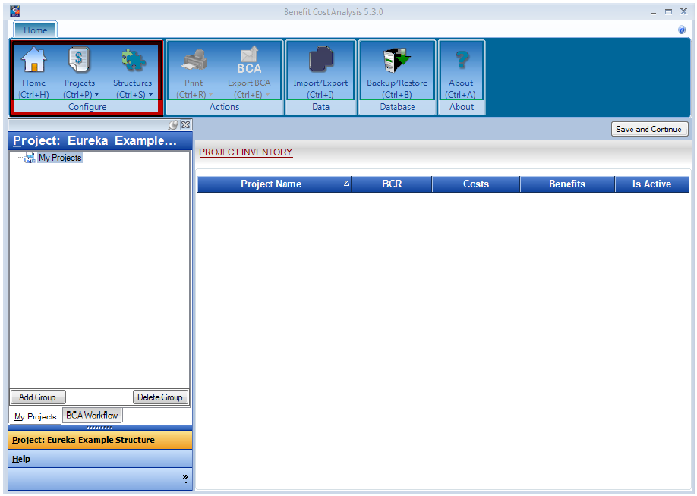
DFA EXAMPLE

Slide 69
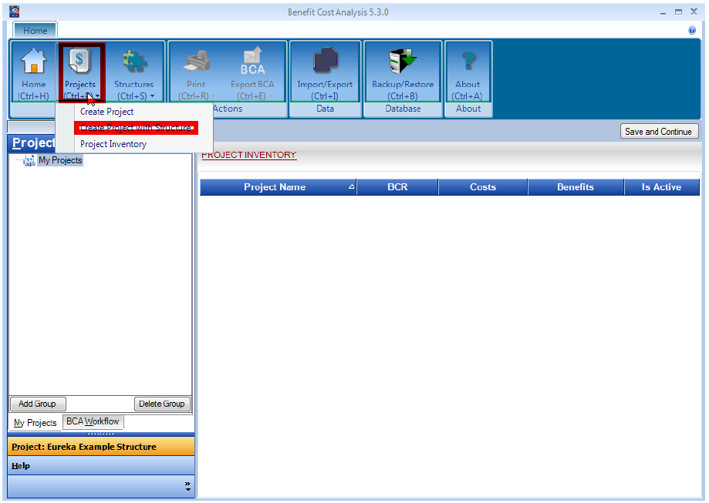
DFA EXAMPLE

Slide 70
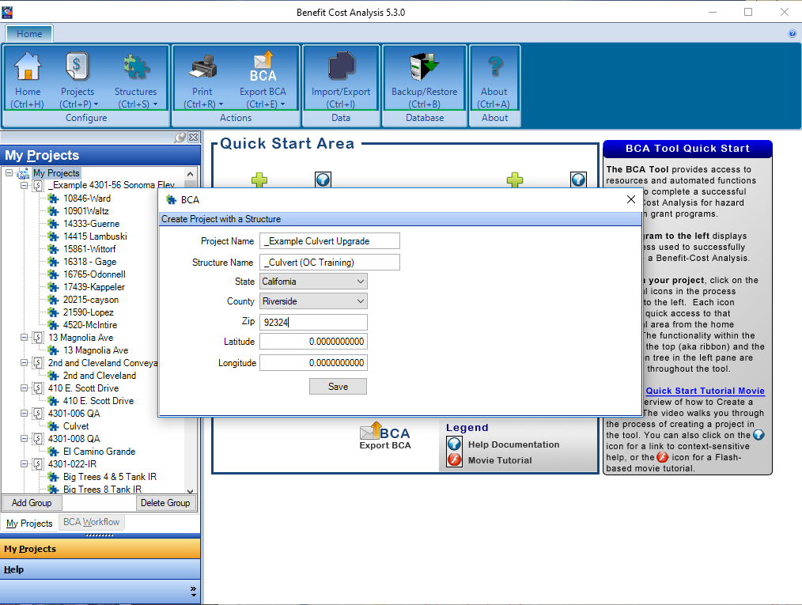
DFA EXAMPLE

Slide 71
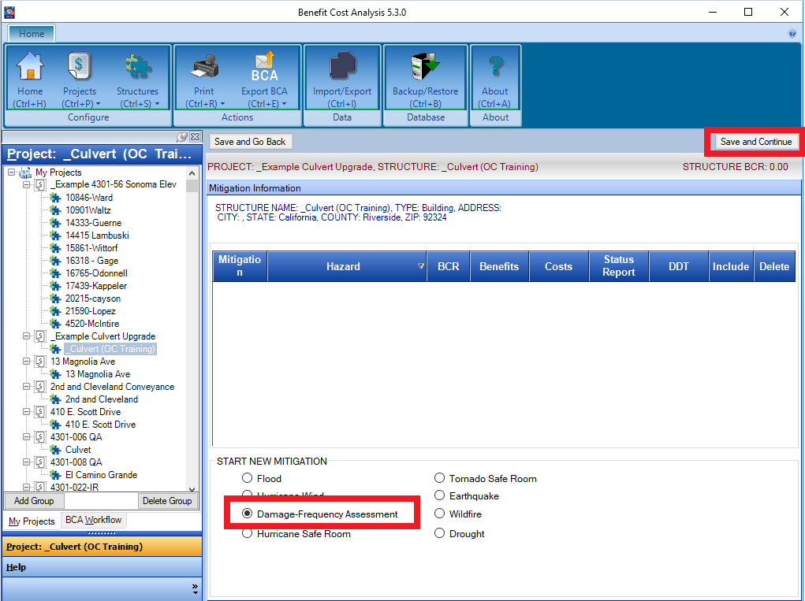
DFA EXAMPLE

Slide 72
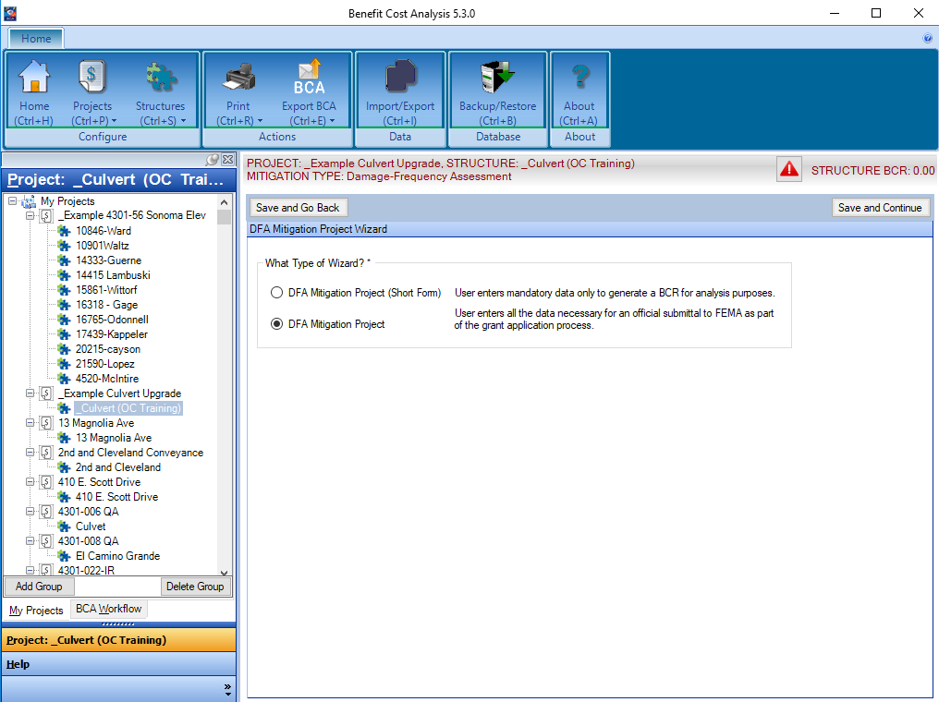
DFA EXAMPLE

Slide 73
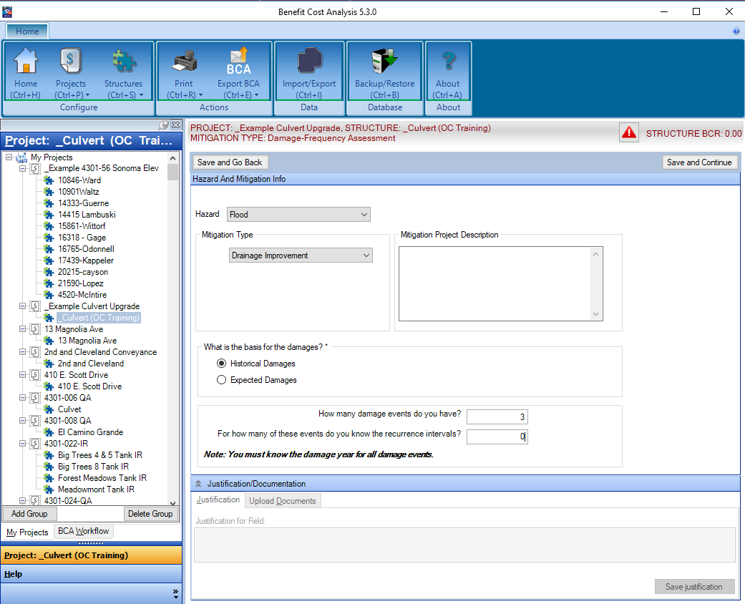
DFA EXAMPLE

Slide 74
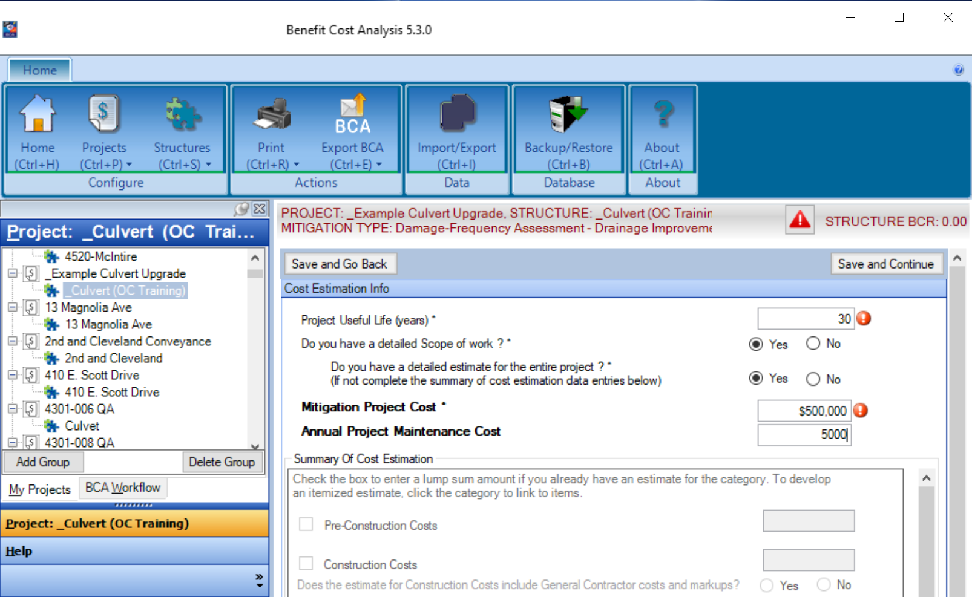
DFA EXAMPLE

Slide 75
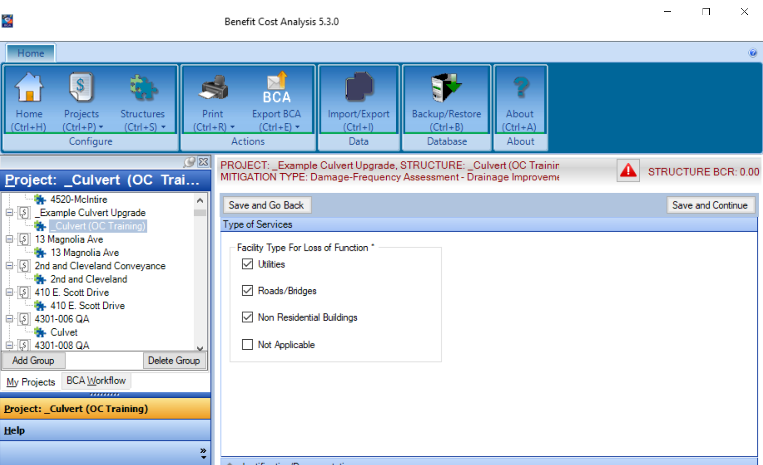
DFA EXAMPLE

Slide 76
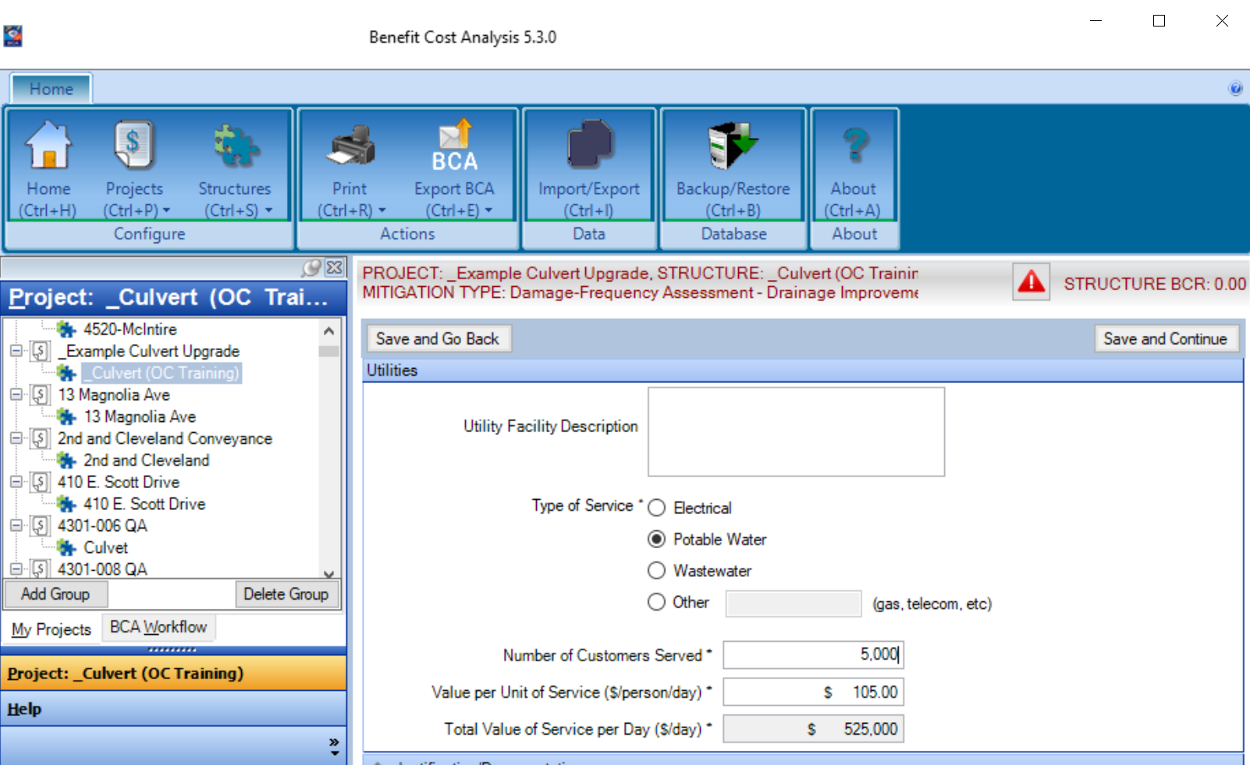
DFA EXAMPLE

Slide 77
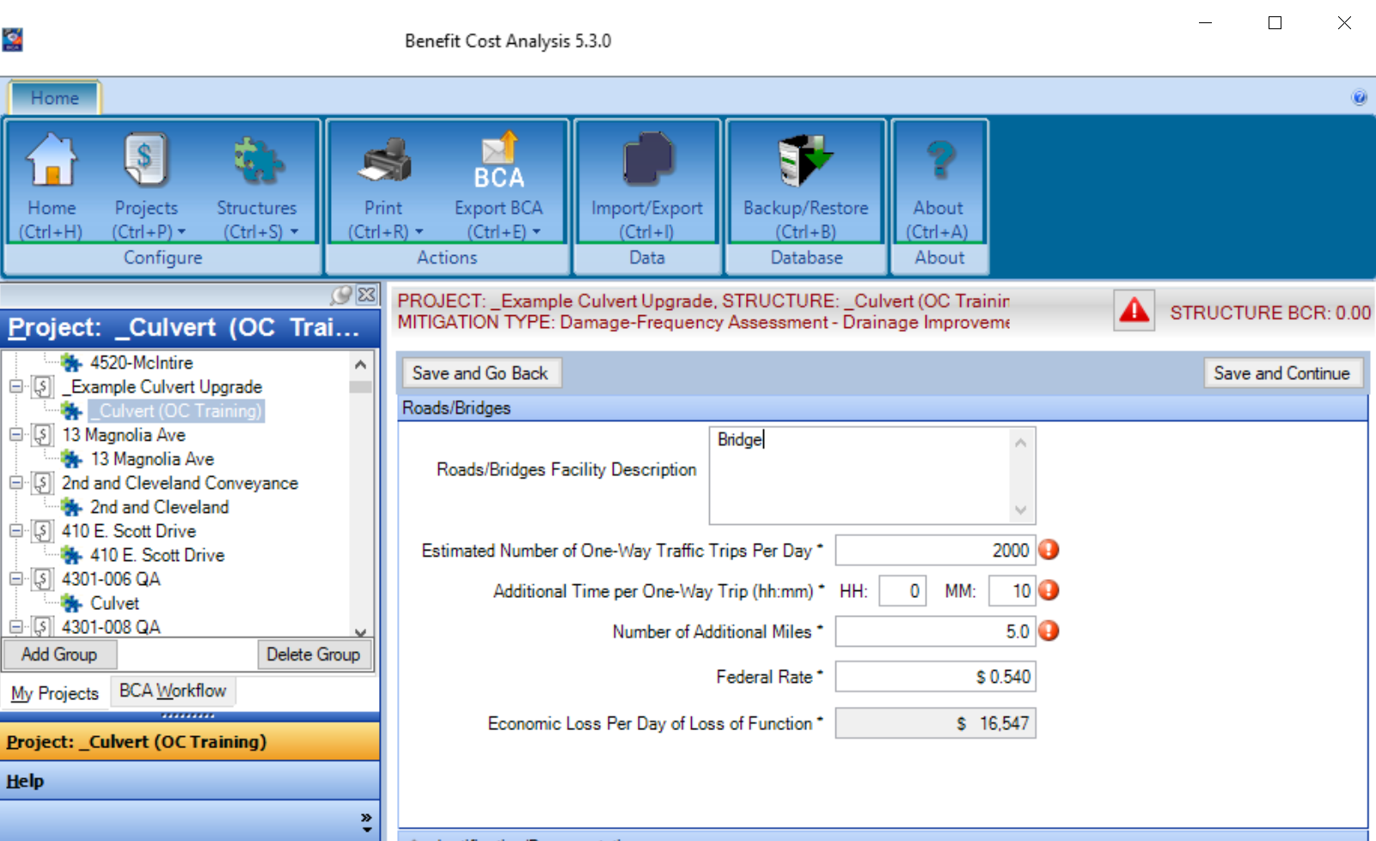
DFA EXAMPLE

Slide 78
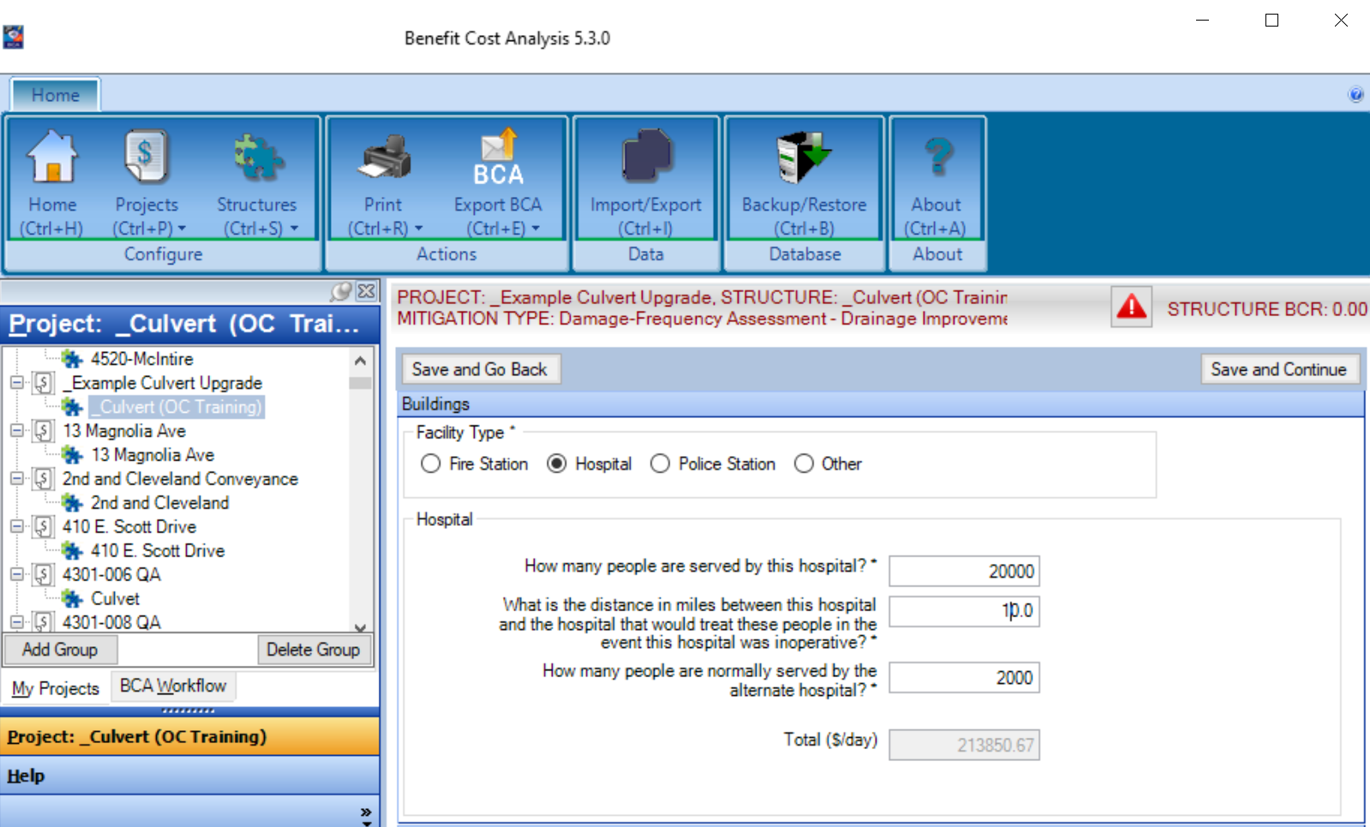
DFA EXAMPLE

Slide 79
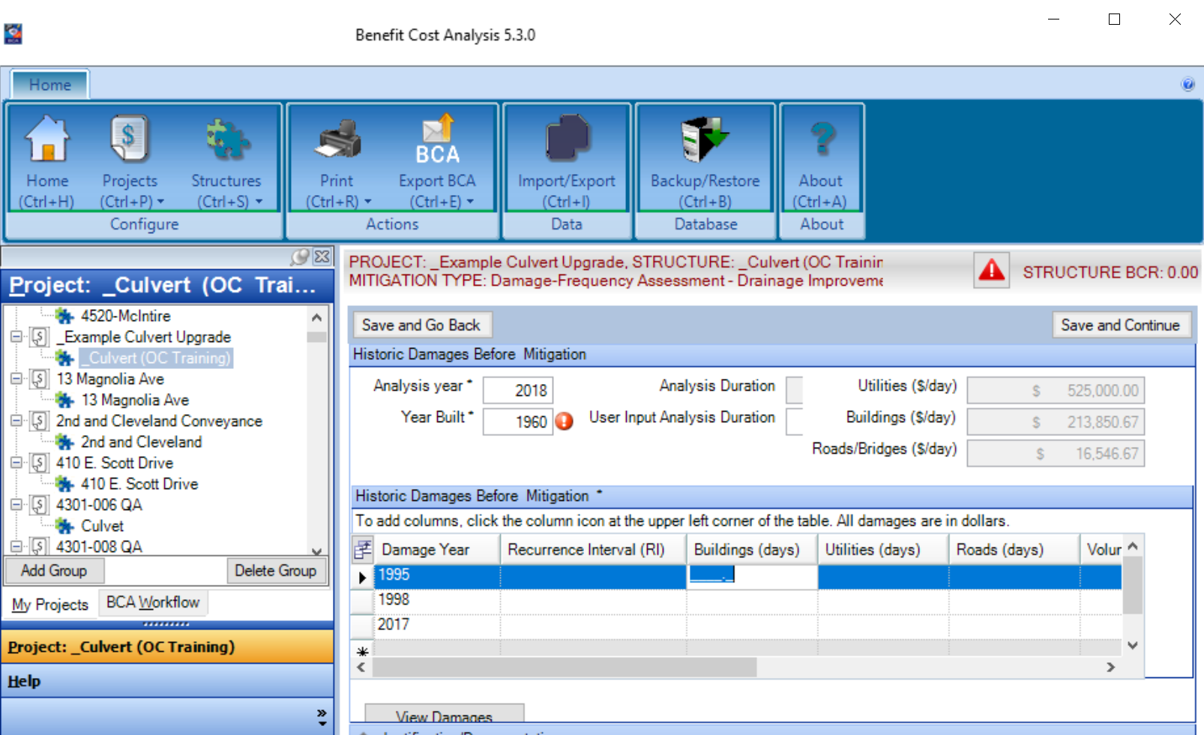
DFA EXAMPLE

Slide 80
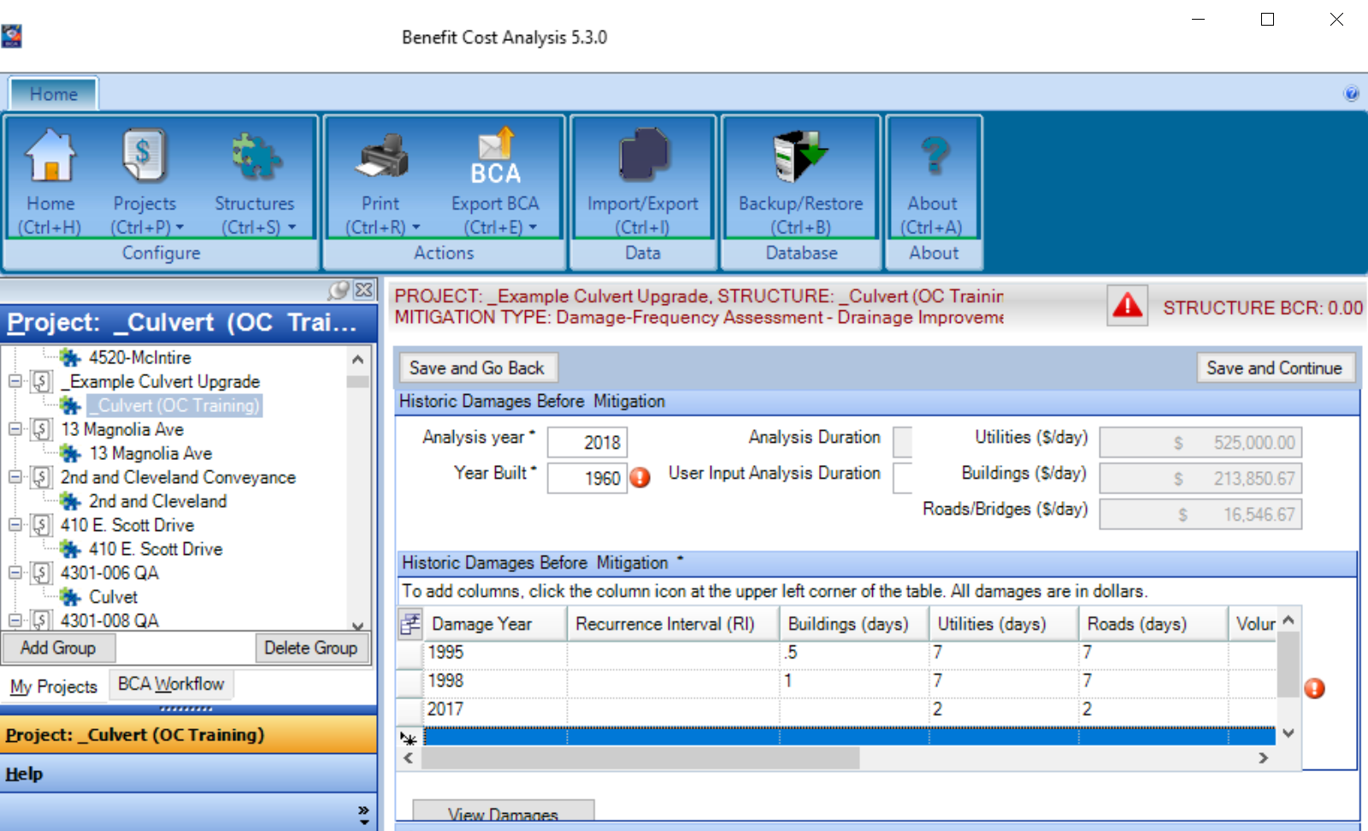
DFA EXAMPLE

Slide 81
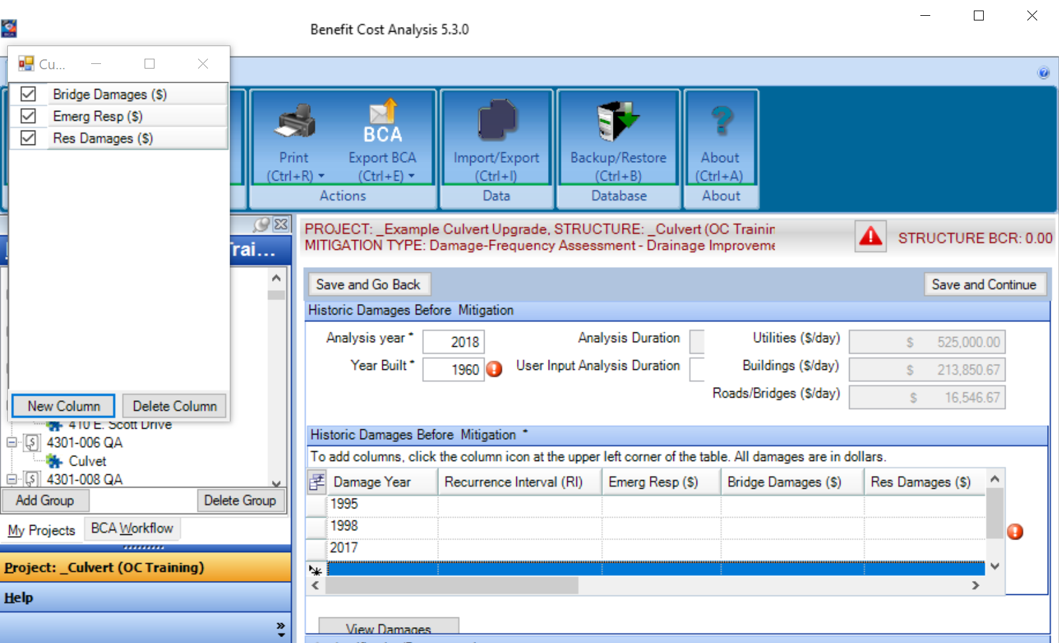
DFA EXAMPLE

Slide 82
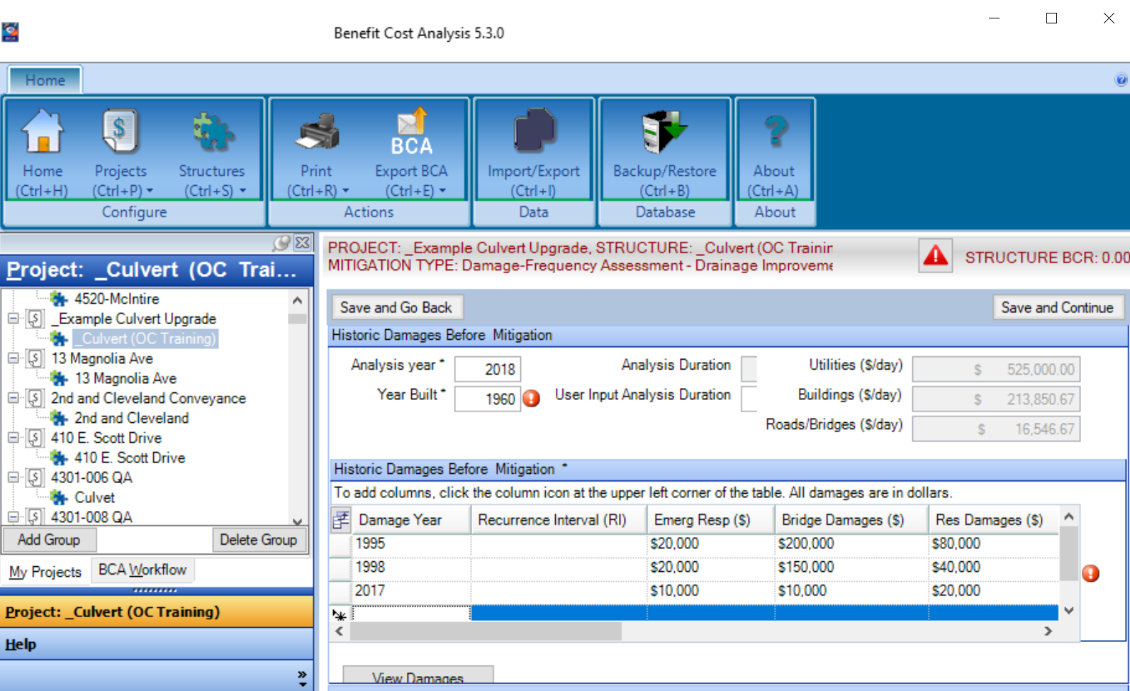
DFA EXAMPLE

Slide 83
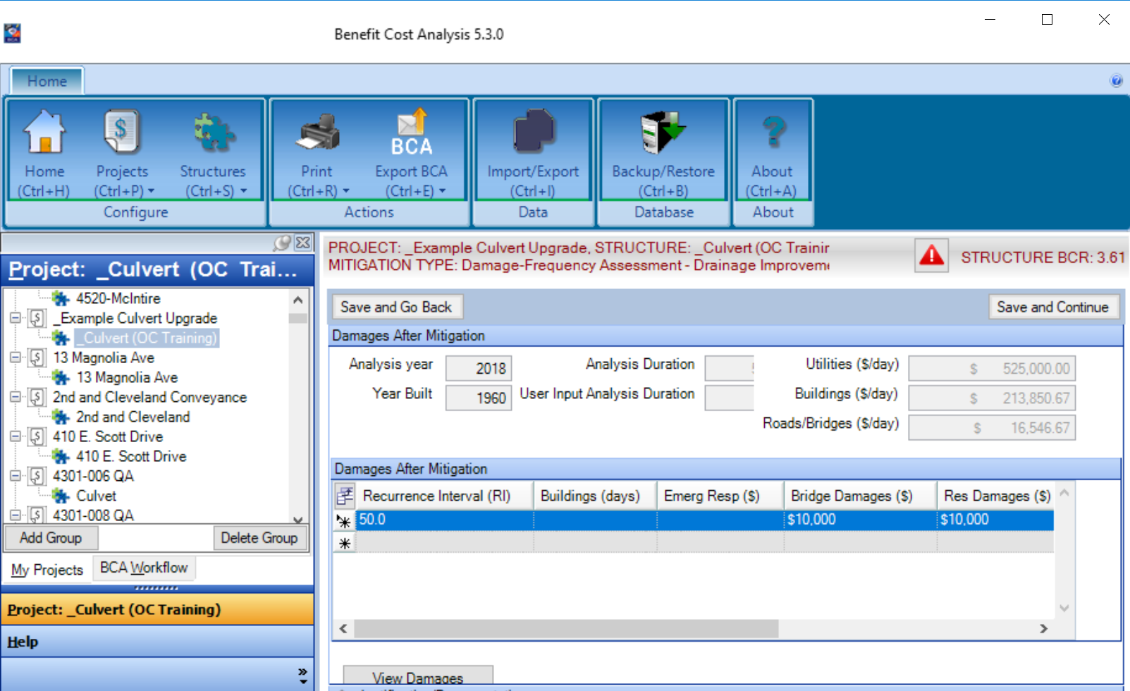
DFA EXAMPLE

Slide 84
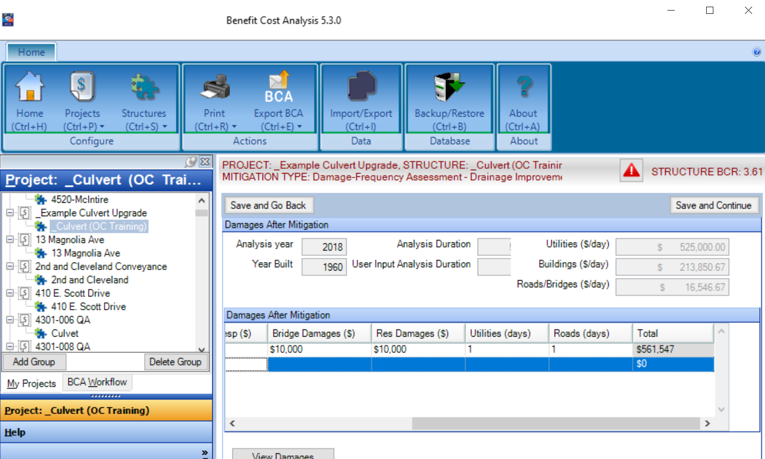
DFA EXAMPLE

Slide 85
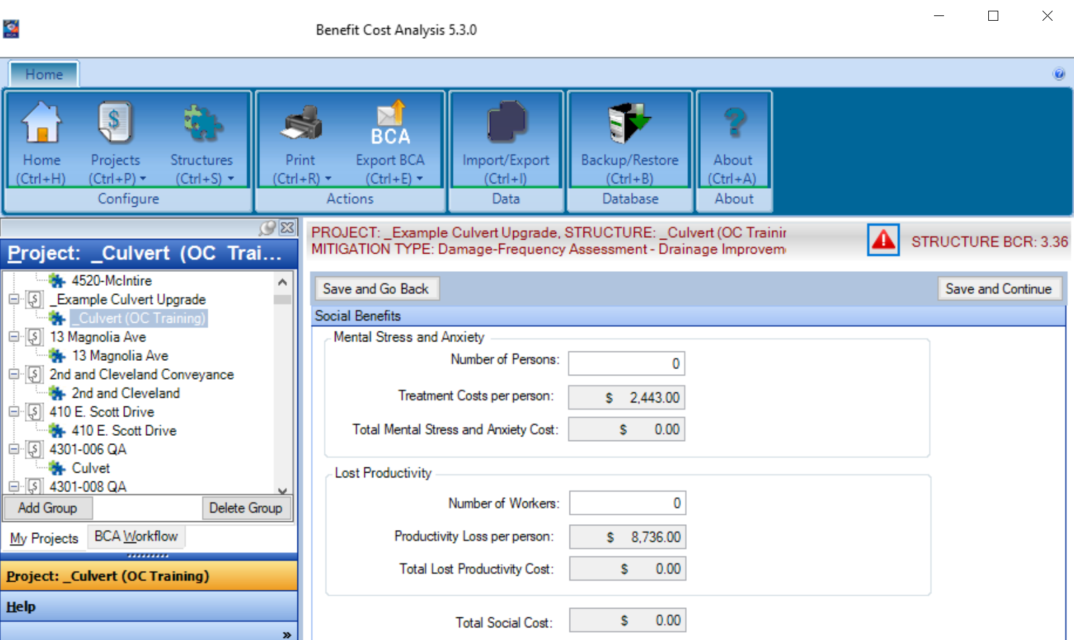
DFA EXAMPLE

Slide 86
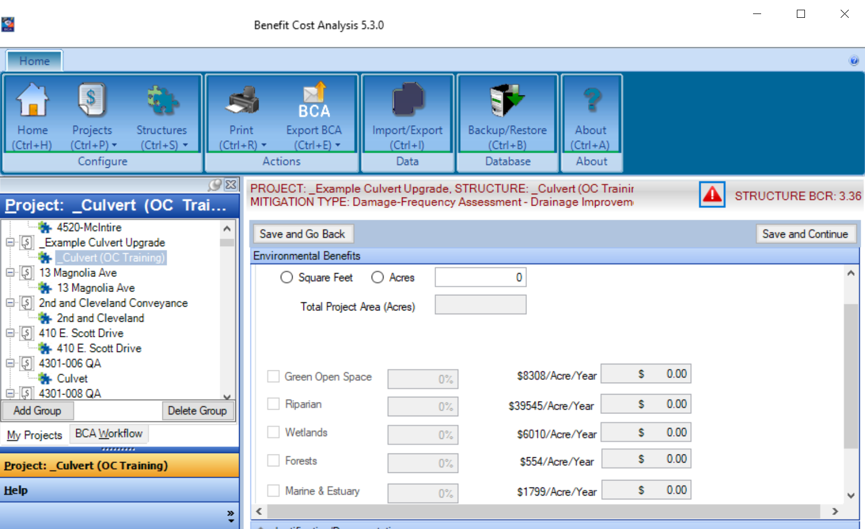
DFA EXAMPLE

Slide 87
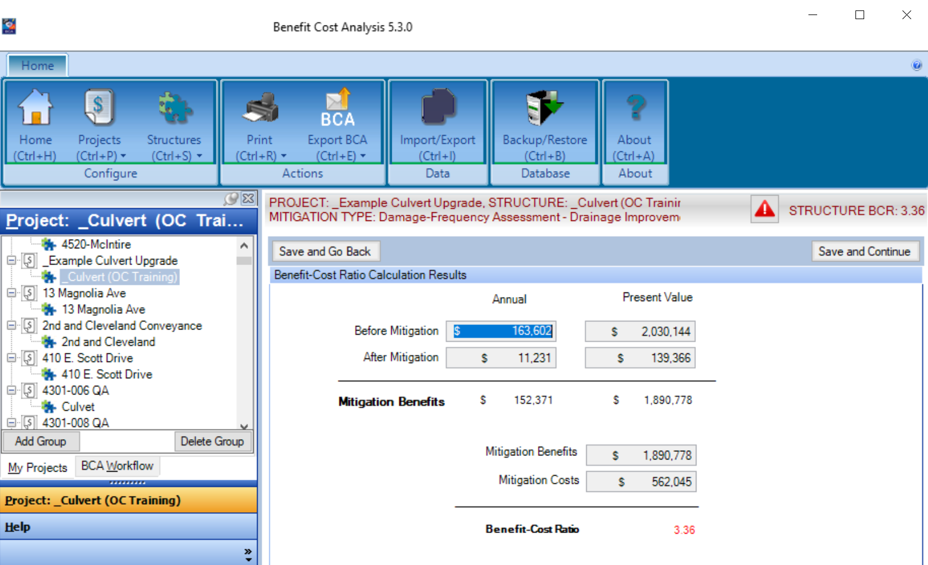
DFA EXAMPLE

Slide 88
QUESTIONS?
Questions?

Slide 89
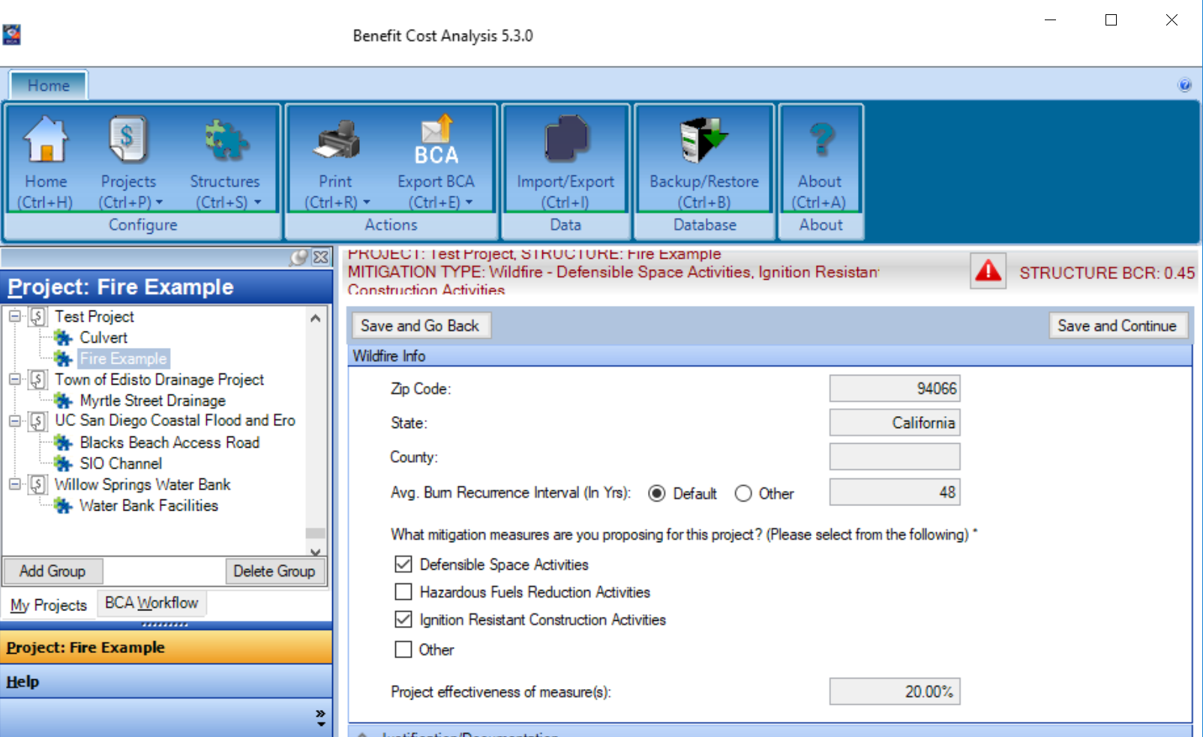
WILDFIRE EXAMPLE

Slide 90
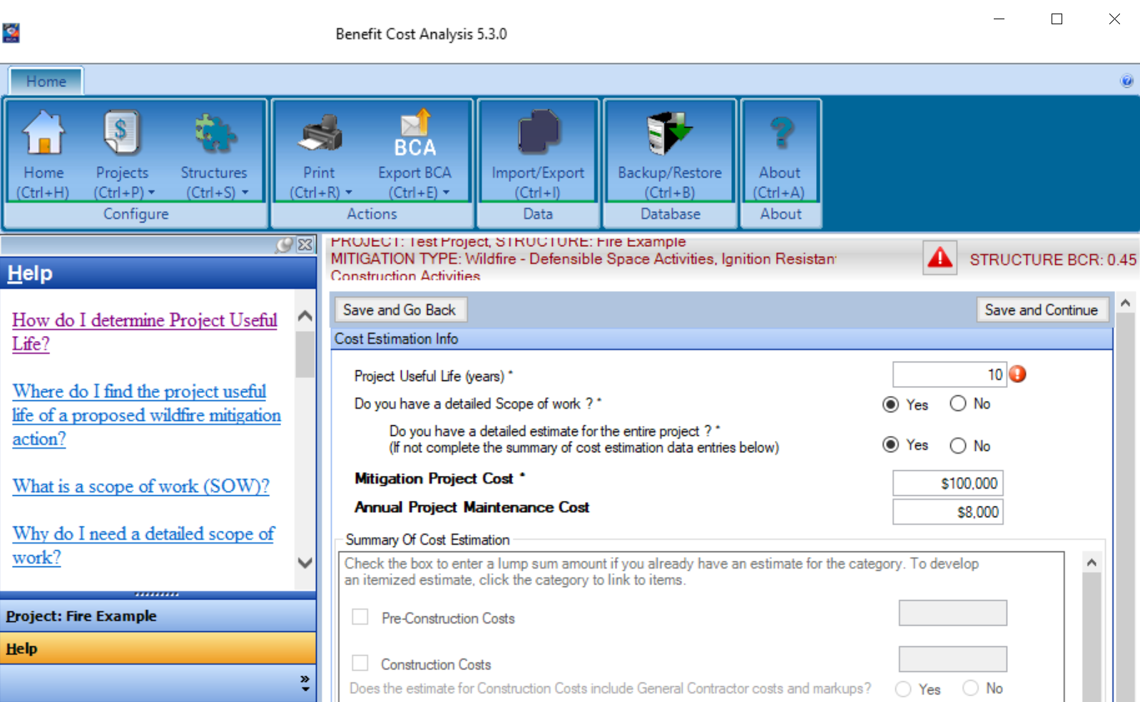
WILDFIRE EXAMPLE

Slide 91
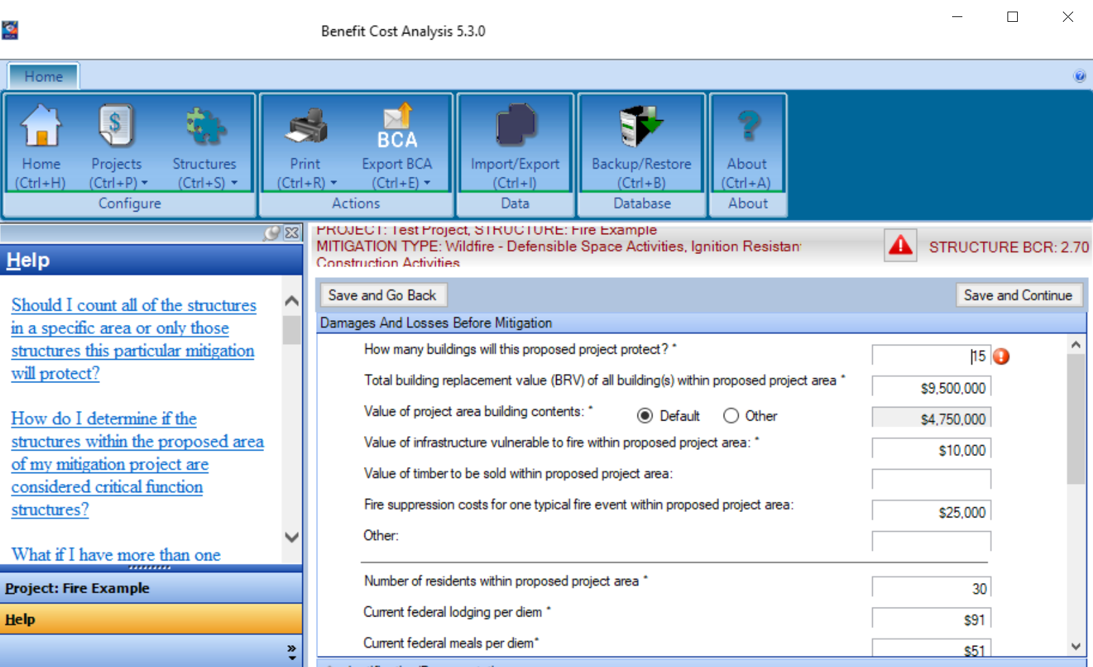
WILDFIRE EXAMPLE

Slide 92
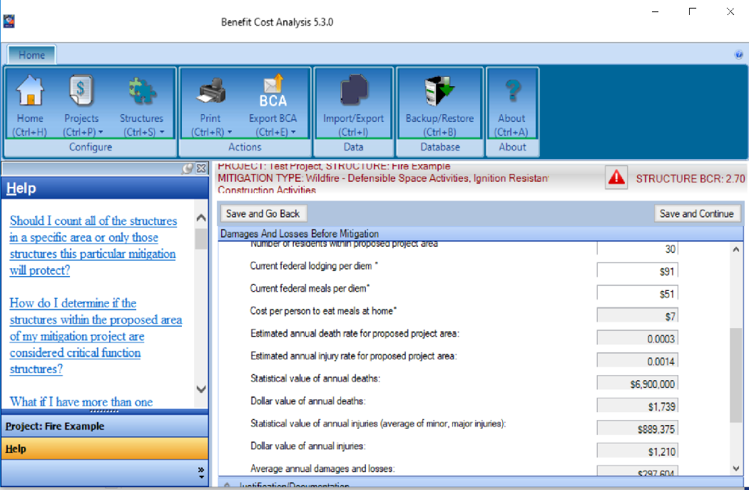
WILDFIRE EXAMPLE

Slide 93
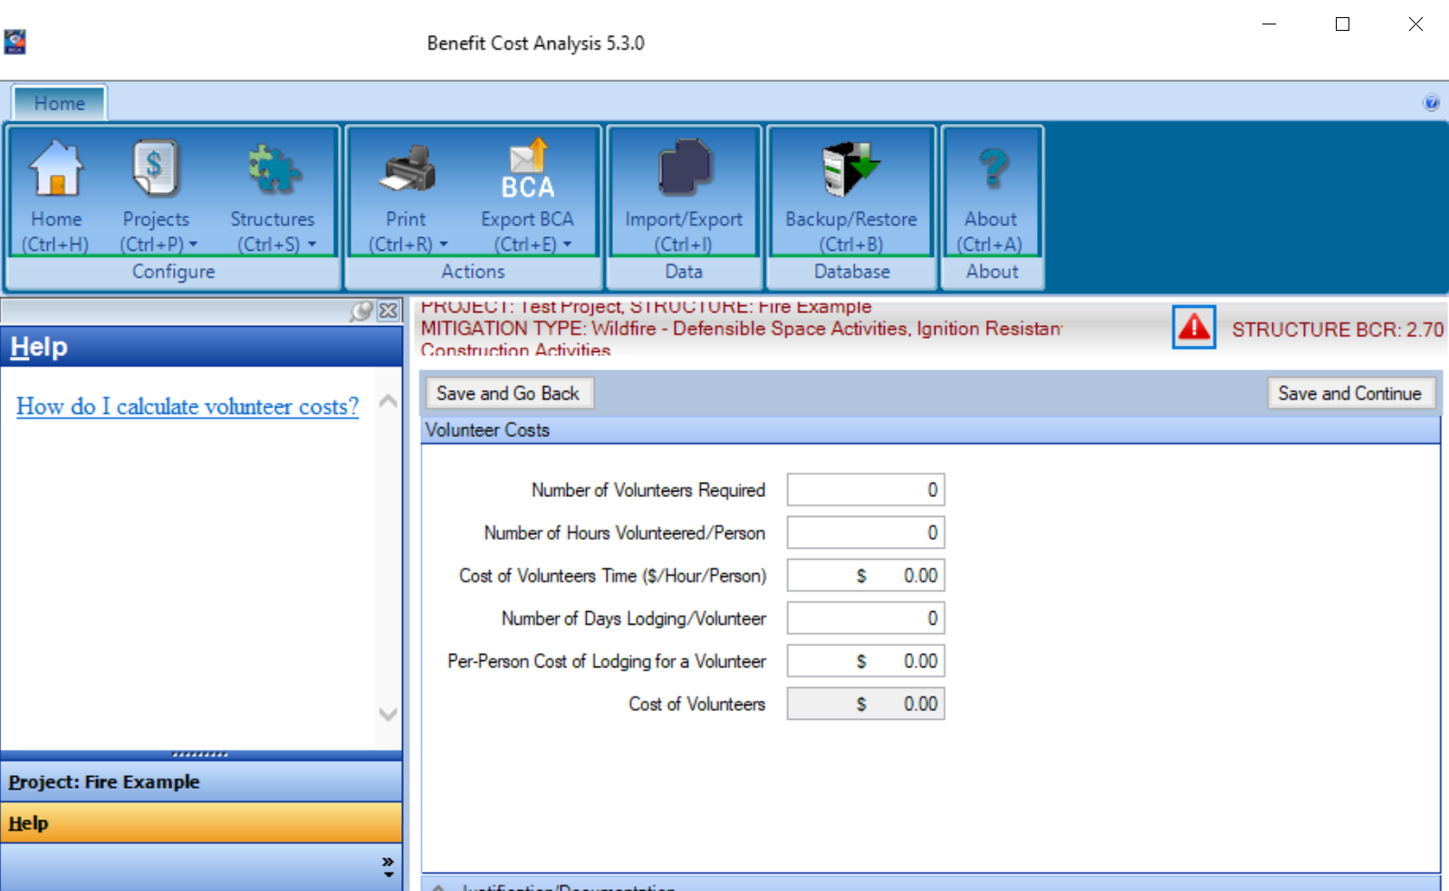
WILDFIRE EXAMPLE

Slide 94
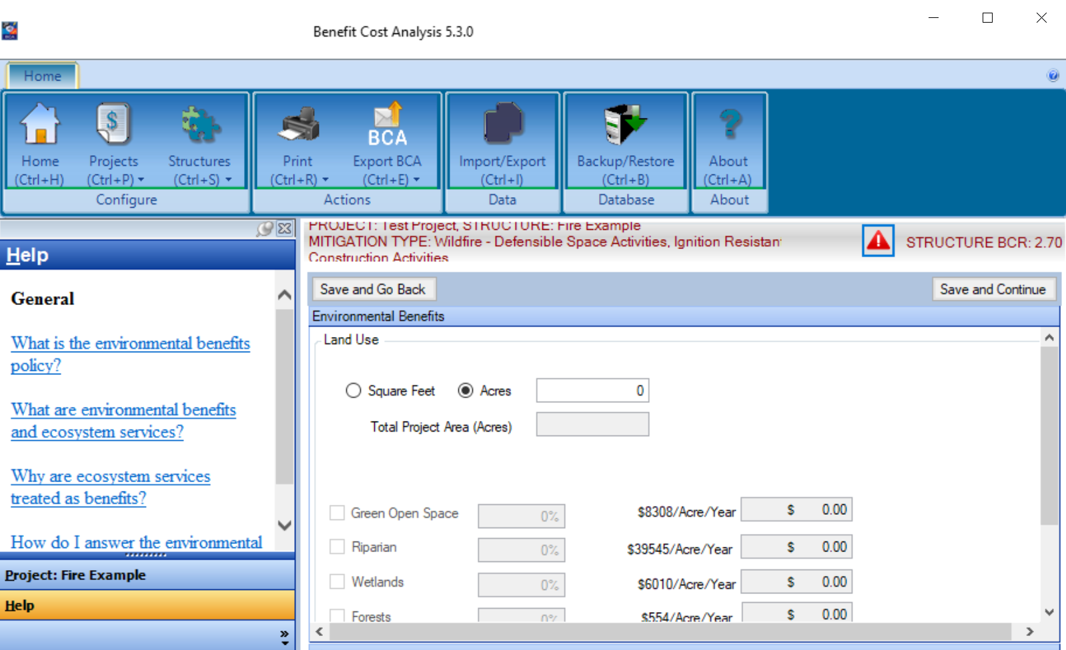
WILDFIRE EXAMPLE

Slide 95
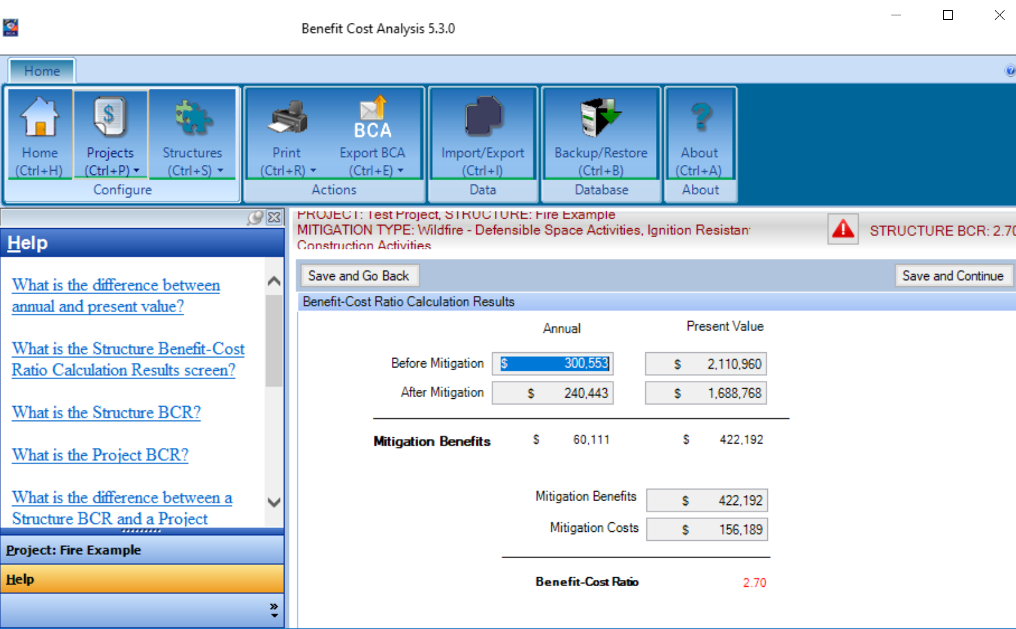
WILDFIRE EXAMPLE

Slide 96
QUESTIONS?
Questions?

Slide 97
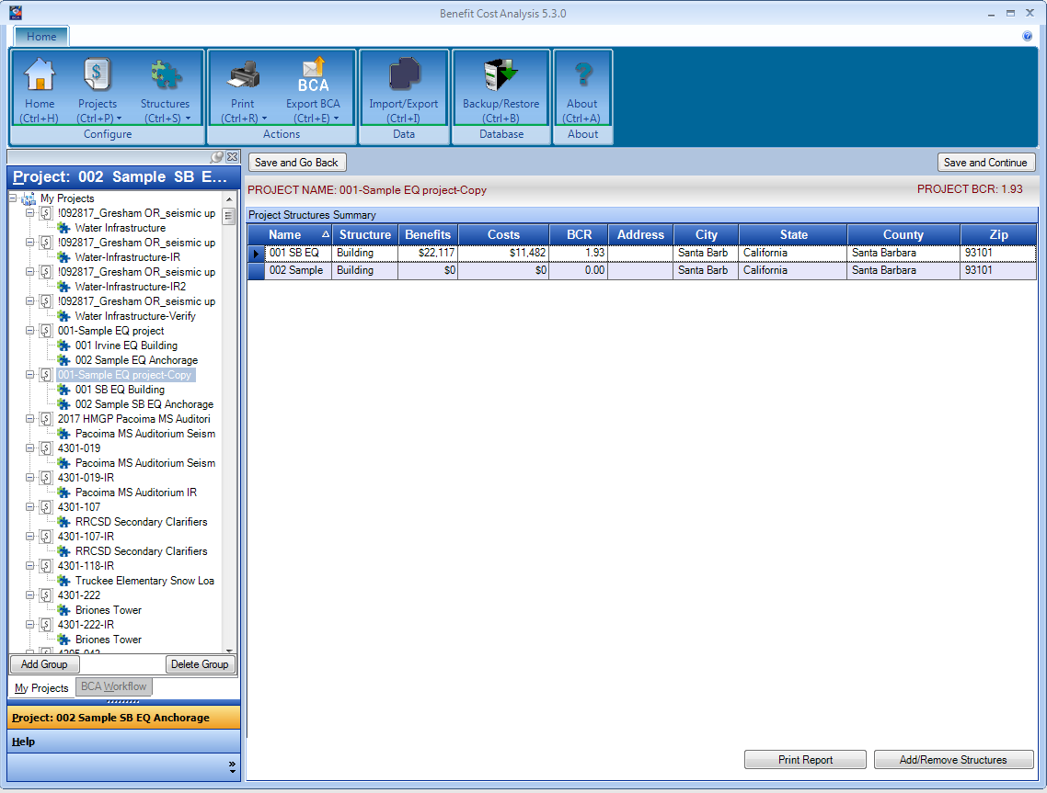
EQ Module

Slide 98
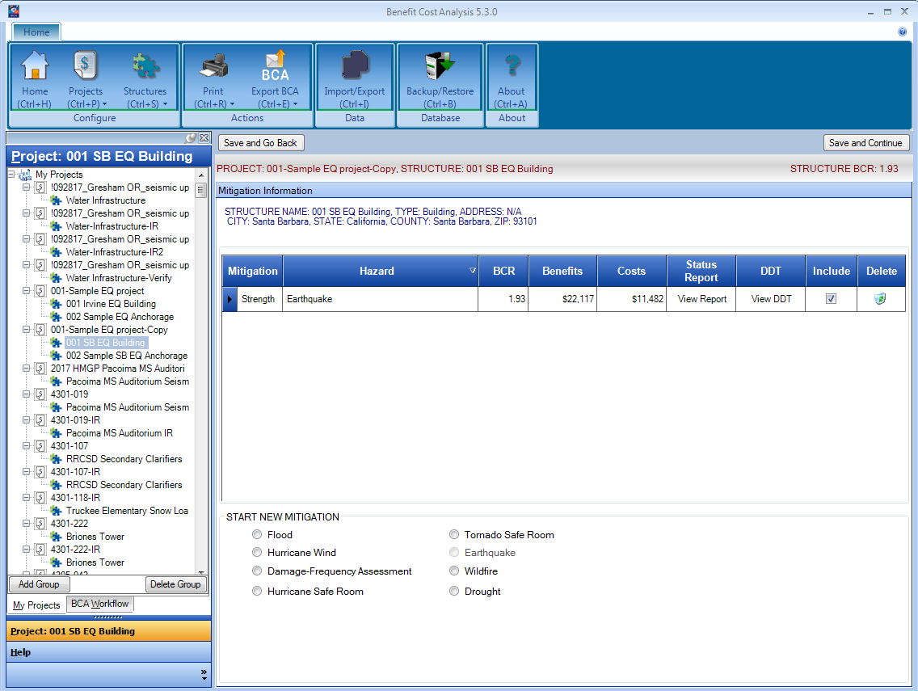
EQ Module

Slide 99
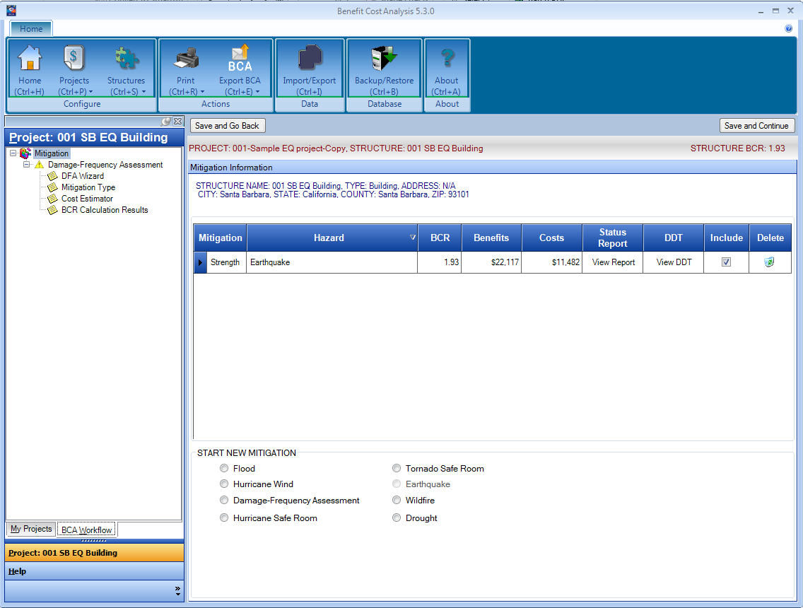
EQ Module

Slide 100
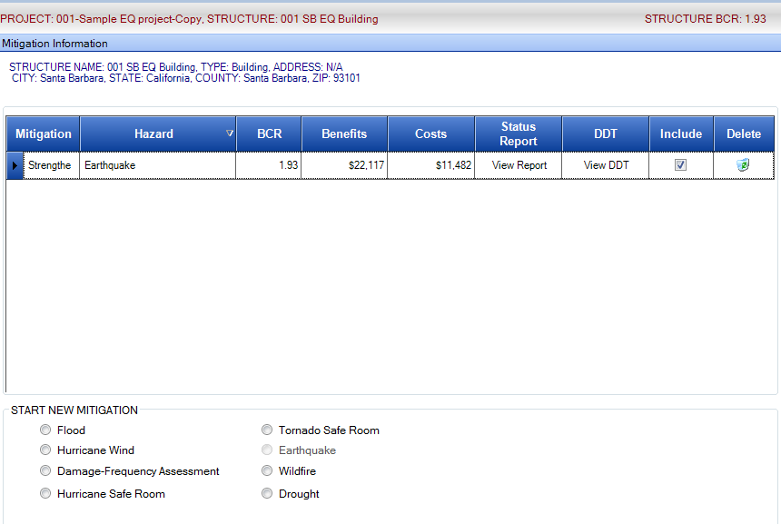
EQ Module: Building retrofit

Slide 101
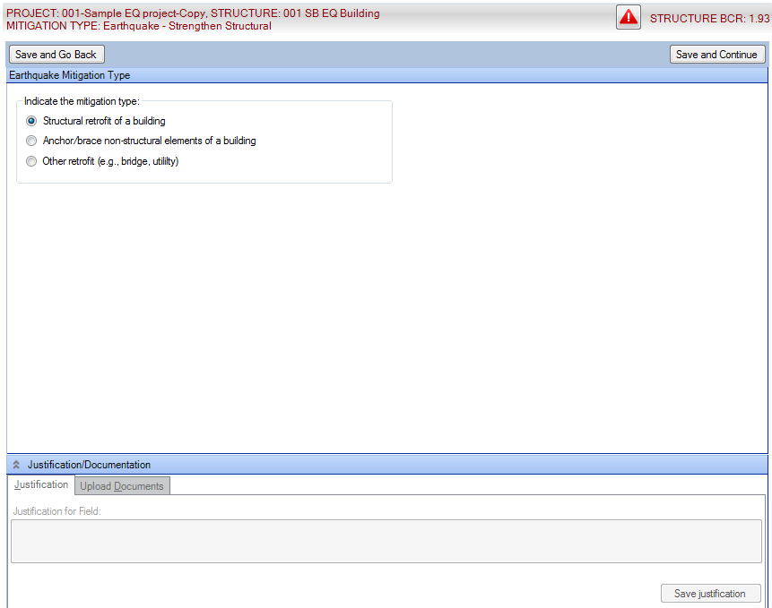
EQ Module: Mitigation Type

Slide 102
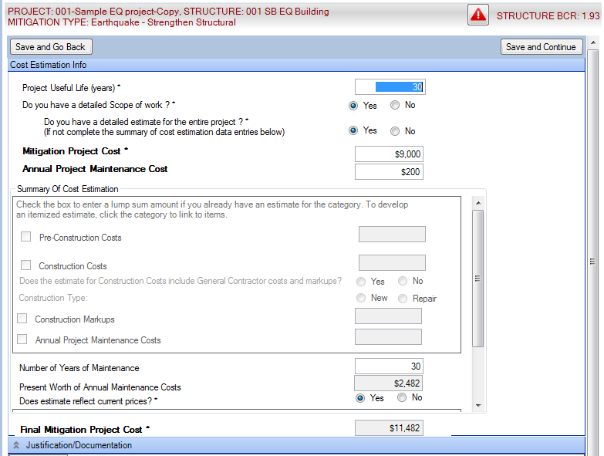
EQ Module: Cost Estimator

Slide 103
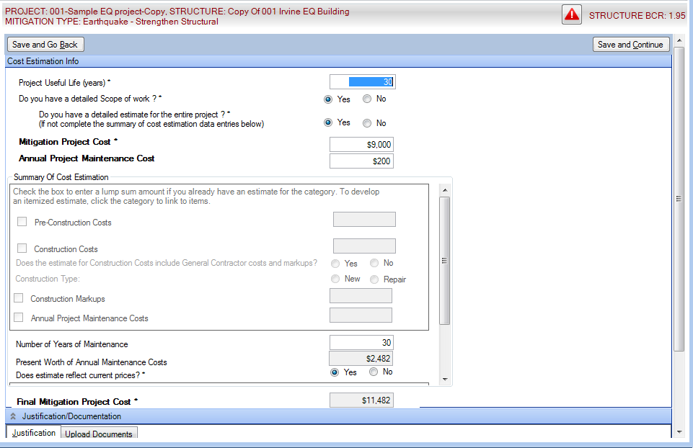
EQ Module: Cost Estimator

Slide 104
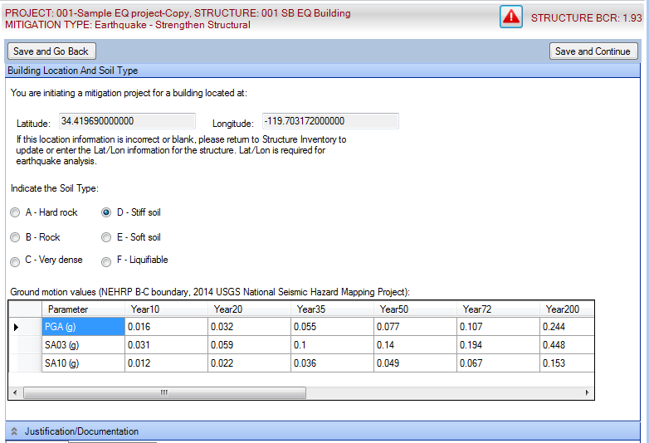
EQ Module: Soil and Element Information

Slide 105
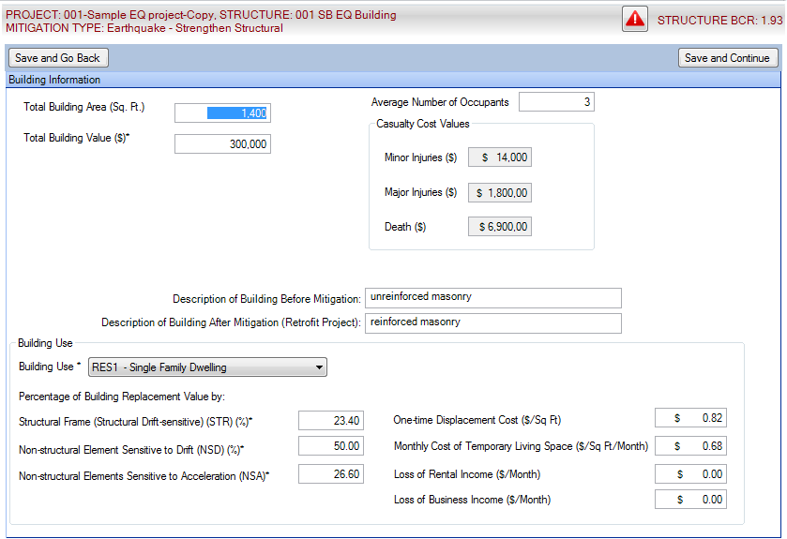
EQ Module: Building Information

Slide 106
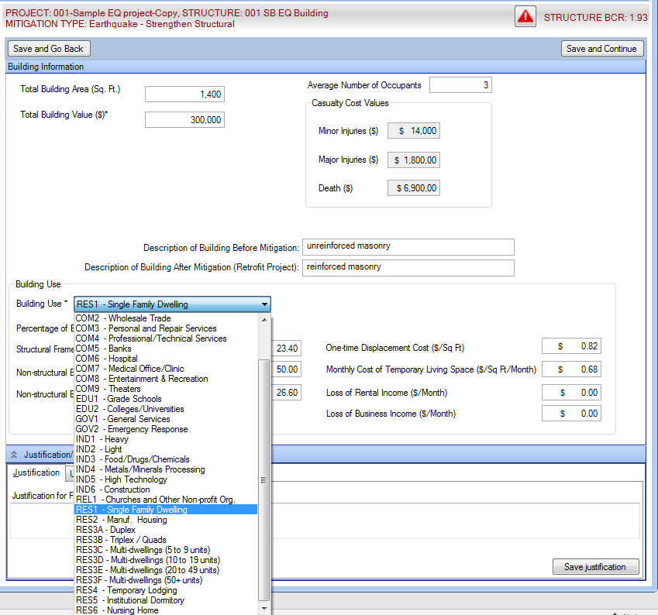
EQ Module: Building Information

Slide 107
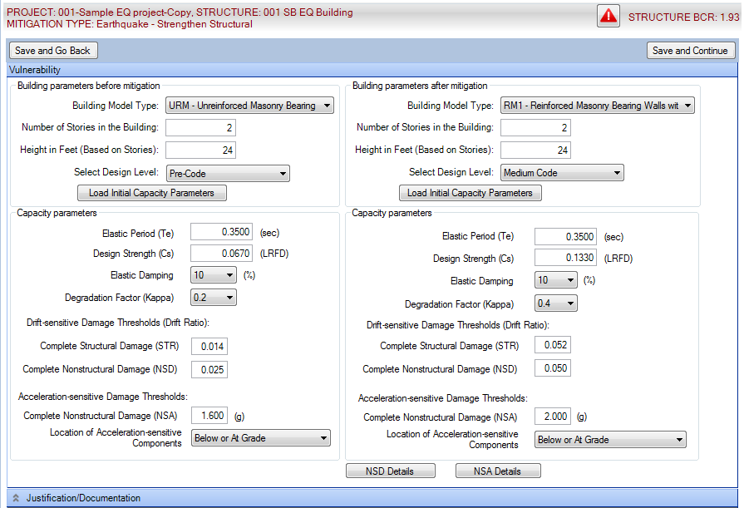
EQ Module: Vulnerability

Slide 108
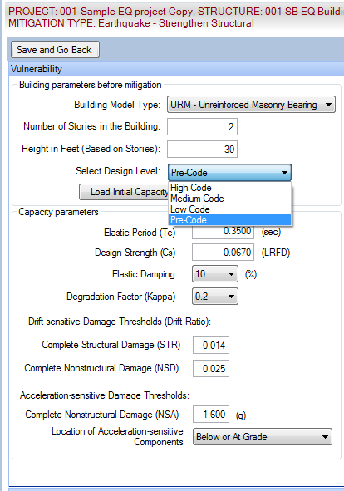
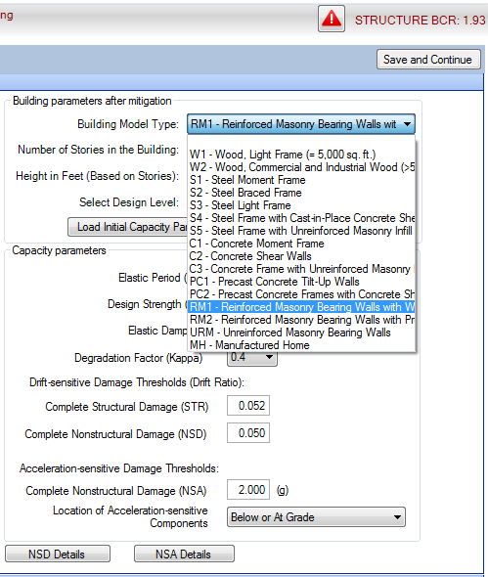
EQ Module: Vulnerability

Slide 109
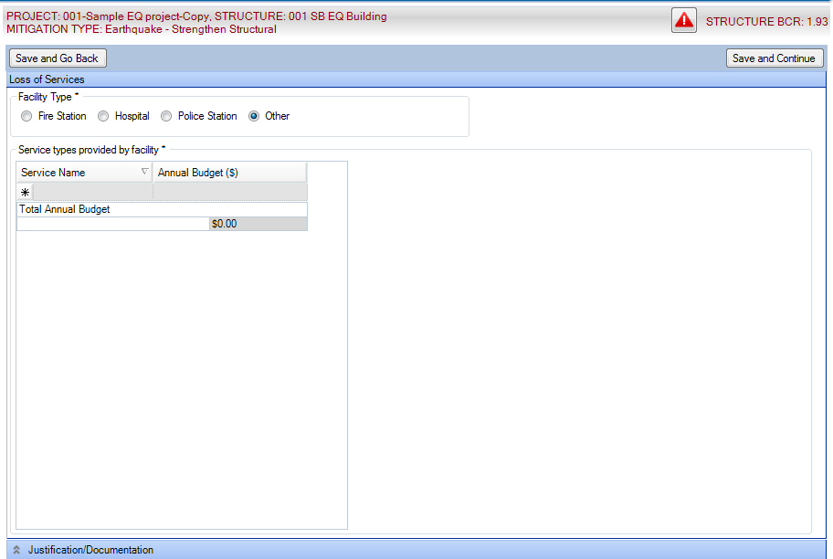
EQ Module: Loss of Service

Slide 110
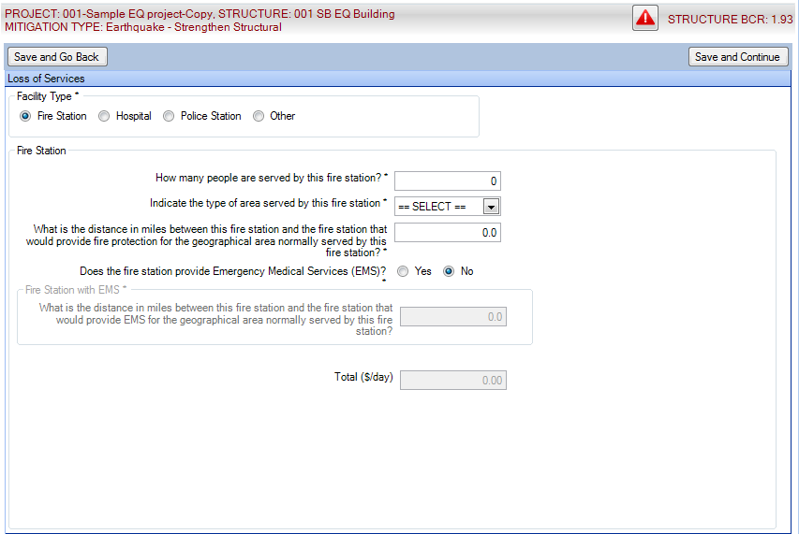
EQ Module: Loss of Service

Slide 111

EQ Module: Volunteer Costs

Slide 112

EQ Module: Analysis (before → after)

Slide 113

EQ Module: BCR Results

Slide 114

EQ Module: Anchorage

Slide 115

EQ Module: Anchorage

Slide 116

EQ Module: Anchorage

Slide 117

EQ Module: Mitigation Type

Slide 118

EQ Module: Cost Estimator

Slide 119

EQ Module: Soil and Element Information

Slide 120

EQ Module: Hazard Data

Slide 121

EQ Module: Damage State Information

Slide 122

EQ Module: Functional Downtime

Slide 123

EQ Module: Element Value-Fall Area

Slide 124

EQ Module: Occupancy and Casualty Data

Slide 125

EQ Module: Secondary Damages

Slide 126


EQ Module: Loss of Service
Volunteer Costs

Slide 127


EQ Module: Summary of Damages

Slide 128

EQ Module: BCR Results

Slide 129


EQ Module: Project Summary

Slide 130
Questions?
Questions?

