Slide 1

Law Enforcement Mutual Aid (LEMA)
Assistance Fund
Christina Curry, Acting Director
California Governor’s Office of Emergency Services
Don O’Keefe, Chief, Law Enforcement Branch
California Governor’s Office of Emergency Services
Cal OES LEMA
Revised: 1/20/26

Slide 2


BACKGROUND
In May 2022, Governor Gavin Newsom, in collaboration with the California State Sheriff’s Association (CSSA), purposed the creation of the Law Enforcement Mutual Aid Assistance (LEMA) Fund pilot program to reimburse local law enforcement agencies that responded to disasters and emergencies. Upon approval by the California State legislature, $25 Million was appropriated on an annual basis. On July 1, 2022, the LEMA Fund took effect, and the Cal OES Law Enforcement Branch was tasked with developing and managing the LEMA Fund.
Upon conclusion of the LEMA Fund pilot program, effective July 1, 2026, the State legislature reappropriated $10 Million General Fund with an extended encumbrance period through June 30, 2029.

Slide 3
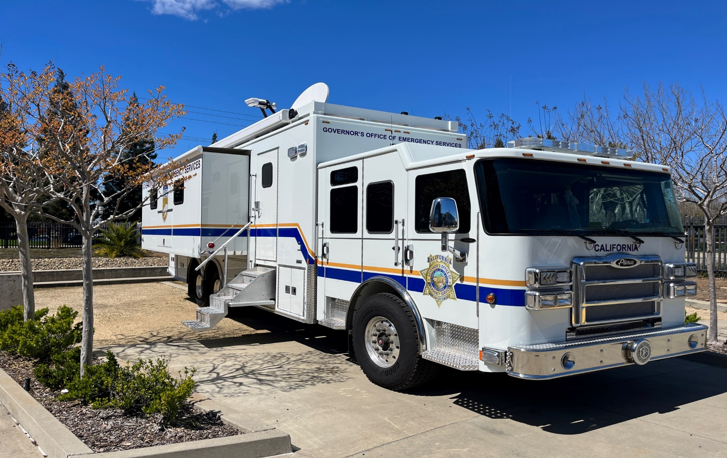
LEMA ASSISTANCE FUND GOALS
Provide a fund source to support LEMA requests for all communities.
Allow for additional resources to be redirected to minimize the cost and impact and expedite the delivery of services.
Allow all communities in California to utilize the LEMA system appropriately.
Support funding for prepositioned resources such as the Incident Command Vehicles and DNA Identification Machines.

Slide 4
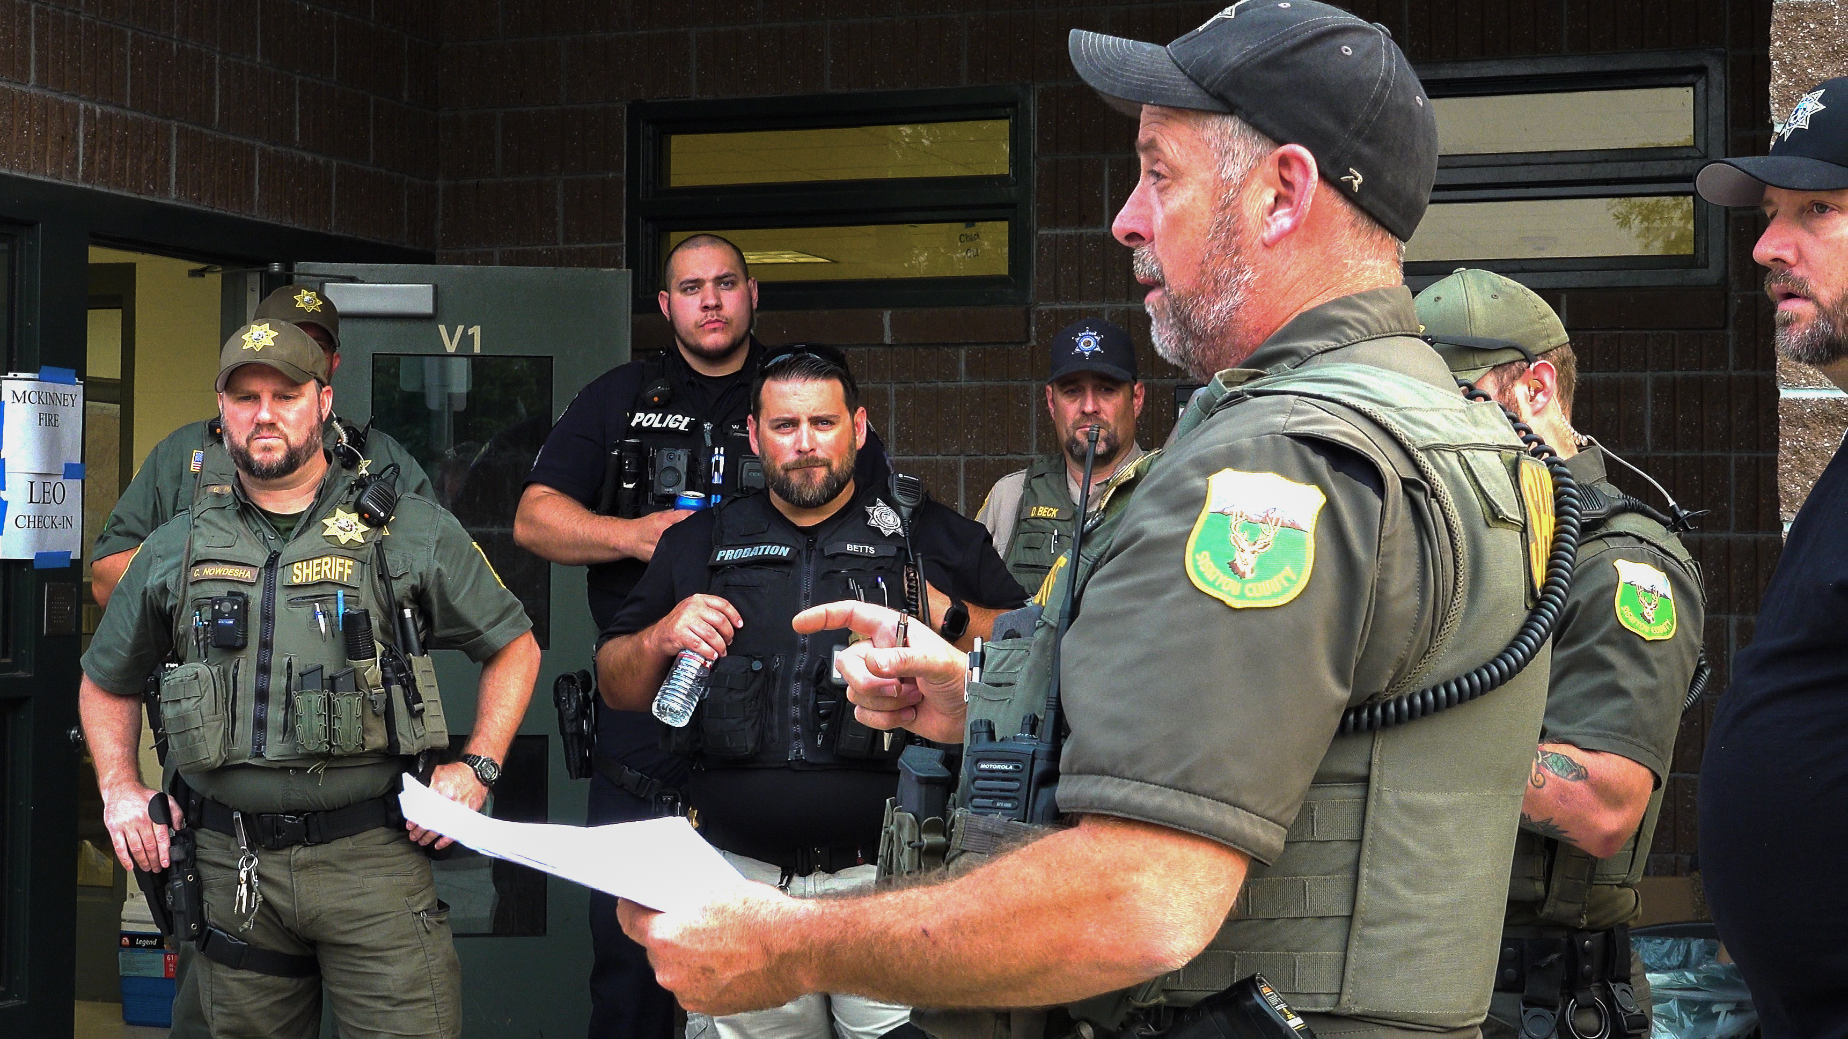
LAW ENFORCEMENT MUTUAL AID REQUEST
Mutual Aid System
The mutual aid system is intended to enable aid to agencies/jurisdictions whose resources have been overwhelmed in an emergency.
County Sheriff’s Office will call their Cal OES regional Coordinator to request mutual aid.
Once the coordinator is aware of the incident, they will deploy.
Number of Assistant Chief’s (AC’s) deployed depends on the size of the incident.

Slide 5
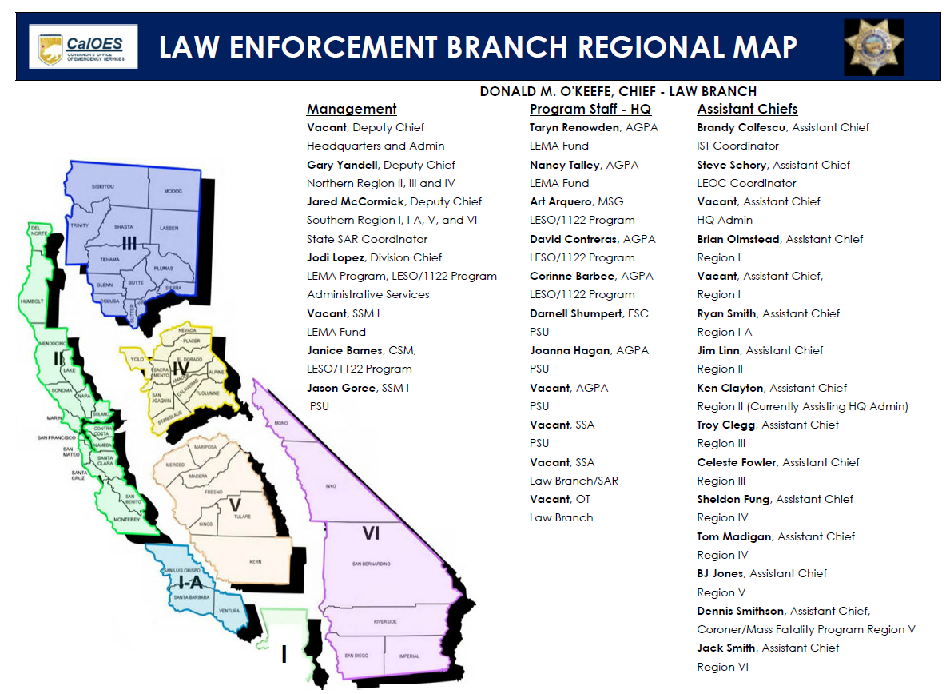
ASSISTANT CHIEFS IN THE FIELD
AC’s coordinate with the LEMA Fund Team to advise mutual aid has been requested.
Staff from the LEMA Fund Team will provide support to AC’s and answer questions during an incident.
It is the goal of the LEMA Fund Team to visit incident sites to answer questions and provide support during an event.
Once in the field, the AC coordinates with agencies upon arrival.
AC’s work with Requesting Agency to ensure all 214’s are filled out daily.
All providing agencies must sign in.
A Post Event Summary will be completed after Mutual Aid has ended.

Slide 6
CRITERIA & ELIGIBILITY
CRITERIA
LEMA requested to preposition resources, undeclared events, or before declarations are known
LEMA request is related to a state or federally declared emergency
LEMA provided for more than a 12-hour period
LEMA requested for a multi-jurisdictional event
Major law enforcement action requiring extended or specialized LEMA
LEMA for a mass casualty incident or extended mass casualty operation
Technology support or specialized resources to support LEMA response (intended for Cal OES LEMA database)
Notes:
LEMA can be requested for prepositioned resources, undeclared events or before declarations are known
LEMA request can be related to a state or federally declared emergency
LEMA has to be more than 12 hours
LEMA Fund can start reimbursement 12 hours after mutual aid has been requested.
The first 12 hours are neighbor helping neighbor – sometimes that’s all that’s needed.
LEMA needs to be a multi-jurisdictional event
Can’t reimburse requesting jurisdiction
It can be a major law enforcement action requiring extend or specialized LEMA
(pre-positioning)
LEMA for a mass casualty incident or extended mass casualty operation
Technology support or specialized resources to support LEMA response
ISU/Cal OES LEMA Database

Slide 7
CRITERIA & ELIGIBILITY
EXAMPLES OF ELIGIBLE INCIDENTS
Fires
Storm/Flooding/Earthquake
Natural or man-made disasters or emergency response
Other extraordinary events requiring emergency law enforcement mutual aid response may be considered on a case-by-case basis
Extra Ordinary Search and Rescue (SAR) for providing Law Enforcement Agencies.
Incidents don’t have to be related to a state or federally declared state of emergency

Slide 8


WHO’S ELIGIBLE?
Non-Eligible Agencies
State Law Enforcement
Federal Law Enforcement
Requesting Agency
Eligible Agencies
Sworn members of CA:
City Police Departments
Sheriff’s Offices
Probation
District Attorney’s
Coroner/Medical Examiners
Coroners Technician/Staff
Reserve Officers
Tactical Dispatchers

Slide 9
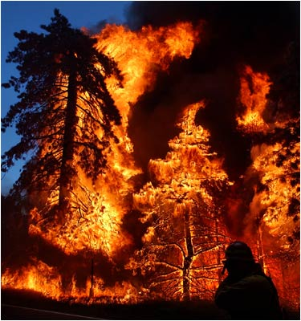
ELIGIBLE EXPENSES
Responding officer overtime
Portal to portal pay – for agencies that pay
portal to portal and have a bargaining unit
MOU in place.
Backfill for responding officers
Mileage - to & from the incident
Lodging (case by case, requires approved justification)
Per Diem (case by case, requires approved justification)
Fuel (case by case, requires approved justification)
Extraordinary Equipment (Case by Case i.e. ISU vehicles, Rapid DNA, etc.)
Overtime, backfill, and fuel will be reimbursed at the actual costs.
Lodging, per diem, and mileage will be reimbursed at the STATE rate.
Providing Agencies can’t request reimbursement for expenses provided by the Requesting Agency.

Slide 10
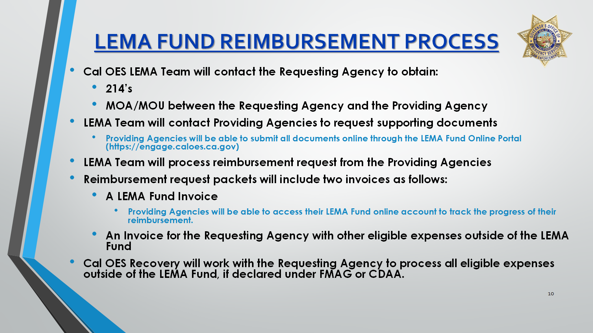

Slide 11
TIMELINE
Providing Agency submits reimbursement request and supporting documentation.
Reimbursement shall be received within 45 days of approved LEMA invoice.
Eligible
Incident Occurs
LEMA Team contacts Requesting & Providing Agencies within 30 days after the conclusion of the Incident.
LEMA Team will process request in order of Incident.
LEMA Team will review and approve reimbursement invoice and authorization payment.

Slide 12
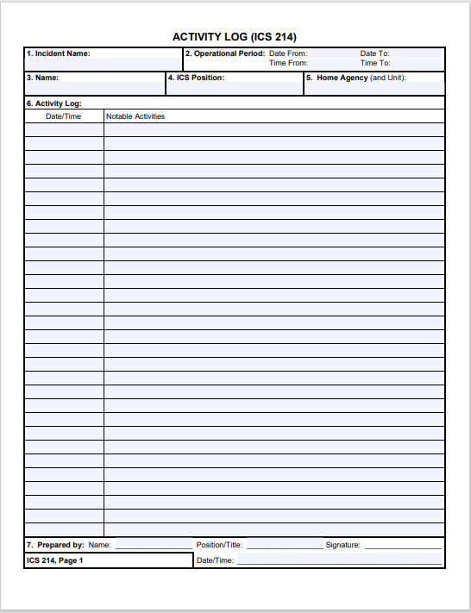
SUPPORTING/BACK UP DOCUMENTS
ICS 214 Form
Please fill out properly!
Name
Dates
Hours worked (Please include travel time)
Vehicle information/mileage
Activity (Patrolling/evacuations/etc..)
Don’t forget me!
Notes:
The initial check in or sign in sheets helps us estimate the amount of reimbursement for each agency so we can plan for enough money for reimbursement.

Slide 13
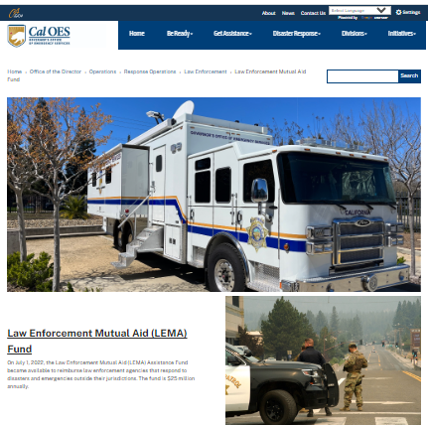
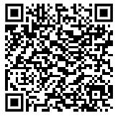
LEMA FUND WEBPAGE
LEMA Fund Information
Eligible Incidents & Fact Sheets
Access to the LEMA Fund On-Line Portal
Training Webinars
LEMA Team Contact Information

Slide 14
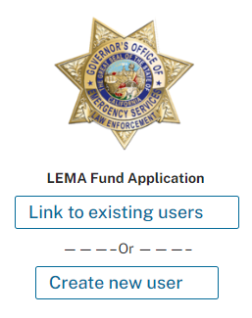
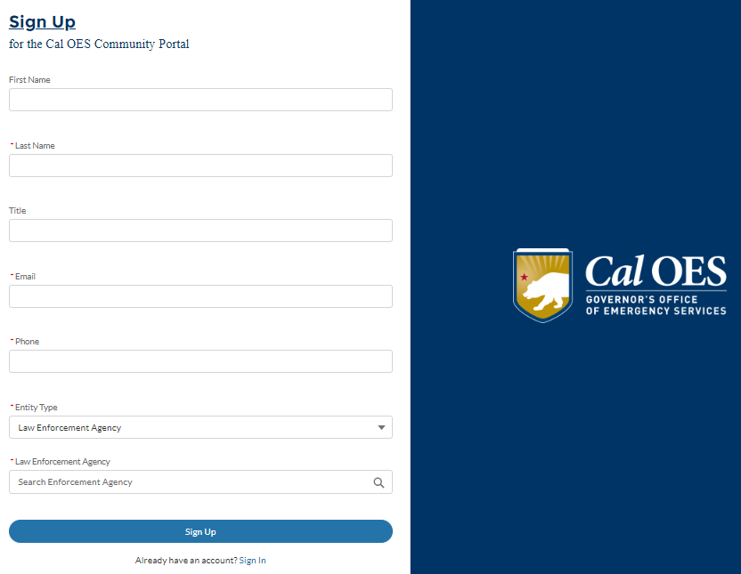
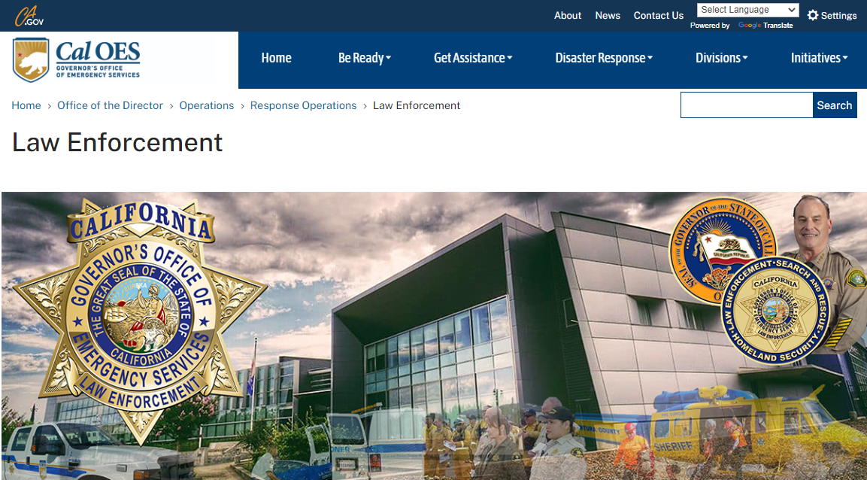
SUBMITTING DOCUMENTATION THROUGH THE ONLINE PORTAL
Providing Agencies can register on the Cal OES Online Portal and submit final reimbursement documents and invoices online.
https://www.caloes.ca.gov/office-of-the-director/operations/response-operations/law-enforcement/law-enforcement-mutual-aid-fund/
Agencies will have access to all their invoices and be able to track payment status.

Slide 15
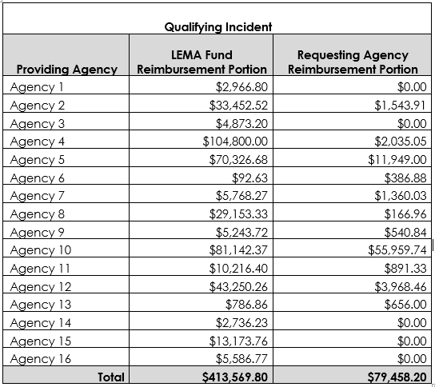
BENEFITS OF THE LEMA FUND
100% Reimbursement to the Providing Agency for eligible expenses
Expediated reimbursement to the Providing Agency
Once the Cal OES LEMA Team receives complete paperwork from the Providing Agency, they can expect reimbursement within 6-8 weeks.
Online Portal records management tool
Substantial financial burden relief to the Requesting Agency (see example)
Less work for the Requesting Agency
The Cal OES LEMA Team will work with the Providing Agencies to get all documents needed and process reimbursement requests, alleviating workload for the Requesting Agencies.
Example

Slide 16
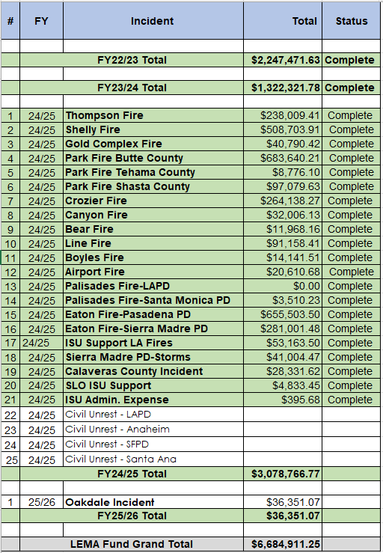
LEMA FUND REIMBURSEMENTS PAID OUT TO DATE:

Slide 17
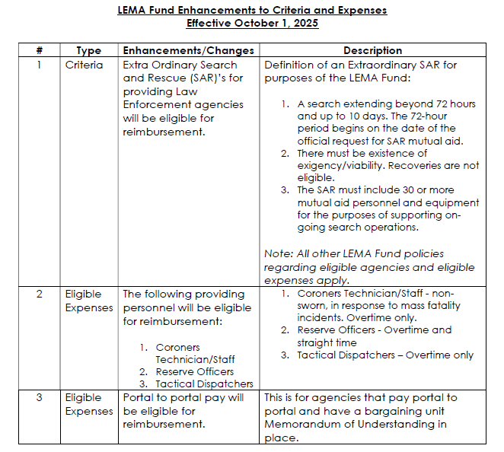
ENHANCEMENTS

Slide 18

CONTACT US
LemaFund@caloes.ca.gov
Nancy Talley
Analyst II, LEMA Program
Law Enforcement Branch
(916) 845-8706
Jodi Lopez
Manager I
Law Enforcement Branch
(916) 845-8307
Taryn Renowden
Supervisor I, LEMA Program
Law Enforcement Branch
(916) 845-8705

