Slide 1
2022 Prepare California JumpStart, Round Two
Program Overview, Eligibility, and Application Review
September 15, 2022
www.caloes.gov
Notes:
WES
Wes – Welcome Message
Jenn / Conchi - Managers Message
Wes continue introductions
Jasmine
Tyler

Slide 2
Webinar Overview
All attendees please mute upon joining | The chat feature will be disabled for the entire presentation. | Q and A will occur at the end
Notes:
WES
Webinar etiquette:
Please keep yourself on mute throughout this presentation if time allows we will take questions at the end.
If we do not get your question during this presentation there is designated office hours for you to speak directly to staff or you can email your question directly to the JumpStart Team
My team is on standby and will try to respond to as many of your questions as possible as we go along. If it’s a particularly good question, I will address it verbally.
That being said, please remain respectful on the chat. We want this to be as productive as possible. If you have an issues that need our attention that may not be appropriate for the chat, again send them the JumpStart email address. This includes questions of eligibility.
Lastly, we will also have a Q&A session at the end.

Slide 3
Eligibility Program Criteria Application Walkthrough Next Steps and Resources Q&A
Notes:
WES:
Today we will be covering eligibility, Program Criteria, Application Walkthrough, Next Steps and Resources with questions and answers at the end.
Next ill turn it over to Jasmine to go over Eligibility.

Slide 4
Eligible Applicants
Eligible applicants considered socially vulnerable and high hazard risk community according to Cal OES Hazard Mitigation Assistance Division’s Vulnerability Map
This can include:
City/Local Jurisdiction
County
Special District
Tribal Government
Applicants must have a FEMA-approved local or tribal hazard mitigation plan in order to be eligible to apply.
If eligible applicants do not meet the LHMP requirement, the county in which they are located or where the work is located must have a FEMA approved mitigation plan.
Notes:
JAS
Eligible applicants are those considered socially vulnerable and high hazard risk according to the Cal OES map.
The map is hyperlinked on the Cal OES website and in the application. You will also receive a PDF of this presentation if you are signed up for the Cal OES listserv.
Eligible entities that can apply include those listed above. (Presenter: Note that PNPs are no longer eligible under round two)
You must have a FEMA-approved, and adopted, local/tribal hazard mitigation plan BY THE APPLICATION DUE DATE (10/7/22). If your organization does not have an LHMP, you can use the county plan in which the project benefitting area is located.

Slide 5
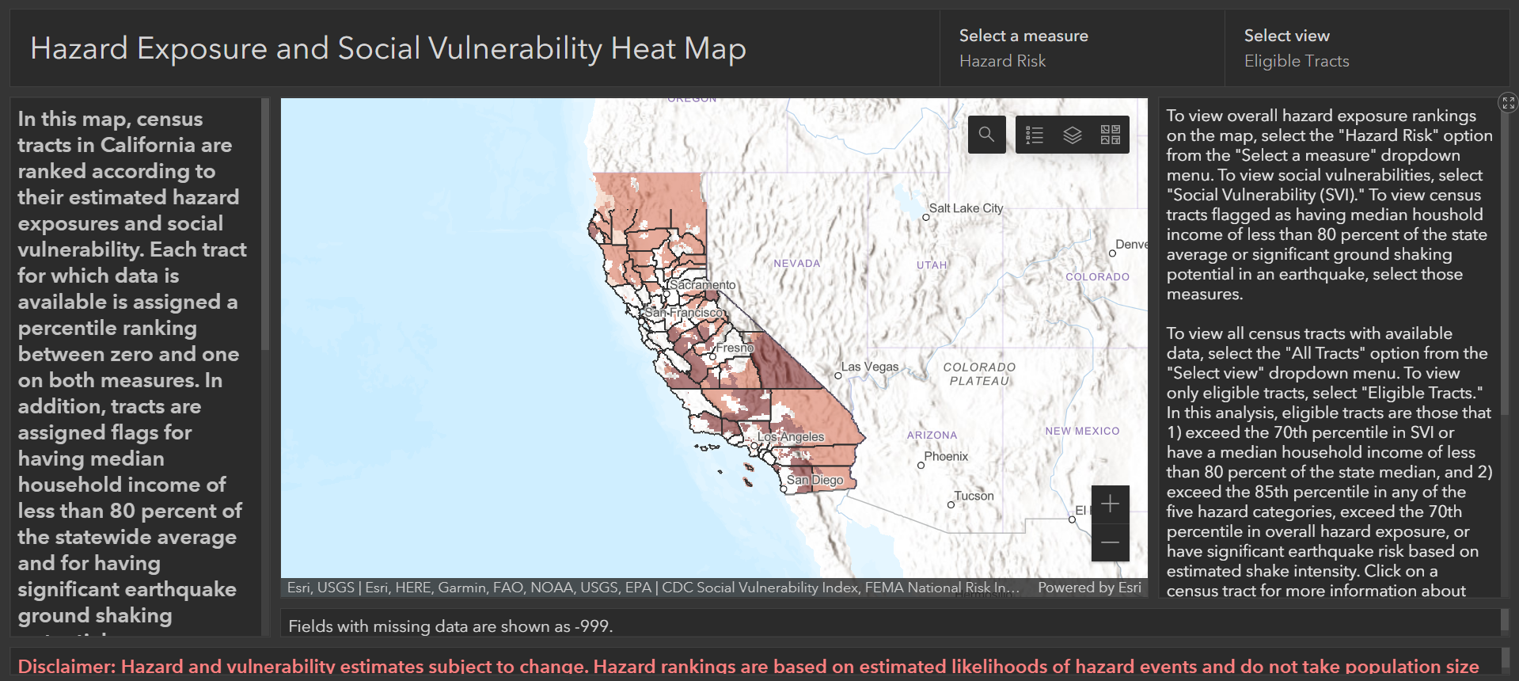
Using the CalOES Vulnerability Map
Notes:
To be eligible, you MUST have one or more eligible census tracts within your jurisdiction. Eligible tracts are those that are highlighted locations in reds/oranges.
This is a critical piece of JumpStart, because not only do these census tracts make you eligible, they also are the areas that should primarily benefit from the activities you submit in your application. The most competitive application will demonstrate that.
This is the starting point for your involvement in the Jumpstart program. To search your jurisdiction, click on the magnifying glass in the upper right corner of the map.

Slide 6
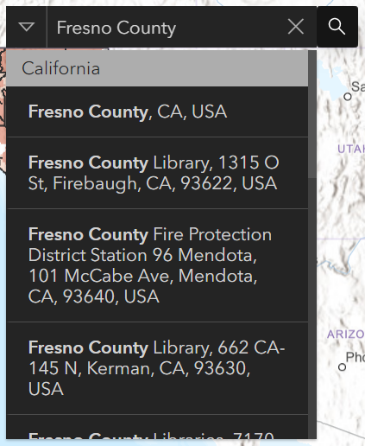
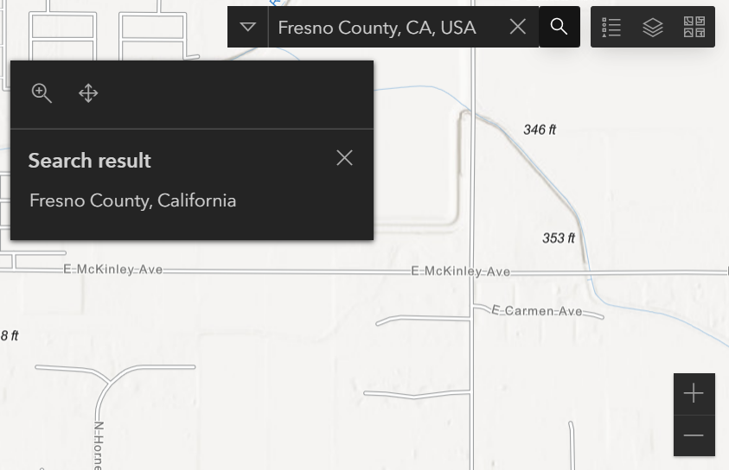
Searching Your Jurisdiction or Region
Input name of jurisdiction and press “Enter” or select from dropdown menu
Using the mapping tools, navigate to the desired area
Notes:
After clicking on the search icon, enter the name of your jurisdiction and click “enter” or select from the dropdown menu.
(Presenter: Note what you can and cannot type in search function. Zip Codes and Census Tracts are not searchable and pecial Districts may have difficulty identifying their boundaries. Functionality is similar to Google Maps or other mapping service.)

Slide 7
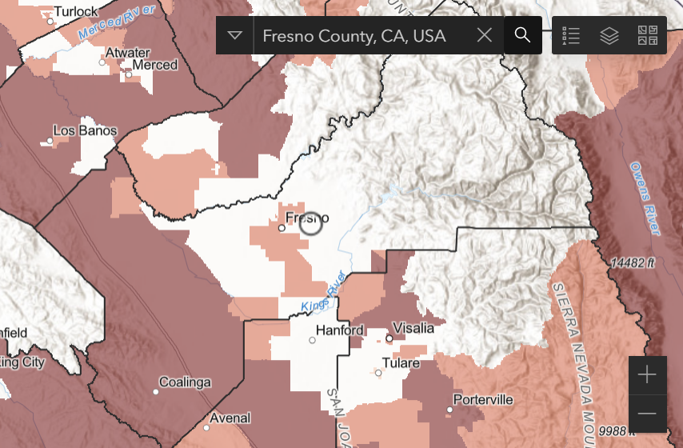
Identifying Eligible Census Tracts
Notes:
As mentioned, you MUST have one or more eligible census tracts within your jurisdiction. Here, Fresno County has numerous eligible census tracts as indicated by the highlighted regions.
If you see a highlighted tract within your boundaries, and you are one of the entity types previously listed, then you ARE eligible for this program.

Slide 8
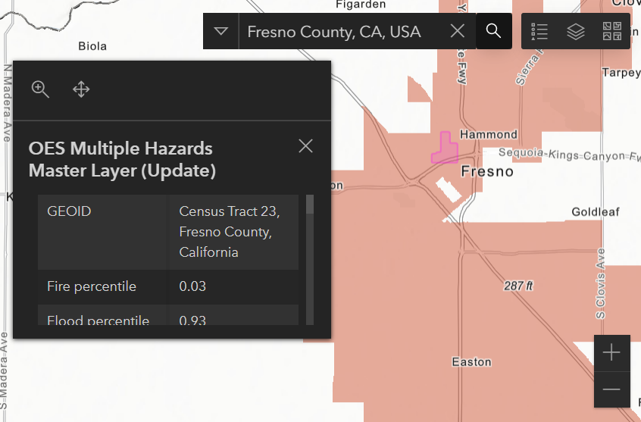
Social Vulnerability and High Hazard Data
Use your cursor to select an eligible census tract on the map
Use the scroll bar in the information window that appears to view data
Notes:
-If you make it past that point and know you’re an eligible entity, the next step is understanding why you are eligible. To do that, we need to see the social vulnerability and high hazard percentiles of your eligible tracts. This information will educate how you structure your application.
- Follow the instructions on the right side of your screen. (Presenter: Note that the selected tract will highlight pink.)

Slide 9
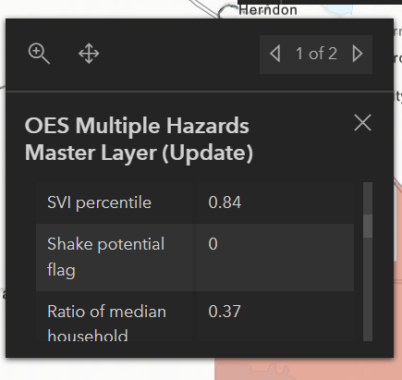
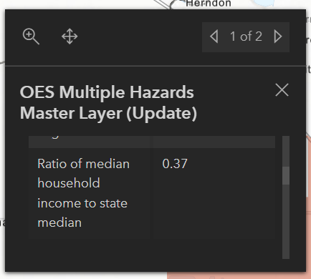
Social Vulnerability Percentile and Median Household Income Ratio
Navigate to bottom rows in pop-up table.
If your “SVI Percentile” is greater than 0.70, OR your “Ratio of median household income to state median” is less than .80, you have completed the first requirement for eligibility. You can continue to analyze your “High Hazard Risk”.
If your “SVI Percentile” or “Ratio of median household income to state median” do not meet the thresholds above, you are not eligible.
Notes:
Right off the bat, you will know if the census tracts of your project benefitting area are eligible because they will have coloration, like this one here in Fresno.
To be eligible, your project area must first be GREATER THAN the 70th percentile in Social Vulnerability, OR, your tract must have a median LESS THAN 80% of the state’s median income.
Here, this census tract in Fresno meets not one, but not both, criteria.
The census tract shown here is the 80th, so it exceeds that threshold.

Slide 10
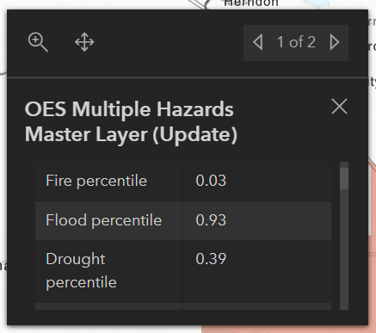
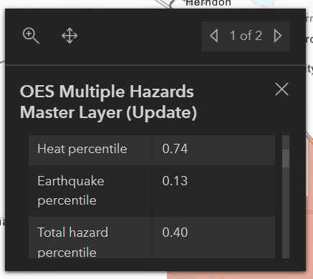
High Hazard Risk Index (if eligible per previous slide)
#1: Overall Hazard Risk
If your “Total Hazard Percentile” is greater than 0.70, you have completed the second requirement for eligibility.
OR
#2: Top Hazard
Look at the different hazard rows (Fire, Earthquake, Flood, Drought, Heat).
If ANY ONE of the “Hazard Percentile” is greater than 0.85.
If the “Shake Potential Flag” is populated, you have completed the second requirement for eligibility.
Notes:
- Next, your census tracts must have high hazard risk.
- If your Total Hazard Percentile is greater than the 70th percentile, you meet this second requirement; OR,
If ANY ONE of your Individual Hazards is greater than the 85th percentile; OR
Have a shake potential greater than 2%.
- In this scenario in Fresno, the flood percentile is 0.93, so this meana that second eligibility threshold is met.
That’s eligibility. One more thing to mention:
- First, deliverables/initiatives completed under JumpStart DO NOT need to tie back to your highest hazard risks. However, doing so may make your application more competitive.

Slide 11
[ If your “Social Vulnerability Percentile” is greater than 0.70
OR your “Ratio of median household income to state median” is less than 0.80]
AND
[Your Total Hazard Percentile is greater than 0.70
OR ANY ONE of your Hazard Percentiles is greater than 0.85
OR you are flagged for Shake Potential]
You are eligible for Jumpstart.
[ If your “Social Vulnerability Percentile” is less than 0.70
AND your “Ratio of median household income to state median” is greater than 0.80]
OR
[Your Overall Hazard Exposure Percentile is less than 0.70
AND none of your Hazard Percentiles are greater than or equal to 0.85
AND you are not flagged for Shake Potential]
You are ineligible for Jumpstart.
Notes:
- If you do not meet those thresholds described, you are NOT eligible for JumpStart. If you have any questions regarding this, please email the JumpStart email address included at the end of this presentation or in the application. This is a description of what makes you eligible. Remember, we have already completed this analysis for you, and you DO NOT need to do it on your own. If you have a census tract or multiple tracts that are eligible, they will be highlighted on the map.

Slide 12
Eligibility Program Criteria Application Walkthrough Next Steps and Resources Q&A
Notes:
JAS

Slide 13
Prepare California JumpStart Application Criteria
The primary activity eligible is the hiring, or continuation of services, of a Chief Resilience Officer or position of similar scope of services and authority.
The position must increase capacity to develop local initiatives that foster resilience and mitigation project scoping, as well as planning, activities, and outreach for mitigation, preparedness, and recovery.
There must be tangible deliverables and initiatives that directly and primarily benefit a qualified socially vulnerable and high hazard risk community.
Project scoping must lead to a Hazard Mitigation Assistance (HMA) subapplication during the period of performance.
Application cost estimate cannot exceed $1 million.
Period of performance cannot exceed 60 months (five years).
Must comply with all applicable California and local procurement laws, regulations, and policies.
Notes:
Jas
(Presenter: Comparison between rounds one and two
There were many eligible activities under round one, now we JUST have staff augmentation as the primary deliverable)
The maximum budget amount remains the same
Period of performance remains the same. With a maximum 60 Months
Because the only eligible activity is staff augmentation, obviously CEQA (Env. Quality Act) and Env. Historic Preservation (EHP) Regulations are not triggered.
Because there are no groundbreaking construction-related activities, prevailing wage requirements do not apply to JumpStart projects.
There are just three eligible cost items in the application under round two: salary, benefits, and supplies/materials that support the position.
Reference California State Code regarding procurement if you need.

Slide 14
Eligibility Program Criteria Application Walkthrough Next Steps and Resources Q&A
Notes:
Jas hand back to Wes

Slide 15
Application Link on CalOES Website
Navigate to the Prepare California webpage at the link here: Recovery Prepare California
Scroll down the page until you see a series of blue hyperlinks.
Notes:
Navigate to the Prepare California webpage at the link here: Recovery Prepare California
Scroll down the page until you see a series of blue hyperlinks.

Slide 16
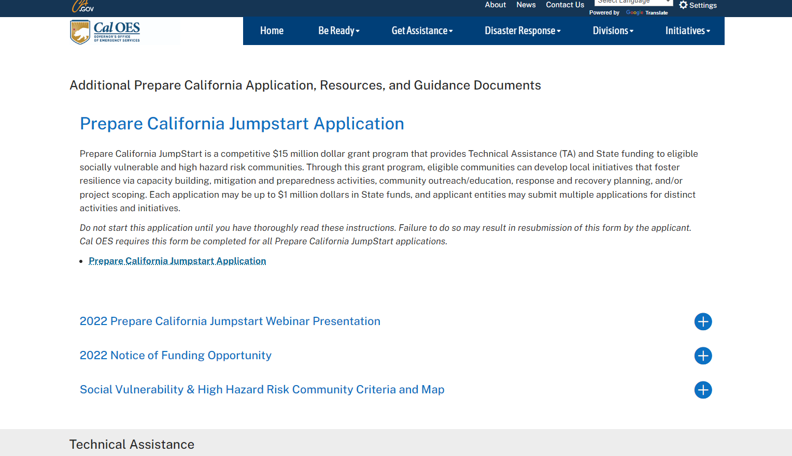
Saving the Application
Click on the hyperlink titled PrepareCA JumpStart Application.
The application will likely open in your browser as a new window.
Notes:
After double clicking, the application will appear in a fillable Adobe PDF form.
Be careful, because it may open directly in your browser.

Slide 17
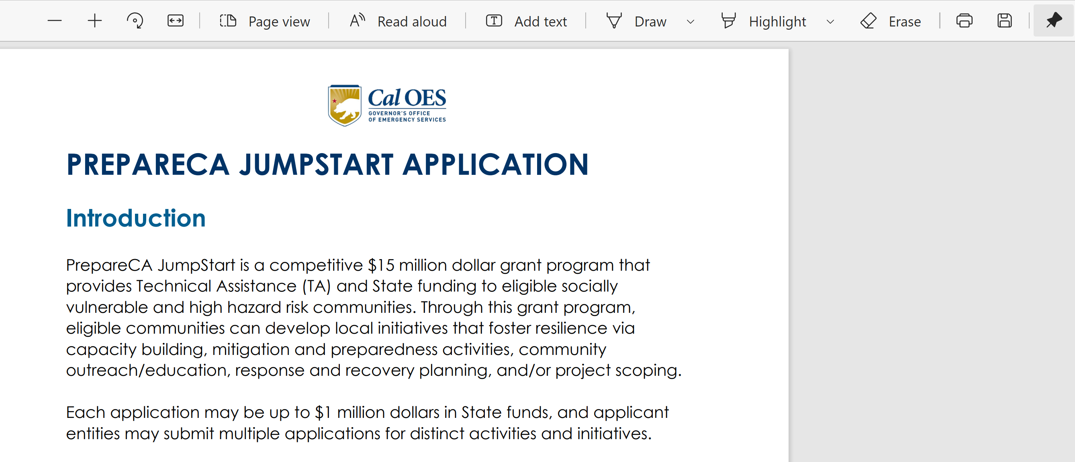
Saving the Application
Click the save icon in the new window. Depending on the device you are using, the save icon may be located in the top of the page or at the bottom.
Navigate to a preferred location on your device to save the JumpStart application.
Notes:
(Presenter:. Please note that depending on the program you are using to view the file you may see two different icons appear when attempting to save the application. Please ensure you save the application locally to your computer.

Slide 18
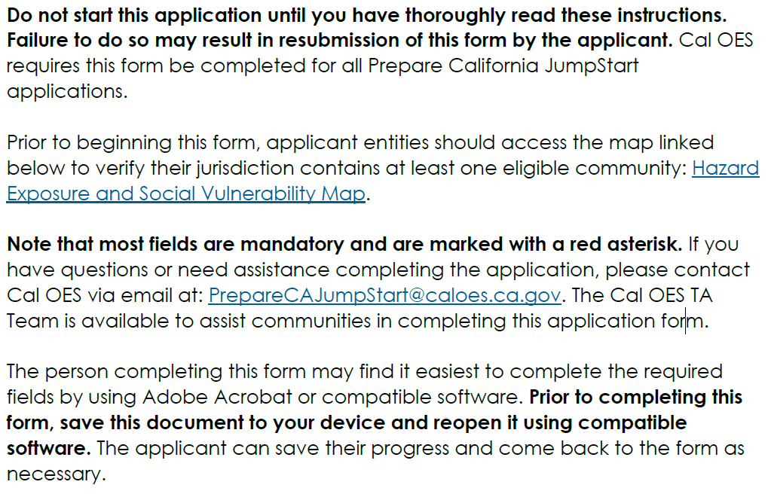
Application Instructions
Notes:
Required Fields
As you’ll see throughout the application, mandatory fields are marked with a red asterisk.
- Again, please save the form and open with compatible software so you can have the full functionality of the fillable PDF.

Slide 19
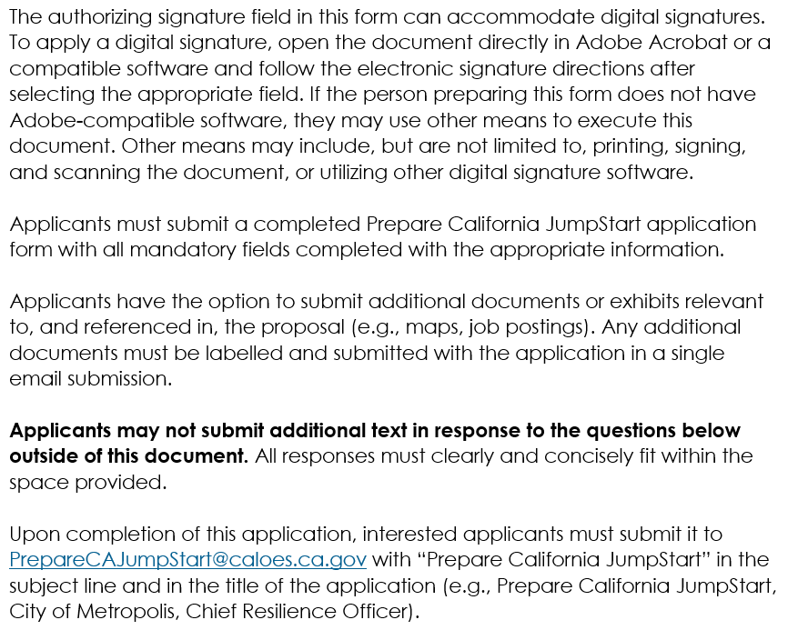
Application Instructions
Notes:
Thoroughly read the application instruction before you begin filling out the form
A major change from round one is that we no longer are accepting supplemental written responses outside of this document. You answers MUST be clearly and concisely presented in this application.
That being said, you can submit additional documentation referenced in or supporting your answers. For example, additional documents that would be accepted include maps, job postings, etc.
If you have a question on what is and is not eligible to submit with your application, email the Jumpstart inbox.

Slide 20
Opening the application properly is CRITICAL to e-signing the application for submission.
Notes:
Part of this form’s functionality is that it accommodates digital signatures. And accessing that ability is only possible if you open the document directly through Adobe or compatible software.

Slide 21
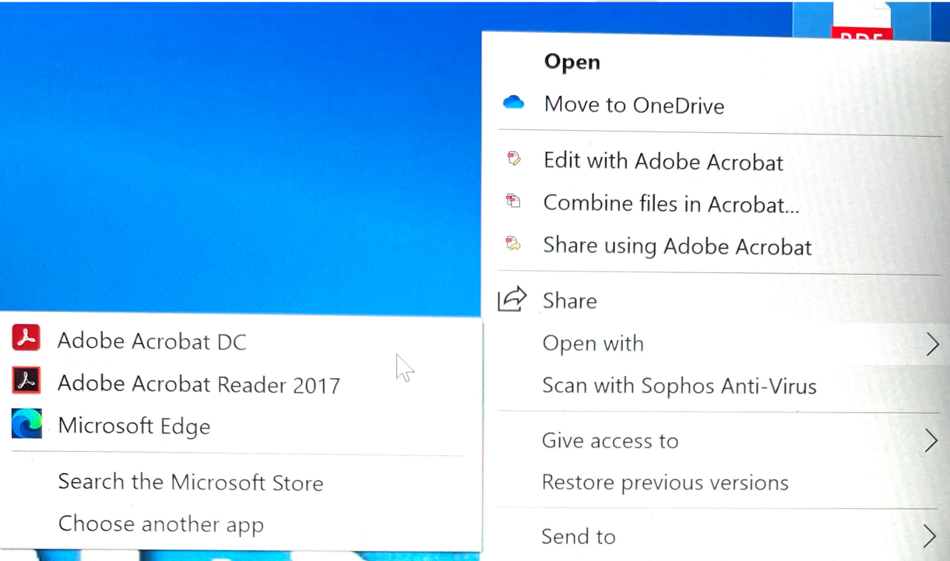
Opening the Application
Right click on the JumpStart Application that you saved to your device.
Select “Open With” from the dropdown menu.
Select Adobe Acrobat or a compatible software to open the PDF.
Notes:
This may look differently depending on the device you have, whether it’s an PC or Mac, but generally you will need to make sure the software opening your document is correct.
If you have any questions about this form’s functionality, feel free to email the JumpStart inbox and request a Technical Assistance meeting. I will be happy to hop on call with you and we can figure out your individual situation together.
I also acknowledge that some of you may have other e-signatures saved to your devices, or software that just isn’t compatible. If you have another methodology that you’re comfortable with, by all means, please use it.
And, if it really comes down to it, you can always print, sign, and scan your application.
This is obviously not preferable because if we have any Requests for Information (RFIs) throughout the review process it may make it more difficult to resubmit your application later.

Slide 22
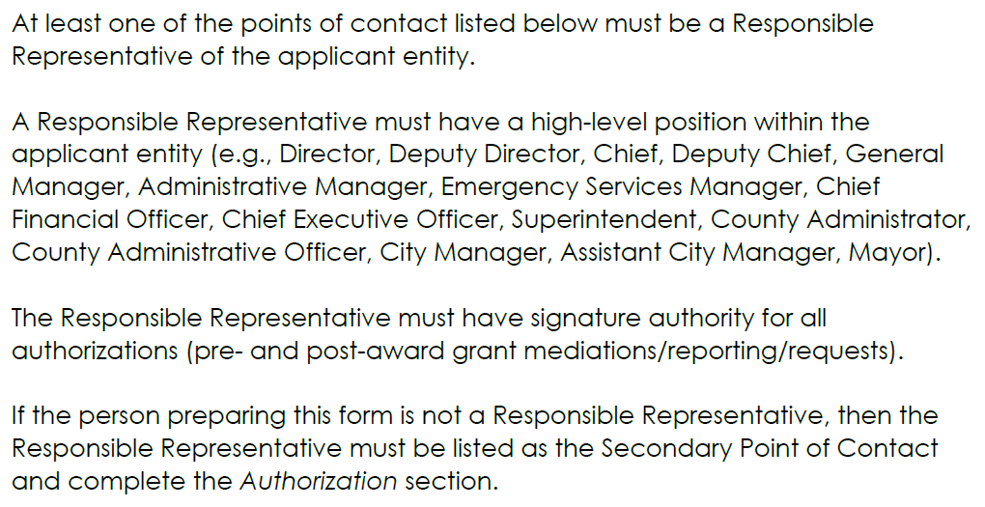
Responsible Representative Instructions
Notes:
The person executing or authorizing this application must be a responsible representative.
It is generally a person with a high-level position within the organization that has the ability to commit to grant funds.

Slide 23
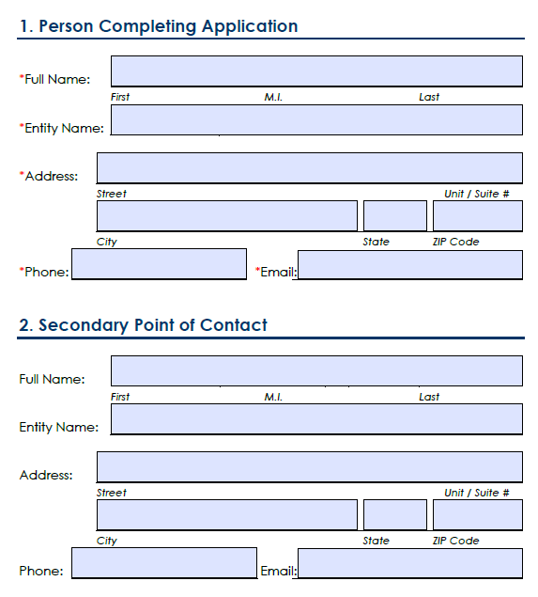
Point of Contact (POC) Information
Notes:
The first section on the application require contact information.
And one of the Points of Contact MUST be a Responsible Representative.
If the person completing the application is the RR, the second POC fields are not required.
If the person completing the application is in more of an administrative role or a consultant and not a RR, that okay, but they will have to enter the RR’s information as the second POC.

Slide 24
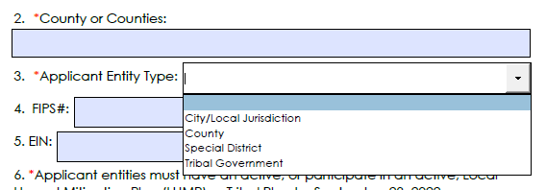
Application Information
Notes:
- Dropdowns are indicated by boxes on the right.

Slide 25
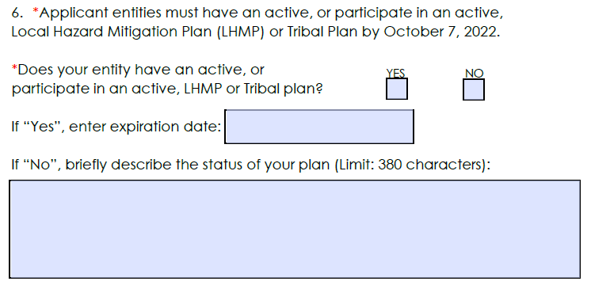
Local Hazard Mitigation Plan (LHMP)
Notes:
(Presenter: note the application due date indicated by the red arrow.)
Texts boxes throughout this document have a “character limit”, NOT a “word limit”. This character limit includes spaces.
Type SUCCINCT paragraphs and sentences to adequately answer the questions will generally take you to the end of the text boxes.
If you are using many spaces or paragraphs, you may go past the text box. Be aware of this as you DO NOT want that to happen.

Slide 26
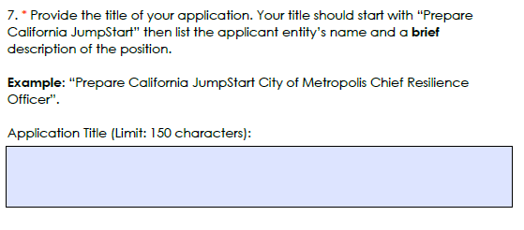
Application Title
Notes:
Here is an example of the character limits we just spoke about

Slide 27
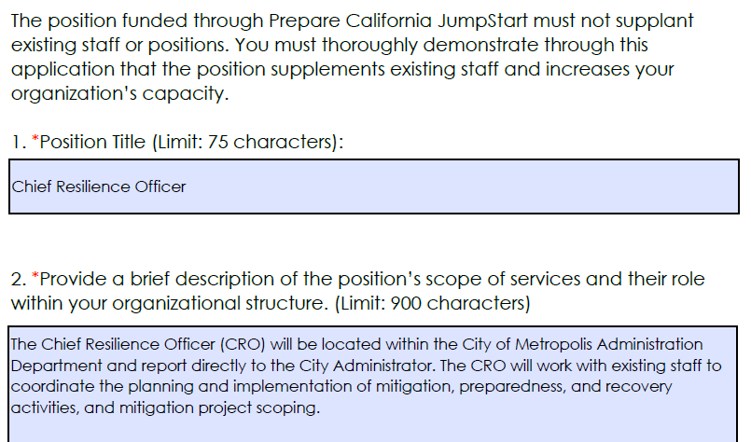
Position Information
Notes:
In many of the application slides, I have included example responses. These examples are solely meant to get you started on the right track. They are quick snippets of what we are looking for, and in NO WAY meant to be fully representative of a perfect response.
There may also not be CONTINUITY between answers.

Slide 28
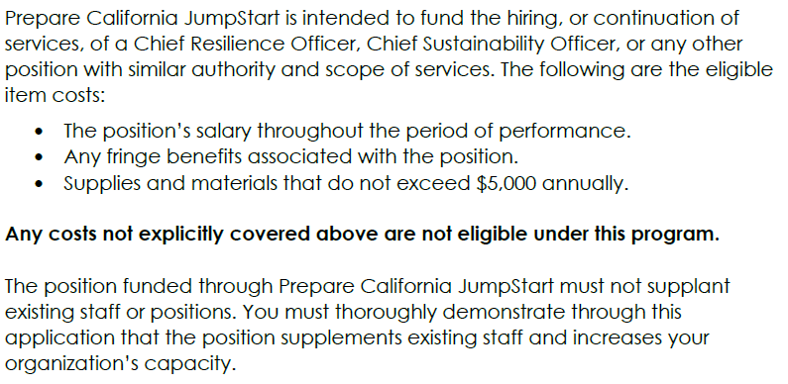
Budget Details
Notes:
Prepare California JumpStart program is intended to fund the hiring, or continuation of services, of a Chief Resilience Officer, Chief Sustainability Officer, or any other position with similar authority and scope of services.
Listed on this slide is the eligible item costs
Any costs not explicitly covered in this section are not eligible under this program.
Also note:
The position funded through Prepare California JumpStart must not SUPPLANT existing staff or positions.
You must thoroughly demonstrate through this application that the position supplements existing staff and increases your organization’s capacity.
Example:
Supplant

Slide 29
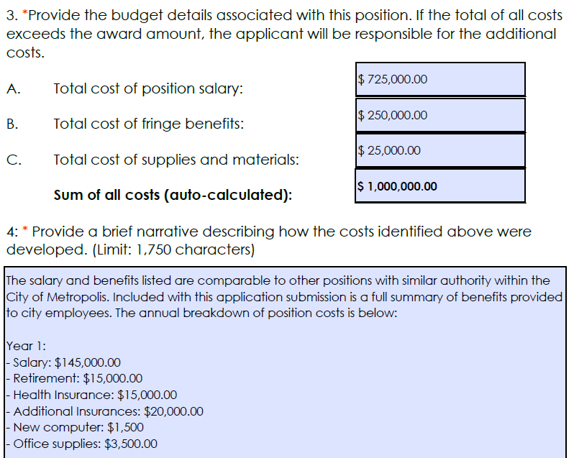
Budget Details
Notes:
Here are the three eligible cost items associated with staff augmentation under JumpStart round two.
Note that if actual costs exceed the grant award amount, you will be responsible for covering those additional costs.
The sum of all costs is auto-calculated based on the answers above. You do not need to complete the field indicated by the red arrow.
Null cost items are acceptable. For example, if you do not have any supply or material costs, you can just enter $0.

Slide 30
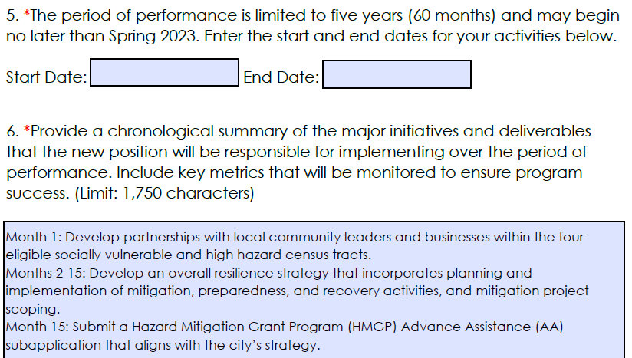
Schedule Details
Notes:
- Again, note that this example is intended to jumpstart your responses. Applicants should pay particularly close attention to formatting.

Slide 31
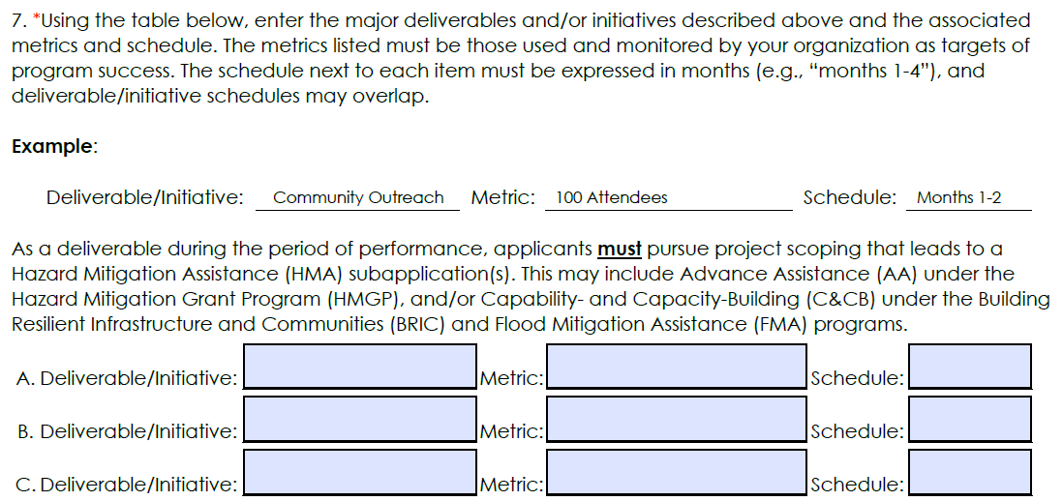
Schedule Details
Notes:
- Note that an example is embedded within the application.

Slide 32
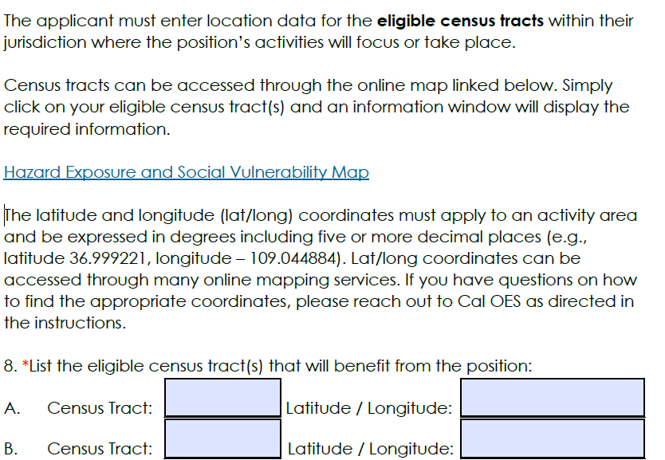
Location Details
Notes:
The applicant is to input the location data for the eligible census tracts That Jasmine previously covered within your jurisdiction where the positions activities will focus or take place.

Slide 33
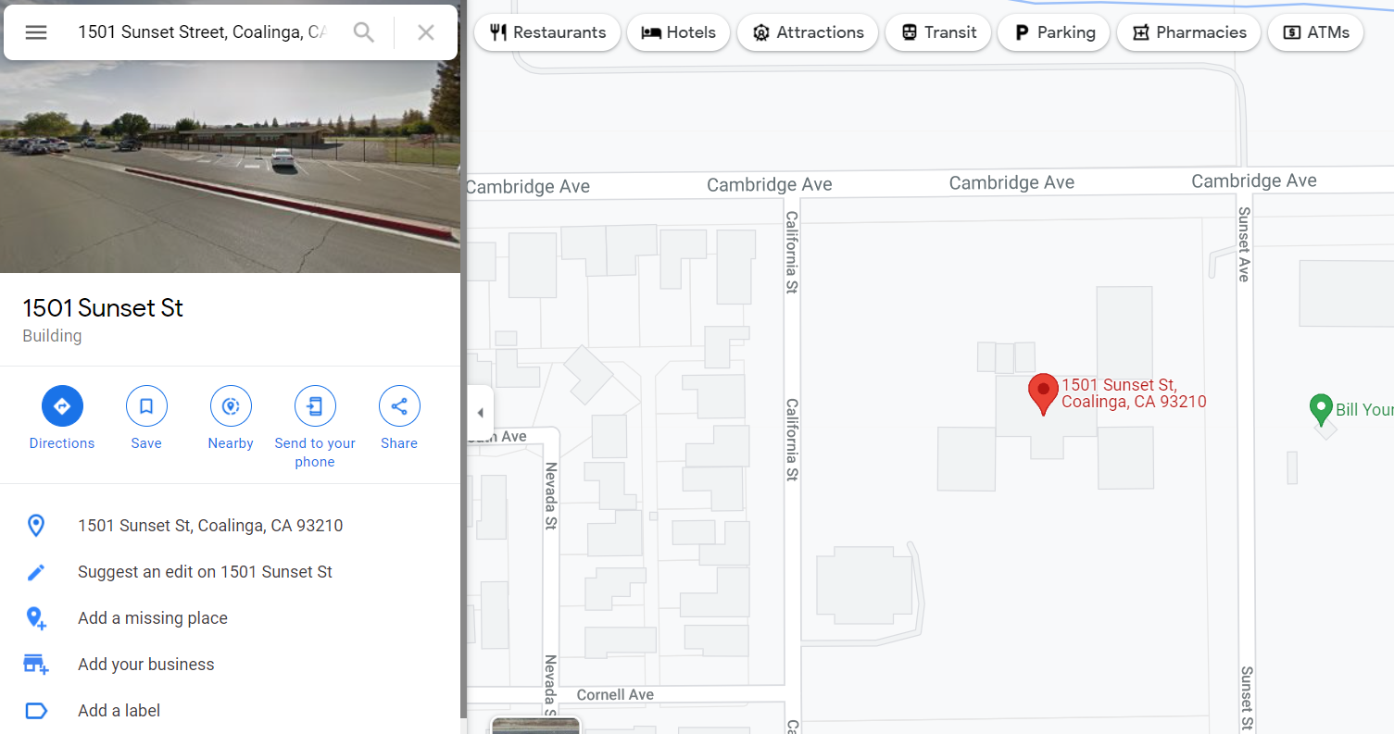
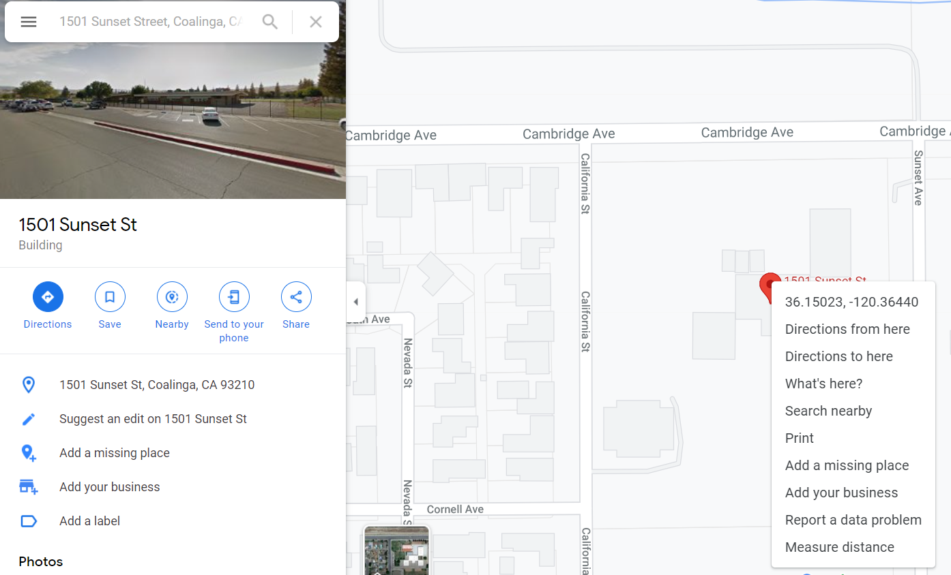
Finding the Latitude and Longitude
Enter an address in your eligible census tracts into Google Maps.
You should see a red pin at the correct location.
Right-click on the red pin to see a pop-up table.
Click on the first row (lat/long) and it will be copied automatically.
Notes:
You can you Bing, Yahoo, or any other mapping service.
Lat/Longs can be representative of whole tracts, so choose something toward the middle.
If you have a single point on the map where an activity is located, such as a community center, you may enter the lat/long for that location.
Can send a map as a supplement documents to support this section

Slide 34
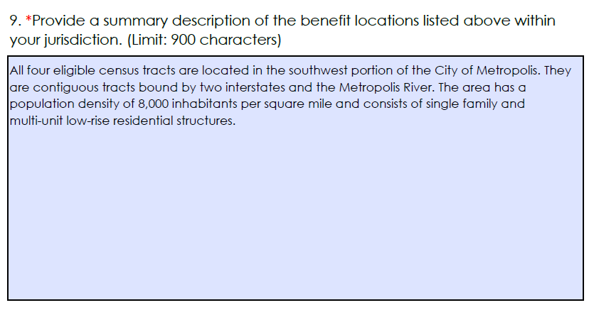
Location Details
Notes:
Provide a real description of the location, geography, and built environment.
Where are they located within your jurisdiction?
Is it urban, rural, or a combination of both
Is the location dense commercial corridors directly adjacent to mountainous terrain with a high hazard risk?
This is the area where you Describe your jurisdiction and the hazards it faces.

Slide 35
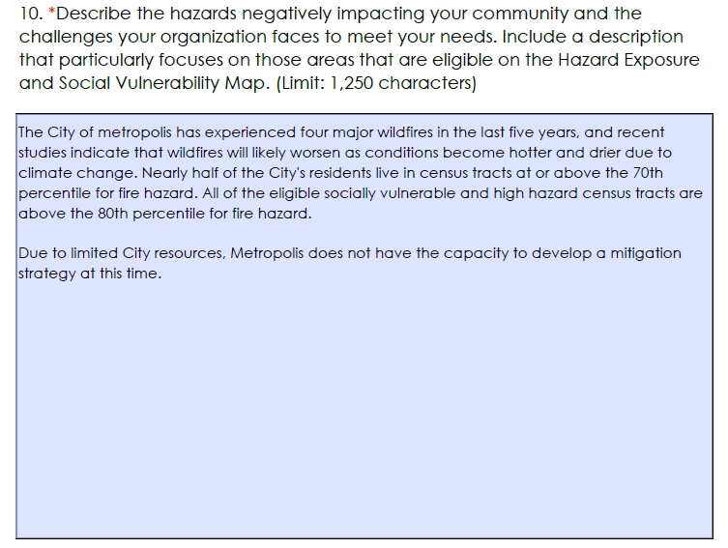
Problem Statement and Solution
Notes:
This question is two parts:
1) Applicants should quantify the problems facing their communities to the best of their ability. If you can, and tie them back to the highest hazards that your eligible tracts and community as a whole faces.
2) State why you cannot currently meet your needs. Funding? Can’t over commit resources? Or additional hurdles?

Slide 36
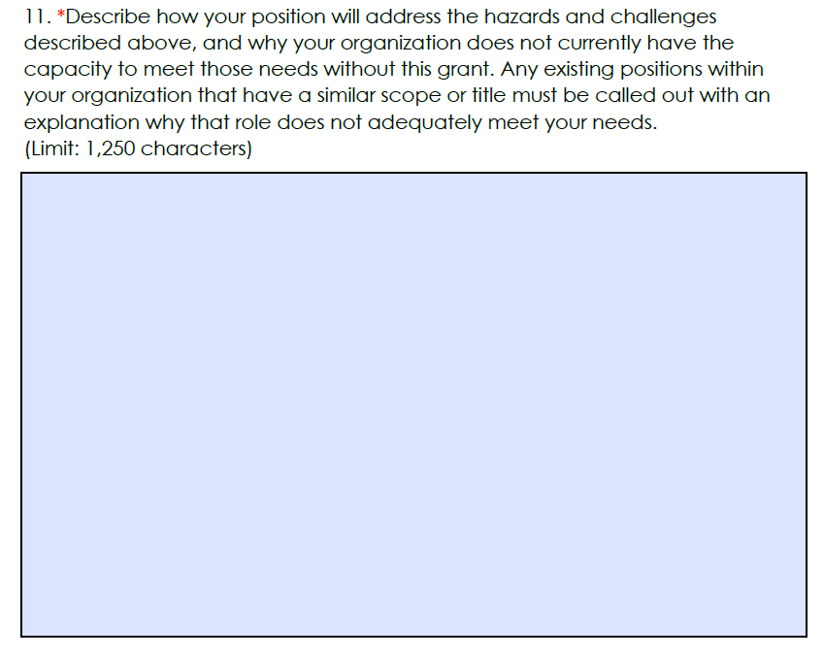
Problem Statement and Solution
Notes:
Tie the position’s workload back to quantified problem that you described in question 10.
If you currently have staff with similar scope or title, please identify it here.
For example, if you have a Chief Sustainability Officer, Chief Heat Officer, or Emergency Services Manager notate it and explain why that role is insufficient and how it could be supplemented by this one.

Slide 37
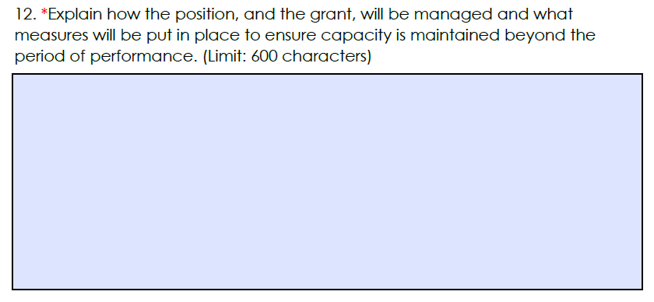
Implementation Plan
Notes:
This is an area for you to explain how the position and the grant will be managed and what measures will be put in place to ensure capacity is maintained beyond the period of performance

Slide 38
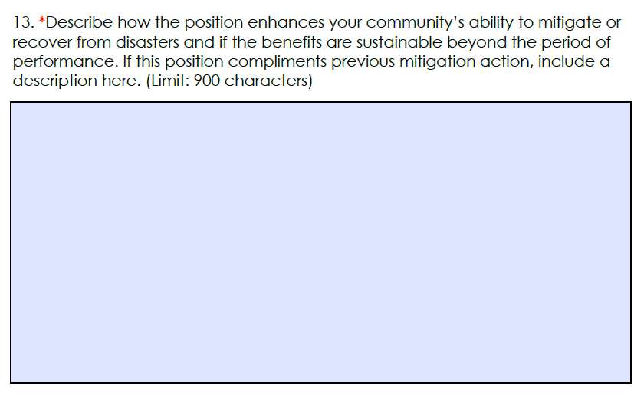
Resilience Outcomes
Notes:
In this section describe how the position enhances your communities ability to mitigate or recover from disasters and if the benefits are sustainable beyond the period of performance.

Slide 39
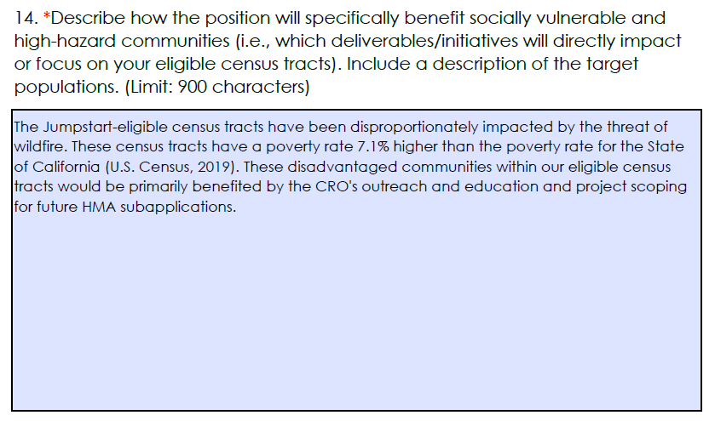
Community Benefit and Equity
Notes:
Under community benefit and equity describe how the position will specifically benefit socially vulnerable and high hazard communities.
For example what deliverables or initiatives will directly impact or focus on your eligible census tracts

Slide 40
Outreach and Community Involvement
Notes:
For outreach and community involvement this is an area for you to explain how the position will engage with the community, or any partnerships that will be established and to what extent stakeholders inform or contribute to the positions activities.

Slide 41
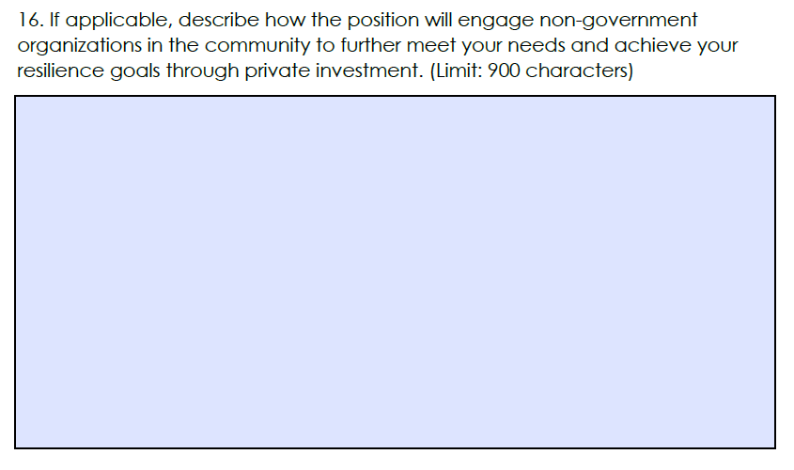
Outreach and Community Involvement
Notes:
This is not a required section
In this section describe how the position will engage with non-government organizations in the community to further meet your needs and achieve your resilience goals.

Slide 42
Future Conditions and Climate Change
Notes:
For question 17 describe how activities performed by the position were informed by future conditions and or climate change.

Slide 43
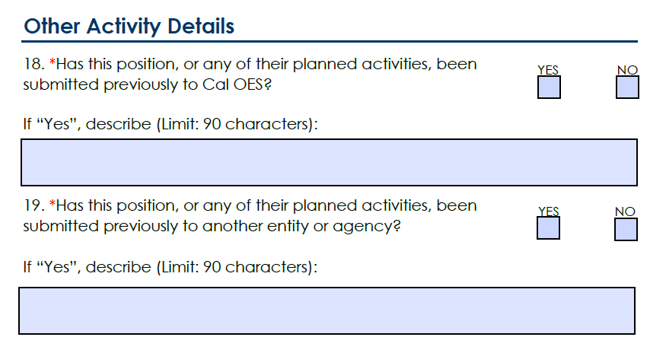
Other Activity Details
Notes:
There is also a portion outlining other activity details. Please check yes and or describe if this position or any of your planned activities have been previously submitted to Cal OES or any other entity or agency..

Slide 44
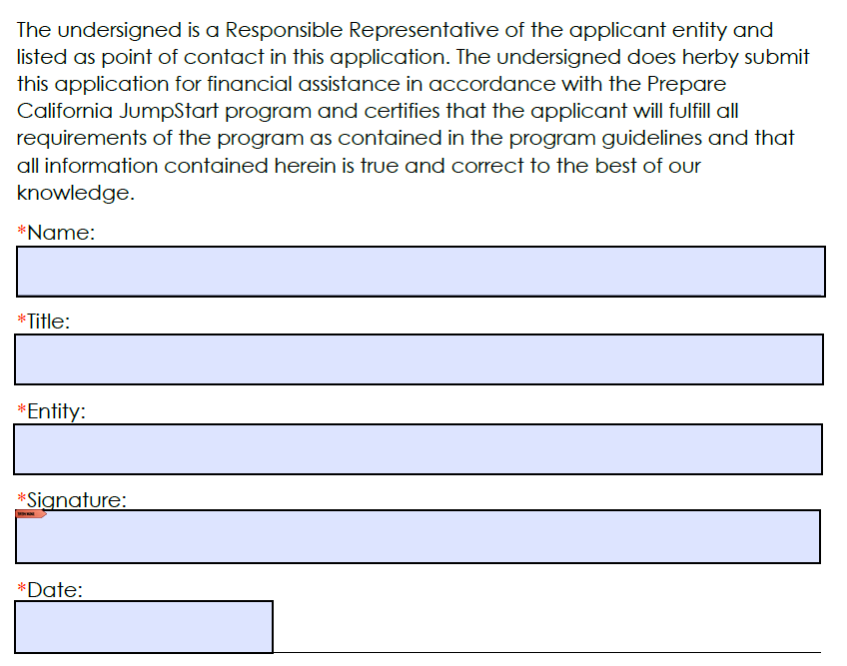
Authorization
Notes:
In the authorizations section this is where the authorized agent will complete the required fields and then sign electronically if they are able to do so.
To sign the application electronically click on the red arrow under signature.

Slide 45
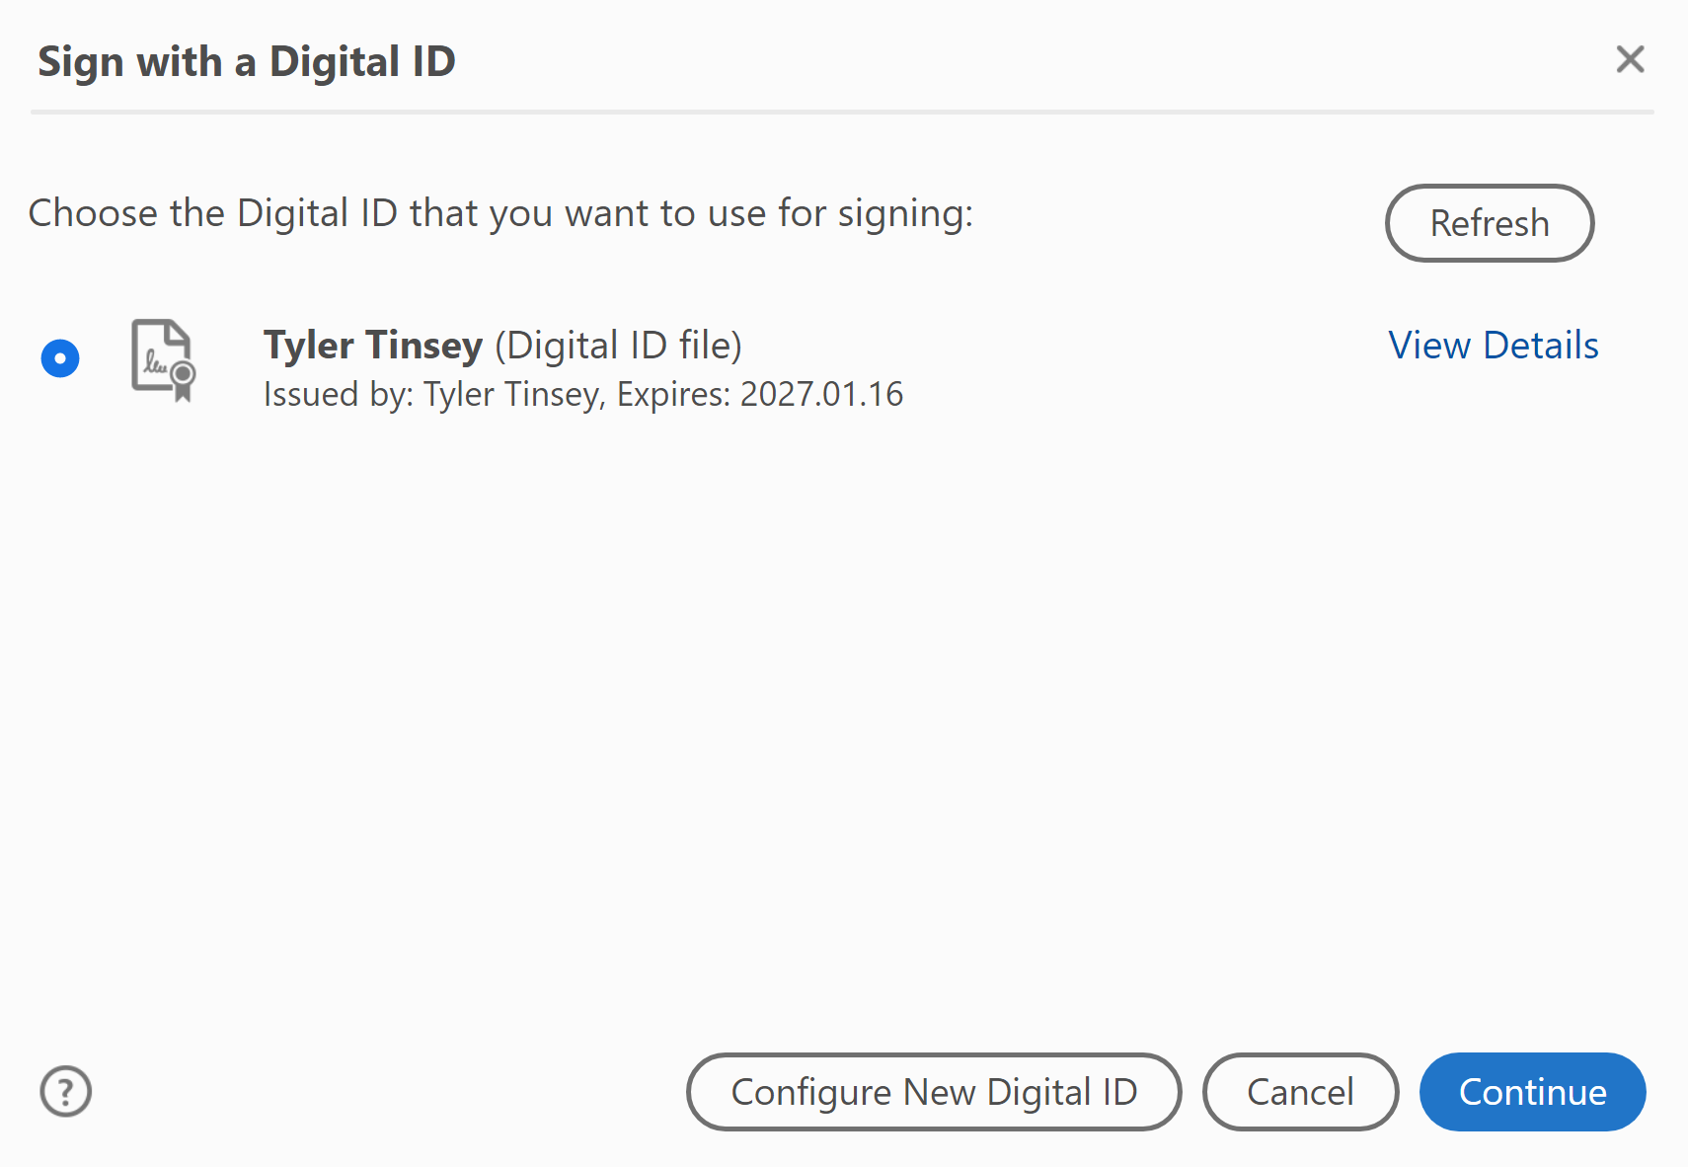
Signature Instructions
Notes:
That will then take you to this screen where you can configure a new digital ID

Slide 46
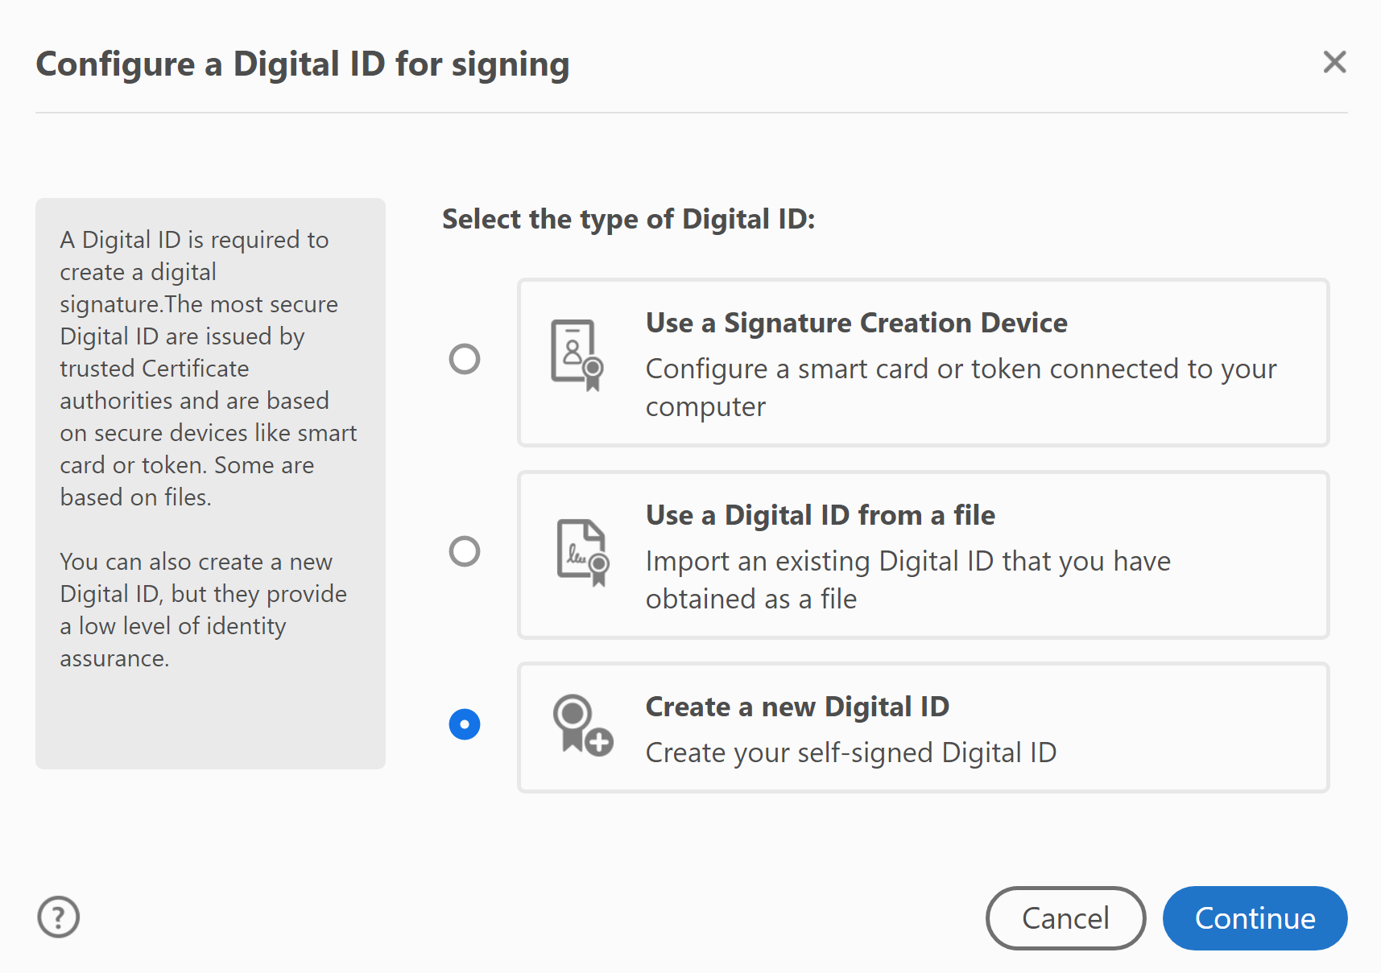
Signature Instructions
Notes:
Then follow the prompts to create a new digital ID

Slide 47
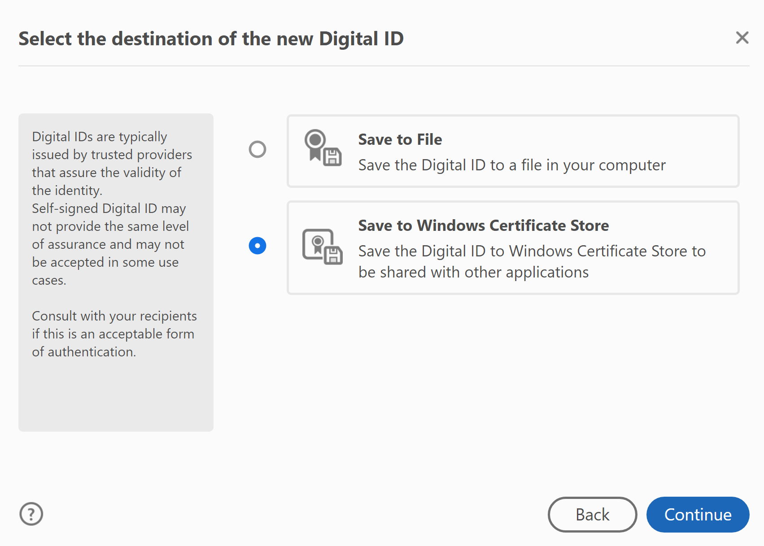
Signature Instructions
Notes:
Again follow the prompts

Slide 48
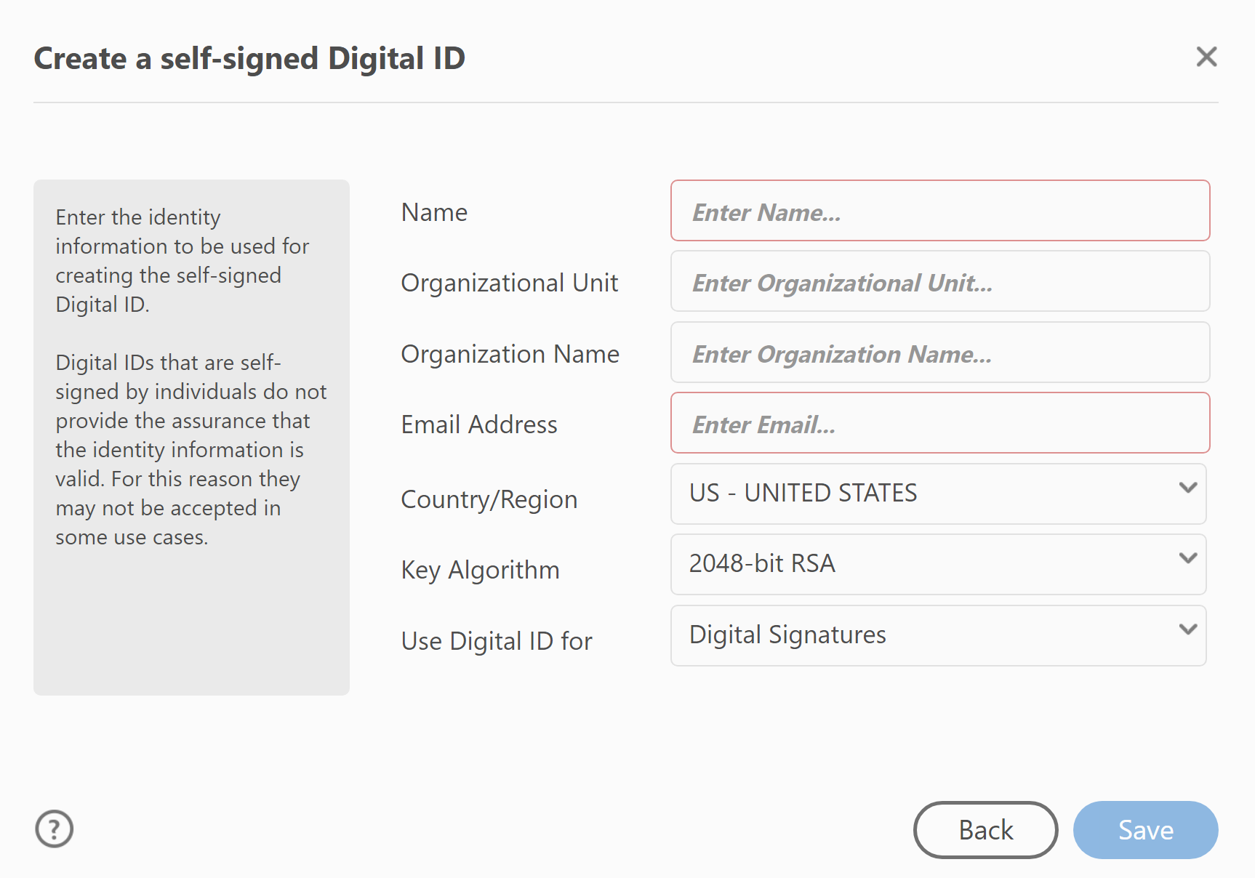
Signature Instructions
Notes:
After this step, an e-signature will be applied, and Adobe will give you the option to “Lock” your document. Meaning you can no longer edit your applicaiton
I will say, if we do RFI your application, it may make it easier to go back, edit your answers, and submit a revised application IF you DO NOT “lock” your document.
At the end of the day just be sure to get a signature on the applicaiotn whatever way works for you and your organization. If you have problems or issue please reach out to us and we will help.

Slide 49
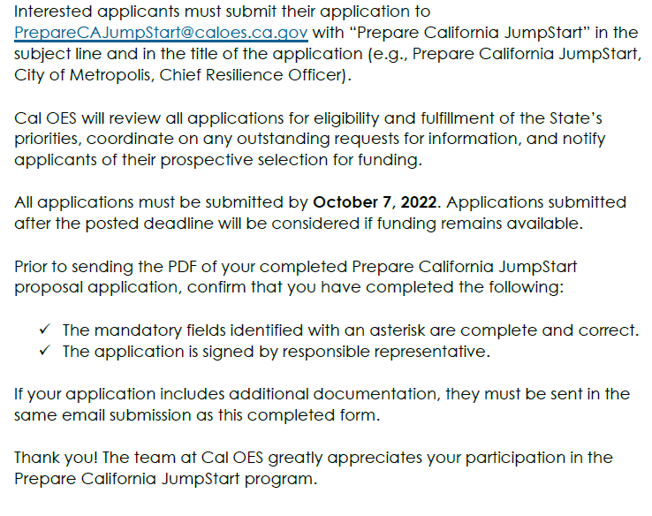
Application Submission Instructions
Notes:
Applications must be submitted to the JumpStart inbox with the correct subject line
You can copy and paste your title from the application directly into the email subject
Applications are due October 7, 2022.

Slide 50
Eligibility Program Criteria Application Walkthrough Next Steps and Resources Q&A
Notes:
I will now hand it back over to Jasmine to go over next steps and resources

Slide 51
Upcoming Webinar Schedule
JumpStart Webinar Hours
September 15, 2022 @ 10am -11am PST
September 22, 2022 @ 10am -11am PST
JumpStart Office Hours
September 9, 2022 @ 10am -11am PST
September 16, 2022 @ 10am -11am PST
September 23, 2022 @ 10am -11am PST
September 30, 2022 @ 10am -11am PST
October 6, 2022 @ 10am -11am PST
October 7, 2022 @ 10am -11am PST
Notes:
Please note that we still have quite a few office hours available. These office hours allow for the opportunity to discuss the application process as well as any technical or programmatic questions that you may have.
Our next office hour timeslot is tomorrow September 9th from 10-11am and if you do not yet already have the link to attend we are happy to provide that to you if you reach out to the PrepareCA jumpstart inbox.

Slide 52
Next Steps for Potential Applicants
Attend any State Cal OES sponsored JumpStart webinars
Sign up for Cal OES email notifications
Visit the Cal OES HMA Website for funding opportunities, timelines, and priorities for funding
Refer to Notice of Funding Opportunity for more information during application development
Reach out to prepareCAJumpStart@caloes.ca.gov if you have any questions.
Notes:
Back to wes for Q&A instructions

Slide 53
Eligibility Program Criteria Application Walkthrough Next Steps and Resources Q&A
Notes:
Back to wes

Slide 54
Q&A
See Notice of Funding Opportunity FAQs
For Prepare California JumpStart funding: send application, supporting documentation and all questions to Cal OES at prepareCAJumpStart@caloes.ca.gov
www.caloes.gov
Notes:
We will now open up for some questions and answers, please utilize the raise hand feature in teams if you have a question and you will be called on to unmute your mic.
Thank you everyone for attending, we will be offering this presentation again next week and the JumpStart team will be available during office hours if you need more one on one technical assistance. As always your can email any questions you have to the email address listed on the screen.

