Slide 1
Building Resilient Infrastructure & Communities
FY 2021 Lessons Learned
August 10, 2022
www.caloes.gov
Notes:
1

Slide 2
Webinar Overview
Place yourself on mute
This presentation is being recorded, slides will be provided after the presentation
During the presentation, use the chat feature to ask questions
Q and A will occur at the end

Slide 3
Evolution of Pre-Disaster Mitigation BRIC 2020/2021 Trends BRIC 2022 Messaging Timeline and Next Steps Q/A

Slide 4
BRIC Funding Evolution
California Numbers:
BRIC 2020 (Competitive)
Projects Submitted
26
Projects Selected
4
BRIC 2021 (Competitive)
Projects Submitted
11
Projects Selected
9
Total Funding per Project:
BRIC 2020
$50 million (Max. Project)
$600 thousand (C&CB)
BRIC 2021
$50 million (Max. Project)
$1 million (C&CB)
BRIC 2022
NOFO ~ Mid-August
CA BRIC 2020 (Fed Share)
CA BRIC 2021 (Fed Share)

Slide 5
Evolution of Pre-Disaster Mitigation BRIC 2020/2021 Trends BRIC 2022 Messaging Timeline and Next Steps Q/A

Slide 6
BRIC 2021 – National Competitive Mitigation Projects
National BRIC 2021 Numbers:
53 competitive projects selected
19 selected applicants, all FEMA Regions received at least one competitive mitigation project this year
The average project dollar amount is $15M (smallest is $189K and the largest is the program max at $50M)
49% of selected projects meet one or more of the Justice40 interim criteria
Success rate of 14% in 2021 – compared to 4% in 2020
DC
Over $100M
$50M - $100M
$10M - $50M
Hawaii
$1M - $10M
No competitive funding
Alaska
US Virgin Islands
American Samoa
Puerto Rico
Guam

Slide 7
BRIC 2021 – Wildfire, Drought, Heat Mitigation
2020 vs 2021:
The first year of BRIC included one competitive wildfire project funded and there were no heat or drought projects selected
This year, one wildfire, three heat, and four drought competitive projects were selected
California
1 Wildfire
1 Heat
2 Drought
New York
2 Heat
North Carolina
1 Drought
Utah
1 Drought
1
Wildfire Mitigation project was approved
4
Drought Mitigation projects were approved
3
Heat Mitigation projects were approved
Wildfire
Hawaii
Heat
Drought
Climate Adaptation
The expansion of funding to drought and extreme heat hazards in BRIC is a deliberate decision to make communities more resilient to climate change and extreme weather events.
Alaska
US Virgin Islands
American Samoa
Puerto Rico
Guam

Slide 8
BRIC 2021 – California
Summary of Identified for Further Review FY2021 California Subapplications
Project Title | County | Project Type | Fed Share
Sonoma Creek Flood Mitigation and Restoration | Sonoma | C&CB | $540,096
Flood Hazard Mitigation Project | Santa Cruz | C&CB | $300,000
Nature-Based Mitigations for Seawall | San Francisco | C&CB | $159,900
Water Resiliency Integrating Groundwater | Sonoma | Drought | $6,066,080
Multi-Family Soft-Story Retrofit Program | Alameda, Contra Costa, Los Angeles | Seismic Retrofit | $20,200,000
K-Line Transmission Hardening Project | Riverside | Utility & Infrastructure Protection | $23,888,095
Floodplain Restoration & Levee Resiliency Project | Colusa | Flood Control | $18,923,625
Bayside Community Resiliency: The Living Levee Project | San Diego | Flood Control | $15,160,988
Nature-Based Shoreline Adaptation Project | Orange | Utility & Infrastructure Protection | $9,799,793
Nature-based Mitigation & Wildfire Retrofitting for Climate Resiliency | Nevada | Vegetation Management | $31,034,243
Lagoon Coastal Levee System Resiliency Project | Marin | Flood Control | $15,610,602
Willow Springs Water Bank Drought Mitigation Project | Kern | Drought | $39,496,828
BRIC 2021 Highlight (Competitive Funding)
California received $180,180,256 of the $795,897,692 (23%), selected for further review, placing the State as the top Applicant for BRIC 2021.

Slide 9
BRIC 2021 – California Submitted Projects
California BRIC 2021 by the Numbers:
Largest identified for review: Kern County Willow Springs Water Bank Drought Mitigation Project
$39,496,828
Smallest identified for review: City of Healdsburg Water Resiliency Integrating Groundwater in Healdsburg Through ASR
$6,066,080
Average dollar amount of identified for review projects:
$20,020,028
3
C&CB Subapplications
Submitted Project Types
9
Competitive Project Subapplications
Subapplications in further review
Subapplications did not meet HMA eligibility

Slide 10
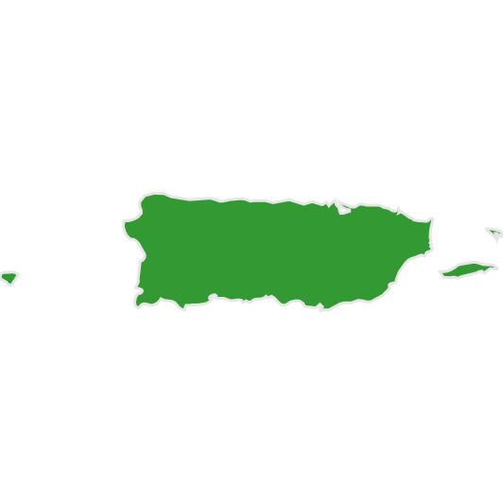
BRIC 2021 – Applicant Building Code Adoption
Map Legend
IBC/IRC: 2018 or 2021
20 points
IBC/IRC: 2015
10 points
IBC/IRC: No 2015 / 2018 / 2021 or no state-wide codes
0 points
Best publicly available data; January 2021 International Code Council
Code Stats
Two competitive projects selected did not have State IRC codes (Wisconsin/Wyoming), this made up 1% ($8,119,079) of the total available competitive funding.
Hawaii
Alaska
US Virgin Islands
American Samoa
Puerto Rico
Guam
Notes:
Talking Points:
This is based on BEST AVAILABLE PUBLIC DATA
Jurisdictions may have better scores than displayed here, this is based on the State data.
10

Slide 11
BRIC 2020 vs 2021 – California Phased Projects
Phased Projects:
A conceptual scope of work that meets FEMA eligibility requirements, but whose complexity requires additional studies and design development to get the subapplication to the point where all eligibility determination can be made.
BRIC 2020
3 / 4 – selected competitive projects submitted as Phased
BRIC 2021
8 / 9 – selected competitive projects submitted as Phased
75%
88.8%
Subapplication Submission | Pre-Screening | Phase 1: Approvals | Phase 1: Deliverables | Phase 2: Project Details Review | Phase 2: Approval

Slide 12
BRIC 2020 vs 2021 – California Overmatched Projects (Increased Federal Share)
Technical Scoring Criteria:
Overmatch (>25%)
Local match (non-Federal cost share) 30% or more obtains an additional 5 points (technical scoring rubric)
EDRC (>10%)
Local match 12% or more obtains an additional 5 points
BRIC 2020
3 / 4 – selected competitive projects overmatched
BRIC 2021
8 / 9 – selected competitive projects overmatched
75%
88.8%
EDRC:
Community of 3,000 or fewer individuals with residents having an average per capita annual income not exceeding 80% of the national per capita income based on best available data.

Slide 13
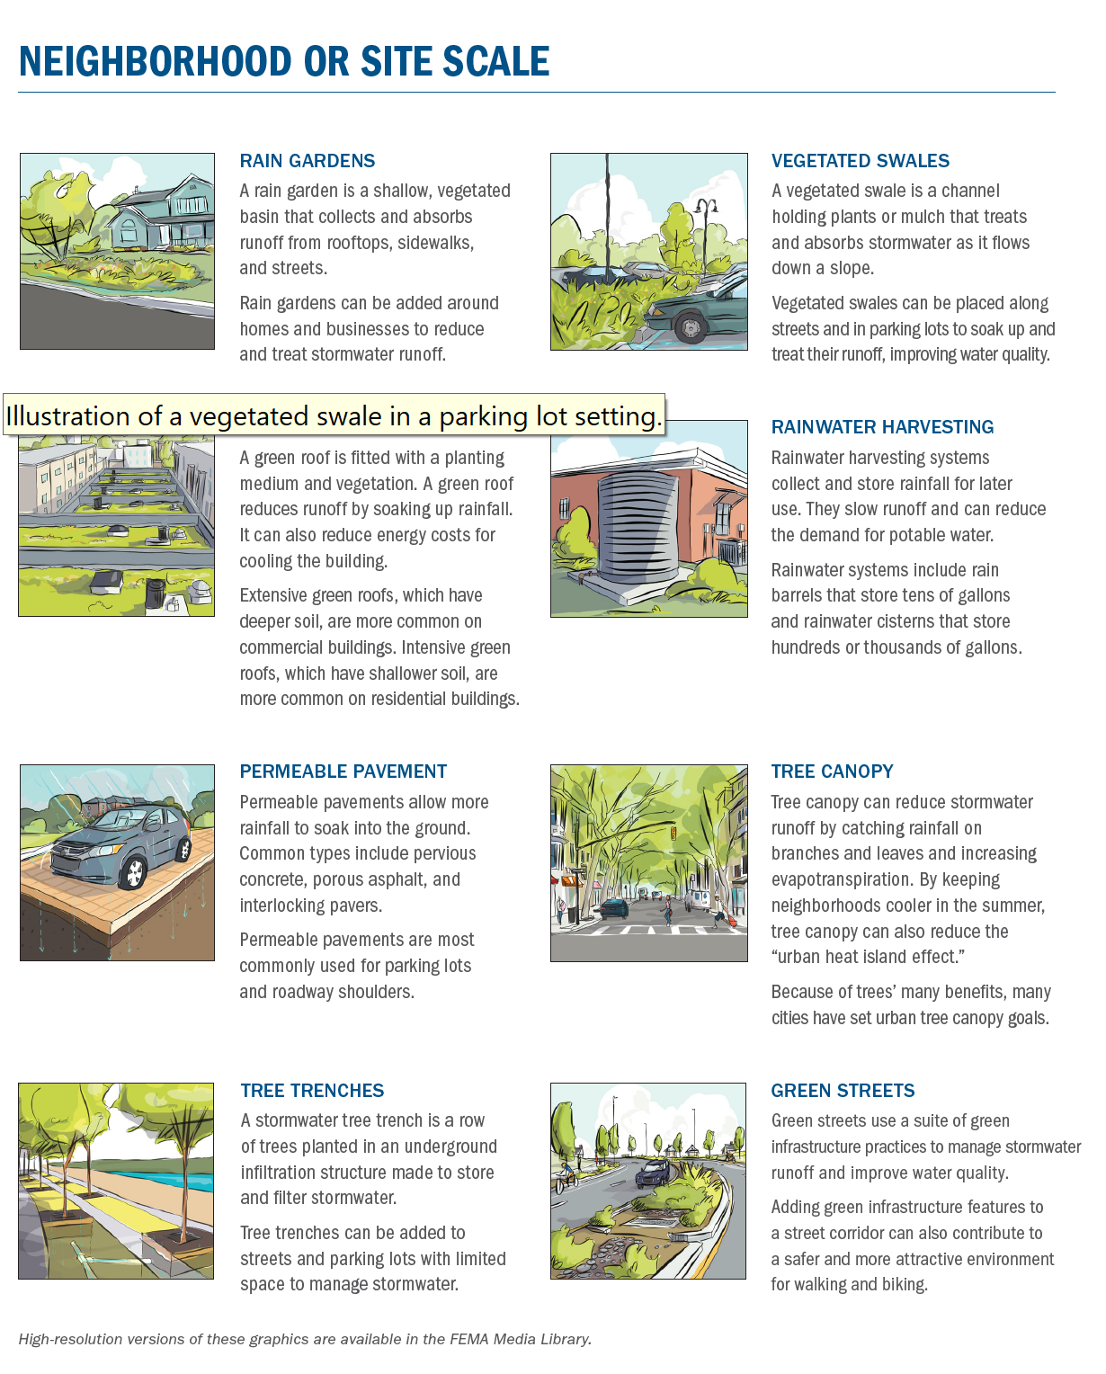
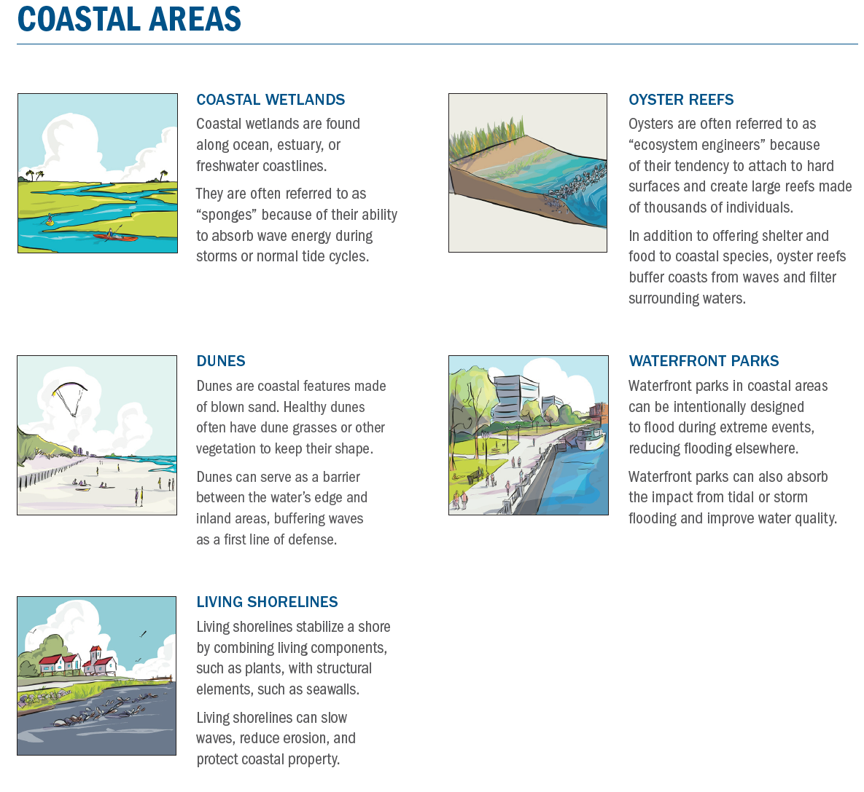
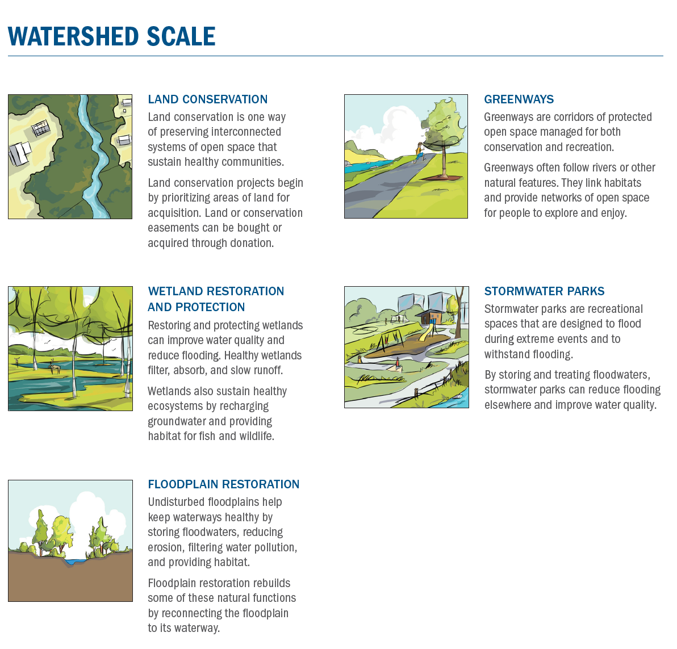
BRIC 2020 / 2021 – Nature Based Solutions (NBS)
Detention basin pools provide salmonid species with a low-flow sanctuary
Enhance approximately 5 acres of western snowy plover breeding habitat by placing oyster shells or pea gravel to enhance the breeding habitat of endangered bird species
Create wildfire buffers near dense urban communities
Earthen berm, hybrid dune, eco-revetments in areas where the beach width is limited, green infrastructure, and a restored wetland
Remember
Nature-based solutions are approaches that include, but are not limited to, restoration of grasslands, rivers, floodplains, wetlands, dunes, and reefs; living shorelines; soil stabilization; aquifer storage and recovery; and bioretention systems.

Slide 14
BRIC Key Findings
BRIC 2020 / 2021 Key Findings
Projects needed to be eligible, feasible, and cost-effective (first and foremost)
Projects needed to be competitive and maximize the scoring rubrics (address each scoring criterion in the subapplication)
FEMA funded States whose projects addressed highest regional based hazards
Strong code adoption and BCEGS rating of 5 or less, remains a priority for success
Phased projects remain competitive; phase projects that are in a preliminary design stage
Projects should seek public private partnerships and directly benefit disadvantaged communities
Include nature-based solutions, future conditions, ancillary benefits, innovation, and climate adaption

Slide 15
Evolution of Pre-Disaster Mitigation BRIC 2020/2021 Trends BRIC 2022 Messaging Timeline and Next Steps Q/A

Slide 16
Technical Scoring Criteria (115 Max)
Technical points are allocated in a “all or nothing approach” highlighting importance of each criterion (reviewed by FEMA):
Infrastructure Project | Mitigation risk to one or more lifelines | Incorporation of Nature-based Solutions | Applicant has mandatory building code requirement (CA has 2018)
Subapplicant has Building Code Effectiveness Grading Schedule Rating of 1 to 5 | Application generated from HMA AA, HHPD, CISA, RRAP or past BRIC TA award | Increased Non-federal cost Share (30% for subapplicants / 12% for EDRC) | Designation as an Economically Disadvantaged Rural Community (EDRC)
20 POINTS
15 POINTS
10 POINTS
20 POINTS
20 POINTS
10 POINTS
5 POINTS
15 POINTS
Notes:
16

Slide 17
Qualitative Scoring Criteria (115 Max)
Scored on a gradient scale for qualitative evaluation criteria (performed by a panel of reviewers):
Risk reduction / resiliency effectiveness | Climate change and other future conditions | Implementation measures
Population impacted | Outreach activities | Leveraging partners
35 POINTS
20 POINTS
15 POINTS
25 POINTS
5 POINTS
15 POINTS
Remember Importance of Future Conditions:
Climate Changes
Demographics Changes
Population Changes
Land use Changes

Slide 18
Capability & Capacity Building (C&CB) Activities
Building Codes
For the allocation funding, Cal OES will prioritize project scoping activities (up to $1M including management costs)
Project scoping, formerly called Advance Assistance, are activities (“seed funding”) that help to build a pipeline of future shovel ready mitigation projects
Project scoping should be used when the mitigation problem and solution are not known and the subapplicant needs to more fully evaluate a potential intervention
Project scoping should include an alternative analysis, selection of a preferred alternative, project design, CEQA, and a future project subapplication
Priorities for Cal OES for 2022 – project scoping for nature-based solutions, heat, drought, and utility protection projects (undergrounding or microgrid)
Partnerships
Capability and Capacity Building Activities
Project Scoping
Planning
Refer to Technical and Qualitative Scoring Rubrics for Additional Competitiveness Factors

Slide 19
Inclusion of Justice40 Initiative
BRIC is prioritizing assistance that benefits disadvantaged communities as referenced in Executive Order 14008 – Tackling the Climate Crisis Home and Abroad (2021)
Four of the six BRIC qualitative evaluation criteria reflect the need for the subapplication to address how the project will benefit disadvantaged communities:
Risk Reduction / Resiliency Effectiveness
Population Impacted
Outreach Activities
Leveraging Partners
Keep In Mind:
Subapplicants will need to quantify this information in the subapplication but also it is recommended to include supporting materials like maps and data that demonstrates how the disadvantaged community benefits from the project.

Slide 20
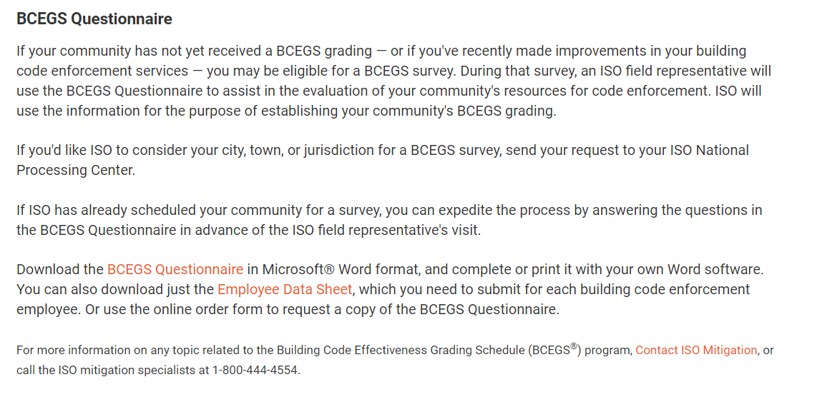
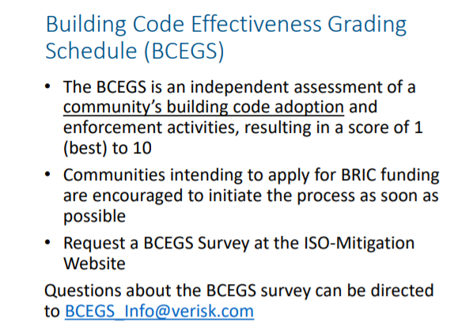
How to Obtain a BCEGS Rating (Subapplicant Level)
Email Dale.Thomure@verisk.com
Visit: isomitigation.com/bcegs

Slide 21
BRIC 2022 Messaging
Focus Areas:
Level of protection increase
Natural hazard mitigation
Must reduce risk as a primary benefit
Clearly explain how the project protects critical infrastructure
Note how the project addresses ancillary benefits like improvement to air/water quality, public health, and the economic opportunity
Relevant changing/future conditions and how the project will protect the community now and in 20-50 years
Call out new and innovative ideas
Use reliable data sources and assumptions
Ensure to include Management Costs
Include CEQA if applicable
Large-scale community (neighborhood) impact and benefit
Include a nature-based solution (NBS)
Phase projects in preliminary design and/or with no EHP completed
Look for a public private partnership (PPP) opportunity
Address all aspects of the technical and qualitative scoring criteria
Address future conditions and climate impacts (climate impacts include sea level rise, drought, more precipitation, more frequent storms)
Target project areas that have a BCEGS score of 5/5 or lower (1/1)
Overmatch for the local match (non-federal share)
Include a well-defined implementation plan (manage the project)
Target disadvantaged communities(Justice40)
Must have a Hazard mitigation plan approved / adopted at time of subapplication submission (December 2022) and grant award

Slide 22
Cal OES Assistance – Technical Assistance
Additional Points:
Ensure detailed Scope of Work (SoW)
Location
Purpose
Approach
Feasibility
Expected outcomes
Benefits of the activity
Cost estimate and narrative describing the anticipated costs
Data collection for cost-effectiveness screening
A FEMA credible BCA is key. If the project is preliminary, phase the project and include a rerun of the BCA as a Phase I deliverable
Identification of the Problem
Problem statement and history of hazards
What is the hazard and risk?
How long has it been occurring?
What are the damages and loss of function/service?
Note quantitative and qualitative losses
Future conditions (SLR, climate impacts, demographic changes, etc.)
How is climate change worsening the problem?
Potential Projects/Solutions
Include:
Hazard Mitigation Planning
Planning Studies
Feasibility Studies
Capital Project Plans
New budgetary need requests
Comprehensive stakeholder engagement for project identification
Do you know if solution is feasible?
What may be the challenges with implementation?
Technical Assistance (TA)
Assistance with project scoping
How to quickly identify projects that may be eligible, feasibility, cost-effective, and competitive
Goal is to identify projects that will be competitive with FEMA’s priorities for BRIC
Focus time and resources on good, fundable projects

Slide 23
Evolution of Pre-Disaster Mitigation BRIC 2020/2021 Trends BRIC 2022 Messaging Timeline and Next Steps Q/A

Slide 24
BRIC 2022 Timeline
2022
2023
AUGUST | SEPTEMBER | OCTOBER -DECEMBER | JANUARY | MARCH - MAY | AUGUST
FY 2021 competitive project selections are announced FEMA NOFO expected in mid-August Issue 2 CFR 200 compliant RFPs for subapplication support if needed | Cal OES BRIC NOI period opens from 9/1/2022 to 9/16/2022 FEMA GO opens 9/30/2022 | Cal OES provides technical assistance and webinars to subapplicants with approved NOIs Develop subapplications (due to OES on December 2, 2022) Respond to Cal OES RFIs as needed | Cal OES finalizes subapplications to be submitted to FEMA by January 25, 2023 | Allocation (C&CB) Rd I announced FEMA reviews subapplications for eligibility / technical scoring criteria National Technical Review (NTR) reviews competitive subapplications Qualitative review panels are convened | BRIC 2022 competitive projects adjudicated, and selections are announced FEMA NOFO for BRIC 2023 expected in mid-August

Slide 25
Next Steps
BRIC 2022 Subapplication Deadline
December 2, 2022
Attend Cal OES BRIC webinars (3 in August)
Attend FEMA BRIC webinars
Set up a project scoping TA call with Cal OES, HMA@caloes.ca.gov
Assembly a high-level scope, schedule, and budget for Cal OES TA call
Submit a BRIC NOI to Cal OES (9/1/22 to 9/16/22)
Obtain Unique Entity Identifier (UEI) and System for Award Management (SAM) information (no more DUNS)
SAM can take up to 4 weeks
Register for FEMA GO (Grants Outcomes)
Obtain BCEGS rating from Insurance Services Office (ISO)
Ensure HMP will be adopted /approved by 12/2/22
Discuss partnership opportunities for local match
If applying as an EDRC, confirm you are an EDRC (meet the definition)
Review the technical and qualitative scoring rubrics
Gather data points and documentation for the BCA
Define the project benefitting area and if the project benefits a disadvantaged community
Conduct needed community outreach
Obtain letters of support for the subapplication / project

Slide 26
Send all project scoping, TA, and questions to Cal OES Hazard Mitigation Assistance at: HMA@caloes.ca.gov
Thank you!

