Slide 1

2020 BRIC & FMA
Subapplication Webinar

Slide 2


Welcome

Slide 3
Ground Rules
Please keep your microphone muted
Ask questions in the chat and they will be addressed when appropriate
You may email additional questions to the HMA Inbox HMA@caloes.ca.gov

Slide 4
Webinar Purpose
Provide an overview of the Building Resilient Infrastructure & Communities (BRIC) and Flood Mitigation Assistance (FMA) grant programs
Outline grant subapplication and BCA considerations, programmatic requirements, and best practices with the goal of making you successful in obtaining FEMA grant funding for your mitigation projects

Slide 5
Due Dates
BRIC and FMA subapplications are due to Cal OES no later than December 3, 2020
Subapplications will be submitted via FEMA Grant Outcomes (FEMA GO)

Slide 6
Building Resilient Infrastructure & Communities Part 1
BRIC assists in building mitigation capacity, developing innovative solutions, establishing partnerships, and funding larger scale infrastructure projects.
The guiding principles of the program are:
Support state and local governments, tribes, and territories through capability- and capacity-building to enable them to identify mitigation actions and implement projects that reduce risks posed by natural hazards

Slide 7
Building Resilient Infrastructure & Communities Part 2
Encourage and enable innovation while allowing flexibility, consistency, and effectiveness
Promote partnerships and enable high-impact investments to reduce risk from natural hazards with a focus on critical services and facilities, public infrastructure, public safety, public health, and communities
Provide a significant opportunity to reduce future losses and minimize impacts on the Disaster Relief Fund

Slide 8
Building Resilient Infrastructure & Communities Part 3
Support the adoption and enforcement of building codes, standards, and policies that will protect the health, safety, and general welfare of the public, take into account future conditions, and have long-lasting impacts on community risk reduction, including for critical services and facilities and for future disaster costs

Slide 9
Building Resilient Infrastructure & Communities Part 4
Capability-and Capacity-Building (C&CB) – activities which enhance the knowledge, skills, expertise, etc., of the current workforce to expand or improve the administration of mitigation assistance. This includes activities in the following sub-categories: building codes activities, partnerships, project scoping, mitigation planning and planning-related activities, and other activities

Slide 10
BRIC Funding Priorities
Incentivize public infrastructure projects
Incentivize projects that mitigate risk to one or more lifelines
Incentivize projects that incorporate nature-based solutions
Increase funding to Applicants that facilitate the adoption and enforcement of the latest published editions of building codes

Slide 11
BRIC vs PDM
FEMA GO has replaced the legacy system (eGrants)
Federal share project cap in BRIC increased to $50M
Planning Related activities are now eligible
Facilities in Special Flood Hazard Areas now require NFIP under BRIC
Advance Assistance projects are now known project scoping under C&CB
BRIC now requires consensus code adoption (2015 or 2018 IBC)

Slide 12
Flood Mitigation Assistance Part 1
FMA assists in reducing or eliminating the risk of repetitive flood damage to buildings insured by the National Flood Insurance Program (NFIP)
The FMA program addresses Presidential Policy Directive 21, critical Infrastructure Security and Resilience, and supports the mitigation mission area through Strategic Goal #1 Building a Culture of Preparedness, Objectives 1.1, 1.2, 1.3, and 1.4 of the 2018 – 2022 FEMA Strategic Plan
Click here for the 2018-2022 FEMA Strategic Plan

Slide 13
Flood Mitigation Assistance Part 2
FMA funding is available for the following:
Project Scoping (previously Advance Assistance): To develop community flood mitigation projects and/or individual flood mitigation projects that will subsequently reduce flood claims against the NFIP
  FEMA will select up to $4 million of Project Scoping subapplications
Community Flood Mitigation Projects: To address community flood risk for the purpose of reducing NFIP flood claim payments
  FEMA will select up to $70 million that address community flood risk

Slide 14
Flood Mitigation Assistance Part 3
Flood Hazard Mitigation Planning: Planning subapplications for the flood hazard component of State, Local, Territory, and Tribal (SLTT) Hazard Mitigation Plans and plan updates
Individual Flood Mitigation Projects: Projects that mitigate the risk of flooding to individual NFIP insured structures

Slide 15
Funding Availability Part 1
BRIC:
National Competition Total: $446,400,000
The State will receive a guaranteed allocation of $600,000 for C&CB activities and/or mitigation projects
  Up to $300,000 may be used for planning and/or planning-related activities
The State may submit an unlimited number of mitigation project subapplications each valued up to $50,000,000 federal share to the national competition

Slide 16
Funding Availability Part 2
FMA:
National Competition Total: $160,000,000
No guaranteed State allocation provided, all funding is competitive nationwide

Slide 17
Applicant vs Subapplicant
State, territories, and Federally recognized tribes are eligible applicants for HMA programs, including HMGP
Applicant: Cal OES
Subapplicant: State agencies, local governments, special districts, and Federally-recognized tribes
Cal OES is responsible for soliciting subapplications from eligible subapplicants and assisting in the preparation, review, and submittal of eligible and complete subapplications to FEMA

Slide 18
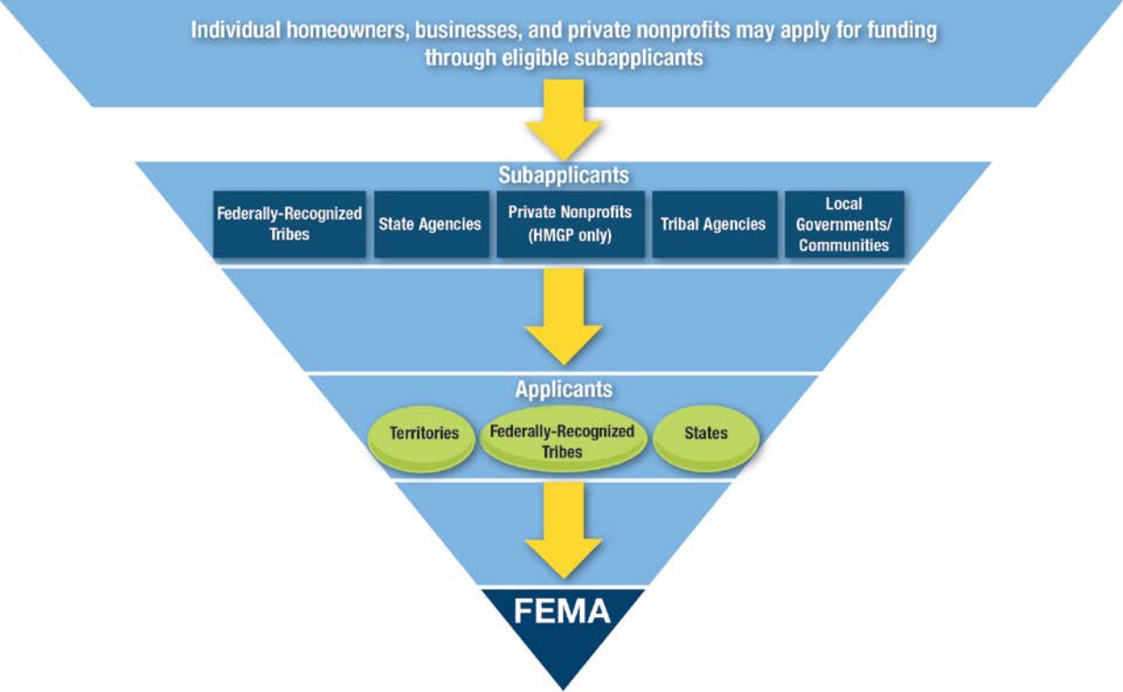

The Process Part 1
You
Cal OES

Slide 19
The Process Part 2
Tier 1: Individual homeowners, businesses, and private nonprofits may apply for funding through eligible subapplicants
Tier 2: Subapplicants- Federally-Recognized Tribes, State Agencies, Private Nonprofits (HMGP only), Tribal Agencies, Local Governments/Communities (You)
Tier 3: Applicants-Territories, Federally-Recognized Tribes, States (Cal OES)
Tier 4: FEMA
You
Cal OES

Slide 20
BRIC Eligibility Requirements Part 1
Must have a FEMA-approved and locally adopted LHMP or MJHMP at the time of applying to Cal OES AND at the time of obligation by FEMA
Private Non-profits are not eligible to apply
25% local cost share match required
  Small, impoverished communities eligible for 10% cost share
Notes:
SIC: 3,000 or fewer individuals identified by the State that is economically disadvantaged, with residents having an average per capita annual income NOT exceeding 80% of the national per capita income, based on the best available data. State must certify and provide documentation.

Slide 21
BRIC Eligibility Requirements Part 2
36-month Period of Performance (POP)
  Cal OES may request a longer POP for more highly complex projects, but must be approved by FEMA
Must obtain environmental clearances
Conform to the latest published codes
NO WORK prior to FEMA approval
  Pre-Award costs may be considered eligible
Notes:
SIC: 3,000 or fewer individuals identified by the State that is economically disadvantaged, with residents having an average per capita annual income NOT exceeding 80% of the national per capita income, based on the best available data. State must certify and provide documentation.

Slide 22
FMA Eligibility Requirements Part 1
Must have a FEMA-approved and locally adopted LHMP or MJHMP at the time of applying to Cal OES AND at the time of obligation by FEMA
Private Non-profits are not eligible to apply
Subapplicants must be participating in the NFIP, and not be withdrawn, on probation, or suspended
25% local cost share match required
  FEMA may contribute up to 100% for Severe Repetitive Loss (SRL) properties or 90% for Repetitive Loss (RL) properties

Slide 23
FMA Eligibility Requirements Part 2
36-month Period of Performance (POP)
  Community flood mitigation projects may be up to 48 months
Must obtain environmental clearances
NO WORK prior to FEMA approval
  Pre-Award costs may be considered eligible

Slide 24
Repetitive Loss Properties
Part 1
An RL property as defined under 42 U.S.C. 4121 is a structure covered by a contract for flood insurance made available under the NFIP that:
Has incurred flood-related damage on two occasions, in which the cost of the repair, on the average, equaled or exceeded 25 percent of the market value of the structure at the time of each such flood event
Notes:
]

Slide 25
Repetitive Loss Properties
Part 2
An RL property as defined under 42 U.S.C. 4121 is a structure covered by a contract for flood insurance made available under the NFIP that:
At the time of the second incidence of flood-related damage, the contract for flood insurance contains Increased Cost of Compliance (ICC) coverage
Notes:
]

Slide 26
Severe Repetitive Loss Properties Part 1
An SRL property as defined under 42 U.S.C. 4104c(h)(3) is a structure that:
Is covered under a contract for flood insurance made available under the NFIP
Has incurred flood-related damage
Notes:
]

Slide 27
Severe Repetitive Loss Properties Part 2
For which four or more separate claims payments (includes building and contents) have been made under flood insurance coverage with the amount of each such claim exceeding $5,000, and with the cumulative amount of such claims payments exceeding $20,000, or
For which at least two separate claims payments (includes only building) have been made under such coverage, with the cumulative amount of such claims exceeding the market value of the insured structure
Notes:
]

Slide 28
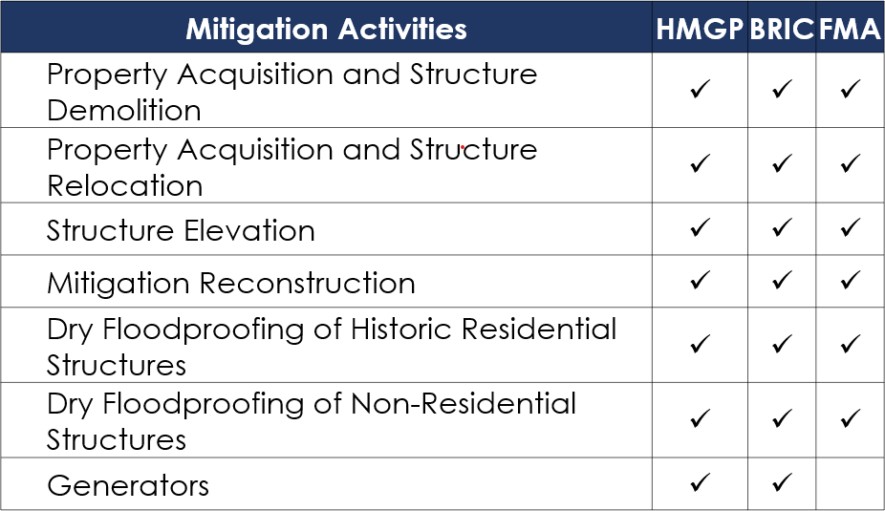
Eligible Activity Types Part 1

Slide 29
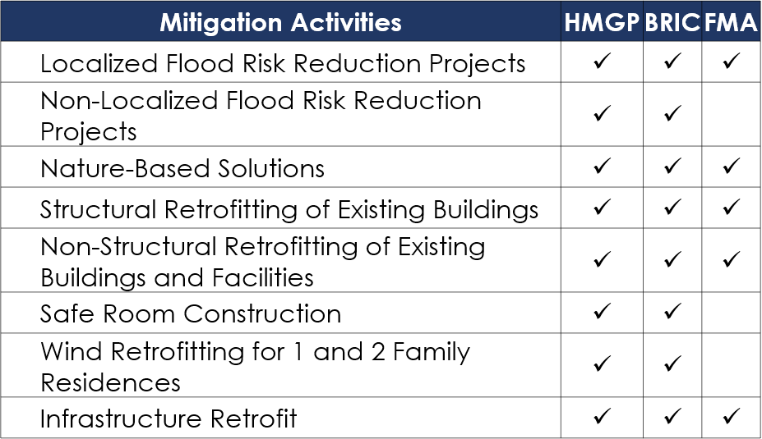
Eligible Activity Types Part 2

Slide 30
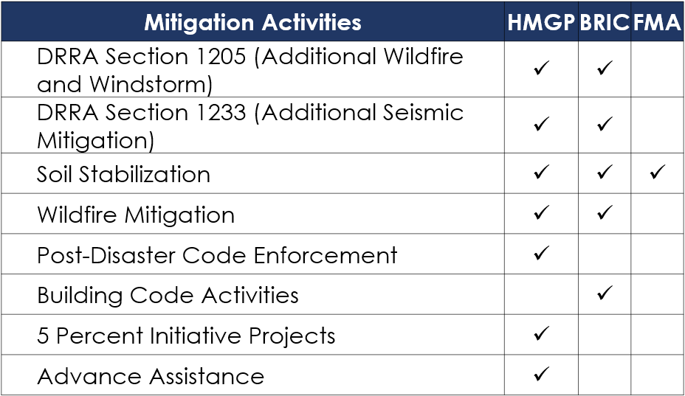
Eligible Activity Types Part 3

Slide 31
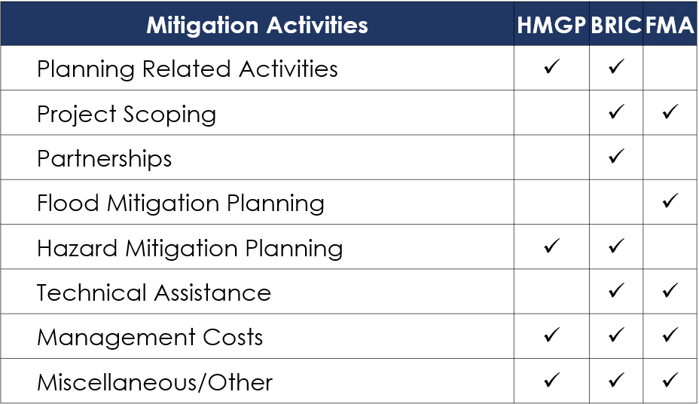
Eligible Activity Types Part 4

Slide 32
Generators
Must be used to protect a critical facility from a loss of function
  Critical facilities must be identified in a jurisdiction’s hazard mitigation plan
Generators must produce an independent solution to a problem
  The necessity of human interaction would make it a dependent action and therefore not an independent, stand-alone, and effective hazard mitigation solution
Generators eligible under BRIC, not FMA

Slide 33
Ineligible Activities Part 1
Projects for which actual physical work has occurred prior to approval
Projects that do not reduce risk to human life, structures, or improved infrastructure
Projects that are dependent on a contingent action in order to be effective (reliant on some other project)

Slide 34
Ineligible Activities Part 2
Property acquisition projects that are not compatible with open space guidelines and do not maintain open space
  Must be deed-restricted in perpetuity to open space uses and restore/conserve natural floodplain functions
Preparedness activities or temporary measures - Response
Hazardous fuels reduction beyond 2 miles of at-risk structures

Slide 35
Ineligible Activities Part 3
Studies that are not directly related to the design and implementation of a proposed hazard mitigation project
Projects that address the operation, deferred/future maintenance, rehabilitation, restoration, or replacement of existing structures, facilities, and/or infrastructure without increasing the level of protection
*A list of ineligible activities can be found on pages 42-43 of HMA Guidance

Slide 36
Common Eligibility Issues
No plan or recently expired plan
Physical construction activities have already started
Projects that are strictly capital improvements (i.e. something has reached the end of its useful life and needs to be replaced)
Projects that only consist of repairs
Projects that are not cost effective upon review
  Adequate supporting documentation not provided
  Inflated data inputs
  Benefit/Cost Ratio < 1.00

Slide 37
Grant Management Costs Part 1
Subrecipients are eligible to receive an amount up to 5% of the total subaward amount (no cost share, paid at 100%) for subrecipient grant management costs
Grant management costs are defined as:
  “Any indirect cost, any direct administrative cost, and any other administrative expense associated with a specific project under a major disaster, emergency or disaster preparedness or mitigation activity or measure.”

Slide 38
Grant Management Costs Part 2
Subapplicants may include subapplicant management costs of up to 5 percent of the total cost of their C&CB activity or mitigation project subapplication to manage the proposed subaward activities
Subapplicant management cost activities must be added to the Scope of Work section and identified as a line item in the Cost Estimate section of subapplications in FEMA’s grant application system
Subapplicants may opt out of receiving grant management costs

Slide 39
Grant Management Costs Part 3
The following are examples of grant management costs:
Staff time to prepare reimbursement requests, quarterly reports, technical assistance, and closeout process
Travel costs related to the implementation of the project
Supply costs may include printer materials
Indirect costs may include depreciation or use allowances on buildings or equipment, cost of operating facilities, and general administration

Slide 40
Pre-Award Costs
Pre-award costs directly related to developing the BRIC or FMA grant subapplication that are incurred prior to the date of the grant award may be eligible for reimbursement
  Must have supporting documentation for all costs
Pre-award costs may be cost shared and subapplicants may identify them as their non-federal cost share
Include as separate line items at the beginning of the cost estimate

Slide 41
BRIC Technical Evaluation Criteria
Part 1
  Total possible technical points = 100
  20 Points - Infrastructure Project
  15 Points - Mitigating risk to one or more lifelines
  10 Points - Incorporation of nature-based solutions
  20 Points - Applicant has mandatory building code adoption requirement (2015 or 2018 versions of International Building Code and International Residential Code)
  15 Points - Subapplicant has Building Code Effectiveness Grading Schedule (BCEGS) Rating of 1 to 5
Notes:
Each scoring criteria is all or nothing, not partial points are awarded.

Slide 42
BRIC Technical Evaluation Criteria
Part 2
  Total possible technical points = 100
  10 Points - Application generated from a previous FEMA HMA Advance Assistance Award
  5 Points - Increased non-federal cost share
  5 Points - Designation as a small impoverished community (as and referenced in 42 U.S.C. § 5133(a)) defined in the BRIC Policy
Notes:
Each scoring criteria is all or nothing, not partial points are awarded.

Slide 43
BRIC Qualitative Evaluation Criteria Part 1
  Total possible qualitative evaluation points = 100
  35 Points - Risk Reduction/Resiliency Effectiveness: The subapplication details how the project will effectively reduce risk and increase resilience (including the benefits quantified in the BCA), realize ancillary benefits, and leverage innovation
  15 Points – Future Conditions: The subapplication describes how the project will anticipate future conditions 1(population/demographic/climate changes, sea level rise, etc.) and cites data sources, assumptions, and models
Notes:
Each scoring criteria is all or nothing, not partial points are awarded.

Slide 44
BRIC Qualitative Evaluation Criteria Part 2
  15 Points – Implementation Measures: The subapplication adequately describes how the costs and schedule will be managed, how the project will be successfully implemented, and how innovative techniques to facilitate implementation will be incorporated. The project’s scope of work identifies sufficient technical and managerial staff and resources to successfully implement this project
Notes:
Each scoring criteria is all or nothing, not partial points are awarded.

Slide 45
BRIC Qualitative Evaluation Criteria Part 3
  15 Points – Population Impacted: The project subapplication demonstrates community-wide benefits and identifies the proportion of the population that will be impacted. The Application also describes how impacts (positive or negative) to socially vulnerable populations informed project selection and design
Notes:
Each scoring criteria is all or nothing, not partial points are awarded.

Slide 46
BRIC Qualitative Evaluation Criteria Part 4
  5 Points – Outreach Activities: The subapplication describes outreach activities appropriate to the project that advance mitigation. The subapplication also outlines the types of community planning processes leveraged during project conception and design and identifies the level of public support obtained during the engagement process
Notes:
Each scoring criteria is all or nothing, not partial points are awarded.

Slide 47
BRIC Qualitative Evaluation Criteria Part 5
  15 Points – Leveraging Partners: The project subapplication incorporates state, tribal, private, and local community partnerships that will enhance its outcome and describes the extent of those partnerships, such as having an increased non-federal cost share, multi-jurisdictional projects, etc.
Notes:
Each scoring criteria is all or nothing, not partial points are awarded.

Slide 48
FMA Scoring Criteria Part 1
  Up to 200 Points – NFIP Insured Multiple Loss Communities: Communities with 50 or more Repetitive Loss (RL) or Severe Repetitive Loss (SRL) structures and have received NFIP claims in a county that has received an Individual Assistance declaration for flood in the past 10 years

Slide 49
FMA Scoring Criteria Part 2
  5 Points for Each NFIP Policy – NFIP Policy Holder: Points will be assessed for every NFIP policy that is active as of the FMA application start date (Section D, Application and Submission Information, Key Dates and Times) and is verified within the benefitting area of the project. (5 per NFIP Policy)
  5 Points for each RL property and 10 Points for each SRL property - Points will be assessed for SRL or RL structure that is verified within the benefitting area of the project (5 per RL and 10 per SRL property)

Slide 50
FMA Scoring Criteria Part 3
  150 Points – Private-Partnership Cost Share: Cost share taken on by private organizations/businesses emphasizing community participation, collaboration, and investment. Points will be assigned based on percentage of private cost share invested

Slide 51
FMA Scoring Criteria Part 4
  10-100 Points – Community Rating System (CRS) Participation: The CRS recognizes and encourages community floodplain-management activities that exceed the minimum National Flood Insurance Program standards. Depending on the level of participation, flood insurance premium rates for policyholders can be reduced up to 45%. Highest weight will be assigned to class 1 and descending through lower classes. (Graded Scale: 1 = 100, 2 = 90, 3 = 80, 4 = 70, 5 = 60, 5 = 50, 6 = 40, 7 = 30, 8 = 20, 9 = 10)

Slide 52
FMA Scoring Criteria Part 5
  20 Points – Advance Assistance Generated Project (Projects Only): Application generated from a previous FEMA HMA Advance Assistance Award
  30 Points – Cooperating Technical Partners (CTP) Program Participation: The CTP is a qualified partnership program in which communities commit to collaborate in maintaining up-to-date flood hazard maps and other flood hazard information. Points will be assigned to CTP participating communities

Slide 53
How to Apply
FEMA GO
Step-by-step instructions to register for FEMA GO:
  Link to FEMA GO Registration Instructions
FEMA GO will replace the legacy systems currently used to manage FEMA grants, but the legacy systems won't go offline until their functionality has been fully tested and validated in the new system
Subapplications due to Cal OES in FEMA GO by December 3, 2020

Slide 54
NOFOs
More information on BRIC and FMA can be found on the FEMA NOFOs by following this link:
Link to Cal OES Pre-Disaster Mitigation Webpage

Slide 55
FEMA Program Support Materials
BRIC:
  Link to FEMA BRIC Support Materials
FMA:
  Link to FEMA FMA Supporting Materials

Slide 56
Additional Resources Part 1
Link to FEMA HMA Guidance
Link to FEMA HMA Guidance Addendum
Link to Title 2 CFR Part 200
Link to Title 44 CFR- Emergency Management and Assistance
    FEMA Go Technical Support:
      FEMA Go Technical Support Inbox FEMAGO@fema.dhs.gov

Slide 57
Additional Resources Part 2
FEMA help guides:
  Link to FEMA Procurement Guidance
  Link to FEMA Procurement Checklist
  Link to FEMA Required Contract Provisions
BCA Technical Assistance:
      (855) 540-6744
      BCA Technical Assistance Inbox bchelpline@fema.dhs.gov

Slide 58
Next Steps Part 1
    Each subapplication will be assigned to a Cal OES HMA Specialist for further review
    The subapplication will be reviewed for technical feasibility and cost effectiveness
    Requests for Information (RFI) may be issued by Cal OES
      RFIs will have tight deadlines and responses must be provided in a timely fashion and without delay
Notes:
Cal OES must submit to FEMA no later than January 2021 (VERY TIGHT TIMELINE)

Slide 59
Next Steps Part 2
    Cal OES will submit the most competitive projects to FEMA for national review
      FEMA will not issue any RFIs for projects and will immediately disqualify them for missing information
Notes:
Cal OES must submit to FEMA no later than January 2021 (VERY TIGHT TIMELINE)

Slide 60
Contact Us!
HMA Inbox
HMA@caloes.ca.gov

Slide 61

Questions?

