Slide 1
2025 California Fire Assistance Agreement Rates and Reimbursement Workshop
Cooperative Agreement For Local Government Fire And Emergency Assistance To The State of California and Federal Fire Agencies
Notes:
Presenter:
Backup Presenter:

Slide 2
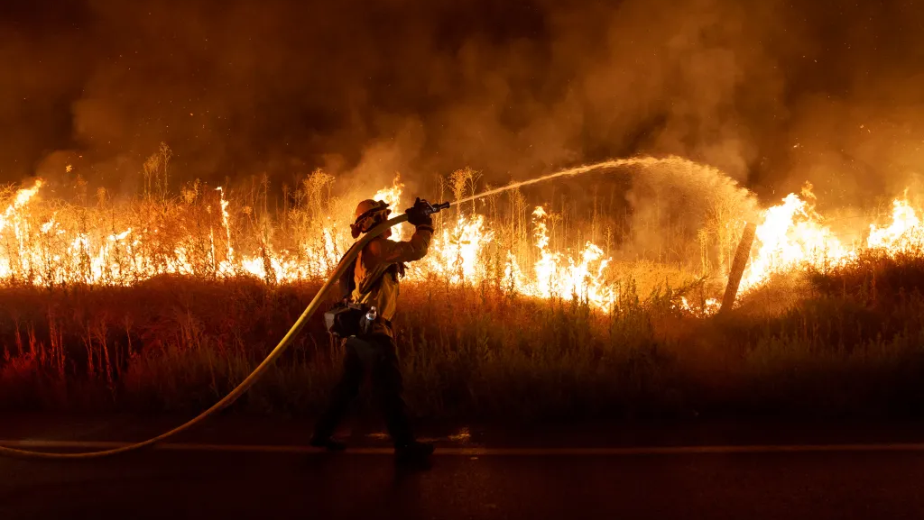
INTRODUCTIONS
Notes:
Presenter: Committee Introductions
Backup Presenter:
Notes:
Last full committee training was around 2017
Audience is encouraged to ask question throughout the presentation and provide feedback

Slide 3
Training Purpose
Provide an overview of the California Fire Assistance Agreement (CFAA).
Review the reimbursement rates, formulas, and methodologies of the Agreement.
Notes:
Presenter: Cal OES (Lori) / USFS (Jamie) / LG Representative
Backup Presenter:

Slide 4
Training Agenda
Agreement Introduction
Recitals
Exhibits
Salary Survey
Administrative Rate
Additional Information
Questions
Notes:
Presenter: Cal OES (Lori) / USFS (Jamie) / LG Representative
Backup Presenter:

Slide 5
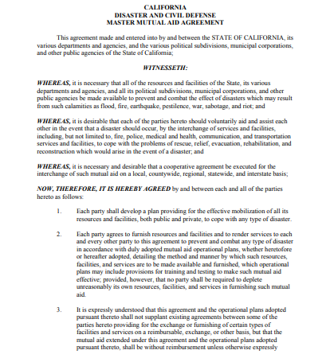
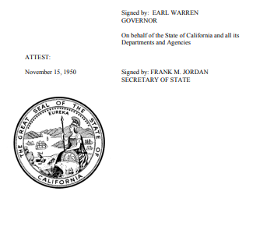
Master Mutual Aid Agreement
Notes:
Presenter: Cal OES (Lori) / USFS (Jamie) / LG Representative
Backup Presenter:
Notes:
State of CA is Cal OES
Various Mutual Aid Agreements: Voluntary, Obligatory
Political Subdivision
Cal OES provide for systematic mobilization, organization, and operation of necessary fire and rescue resources.
Cal OES ensure that all parties understand and comply with the terms and conditions of the Agreement.

Slide 6
Master Mutual Aid Agreement
Enacted in the 1950’s for the purposes of providing mutual aid amongst two or more parties who voluntarily agree to furnish resources and facilities and to render services to each party of the Agreement to prevent and combat any type of disaster or emergency.
  This Agreement is between the State of California, its various departments and agencies, and the various political subdivisions, municipal corporations, and other public agencies.
  Sets the foundation for all existing mutual aid agreements.
This is the legal means to how you are accessed through the California Fire and Rescue Mutual Aid System established in the 1970’s.
NOTE: In 2021, federally recognized Indian tribes of California were codified in statute to contribute as part of the state’s emergency response infrastructure.
Notes:
Presenter: Cal OES (Lori) / USFS (Jamie) / LG Representative
Backup Presenter:
Notes:
State of CA is Cal OES
Various Mutual Aid Agreements: Voluntary, Obligatory
Political Subdivision
Cal OES provide for systematic mobilization, organization, and operation of necessary fire and rescue resources.
Cal OES ensure that all parties understand and comply with the terms and conditions of the Agreement.

Slide 7
Cal OES Responsibility
California's emergency assistance is based on a statewide mutual aid system designed to ensure additional resources are provided to the state’s political subdivisions whenever their own resources are overwhelmed or inadequate. The basis for this system is the California Disaster and Civil Defense Master Mutual Aid Agreement (MMAA).
Notes:
Presenter: Cal OES (Lori) / USFS (Jamie) / LG Representative
Backup Presenter:

Slide 8
Agreement Background
Established in the 1970’s as the “3 Party Agreement” for the use of the first 100 OES engine.
  The Initial Agreement was Between:
    USFS
    Cal OES
    CDF
  Subsequent Years Added:
    BLM
    NPS
    BIA
    FWS
    In 2002, the name was officially changed from the “5 Party Agreement” to the California Fire Assistance Agreement.
    In 2009, the Agreement officially became use for all hazard responses.
Notes:
Presenter: Cal OES (Lori) / USFS (Jamie) / LG Representative
Backup Presenter:
Notes:
1970-2008 – used for Wildland Fire Suppression primarily
2009 – updated agreement for the formal use of all hazard

Slide 9

The CFAA Committee
The Committee includes representatives from Cal OES, CAL FIRE, the Federal Fire Agencies, and three advisory representatives from local government fire agencies in California: one from Northern California, one from Southern California, and one representing volunteer fire departments. The local government agency representatives shall be appointed by the Chairperson of the State of California Fire and Rescue Advisory Committee/FIRESCOPE, Board of Directors.
Notes:
Presenter: Cal OES (Lori) / USFS (Jamie) / LG Representative
Backup Presenter:

Slide 10







Signatory Agencies
Governor’s Office of Emergency Services (Cal OES)
Department of Forestry and Fire Protection (CAL FIRE)
USDA Forest Service (USFS)
USDI Bureau of Land Management (BLM)
USDI National Park Service (NPS)
UDSI Fish and Wildlife Service (FWS)
USDI Bureau of Indian Affairs (BIA)
Notes:
Presenter: Cal OES (Lori) / USFS (Jamie) / LG Representative
Backup Presenter:
Notes:
Department of Defense is not signatory to the agreement.

Slide 11
CFAA Chair and Local Government Representatives
The CFAA Chair:
Lori Lopez
Deputy Chief of Administration, Cal OES
(916) 845-8722
Lori.Lopez@CalOES.ca.gov
The three local government representatives:
Local government is not signatory to the Agreement but follows the terms.
Jeffery Gilbert Fire Chief, Williams FPA (530) 681-5390 C300@williamsfire.net | Mark Lorenzen Fire Chief, Menlo Park FPD (805) 469-3170 mlorenzen@menlofire.org | Kyle Heggstrom Fire Chief, Linda FPD (530) 743-1553 kyleh@lindafire.org
Notes:
Presenter: Cal OES (Lori) / USFS (Jamie) / LG Representative
Backup Presenter:

Slide 12
The Committee Roles and Responsibilities
Meet throughout the year
  Annually to negotiate the exhibits and publish the Rate Letter
  Starting 15 months before the expiration of the Agreement
Dispute Resolution
Examination and Audit
CFAA Reference: Recitals 16, 30, and 32
Notes:
Presenter: Cal OES (Lori) / USFS (Jamie) / LG Representative
Backup Presenter:
Composition:
Cal OES, CAL FIRE, USFS, BLM, NPS, BIA, FWS
One Southern California
One Northern California
One volunteer
Meetings:
Begin meeting fifteen (15) months before the expiration date of the CFAA.
Produce a final document for signatures no later than six (6) months before the expiration.
No later than March 30th of each year, recommend amendments to the incorporated exhibits.
Dispute Resolution:
When issues arise, the CFAA Chair and committee are responsible for executing the dispute resolution process which involves the filing of a formal complaint, meeting with the affected party, and providing a formal response.
Examination and Audit:
All source documentation related to rates and methodologies must be kept for five (5) years after the final payment.

Slide 13
Agreement Intent
The CFAA allows signatory state and federal agencies to access local government resources once local agreement resources are exhausted, or where a local agreement is not in place.
It is the intent of the signatories to the CFAA to reimburse California Fire and Rescue Mutual Aid System Agencies for the cost of assisting the State of California and the Federal Fire Agencies.
The rates, methodologies, and formulas in the Agreement are intended to provide for reimbursement of costs within the parameters of the Agreement.
Notes:
Presenter: Cal OES (Lori) / USFS (Jamie) / LG Representative
Backup Presenter:
Intent is to be made whole over the year.
MMA, not always going to get reimbursed. Here to help each other.

Slide 14
The Agreement
The Agreement is a 5-year term with yearly negotiations to update the exhibits.
The current Agreement commenced on May 1, 2020, and was set to expire on December 31, 2024.
An extension is in place through November 30, 2025.
Actively developing an additional extension through October 30, 2026.
Notes:
Presenter: Cal OES (Lori) / USFS (Jamie) / LG Representative
Backup Presenter:

Slide 15
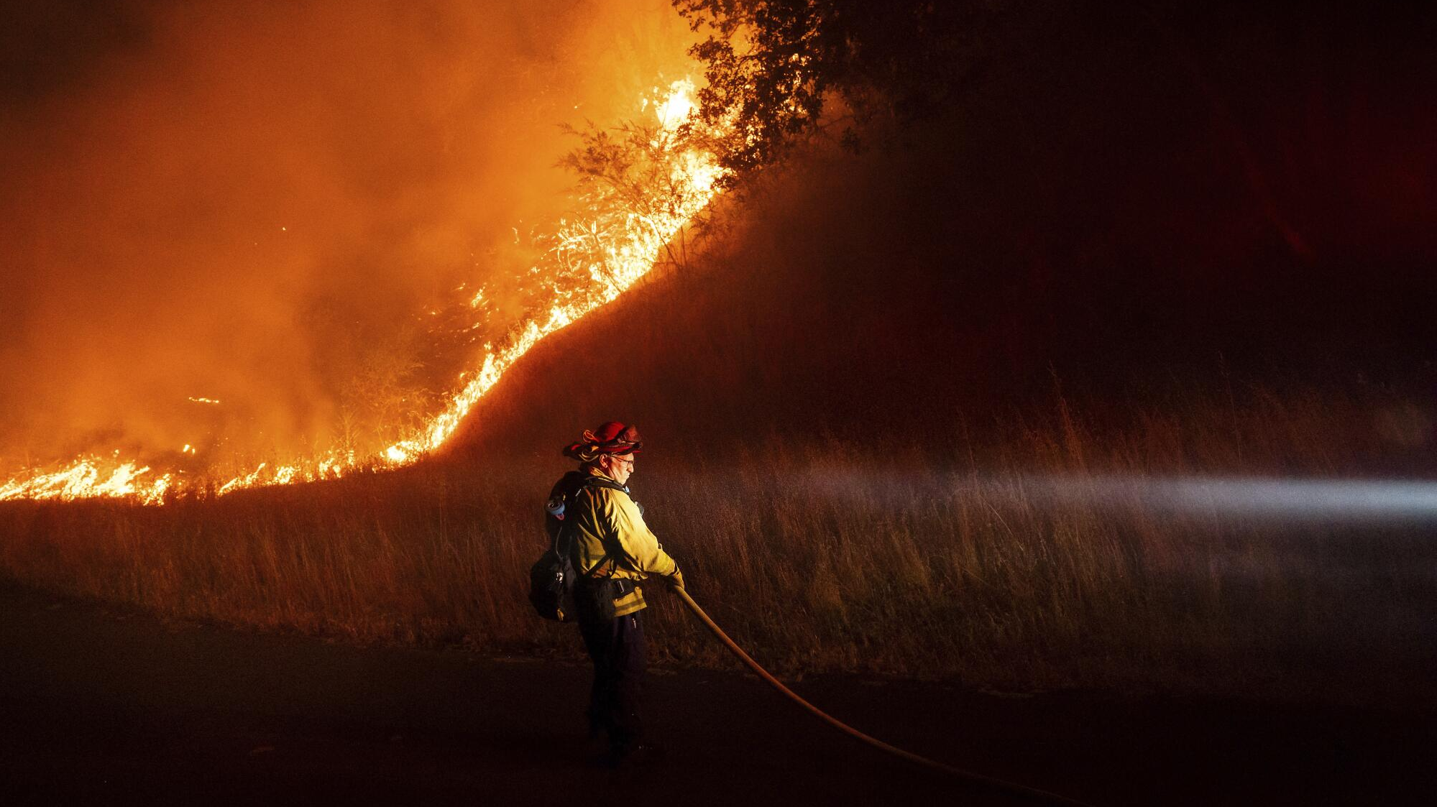
RECITALS
Notes:
Presenter: Cal OES (Lori) / USFS (Jamie) / LG Representative
Backup Presenter:

Slide 16
Resources
All signatory agencies utilize the Agreement for engines, water tenders, bulldozers, hand crews, and overhead.
Cal OES and the Federal Fire Agencies utilize the Agreement to order aviation resources.
Cal OES utilizes the Agreement to mobilize all-hazard resources.
CFAA Reference: Recitals 9 through 11
Notes:
Presenter: Cal OES (Lori) / USFS (Jamie) / LG Representative
Backup Presenter:
Notes:
CAL FIRE does not participate in the use of aviation through the CFAA.

Slide 17
MMA Orders Invoking CFAA
A local agency may utilize this Agreement as the fiscal authority for reimbursing other local agencies following the terms and conditions of the CFAA.
CFAA Reference: Recital 14
Notes:
Presenter: Cal OES (Lori) / USFS (Jamie) / LG Representative
Backup Presenter:
Notes:

Slide 18
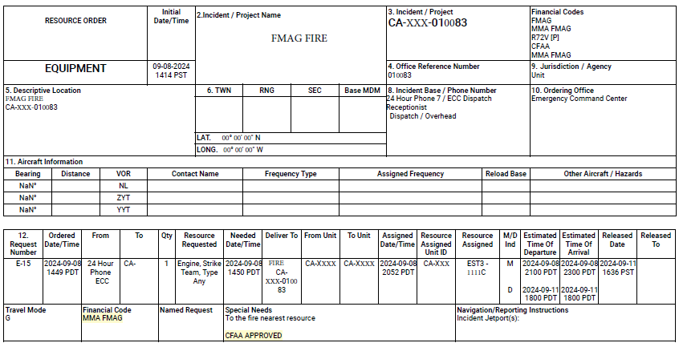
MMA Orders Invoking CFAA
Notes:
Presenter: Cal OES (Lori) / USFS (Jamie) / LG Representative
Backup Presenter:
Notes:

Slide 19
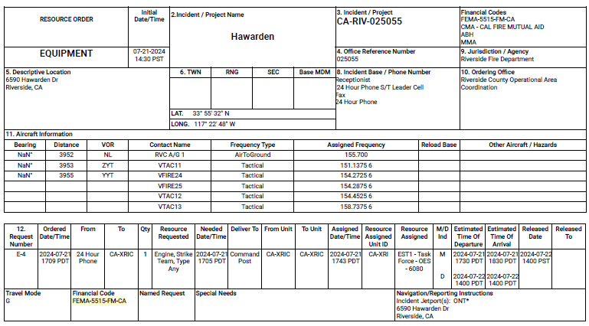
MMA Orders Invoking CFAA
Notes:
Presenter: Cal OES (Lori) / USFS (Jamie) / LG Representative
Backup Presenter:
Notes:

Slide 20
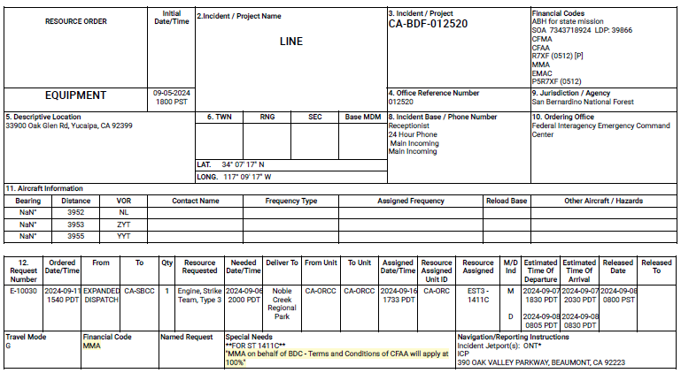
MMA Orders Invoking CFAA
Notes:
Presenter: Cal OES (Lori) / USFS (Jamie) / LG Representative
Backup Presenter:
Notes:

Slide 21
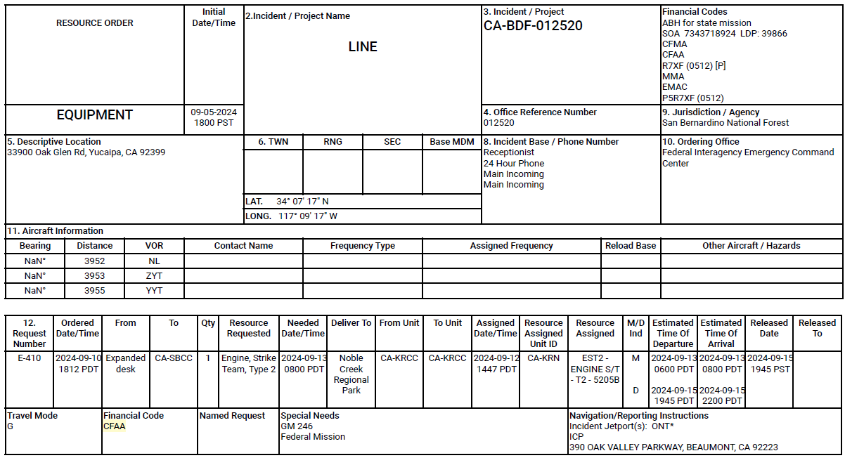
CFAA Order
Notes:
Presenter: Cal OES (Lori) / USFS (Jamie) / LG Representative
Backup Presenter:
Notes:

Slide 22
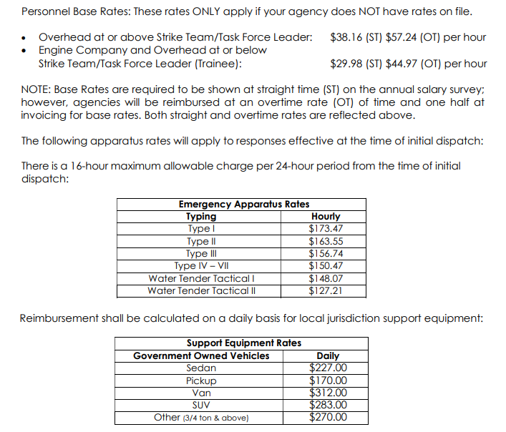
Rate Letter
The current Rate Letter is effective as of May 1, 2025.
  The Rate Letter contains:
  Personnel Base Rates
  Emergency Apparatus Rates
  Support Equipment Rates
  POV Rate
  Rental Vehicle Rates
  Lodging Rate
  Meal and Incidental Rates
  De minimis Administrative Rate
CFAA Reference: Recital 16
Notes:
Presenter: Cal OES (Lori) / USFS (Jamie) / LG Representative
Backup Presenter:

Slide 23
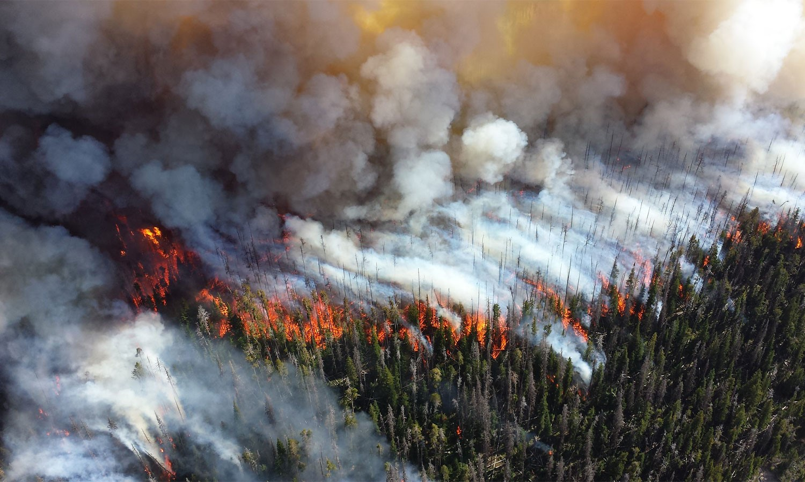
EXHIBIT A
Notes:
Presenter: BLM (Vanessa) / Cal OES (Auburn or Sage) / USFS (Allison) / CALFIRE (?) or LG Representative
Backup Presenter:

Slide 24
Free Period
There is no reimbursement for responses that do not exceed the specified free period.
  On State or USFS incidents, any responses of 12 hours duration or less.
  On Department of Interior (DOI) fire agencies (BLM, NPS, FWS, and BIA) incidents, any responses of 4 hours duration or less.
  Bulldozers and hand crews, any responses of 2 hours duration or less.
  Aviation resources are not subject to a free period and will be reimbursed from the time of dispatch.
Free periods are cumulative, responding personnel and/or emergency apparatus shall only be subject to one free period from the original time of dispatch, regardless of the number of re-assignments that may occur.
After the free period is completed, reimbursement will begin at the time of the CFAA order.
CFAA Reference: Clauses A-5 and A-6
Notes:
Presenter: BLM (Vanessa) / Cal OES (Auburn or Sage) / CALFIRE (?) or LG Representative
Backup Presenter:
Notes:
Resources originally ordered under MMA and then converted to CFAA on the same incident, will have their MMA time applied to the free period but not for reimbursement.
There is no free period for OES Prepositions, any time within the incident period established on the approval form is reimbursable.

Slide 25
Labor Agreements (MOU/MOA, GBR)
Any agency seeking reimbursement for portal-to-portal or overtime above the Battalion Chief level must have on file in MARS an MOU/MOA, GBR, or equivalent.
Agreements must not be contingent on the CFAA or executed on the sole basis that there is reimbursement from Cal OES, CAL FIRE, or the Federal Fire Agencies.
Personnel must be physically present on the incident in order to receive portal-to-portal compensation, unless documented and approved by the paying agency.
CFAA Reference: Clauses A-5 and A-9
Notes:
Presenter: BLM (Vanessa) / Cal OES (Auburn or Sage) / CALFIRE (?) or LG Representative
Backup Presenter:
Note:
Examples of contingent language include “when performing work outside the district”, “at the time of reimbursement to the city”, and “for mutual aid assignments under the CFAA”.
Approval for portal-to-portal on a virtual assignment needs to come from a level higher than the incident management team. Position differs by signatory agency.
When required to submit actual hours in box 13 of the F-42, submitting 24-hours a day (unless 24 on and 24 off) is not acceptable. Agencies will be required to provide true hours actually worked excluding time spent sleeping.

Slide 26
Labor Agreement Examples
Example #1 of Contingent Language:
Example #2 of Contingent Language:
Acceptable Language:
Whereas, the board of directors voted to designate that firefighters are paid portal to portal for mutual aid incidents under the California Fire Assistance Agreement (CFAA).
In the event the Fire Chief is assigned to serve with either the California Department of Forestry and Fire Protection, and United States Forest Service, or the California Governors’ Office of Emergency Services on Mutual Aid Assignments, employees shall be compensation by the contracting agency, portal to portal. The response costs that are reimbursed will provide employee compensation, at the time of reimbursement to the City.
WHEREAS, the City will compensate its employees’ overtime in accordance with their current Memorandum of Understating while in the course of their employment and away from their official duty station and assigned to an emergency incident, in support of an emergency incident, or pre-positioned for emergency response.
Notes:
Presenter: BLM (Vanessa) / Cal OES (Auburn or Sage) / CALFIRE (?) or LG Representative
Backup Presenter:
Note:
Examples of contingent language include “when performing work outside the district”, “at the time of reimbursement to the city”, and “for mutual aid assignments under the CFAA”.
Approval for portal-to-portal on a virtual assignment needs to come from a level higher than the incident management team. Position differs by signatory agency.
When required to submit actual hours in box 13 of the F-42, submitting 24-hours a day (unless 24 on and 24 off) is not acceptable. Agencies will be required to provide true hours actually worked excluding time spent sleeping.

Slide 27
CIIMT Participation
Those who apply for participation on a Federal California Interagency Incident Management Team (CIIMT), must be employed with a federal, state, or local agency in a full time, seasonal, part-time, or retired-annuitant position for a purpose other than participation on a CIIMT.
The California Wildland Fire Coordinating Group (CWCG) coordinates the application and selection process for IMT rosters and may request proof of employment documentation as part of that process.
Applicants who do not meet the criteria can apply under the casual hiring authority as outlined in the Standards for Interagency Incident Business Management.
CFAA Reference: Clause A-17
Notes:
Presenter: BLM (Vanessa) / Cal OES (Auburn or Sage) / CALFIRE (?) or LG Representative
Backup Presenter:
Notes:
CWCG is likely going to update the application process to require employment documentation when applying for CIIMT and CIBC representatives to review.

Slide 28
Engine and Water Tender Standards
Engine company reimbursement will be based on the actual classifications responding, not to exceed one (1) Company Officer, one (1) Apparatus Operator, and one (1) or two (2) Firefighters.
  Engine company staffing shall not be less than three (3) or a reimbursable maximum of four (4).
Tactical water tender staffing shall be reimbursed based upon the actual classifications responding, not to exceed two (2) Apparatus Operators or one (1) Company Officer and one (1) Firefighter.
Due to the short-term staffing crisis caused by multiple factors including COVID, exceptions to staffing will be on a case-by-case basis and approved by the ordering incident, documented in the resource ordering system of record, or documented on a General Message Form ICS-213 by the Incident Commander (IC), Finance Section Chief (FSC), Incident Business Advisor (IBA), or Agency Administrator (AA).
CFAA Reference: Clauses A-6 and A-18
Notes:
Presenter: BLM (Vanessa) / Cal OES (Auburn or Sage) / CALFIRE (?) or LG Representative
Backup Presenter:
Notes:
Need to explain what vehicle module composition means. (Is this 5 vehicles that transport people? Or 5 vehicles with a motor and wheels (such as ATV)?)

Slide 29
Hand Crew Standards
Hand crew makeup will consist of a minimum of 10 and a maximum of 25 crew members including one qualified crew boss. Vehicle module composition will not exceed 5.
Responses of 2 hours duration or less will not be reimbursable.
CFAA Reference: A-18
Notes:
Presenter: BLM (Vanessa) / Cal OES (Auburn or Sage) / CALFIRE (?) or LG Representative
Backup Presenter:
Notes:
Need to explain what vehicle module composition means. (Is this 5 vehicles that transport people? Or 5 vehicles with a motor and wheels (such as ATV)?)

Slide 30
Strike Team/Task Force Leader Trainee
A strike team/task force may, at the discretion of the local jurisdiction, include a Strike Team/Task Force Leader Trainee as a reimbursable member of the unit.
The trainee may provide the vehicle for the assignment, but no more than one vehicle will be reimbursed.
CFAA Reference: Clause A-19
Notes:
Presenter: CALFIRE (?) or LG Representative (Kyle)
Backup Presenter: BLM (Vanessa) / Cal OES (Auburn or Sage)

Slide 31
Emergency Apparatus
All equipment will be reimbursed in accordance with the FEMA Schedule of Equipment Rates which become effective once reviewed and approved by the Committee.
If a FEMA equipment rate is not identified for the type of equipment being used, a rate may be developed using the FEMA Equipment Rate Formula in Exhibit “F”.
Equipment rates are based on a 16-hour maximum allowable charge, per 24-hour period.
If appropriate, reimbursement for emergency apparatus refurbishment and rehabilitation may be approved up to a maximum of 2 hours.
CFAA Reference: Clauses A-17 through A-29
Notes:
Presenter: CALFIRE (?) or LG Representative (Kyle)
Backup Presenter: BLM (Vanessa) / Cal OES (Auburn or Sage) / USFS (Allison) /
Notes:
The appropriate FEMA rates are loaded into MARS for ease.
16-Hour Rule:
Equipment hours are calculated on a 24-hours basis starting at the time of commitment. If the equipment started at 8am, the clock does not reset until 8am on the following day as some agencies have been under the impression the clock resets at midnight and are being shorted hours.
There are 8 hours in a 24-hour period that you are not compensated when the equipment is not running, and the crew is off shift.
Rehabilitation:
These hours are intended for apparatus and equipment.

Slide 32
Support Equipment and POV
Agency owned support vehicles are reimbursed on a calendar day basis at the rate established by the Committee and published on the Rate Letter for the type or category of vehicle used.
Privately-owned vehicle rates will be reimbursed on a per mile basis according to the Internal Revenue Service (IRS) standard rate published in the Rate Letter.
CFAA Reference: Clauses A-30 through A-32
Notes:
Presenter: BLM (Vanessa) / Cal OES (Auburn or Sage) / USFS (Allison) /CALFIRE (?) or LG Representative
Backup Presenter:
Notes:
Support vehicle rates are a blend of rates from the FEMA Schedule of Equipment and daily short-term rental rates.
Support vehicles are billed on a calendar day basis.

Slide 33
Rental Vehicles
The use and reimbursement of rental vehicles must be approved on the resource order or documented by written approval at the incident.
Fuel expense while responding to, during, or returning from an incident will be reimbursed for the actual costs incurred.
Reimbursement for mileage or other transportation to and from rental agency will be allowed.
The full process for obtaining reimbursement for rental vehicle expenses is outlined in Exhibit “H”.
CFAA Reference: Clauses A-30 through A-32
Notes:
Presenter: BLM (Vanessa) / Cal OES (Auburn or Sage) / USFS (Allison) CALFIRE (?) or LG Representative
Backup Presenter:
Notes:
Each agency is responsible for becoming familiar with the full process for rental vehicles outlined in exhibit H.

Slide 34
Vehicle Operational Costs
Agencies shall assume operational costs, including necessary motor fuels and lubricants used in its emergency apparatus, support equipment, and POVs while responding from their home base and returning to their home base from the incident.
Once at the incident and until released or reassigned, the ordering agencies will provide for motor fuel and lubricants, normal servicing costs, and minor repairs incidental to operation of emergency apparatus including agency support equipment and POVs.
  Fuel between incidents is reimbursable.
CFAA Reference: Clauses A-28 and A-29
Notes:
Presenter: BLM (Vanessa) / Cal OES (Auburn or Sage) / USFS (Allison) CALFIRE (?) or LG Representative
Backup Presenter:
Notes:
Rental vehicles are the only exception, they are automatically approved for fuel.
Fuel to and from is the responsibility of the responding agency because the reimbursement rates are wet rates.
Fuel in between incidents is reimbursable however resources are expected to fuel up prior to leaving one incident to travel to another.

Slide 35
Off-Shift Rest
When practical, sanitary, shaded, and/or climatically maintained accommodations for off-shift sleeping, rest, and recuperation will be provided.
If the incident command finds it operationally feasible to place local jurisdiction resources in a commercial sleeping accommodation, it may be provided.
CFAA Reference: Clause A-38
Notes:
Presenter: BLM (Vanessa) / Cal OES (Auburn or Sage) / USFS (Allison) CALFIRE (?) or LG Representative
Backup Presenter:

Slide 36
DOD and Tribal
Reimbursement of Tribal Fire Departments that respond to a Federal Fire Agencies order and request through this Agreement and have a current Cooperative Agreement with BIA will be in accordance with the CFAA reimbursement provisions.
Federal Fire Agencies will not reimburse Federal Fire Departments and DOD under this Agreement.
CFAA Reference: Clause A-51
Notes:
Presenter: BLM (Vanessa) / Cal OES (Auburn or Sage) / USFS (Allison) CALFIRE (?) or LG Representative / BIA (?)
Backup Presenter:

Slide 37
Reimbursement Timeline
Local Government Agency responds to incident under the California Fire Assistance Agreement
Incident Demob – Local Government submits F-42s within 30 days to Cal OES Fire
Cal OES Fire has 60 business days to process F-42s into invoices & mail to Local Government for review and signature
Local Government has 30 business days to review, sign, and return invoices to Cal OES
Cal OES has 30 business days to re-review invoice for accuracy and submit to paying entity (CAL FIRE, USFS, NPS, BLM, FWS)
Paying Entity has 60 business days to process reimbursement back to responding Local Government Agency
Direct Deposit / Check Directly from Paying Entity
30 Days
Local Government
60 Days
Cal OES
30 Days
Local Government
30 Days
Cal OES
60 Days
Paying Entity (CAL FIRE, USFS, NPS, BLM, FWS)
TOTAL Maximum days allowed per the CFAA = 210 days
CFAA Reference: Clauses A-41 through A-46
Notes:
Presenter: BLM (Vanessa) / Cal OES (Auburn or Sage) / USFS (Allison) CALFIRE (?) or LG Representative / BIA (?)
Backup Presenter:
Notes:
Our goal is that MARS will reduce the overall timeline of reimbursement however there is a transition period.
There are certain reimbursement that do not follow this timeline. Primarily, those that will be paid entities that are not signatory to the CFAA such as payments related to a federal or state declaration or other agreements (EMAC).

Slide 38
Payment Requirements
Federal Payment Requirements:
Each agency must have Unique Entity Identifier (UEI) obtained through SAM.gov and has to be updated every year and payment cannot be processed until that registration is active.
  For Unique Entity Identifier (UEI) assistance, call (866) 606-8220 or visit https://www.fsd.gov/gsafsd_sp.
  Contact the SAM Assistance Center at (866) 606-8220.
State Payment Requirements:
Each agency must have a FI$Cal Supplier I.D.
  For assistance call (855) 421-6355 ext. 1 or email vendors@fiscal.ca.gov.
CFAA Reference: Clauses A-28 and A-29
Notes:
Presenter: BLM (Vanessa) / Cal OES (Auburn or Sage) / USFS (Allison) / CALFIRE (Jennifer) or LG Representative / BIA (?)
Backup Presenter:
Notes:
All identification numbers must be updated in MARS.
Electronic transfer payments will go to the bank account registered at SAM.gov.
Name needs to match with FI$Cal since that is who payment is made out to.
Contact Cal OES for assistance with obtaining or updating a Supplier ID.

Slide 39
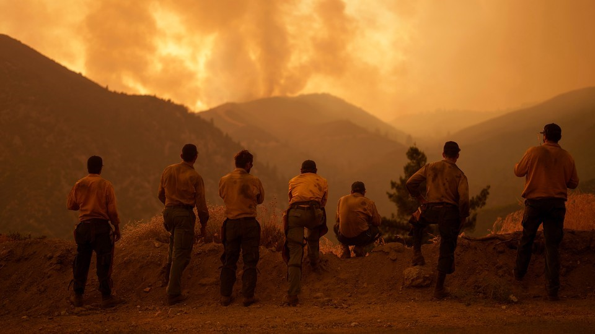
EXHIBIT B
Notes:
Presenter: LG Representative (Kyle) /CAL FIRE (Bryan) / USFS (Jaime)
Backup Presenter:

Slide 40
Engine and Water Tender Standards
Engine and Water Tender Standards Type 3-7:
1. Short wheelbase
2. High ground clearance
3. High angle of approach and departure
4. Lower Gross Vehicle Weight (GVW) than Type 1 or 2 engine
5. Unit number on roof
CFAA Reference: Clauses B-2 and B-3
Notes:
Presenter: LG Representative (Kyle) /CAL FIRE (Bryan) / USFS (Jaime)
Backup Presenter:
Notes:
Reference FOG

Slide 41
PPE Standards
Each employee responding to or engaging in fire suppression activities will use the appropriate safety clothing and equipment. Each agency is responsible for seeing that Cal OSHA standards for safety clothing and equipment are provided and used for wildland firefighting.
1. Head protection meeting the requirements of CCR, Title 8, Section 3410
2. Eye and face protection meeting the requirements of CCR, Title 8, Sections 3382 and 3404
3. Ear and neck protection meeting the requirements of CCR, Title 8, Sections 3405 and 3410(c)
4. Body protection meeting the requirements of CCR, Title 8, Section 3406(c)
5. Gloves, meeting the requirements of CCR, Title 8, Section 3410
6. Foot protection meeting the requirements of CCR, Title 8, Section 3408
7. Wildland fire shelter meeting Forest Service specification 5100-606
8. Recommended disposable filtering face piece respiratory protection
CFAA Reference: Clause B-4
Notes:
Presenter: LG Representative (Kyle) /CAL FIRE (Bryan) / USFS (Jaime)
Backup Presenter:

Slide 42
Training Standards
All responding personnel shall be in compliance with the current NWCG 310-1 Sub System Guide or CICCS.
Training topics include but are not limited to:
    Wildland Strategy and Tactics Backfiring/Firing-out
    Wildland Fire Behavior Handline Construction
    Wildland Hose Lays Structure Triage
    Wildland Fire Safety Structure Defense Preparation
    Fireground Communications Fire Weather
CFAA Reference: Clause B-5
Notes:
Presenter: LG Representative (Kyle) /CAL FIRE (Bryan) / USFS (Jaime)
Backup Presenter:

Slide 43
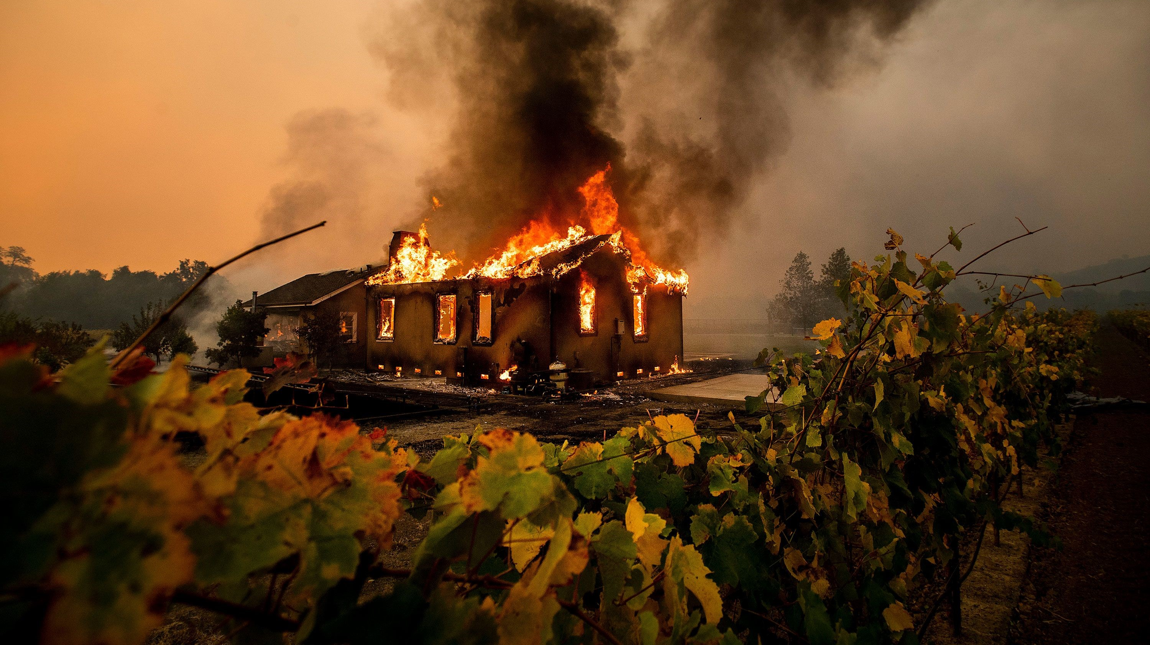
EXHIBIT C
Notes:
Presenter: LG Representative (Kyle) /CAL FIRE (Bryan) / USFS (Jaime)
Backup Presenter:

Slide 44
Approved Personnel Rotations
Personnel under this Agreement are to be available a minimum of seven (7) days excluding travel (portal-to-portal) before needing replacement, regardless of the number of assignments.
If both the emergency apparatus and the personnel need replacement, the resources will be released, and a new resource will be ordered.
An ICS General Message Form-213/Rotation Job Aid Template designed specifically for personnel rotation must be signed by the Incident Commander or MOB Center Manager approving the rotation. The Rotation Job Aid must be uploaded in box 17 of the F-42.
CFAA Reference: Clauses C-1 and C-2
Notes:
Presenter: LG Representative (Kyle) / Cal OES (Auburn)
Backup Presenter:/CAL FIRE (Bryan) / USFS (Jaime)
Notes:
Example of informal crew rotation () that is not reimbursable and is the responsibility of the local jurisdiction.

Slide 45
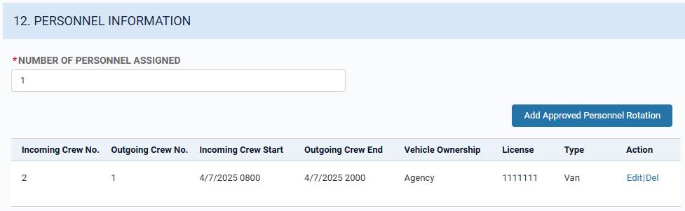
Approved Personnel Rotations
Documentation Requirements – Completed in MARS:
  Method/Mode, date and time of transportation must be documented.
  Box 12 of the OES F-42 will document any personnel rotation with the date and time of the rotation for all individuals whether or not the personnel rotation will be reimbursed.
CFAA Reference: Clauses C-1 and C-2
Notes:
Presenter: LG Representative (Kyle) / Cal OES (Auburn)
Backup Presenter: CAL FIRE (Bryan) / USFS (Jaime)
Notes:
Use Invoices will identify personnel involved in any rotation and will itemize the costs of transportation.
Details of personnel rotation need to be documented (Unit Logs to be retained on file by individual fire agency).
Personnel rotations that are not approved will not be reimbursed for overlap in time or vehicle for exchange.

Slide 46
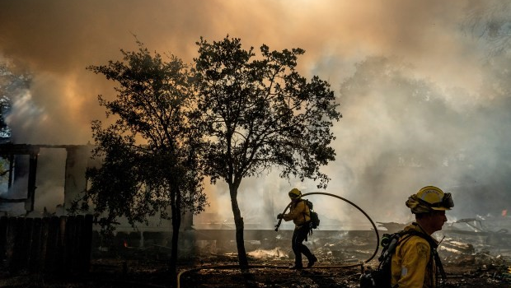
EXHIBIT D
Notes:
Presenter: LG Representative (Kyle) /CAL FIRE (Bryan) / USFS (Jaime)
Backup Presenter:

Slide 47
Communication Capabilities
It shall be the responsibility of the agency sending mutual aid resources to ensure that those resources have adequate communication capabilities.
Effective January 1, 2024, radios will be required to have a minimum capacity of 400 channels with a recommended minimum of 500 channels.
Agencies should provide a minimum of 4 hours of annual basic radio training for Division Supervisors, Strike Team Leaders, and single resource leader positions.
CFAA Reference: Clauses D-1 through D-6
Notes:
Presenter: LG Representative (Kyle) /CAL FIRE (Bryan) / USFS (Jaime)
Backup Presenter:

Slide 48
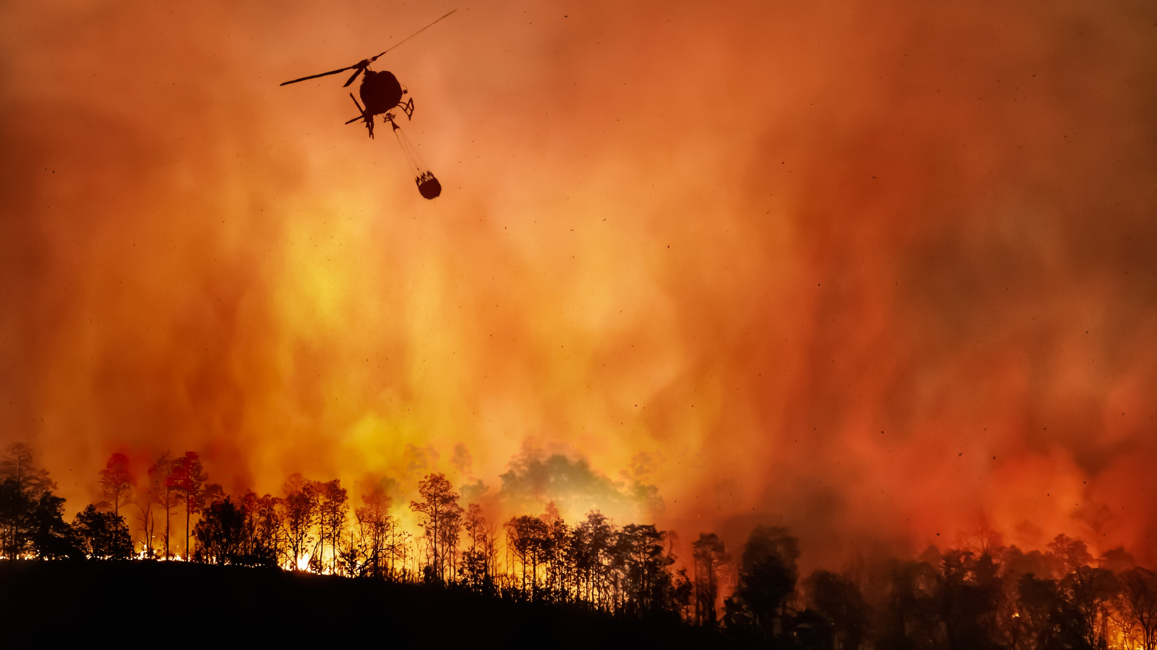
EXHIBIT E
Notes:
Presenter: USFS / Cal OES
Backup Presenter: Diane Sauer

Slide 49
Aviation Use
Cal OES and the Federal Fire Agencies will use the CFAA to order the appropriate aviation resources.
CAL FIRE will not use the CFAA to access aircraft.
There is no free period for the reimbursement of aviation resources, and they will be paid from the time of dispatch.
Notes:
Presenter: USFS (Allison) / Cal OES (Sage)
Backup Presenter: Diane Sauer

Slide 50
Aircraft Equipment Reimbursement
For each day, agencies will receive equipment reimbursement for either the minimum daily of 4 hours or the Hobbs meter (flight) time, whichever is greater.
If the time assigned is less than 4 hours the agency will only receive equipment reimbursement based upon the time assigned to the incident for that day.
Minimum daily hours for Federal Fire Agency requests are based upon a calendar day.
Minimum daily hours for Cal OES approved prepositions are based upon a 24-hour period beginning at the time of initial dispatch.
CFAA Reference: Clause E-6
Notes:
Presenter: USFS (Allison) / Cal OES (Sage)
Backup Presenter: Diane Sauer
Notes:
Agencies need to track Hobbs Meter hours based on the timeframes requested on the F-42. These will differ between a federal assignment and a Cal OES assignment.

Slide 51
Aircraft Equipment Reimbursement
Federal Example
Start Date | Start Time | End Date | End Time | Flight Hours | Reimbursable Hours
4/21/2025 | 08:00 | 4/21/2025 | 23:59 | 2 | 4
4/22/2025 | 00:00 | 4/22/2025 | 23:59 | 5 | 5
4/23/2025 | 00:00 | 4/23/2025 | 10:00 | 0 | 4
TOTAL |  |  |  | 7 | 13
Cal OES Example
Start Date | Start Time | End Date | End Time | Flight Hours | Reimbursable Hours
4/21/2025 | 08:00 | 4/22/2025 | 07:59 | 2 | 4
4/22/2025 | 08:00 | 4/23/2025 | 07:59 | 5 | 5
4/23/2025 | 08:00 | 4/23/2025 | 10:00 | 0 | 2
TOTAL |  |  |  | 7 | 11
CFAA Reference: Clause E-6
Notes:
Presenter: USFS (Allison) / Cal OES (Sage)
Backup Presenter: Diane Sauer
Notes:
Agencies need to track Hobbs Meter hours based on the timeframes requested on the F-42. These will differ between a federal assignment and a Cal OES assignment.

Slide 52
Aviation Equipment Rates
Agencies will develop aviation equipment rates in accordance with their own internal business practices. Rate must be submitted in MARS to Cal OES before reimbursement is made.
The pilot rate will be included in the equipment rate. The calculation for the pilot rate will include the annual salary and benefit costs for all agency pilots divided by total flight hours for all agency aircraft.
Federal Excess Property (FEP) equipment should be identified separately excluding any purchase or replacement costs for the aircraft rate.
CFAA Reference: Clauses E-4 and E-5
Notes:
Presenter: USFS (Allison) / Cal OES (Sage)
Backup Presenter: Diane Sauer
Notes:
Salary rates for all aviation personnel (other than pilot) will be calculated in accordance with the standard CFAA methodology and submitted via the salary survey.
The methodology of including the pilot in the equipment rate will be in lieu of backfill costs.
Intent was that only the pilot should be included in the equipment rate. The mechanic and crew chief should be separate.

Slide 53
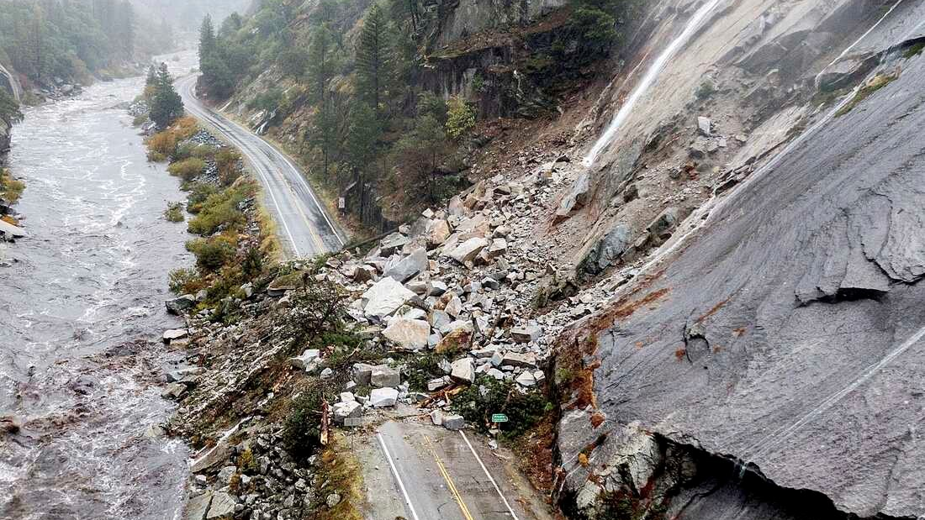
EXHIBIT F
Notes:
Presenter: Cal OES (Sage)
Backup Presenter:

Slide 54
Equipment Rate Formula
The formula should be used when an equipment rate is not identified on the FEMA Schedule of Equipment Rates listing.
Hourly Rate = Depreciation + Overhead + Overhaul Labor + Overhaul Parts + Field Labor + Field Parts + Fuel + Lube + Tires
Agency specific rates need to be submitted in MARS prior to dispatch.
Notes:
Presenter: Cal OES (Sage)
Backup Presenter:
Notes:
Examples are heavy rescue and UTVs.
Agency specific special equipment rates must be on file prior to dispatch.
FEMA rates do not need to be submitted.

Slide 55
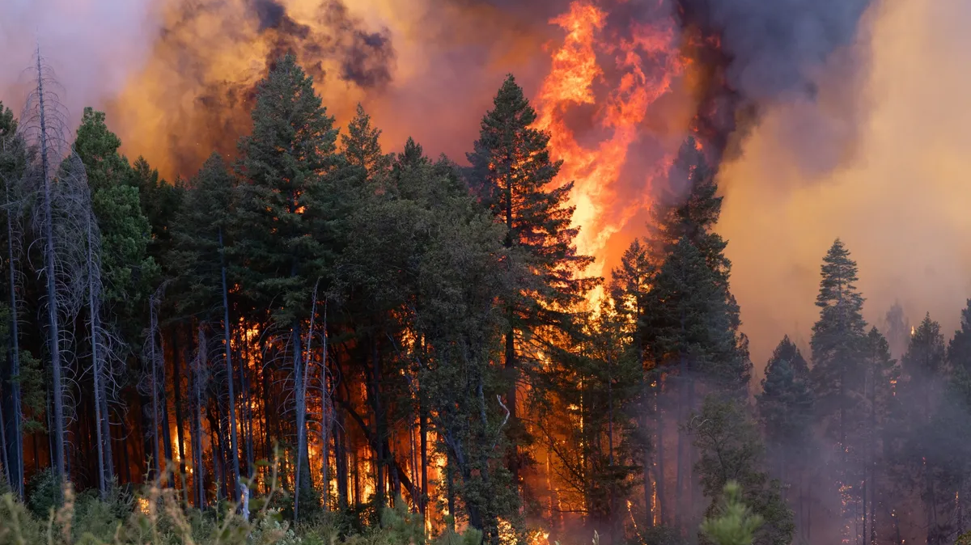
EXHIBIT G
Notes:
Presenter: USFS (Allison)
Backup Presenter:

Slide 56
Out of State
Travel costs for lodging, per diem, and rental vehicles for personnel shall be reimbursed at the travel rates specified in the Rate Letter.
Agencies may seek approval for the reimbursement of operational costs, including necessary motor fuels and lubricants used in its emergency apparatus while responding from their home base and returning to their home base from the incident.
Standard assignment length is fourteen (14) days, exclusive of travel from and to the home unit. Time spent in staging and preposition status counts toward the 14-day limit, regardless of pay status, for all personnel, including Incident Management Teams.
CFAA Reference: Clauses G-1 and G-2
Notes:
Presenter: USFS (Allison)
Backup Presenter:
Notes:
*Any exceptions to this Exhibit need prior approval by USDA Forest Service Region 5 Fire and Aviation Management Director and/or Deputy Director*
Air travel (what documentation is required for air travel/baggage fees?)
Those responding out of state need to tie in with Finance when they arrive on scene to set up Authorized Incident Personnel MARS account.

Slide 57
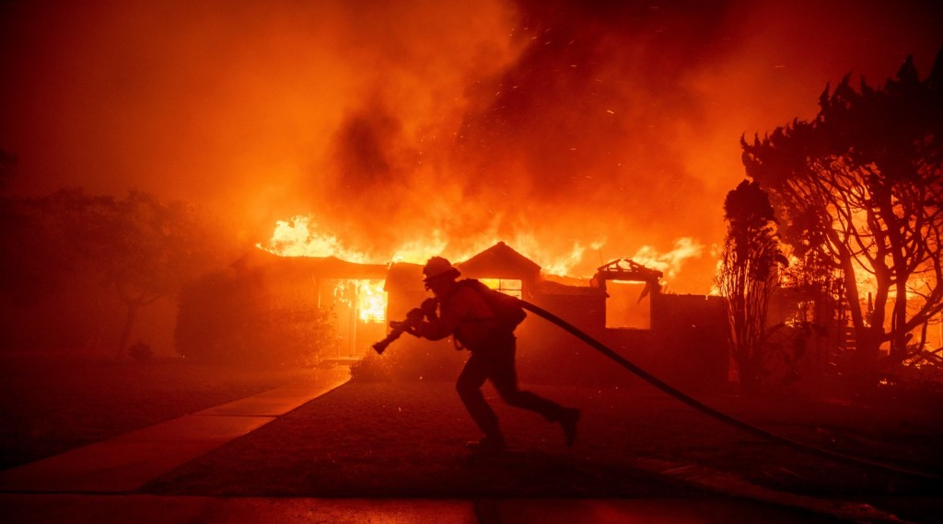
EXHIBIT H
Notes:
Presenter: USFS (Allison) / Cal OES (Auburn or Sage)
Backup Presenter:

Slide 58
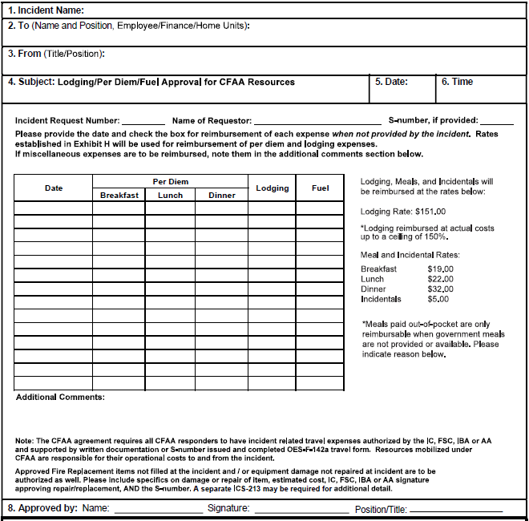
Incident Related Expense Approval
To be eligible for reimbursement of expenses related to incident related expenses, the approval MUST be formally documented in writing using a General Message Form ICS-213 and/or provide the associated S# validating the expense(s) on both the General Message Form ICS-213 and the OES F-42.
The USDA Forest Service will determine if a General Message ICS-213 or an S# is required (this will also be documented in the resource order).
CFAA Reference: Clause H-2
Notes:
Presenter: USFS (Allison) / Cal OES (Auburn or Sage)
Backup Presenter:
Notes:
Fuel to and from is the responsibility of the local agency.

Slide 59
Incident Related Expense Approval
When the General Message Form ICS-213 is used, it must be signed by one of these four positions: Incident Commander, Finance Section Chief, Incident Business Advisor, or Agency Administrator.
S#’s and approved General Message Form ICS-213’s should ONLY be issued when the incident cannot accommodate the expense in need, and all other options to provide the expense(s) have been exhausted.
CFAA Reference: Clause H-2
Notes:
Presenter: USFS (Allison) / Cal OES (Auburn or Sage)
Backup Presenter:
Notes:
Explain when expenses are authorized on ICS-213 there should be a justification such as no fuel tender available until a certain date.

Slide 60
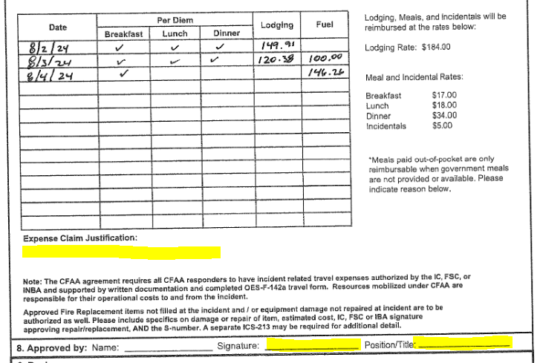
Incident Related Expense Approval
Example of Incorrect ICS-213:
Missing justification to explain the need for incidentals.
Missing the appropriate signature.
Notes:
Presenter: USFS (Allison) / Cal OES (Auburn or Sage)
Backup Presenter:

Slide 61
Loss or Damage Approval
To be eligible for reimbursement of expenses related to loss or damage, the approval MUST be formally documented in writing using a General Message Form ICS-213 AND provide the associated S# validating the expense(s) on both the General Message Form ICS-213 and the OES F-42.
CFAA Reference: Clause H-2
Notes:
Presenter: USFS (Allison) / Cal OES (Auburn or Sage)
Backup Presenter:

Slide 62
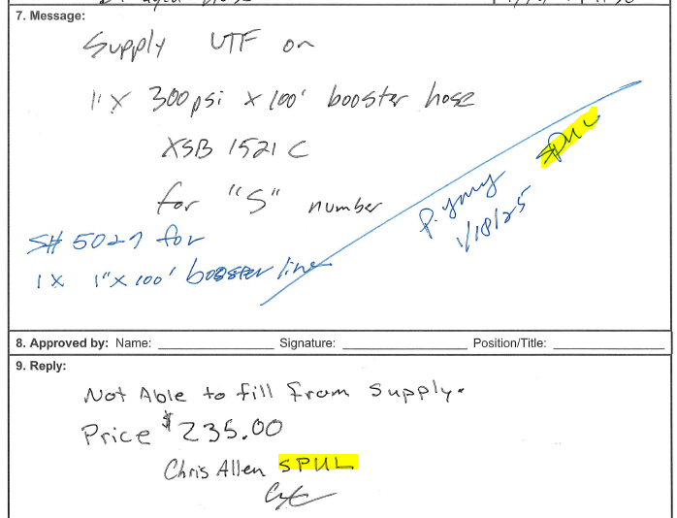
Incident Related Expense Approval
Example of Incorrect ICS-213:
Missing a signature from the Incident Commander, Finance Section Chief, Incident Business Advisor, or Agency Administrator.
Notes:
Presenter: USFS (Allison) / Cal OES (Auburn or Sage)
Backup Presenter:

Slide 63
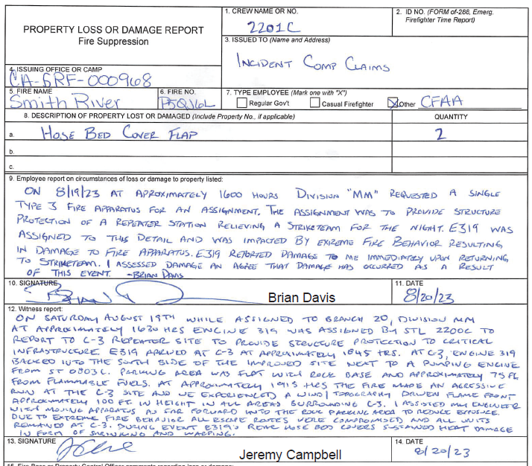
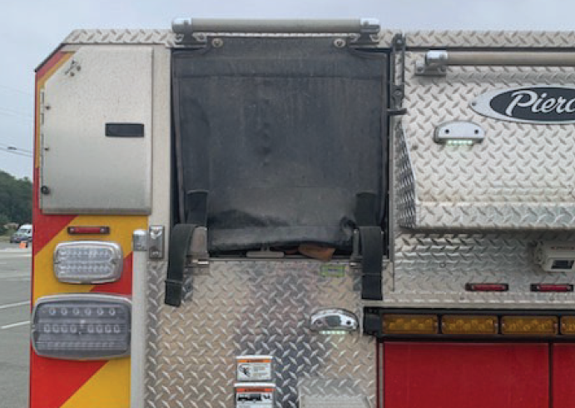
Incident Related Expense Approval
Example of Correct Damage Claim:
Provided approved explanation of being attributable to the incident.
Provided pictures of damage.
Notes:
Presenter: USFS (Allison) / Cal OES (Auburn or Sage)
Backup Presenter:

Slide 64
Meals and Incidentals
Meals and incidentals will be reimbursed using the rates published in the Rate Letter.
Meals and incidentals not provided by the incident on the first and last days of travel while responding from home base and returning to home base are reimbursable without approval.
While assigned to an incident, excluding first and last travel days, meals not provided by the incident will be reimbursable with approval documentation.
CFAA Reference: Clause H-3
Notes:
Presenter: USFS (Allison) / Cal OES (Auburn or Sage)
Backup Presenter:
Notes:
When two-day travel is required, only the very first and very last days are automatically approved. Responders need to obtain approval for any travel days where they are not leaving or arriving at their home unit.
The responding agency is responsibly for submitting an expense claim if for automatically approved costs.
Receipt are not required for meals (however you may need to keep copies for your home agency).

Slide 65
Lodging
  Agencies must attempt to obtain lodging at best available rates.
  Actual lodging costs will be reimbursed up to a ceiling of 150% of the rate published in the Rate Letter. Anything above the ceiling requires additional approval.
  For unconventional lodging, the ceiling includes all fees, including service and cleaning fees, but excludes taxes.
  Itemized zero balance receipts are required.
CFAA Reference: Clause H-3
Notes:
Presenter: USFS (Allison) / Cal OES (Auburn or Sage)
Backup Presenter:
Notes:
USFS cannot go over the 150% ceiling.
Rate is applied on a per room per night regardless of the number of people in the room.
Third party bookings sometimes include additional fees or complications with cancellations so best practice is to go direct to the hotel.

Slide 66
Rental Vehicles
  Use the agency specific account number when using an agency direct bill account.
  When paying with a credit card, it is encouraged to use account number XZCPFIR to access the state rates. In both cases, ensure charges comply with the allowable expenses.
  Items listed below are NOT allowable expenses:
    Personal accident insurance, personal effects coverage, or other optional coverage
    Rental agency refueling charges
    Extension or late return costs
    Airport parking fees
    GPS unit
    Satellite radio services (e.g. Sirius XM)
    Roadside service
    Damage attributable to the incident may be local government agency responsibility
CFAA Reference: Clause H-4
Notes:
Presenter: USFS (Allison) / Cal OES (Auburn or Sage)
Backup Presenter:
Notes:

Slide 67
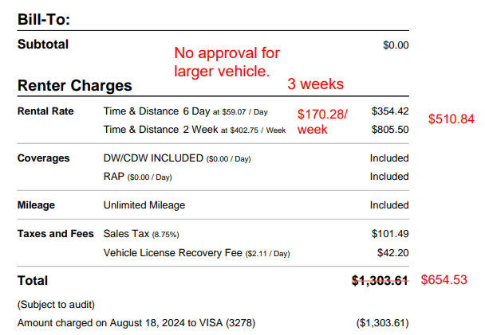
Rental Vehicles
Only positions in the Operation Section of the incident are eligible for reimbursement above a compact or intermediate rental without additional documentation, any other positions need 4x4 documented in the resource order unless formally documented and approved on a signed ICS-213 or S#.
At time of rental, you may need to make remarks on your contract that this vehicle is going to an incident base camp and may be driven off pavement.
CFAA Reference: Clause H-4
Notes:
Presenter: USFS (Allison) / Cal OES (Auburn or Sage)
Backup Presenter:
Notes:
The Committee is developing a formal list of positions that are eligible for above a compact.

Slide 68
Rental Vehicles
Required to provide a final receipt submitted through the expense claim in MARS.
Rental vehicles authorized on the resource order do not need additional incident approval.
Rental vehicles that are not authorized on the resource order must receive the formal written approval from the incident.
Fuel for rental vehicles do not need additional approval and receipts must be submitted through the expense claim in MARS.
CFAA Reference: Clause H-4
Notes:
Presenter: USFS (Allison) / Cal OES (Auburn or Sage)
Backup Presenter:

Slide 69
Required Supporting Documentation
Checklist - Completed in MARS:
  Completed OES F-42
  General Message Form (ICS-213) signed by the Incident Commander, Finance Section Chief, Incident Business Advisor, or Agency Administrator
  S# documented on the ICS-213 and OES F-42
  Completed and signed expense claim reimbursement log (F-142A) with expense documented in date order
  Legible itemized Receipt(s) in date order
  When local agencies are seeking reimbursement for expenses incurred on behalf of personnel from an agency other than their own, a manifest is required.
CFAA Reference: Clauses H-3 and H-5
Notes:
Presenter: USFS (Allison) / Cal OES (Auburn or Sage)
Backup Presenter:
Notes:
Receipts are not required for meals and incidentals (however the local agency may require you to keep those for internal policies).
Prepaid fuel receipts are not allowable. Bank statements independently for fuel are not allowable.
Rental vehicle receipts must be final (shows return date/time and final amount billed/paid). Best if zero balance.

Slide 70
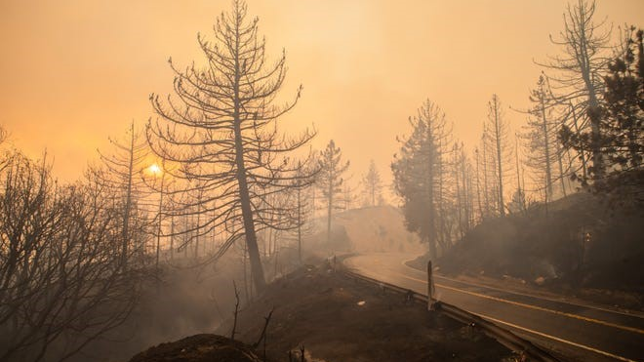
EXHIBIT I
Notes:
Presenter: Cal OES (Auburn or Sage)
Backup Presenter:

Slide 71
Definitions
Agencies should familiarize themselves with the definitions outlined in exhibit I.
CFAA Reference: Clauses I-1 through I-47
Notes:
Presenter: Cal OES (Auburn or Sage)
Backup Presenter:

Slide 72
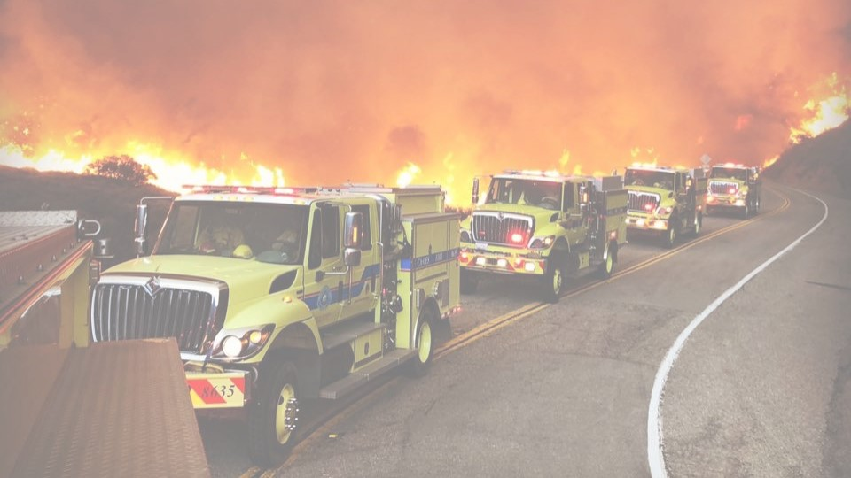
SALARY SURVEY
Notes:
Presenter: Cal OES (Auburn or Sage)
Backup Presenter: Diane Sauer

Slide 73
Salary Survey Base Rate
  Agencies can elect to utilize the personnel base rates outlined in the Rate Letter.
  The Base Rates are an average of the CAL FIRE Fire Captain or Fire Apparatus Engineer rates and the federal emergency hire rates applied to a 168-hour week, with 40 hours at straight time and 128 hours at overtime. The total amount is then divided by 168 hours resulting in a blended rate.
    (AD-H or AD-F) + (CAL FIRE Fire Captain or CAL FIRE Fire Apparatus Engineer) / 2 = Combined Rate
    ((Combined Rate x 40 hours) + (Combined Rate x 128 hours)) / 168 = Overtime Base Rate x .6667 = Straight Time Base Rate
CFAA Reference: Clause A-14
Notes:
Presenter: Cal OES (Auburn or Sage)
Backup Presenter: Diane Sauer

Slide 74
Salary Survey Salary Rate
If you choose to calculate agency specific personnel rates, it must be in accordance with the CFAA and Salary Survey Instructions.
Personnel rates must be based on actual costs to the responding agency, and not contingent upon reimbursement from the State of California or Federal Fire Agencies at a rate that exceeds what the agency will pay its personnel.
CFAA Reference: Clause A-9
Notes:
Presenter: Cal OES (Auburn or Sage)
Backup Presenter: Diane Sauer

Slide 75
Salary Rate Calculation
Step 1:
Identify classifications for which you will be seeking reimbursement (including Suppression and Non-Suppression)
Step 2:
Identify current actual base hourly rate (regular salary without benefits) for each employee within each classification
If hourly rate is not readily available from local agency system:
Use 2,912 annual hours for 56-hour employees
Use 2,080 annual hours for 40-hour employees
Notes:
Presenter: Cal OES (Auburn or Sage)
Backup Presenter: Diane Sauer

Slide 76
Salary Rate Calculation
Step 3:
Identify specialty and incentive pay that is tied to each OVERTIME hour worked. If there is no extra payment to the employee or no extra cost to the department for that benefit when an OT hour is worked, then DO NOT include.
Benefits Typically Included:
Paramedic, Hazmat, EMT, US&R, education, longevity, FICA, and Medicare
Benefits Typically Not Included:
Retirement, health insurance, and merit pay
Notes:
Presenter: Cal OES (Auburn or Sage)
Backup Presenter: Diane Sauer
Notes:
Incentives vary from department to department – if the incentive/specialty benefit is paid when a person works OT then it should be included.
Benefit lists are not all inclusive, each agency needs to go through their individual costs.

Slide 77
Salary Rate Example
Job Classification - Firefighter |  | Amount
Base Salary - Current Actual Annual Salary |  | $75,924
Annual Scheduled Hours | 56-Hour Employee | 2,912
Regular Hourly Rate without benefits |  | $26.07
Incentive/Specialty Pay (Specify) | Emergency Medical Technician | $0.75
 | Education Incentive | $0.34
 | Paramedic Premium Pay | $2.00
Hourly Rate with Incentive Pays |  | $29.16
Benefits
FICA/Medicare | 1.45% | $0.42
Retirement | Not Applicable to overtime | -
Health Benefits / Flex Credits | Not Applicable to overtime | -
Other: (Specify) |  | -
Hourly Actual Rate (including applicable benefits) for FF/Medic 1 |  | $29.58
Notes:
Presenter: Cal OES (Auburn or Sage)
Backup Presenter: Diane Sauer

Slide 78
Salary Rate Calculation
Step 4:
For each employee, add hourly salary and benefit costs together.
Step 5:
Calculate average hourly rate for the classification.
Step 6:
Incorporate workers compensation insurance rate and unemployment insurance rate, if applicable.
Notes:
Presenter: Cal OES (Auburn or Sage)
Backup Presenter: Diane Sauer
Notes:
Incentives vary from department to department – if the incentive/specialty benefit is paid when a person works OT then it should be included.
Benefit lists are not all inclusive, each agency needs to go through their individual costs.

Slide 79
Salary Rate Example
Average All Firefighters
Example: | Average Actual Rate
Firefighter Paramedic 1 | $29.58
Firefighter Paramedic 2 | $29.28
Firefighter Paramedic 3 | $28.34
Firefighter 4 | $25.10
Firefighter 5 | $23.19
Firefighter 6 | $24.20
Firefighter 7 | $24.67
Average Actual Hourly Rate | $26.34
Notes:
Presenter: Cal OES (Auburn or Sage)
Backup Presenter: Diane Sauer
Notes:
Do not take average all individuals in each step separately or average the salary rate for each step.

Slide 80
Salary Rate Example
Workers Compensation Insurance Rate:
$26.34 per hour x 8.5% Workers’ Compensation Rate = $2.24
Unemployment Insurance Rate:
Maximum Annual Contribution per Employee / Standard Hours for the Classification
Safety/Shift Personnel:
$434.00 per employee per year / 2,912 hours = $0.15 per hour
Staff/Civilian Personnel:
$434.00 per employee per year / 2,080 hours = $0.21 per hour
Non-Full Time or Volunteer Personnel:
$434.00 per employee per year / 960 hours = $0.45 per hour
Average Hourly Rate + Workers Compensation + Unemployment Insurance = Salary Rate
$26.34 + $2.24 + $0.15 = $28.73
Notes:
Presenter: Cal OES (Auburn or Sage)
Backup Presenter: Diane Sauer
Notes:
The Human Resources Department, Personnel Office, or Budget Office at your agency should be able to assist you in determining the insurance premium for workers compensation and unemployment insurance.

Slide 81
Salary Survey Requirements
All agencies must utilize the Mutual Aid Reimbursement System (MARS) to complete and sign the required annual salary survey to file personnel rates with Cal OES.
The Authorized Representative will provide certification through signature under penalty of perjury that the personnel wages are accurate and correct for each requested classification.
Reimbursements will be based on the salary survey that is on file with Cal OES at the time of the initial dispatch.
Liability for workers’ compensation claims and/or payment of unemployment benefits shall remain the responsibility of the responding local, state, federal, and tribal agencies that directly employ the personnel.
CFAA Reference: Clauses A-9 and A-10
Notes:
Presenter: Cal OES (Auburn or Sage)
Backup Presenter: Diane Sauer
Notes:
Although the personnel rate calculation includes compensation for WC/UI, liability remains with the responding agency.
As long as you have a salary survey submitted within the last 12 months, you are in compliance with the annual requirement.

Slide 82
Invoice Personnel Formula
B or S x H1 or H2 x 1.5 (if applicable) = Total Personnel Reimbursement
  B – Base Rate
  S – Salary Rate
  H1 - All Hours (portal-to-portal)
  H2 –Actual Hours Worked
  1.5 – Overtime component
  These formulas and rates of payment shall constitute full reimbursement for direct costs, including backfill to local jurisdictions relative to personnel provided.
CFAA Reference: Clauses A-10, A-15, and A-16
Notes:
Presenter: Cal OES (Auburn or Sage)
Backup Presenter: Diane Sauer
Note:
The overtime component is applied to all hours with the intention that when the deployed personnel are being paid straight time the excess is used to cover the additional cost required to backfill.

Slide 83
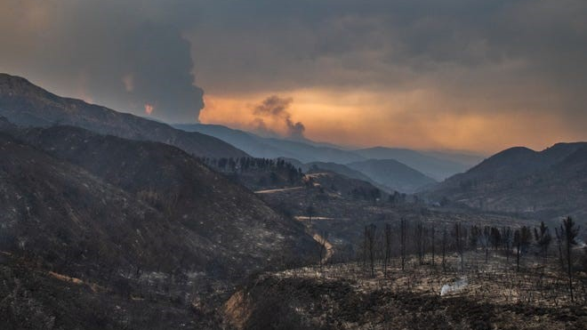
ADMINISTRATIVE RATE
Notes:
Presenter: Diane Sauer
Backup Presenter:

Slide 84
Administrative Rate
An Administrative Rate will be added to the total claim by applying the rate to the direct cost (personnel, equipment, and travel).
Agencies can elect to utilize the identified de minimis rate or calculate their own rate in accordance with the CFAA.
Agency submitted administrative rates must be on file in MARS by July 1st of each year.
CFAA Reference: Clause A-7
Notes:
Presenter: Diane Sauer
Backup Presenter:
Notes:
Those that do not submit by July 1st will be defaulted to the de minimis rate.

Slide 85
Administrative Rate
The de minimis rate (15%) will be reviewed and set annually by the Committee per the annual rate letter published by Cal OES Fire and Rescue Division.
If you choose to utilize an agency specific administrative rate it must be in accordance with the CFAA actual administrative rate process and instructions. Please submit this rate via MARS.
The agency specific Administrative Rate is based on the 2 CFR part 200 regulations as modified by the CFAA negotiations.
CFAA Reference: Clause A-7
Notes:
Presenter: Diane Sauer
Backup Presenter:
Notes:
Calculation must be submitted each year by July 1 to avoid default to the base administrative rate.

Slide 86
Administrative Rate Definitions
“Expenses”
  Labor – include all salaries and benefits
  Services and Supplies – services and supplies include consumable items with a useful life of less than one year
  Minor Equipment – items with a useful life greater than one year and less than $5,000 per unit cost
  Fixed Assets – items with a per unit cost of $5,000 or more
Notes:
Presenter: Diane Sauer
Backup Presenter:

Slide 87
Administrative Rate Definitions
“Cost Characteristics”
  Allowable – costs included in the computation of the indirect/administrative cost rate
  Unallowable – costs excluded from the computation (see the Cal OES Indirect Cost Rate Plan (ICRP) Definitions)
Notes:
Presenter: Diane Sauer
Backup Presenter:

Slide 88
Administrative Rate Definitions
“Allowable Cost Categories”
  Direct – costs identified specifically with agency’s DIRECT operations or costs that can be identified specifically with a particular final cost objective
    Use Table – DO NOT DEVIATE
  Indirect – expenses not identified directly with operations but rather administrative or supporting costs
    Use Table – DO NOT DEVIATE
  Descriptions and definitions of Programs that are allocated to Direct and Indirect cost pools are included in instructions from Cal OES
Notes:
Presenter: Diane Sauer
Backup Presenter:

Slide 89
Administrative Rate Definitions
Cost Categories * | Indirect | Direct | Unallowable
Emergency Medical Services | x | x
General Administration | x |  | Costs of Lobbyists, City Council Members, Board of Supervisors, Board of Director
Information Technology | x
Logistics/Procurement/Supply/ Minor Fire Equipment | x
Public Information Office | x
Telecommunications | x
Arson Investigation |  | x
Community Education |  | x
Facilities |  | x
Fire Communication Center/Dispatch/Command and Control Center |  | x
Fire Hazard Reduction Program |  | x
Fleet |  | x | Costs of Fixed Asset Purchases, Replacements and Depreciation.
Hazardous Materials Response Program |  | x
Mapping |  | x
Operations |  | x
Prevention |  | x
Training |  | x
Urban Search and Rescue |  | x
* Cost categories include salaries and benefits, services and supplies and minor equipment.
Notes:
Presenter: Diane Sauer
Backup Presenter:

Slide 90
Administrative Rate Calculations
  The purpose is to determine the ratio of allowable indirect costs to allowable direct costs.
  Not all categories of direct and indirect costs will follow your normal practice; however, this was an equitable, reasonable, and defendable negotiated approach and shall not be changed.
  Insert prior fiscal year actual departmental indirect and direct costs into MARS (referred to as “prior prior actual”).
  Divide the sum of the allowable indirect costs by the allowable direct costs to generate indirect/administrative percentage.
  Indirect costs/direct costs = indirect cost rate %.
Notes:
Presenter: Diane Sauer
Backup Presenter:

Slide 91
Calculating Indirect Cost Rate
Proposal
Indirect Cost Rate Proposal = | Allowable Indirect Costs | = | 2,175,000 | 18.13%
 | Allowable Direct Costs |  | 12,000,000
Notes:
Presenter: Diane Sauer
Backup Presenter:

Slide 92
Calculation Tips
Budget data should not be used in place of actual costs.
Data should represent finalized year end actuals.
The purchase of fixed assets should not be included in the calculation.
If a resource is used or responds and is billed to an incident, the resource should be categorized as a direct cost.
The methodology used for including centralized costs needs to be reasonable.
Notes:
Presenter: Diane Sauer
Backup Presenter:
Notes:
Administrative rates in excess of 24.99% may be viewed as excessive.

Slide 93
Yearly Sample and Audits
  Under clause A-10.1, the CFAA Committee does perform annual reviews of a select number of administrative rate calculations and documentation.
  Agencies will have (30) calendar days to provide Cal OES supporting documentation used to establish rates and method of pay.
  Recital 32 of the CFAA specifies that all source documentation related to rates and methodologies must be kept for five years after final payment.
  All rates are subject to review or audit by any of the signatory agencies.
Notes:
Presenter: Diane Sauer
Backup Presenter:
Notes:
Under A-10.1 the committee has asked Cal OES to focus the upcoming annual reviews on the administrative rate utilizing the State Controllers Office (SCO).
Administrative rates in excess of 24.99% may be viewed as excessive.

Slide 94
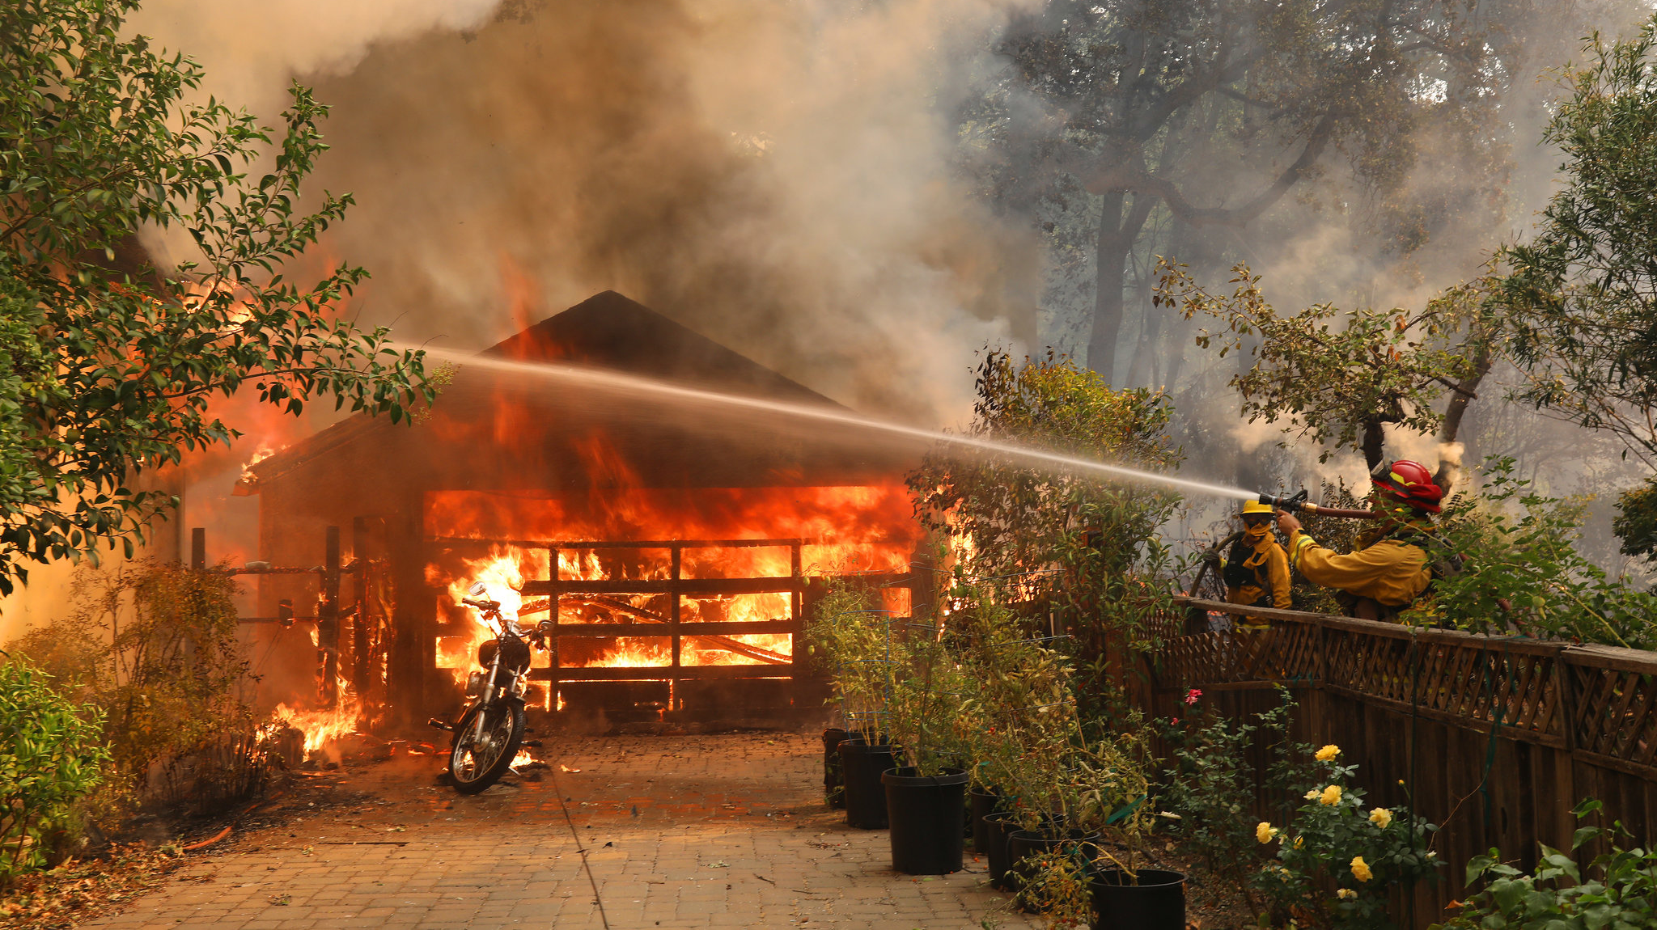
ADDITIONAL INFORMATION
Notes:
Presenter: Cal OES
Backup Presenter:

Slide 95
Additional Information
It is the responsibility of the responding personnel to ensure all required documentation is reviewed and approved by incident command.
All related reimbursement documentation must be completed or uploaded in MARS.
Please contact Cal OES Fire & Rescue at (916) 845-8711or CFAAreimbursement@caloes.ca.gov with any questions, concerns, or issues related to reimbursement.
Notes:
Presenter: Cal OES
Backup Presenter:
Notes:
If MARS is not available, all paper documentation needs to be added to MARS upon return to the home unit.
Responding personnel are encouraged to communicate to authorized incident personnel (incident command approving F-42s) the requirements and approval process in MARS potentially providing guidance or Cal OES contacts for assistance.
Responders need to check with your own agency first on reimbursement questions.

Slide 96
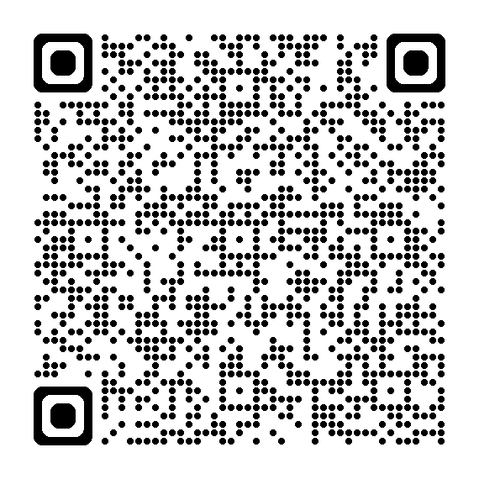
MARS
Scan the QR code to access information regarding the Mutual Aid Reimbursement System (MARS) and view instructional material.
Notes:
Presenter: Cal OES
Backup Presenter:

Slide 97
10-Year Summary
CFAA Reimbursements
Year | Total Invoices | Total Amount
2025 | 1,110 | $106,974,994
2024 | 5,519 | $413,966,234
2023 | 2,619 | $158,099,839
2022 | 2,785 | $153,807,844
2021 | 4,142 | $365,958,872
2020 | 5,897 | $420,571,754
2019 | 2,456 | $81,514,917
2018 | 4,523 | $268,593,715
2017 | 5,750 | $283,397,425
2016 | 3,505 | $165,652,697
Notes:
Presenter: Diane Sauer
Backup Presenter:
Notes:
Administrative rates in excess of 24.99% may be viewed as excessive.

Slide 98
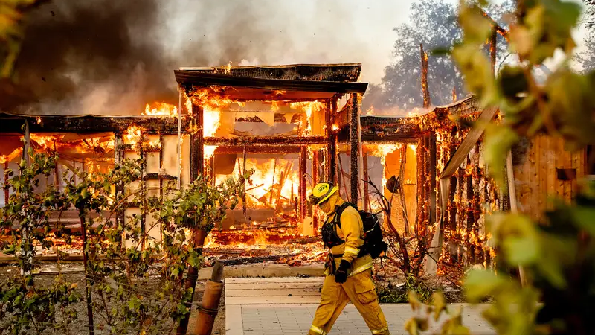
Q UESTIONS
Notes:
Presenter:
Backup Presenter:

Slide 99
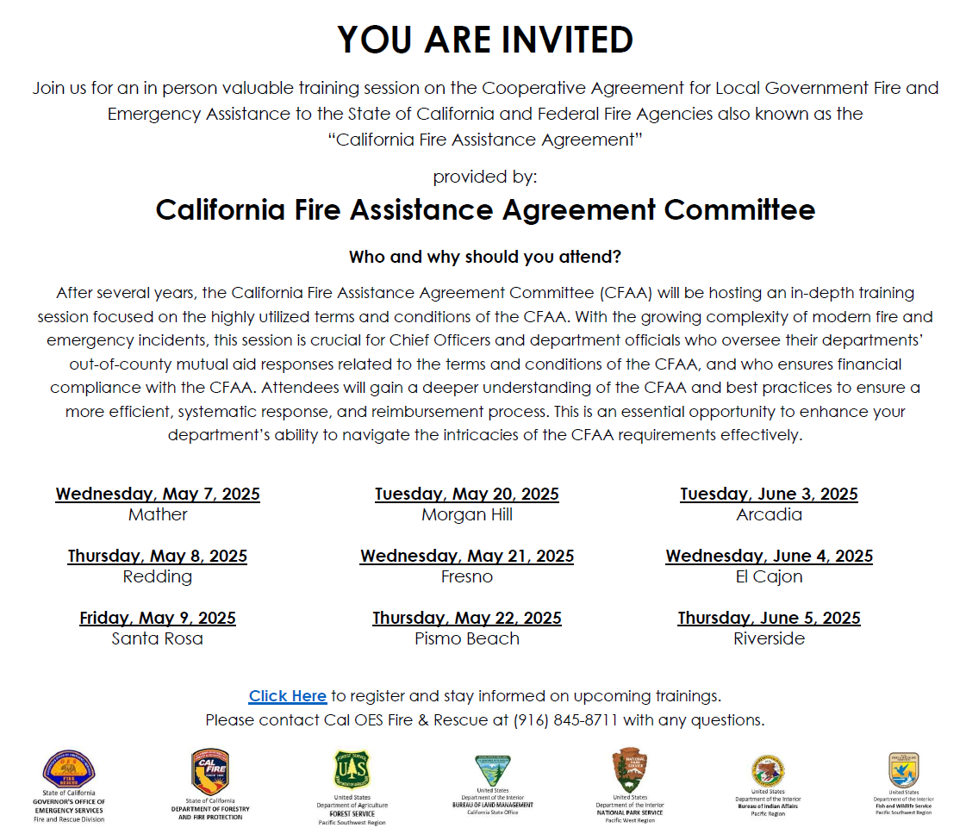
Notes:
Presenter: Cal OES
Backup Presenter:

