Slide 1

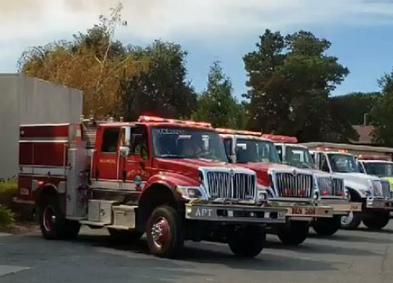
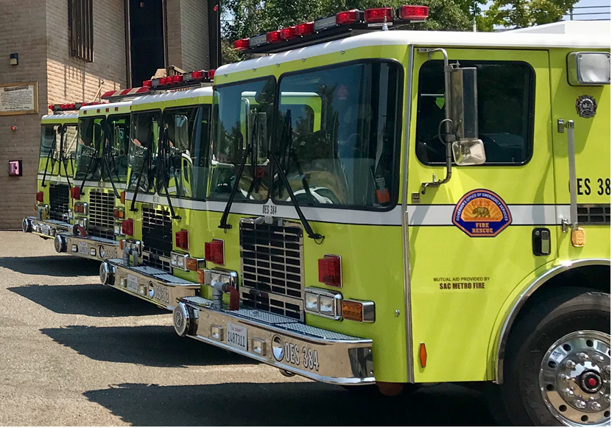
California State Mutual Aid
Pre-Incident Preparedness/Mobilization Guideline

Slide 2
California State Mutual Aid
Pre-Incident Preparedness/Mobilization Topics
Cap and Trade History (How did we get here?)
Pre-Incident Preparedness/Mobilization Guideline
Decisions and Request Processes
  Mobilization Scoresheet
  Predictive Services Links page
  Resource Request Order Sheet
  Preparedness/Mobilization Resource Approval Form
Needs of Retaining Preposition/Mobilization Order
Reassignment of Preposition/Mobilization Resources
Demobilization of Preposition/Mobilization Resources
Frequently Asked Questions

Slide 3
Cap and Trade History
How did we get here?
The Global Warming Solutions Act of 2006 commonly referred to as AB 32 (Pavley), established the goal of reducing greenhouse gas (GHG) emissions statewide to 1990 levels by 2020.
In order to help achieve this goal, the California Air Resources Board (ARB) adopted a regulation to establish a Cap and Trade program that places a “cap” on the aggregate GHG emissions from entities responsible for roughly 85 percent of the state’s GHG emissions.
As part of the Cap and Trade program, the ARB conducts quarterly auctions where it sells emission allowances to generate billions of dollars in state revenue over the coming years.

Slide 4
Cap and Trade History
How did we get here cont’d.
SB 1018 (Chapter 39, Statutes of 2012) enacted the Greenhouse Gas Reduction Fund (GGRF) which is where all auction revenue is deposited.
AB 1522 requires that Cap and Trade auction revenues are used for:
  reducing GHG emissions
  achieving co-benefits such as job creation, air quality improvements, and public health benefits
Wildland fires release carbon in the air and our ability to suppress these fires early on will reduce the carbon released into the atmosphere.

Slide 5
Cap and Trade History
How did we get here cont’d
The Cap and Trade program is one of the state’s key policies intended to reduce statewide greenhouse gas (GHG) emissions.
Therefore, in FY 2017/18 budget year California Professional Firefighters used the Cap and Trade program to obtain the initial $25 million for preposition via AB 109 Budget Bill Jr.
Additionally, the California Fire Service Leadership obtained $25 million more for FY 2018/19 budget year to support ongoing efforts.

Slide 6
Pre-Incident Preparedness/Mobilization Guideline
The California State Mutual Aid Pre-Incident Preparedness/Mobilization Guideline has been developed to address resource augmentation for anticipated significant fire or other disaster events.
It is a preparation tool and meant to be used as a guideline that can assist the Operational Areas (OA) and Cal OES Fire and Rescue Mutual Aid Regions in determining the level of augmentation for personnel and equipment.
The process allows us to evaluate the needs of the California Fire and Rescue Mutual Aid System given the severity of each of the factors contained in the guideline.

Slide 7
Pre-Incident Preparedness/Mobilization
Guideline cont’d.
The guideline assumes resource augmentations are in addition to normal staffing.
It is also designed to ensure that in no way funding to be provided for prepositioning resources will be used to supplant local government costs for normal staffing.
Intent: Only when your local fire agency or OA determines there is a need to exceed above normal staffing and equipment to combat a pre-determined threat that meets the criteria within the guideline to augment.

Slide 8
Decisions and Request Processes
All decisions and processes developed are based on the needs of the entire California Fire and Rescue Mutual Aid System.
California Governor’s Office of Emergency Services (Cal OES) has the fiscal management and oversight of prepositioning local government fire agency resources for approved qualifying event/incidents.

Slide 9
Decisions and Request Processes cont’d.
The process for prepositioning resources will require continuous improvement and we have committed to allow for flexibility according to the needs of the California Fire and Rescue Mutual Aid System and through lessons learned.
The method of evaluating prepositioning requests is a sound and tried system that includes scientific analysis from Predictive Services and has been utilized for many years within the state.

Slide 10
Decisions and Request Processes cont’d.
Severity of event is based on a mobilization score sheet and a qualifying event severity will be categorized as:
  Moderate Event
  Severe Event
  Extreme Event
In addition, other considerations may be addressed to assess the level of severity for the event such as:
  Potential threat to lives and improved property, including critical facilities
  Availability of federal, state, and local firefighting resources
  Potential major economic impact

Slide 11
Decisions and Request Processes cont’d.
Steps
Local Fire Chief and OA Coordinator evaluates and determines there is a need to preposition resources.
Cal OES approves request for a 12 hour period.
Resources are ordered by the OA.
Resources are mobilized.
At the end of the 12 hour period the need is re-evaluated.
Once the pre-positioned resources are no longer needed demobilization will occur.
Cal OES will be the approving agency. It is understood that collaboration and coordination amongst the California fire service shall occur.
Notes:
#3. Resources are ordered:

Slide 12
Decisions and Request Processes cont’d.
Request to preposition resources will begin at the local level within the OA.
If it is determined there is a need, and meets the criteria, the OA Fire and Rescue Coordinator will concurently contact the Cal OES Regional Fire and Rescue Coordinator and Cal OES Fire and Rescue Duty Chief.

Slide 13
Decisions and Request Processes cont’d.
FIRESCOPE MACS Modes and CWCG Preparedness Levels:
Both systems have their place in establishing levels of operational readiness depending on the magnitude of the emergency.
Both CWCG Preparedness Levels and FIRESCOPE MACS Modes were designed in response to managing resource commitment during periods of high demand due to multiple emergencies.
Although either system could be used alone, both systems are used collaboratively as each have their advantages when considering the variety and complexity of emergencies that tend to occur in California.

Slide 14
Decisions and Request Processes cont’d.
FIRESCOPE MACS “Modes of Operation”
FIRESCOPE MACS Modes are more operationally focused and tend to consider other all hazard incidents that may impact the availability of emergency response resources.
The four MACS modes of operations are based on:
Reflective of overall regional emergency activities
Specific incident activity
Resource commitment
Predicted weather patterns that may result in continued or increased resource commitments.

Slide 15
Decisions and Request Processes cont’d.
CWCG Preparedness Levels
CWCG has accepted the National Preparedness Levels.
CWCG Preparedness Levels (PL) are similar to the FIRESCOPE MACS Modes in that they are based on:
combination of incident activity
resource commitment
predicted weather
However, Preparedness Levels differ from the FIRESCOPE MACS Modes because they take into consideration the full range of wildland fire activities, such as prescribed fire.

Slide 16
Decisions and Request Processes cont’d.
CWCG Preparedness Levels
This ensures that fire protection responsibility and prescribed fire does not exceed the state’s wildland fire response capabilities and are coordinated with the state and national wildland fire activities.
There are five distinct Preparedness Levels starting at Level 1 and peak at Level 5.

Slide 17
Decisions and Request Processes cont’d.
7 Day Significant Fire Potential
The primary responsibility of Predictive Services is to provide sound guidance to regional and national resources managers concerning current and projected “Significant Fire Potential”.
The goal of this guidance is to help these managers make effective and efficient use of available resources.

Slide 18
Decisions and Request Processes cont’d.
Significant Fire Potential
Significant Fire Potential is defined as “the likelihood that a wildland fire event will require mobilization of additional resources from outside the area in which the fire originates”.
It is crucial to understand that although weather is a major contributor to Significant Fire Potential, this product is not a weather forecast.
It is a forecast of Significant Fire Potential only.

Slide 19
Decisions and Request Processes cont’d.
7 Day Significant Fire Potential Product
The 7-day chart is divided up into Predictive Service Areas (PSA), with color coded forecast Fuel Dryness Levels (DL) values for each of the next 7 days.
High Risk Days are highlighted with orange or red boxes and include a symbol for the associated weather or trigger element.

Slide 20
Decisions and Request Processes cont’d.
Fuel Dryness Levels (DL)
Dryness Level (DL) is a combination of one or two fuel dryness and/or fire weather indices which correlate well to large fire occurrence.
Moist (Green) - a burn environment which has historically resulted in a very low or no probability of new large fires or significant growth on existing fires.
Dry (Yellow) - a transitional burn environment that will not typically result in new large fires or significant growth on existing fires.
Very Dry (Brown) - a very dry burn which results in a higher than normal probability of significant growth and new large fires.

Slide 21
Decisions and Request Processes cont’d.
High Risk Days
High Risk Days are rare occasions when conditions exist that historically have yielded a significantly higher than normal chance for a new large fire or significant growth on existing fires.
There are three contributing factors for a High Risk Day:
Critical Burn Environment.
Ignition Triggers.
Resource Availability.

Slide 22
Decisions and Request Processes cont’d.
High Risk Days - Critical Burn Environment
Critical Burn Environment (Orange) results when a combination of sufficiently dry fuels and critical weather conditions are expected such as:
High winds
Low humidity
An unstable atmosphere and very hot weather

Slide 23
Decisions and Request Processes cont’d.
High Risk Days - Ignition Triggers
Ignition Triggers (Red): unlike the Burn Environment which merely promotes or inhibits fire growth should a fire occur, an Ignition Trigger actually starts fires.
A lightning outbreak is the most common Ignition Trigger, but others are possible depending on the geographic area (i.e. strong winds in areas that experience Santa Ana or Sundowner winds).

Slide 24
Decisions and Request Processes cont’d.
High Risk Days - Resource Availability
Resource Availability: when enough fires occur within a geographic area, Initial Attack resources can be overwhelmed, leading to an elevated chance of large fires.
In addition, sending resources to fires in other geographic areas will increase the probability of large fire occurrence in the home GACC, since the ability to respond quickly to new ignitions is impaired.

Slide 25
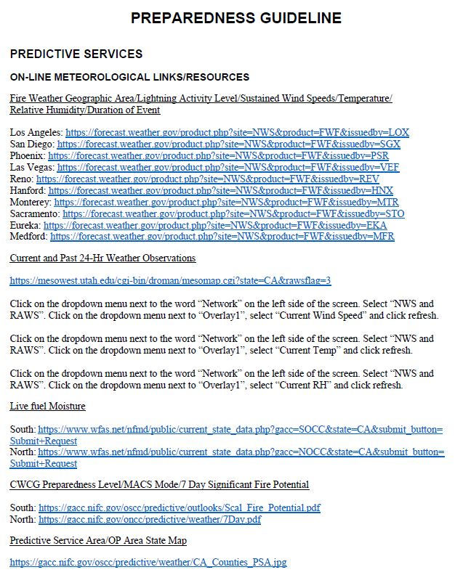
PREPAREDNESS GUIDELINE

Slide 26
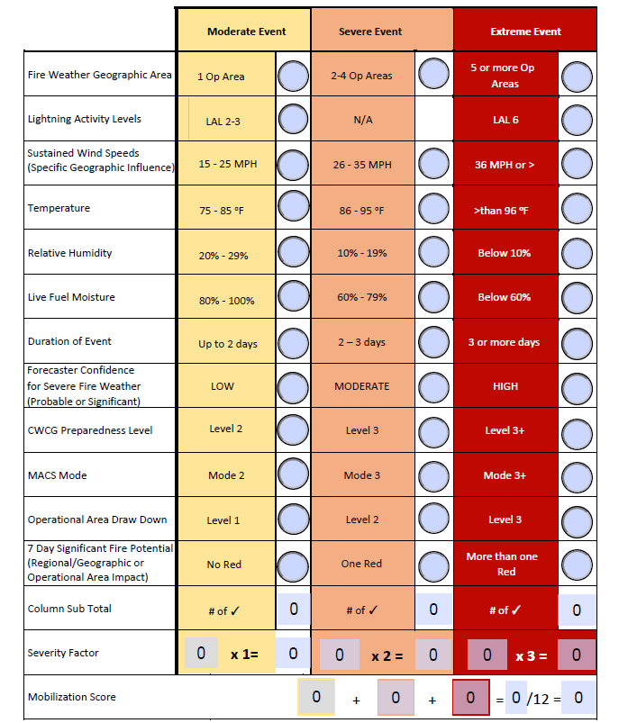
Wildland Fire Mobilization Score Sheet
Notes:
1. Within each row, check the radial button in the box that best describes the forecasted condition. If there is no value for a row, it would be left blank. (See Predictive Services on Page 11 for links to meteorological info)
2. Total the number of check marks per column and enter their sub-total in the box provided.
3. Multiply the column sub-totals by the severity factor and enter this adjusted sub-total in the same colored box provided in the next row.
4. Enter the adjusted sub-totals into the formula provided at the bottom of the sheet.
5. Add the three adjusted sub-totals and divide by 12 to complete the mobilization score.
6. Utilize the final score from the mobilization score sheet to refer to the resource order sheet for the numbers recommended for augmentation.
7. If the score sheet recommends a MODERATE EVENT, both the Cal OES Director and Cal OES State Fire and Rescue Chief will review and provide approval in addition to the Cal OES Operations Deputy Chief.

Slide 27
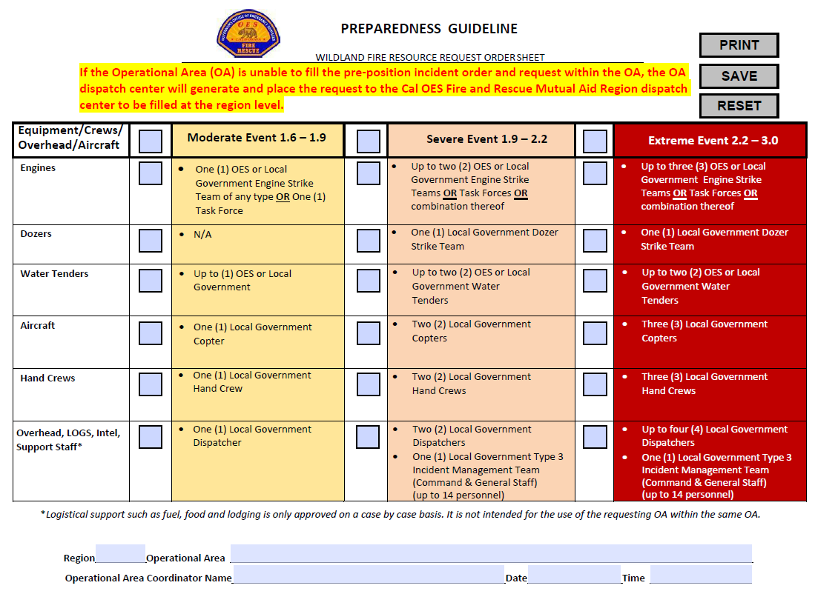
PREPAREDNESS GUIDELINE

Slide 28
Decisions and Request Processes cont’d.
If approved by Cal OES, the OA Coordinator will provide the OA dispatch center and Cal OES Fire and Rescue Regional Coordinator a copy of the Cal OES Preparedness/Mobilization Resource Approval Form.
Create and fill request(s) as directed by OA Coordinator.
If unable to fill within the OA, place request(s) to the respective Cal OES Fire and Rescue Mutual Aid Region.
Notes:
We will provide a PPT for the OA Dispatch Centers and Cal OES Region Dispatch Centers to provide direction on how to create and fill a Cal OES PrePo incident.

Slide 29
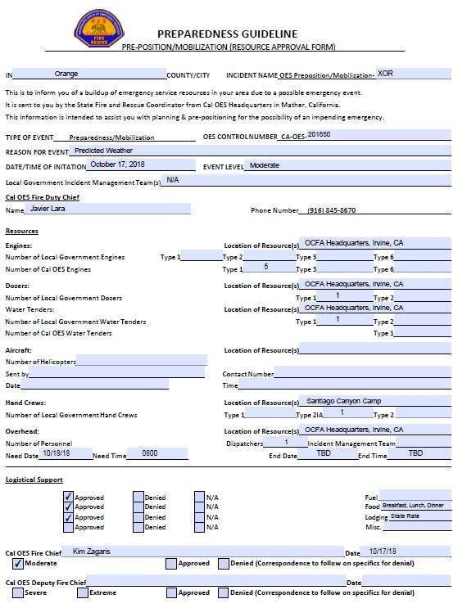
PREPAREDNESS GUIDELINE
Notes:
Pete sent sample and will point to sample

Slide 30
Needs of Retaining
Preparedness/Mobilization Order
Evaluation for continuance will be performed every 12 hours amongst the OA Fire and Rescue Coordinator, Cal OES Fire and Rescue Duty Chief, Cal OES Fire and Rescue Operations Deputy Chief.
The OA Fire and Rescue Coordinator shall provide a courtesy notification to the Cal OES Regional Fire and Rescue Coordinator on the outcome.
As conditions warrant, there made be a need to approve a 24 hour period(s).

Slide 31
Needs of Retaining
Preparedness/Mobilization Order cont’d.
Each 12 hour period will require an updated mobilization score sheet and resource order sheet by the Cal OES OA Fire and Rescue Coordinator.
The mobilization score sheet and resource order sheet should be routed in the same fashion as the initial request.
If approved, the OA Coordinator will provide the OA dispatch center a copy of the Cal OES Preparedness/Mobilization Resource Approval Form.

Slide 32
Needs of Retaining
Preparedness/Mobilization Order cont’d.
If it is determined any resources need to be released, they have authority to make that decision, but must also notify the original requesting local government Fire Chief.
Subsequently, the Cal OES Regional Fire and Rescue Coordinator and Cal OES Fire and Rescue Fire Duty Chief will be notified of the possible reassignment or release of resources to home.

Slide 33
Reassignment of
Preparedness/Mobilization Resources
Assigned resources remain in control of the requesting OA.
If the OA receives an order and request from another OA or Region, the OA Coordinator has the authority to move the resources following the California State Mutual Aid Plan and normal day to day ordering processes. (Cal OES Operations Bulletin #1)
If the prepositioned threat still exists, backfill of the prepositioned re-assigned resources may be considered.
Notes:
The OA Coordinator shall immediately notify the CalOES Region Coordinator who shall immediately notify the State Fire and Rescue Coordinator of this action to ensure the necessary resource tracking, notifications, and coordination matters are appropriately addressed. (Ops Bulletin 1)

Slide 34
Reassignment of
Preparedness/Mobilization Resources cont’d.
Preposition funding will be approved for resources re-dispatched to and from a preposition/mobilization incident(s) with the exception of state and federal responsibilty incident(s) that are within/or outside the OA and within the approved 12 hour period.
If responses involve re-dispatch orders and requests to a state or federal responsibility incident(s) through the CFAA, reimbursement is at 100%. (Preposition funding source stop/start)

Slide 35
Reassignment of
Preparedness/Mobilization Resources cont’d.
If the resources are assigned outside the 12 hour period and there is no extension, more than likely these resources will be considered MMA unless other funding sources support the request, i.e., FMAG, CDAA, Presidential Declaration etc., generally approved for 75% reimbursement.

Slide 36
Reassignment of
Preparedness/Mobilization Resources cont’d.
Prepositioned resources will not be re-dispatched for orders and requests involving:
    Assistance by Hire (ABH) *
    Local Forest Agreements (LFA) *
  * With the exception of engines, water tenders and overhead, other resources such as dozers and hand crews may qualify for a re-dispatch using ABH or LFA.
These circumstances will need to be discussed prior to a re-dispatch with your OA Coordinator and the Cal OES Fire Duty Chief.

Slide 37
Demobilization of
Preparedness/Mobilization Resources
Once it has been decided that the event will be terminated, the Cal OES Fire and Rescue Duty Chief will be notified.
Concurrent notification to the Cal OES OA Fire and Rescue Coordinator, Cal OES Fire and Rescue Operations Deputy Chief, and Cal OES Regional Fire and Rescue Coordinator.
Notes:
How is it determined that an incident can be terminated? Weather changes, conditions change, OA or local fire agency doesn’t want to extend, etc.

Slide 38
Frequently Asked Questions
Q: Should OA Coordinator collect and mail F-42?
A: If AC not available, need to coordinate w/AC and mail to OESH
Q: Communication expectations (VHF)
A: Statewide Plan
Q: Lodging Issue (over state per diem, unable to cancel, etc.)
A: Due diligence in securing state rate
Q: Lodging in hotel or lodging in stations? (expense in lodging)
A: Will be discussed at the time of approval based on the need of the OA
Q: Why are OES engines preferred
A: Cost saving as it is a state resource, ability to improve surge capacity of own local government resources
Notes:
Complaint has been possible delay due to geographic challenge v. LG, cost savings consideration for the state

Slide 39
Frequently Asked Questions
Q: Who is responsible for obtaining logistical support for the approved resources?
A: Generally the requesting fire agency/OA is responsible for logistical support for any mutual aid requested on their behalf, however, this can be negotiated between the OA and responding resources.
Q: What are crews expected to be doing during the preposition assignment?
A: Project work will be developed by Cal OES and Fire Service leadership published in an Cal OES Ops Bulletin
Q: Strike team formation or split resources among OA?
A: Will be determined at the time of approval based on the needs of the state and OA.
Notes:
OES engines preferred due to cost savings and provide added surge capacity v. having OES reach back into the OA if requesting those engines. Practice should be to offer the OES equipment first out of the OA to prevent further impacts to resource commitments.

Slide 40
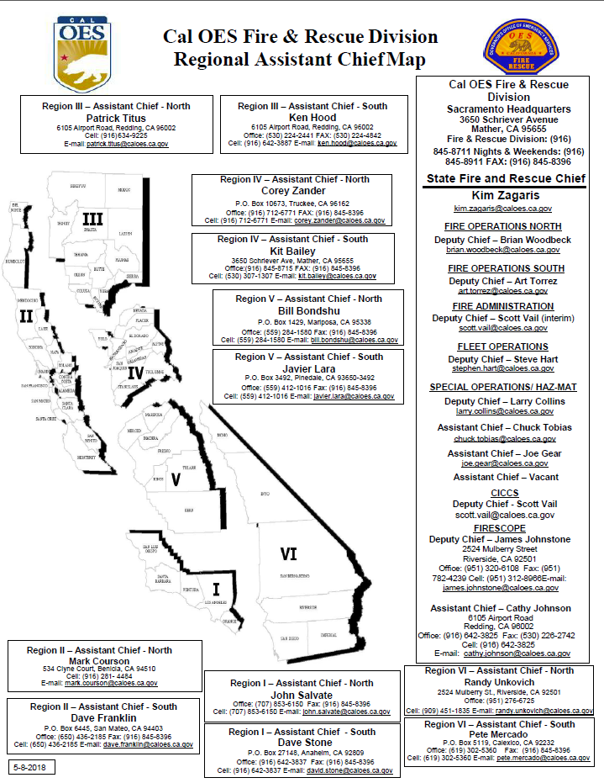
Cal OES Fire & Rescue Division Regiona Assistant Chief Map
Notes:
We will look for a slide to incorporate /Link to OES page for PPT and Forms

Slide 41
California State Mutual Aid Pre-Incident/ Mobilization Preparedness Link
http://www.caloes.ca.gov/cal-oes-divisions/fire-rescue/fire-operations
Notes:
Go over the website and specifically call attention to the ECC PPT and the Op Areas should be responsible to make sure ecc’s receive the presentation or AC’s will provide support.
http://www.caloes.ca.gov/cal-oes-divisions/fire-rescue/fire-operations

Slide 42
Questions

