Slide 1
Cal OES Fire & Rescue
Mutual Aid Reimbursement System (MARS)
April 24, 2023 and April 25th, 2023

Slide 2
Presenters
Lori Lopez
Deputy Chief, Administration
Auburn Diede
Staff Services Manager I
Sage Torrez
Associate Governmental Program Analyst

Slide 3
MUTUAL AID REIMBURSEMENT SYSTEM (MARS)
Overview:
History
Application
Workflow
Statewide Training Implementation
For Help

Slide 4
MARS Purpose
MARS is a web-based application that will be managed by Cal OES and utilized by all fire agencies that respond under the California Fire and Rescue Mutual Aid System.
The intent of this system is to reimburse fire agencies ordered and requested through the California Fire Assistance Agreement (CFAA) or terms of more efficiently and seamlessly.
The reimbursement process will be housed on one platform that is easily accessible to Cal OES, the paying entities, and the responding fire agencies.

Slide 5
MARS History
Jan. 2021
Cal OES began development on the second version of MARS, with an off-the-shelf product and a more robust development team.
Aug. 2021
The MARS application went live with a pilot program.
Jan. 2023
Cal OES is expanding the program statewide in 2023.
Feb. 2018
Cal OES began development on the first version of MARS with a primarily internal development team.

Slide 6
MARS History
To date, Cal OES has utilized the pilot program and the application has:
2,035 approved users from 370 different local government fire agencies
2,067 F-42s that have been entered into the system for reimbursement processing
588 invoices generated totaling approximately $17.5 million

Slide 7
MARS Application
Provide an improved user interface to streamline data entry and access.
The system includes a variety of features to improve efficiency and ensure data completeness. Dropdowns, search fields, and checkboxes are used to ease manual entry and avoid typos. Error messages have been implemented to ensure all required information is provided in the correct format.
Real time updates on the status of reimbursement documentation.
Fire agencies will be able to track their reimbursements through every step of the process. All rate, agreement, F-42, expense claim, and invoice submissions can be viewed and managed through the system. Each screen includes a status indicating what stage the documentation is at and it if requires action.

Slide 8
MARS Application
Reduce reimbursement times for mutual aid responders
Local Government Agency responds to incident under the California Fire Assistance Agreement
Incident Demob – Local Government submits F-42s within 30 days to Cal OES Fire
Cal OES Fire has 60 business days to process F-42s into invoices & mail to Local Government for review and signature
Local Government has 30 business days to review, sign, and return invoices to Cal OES
Cal OES has 30 business days to re-review invoice for accuracy and submit to paying entity (CAL FIRE, USFS, NPS, BLM, FWS, BIA)
Paying Entity has 60 business days to process reimbursement back to responding Local Government Agency
Direct Deposit / Check Directly from Paying Entity
30 Days
Local Government
60 Days
Cal OES
30 Days
Local Government
30 Days
Cal OES
60 Days
Paying Entity (CAL FIRE, USFS, NPS, BLM, FWS, BIA)
TOTAL Maximum days allowed per the CFAA = 210 days

Slide 9
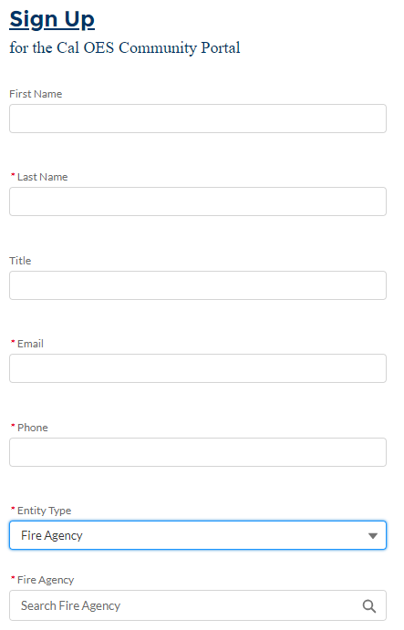
MARS Application
Fire agency users should sign up for an account
Select fire agency as the entity type at sign up and then find their fire agency.
Users should only sign up once.
If a correction needs to be made please contact Cal OES.

Slide 10
MARS Application
Fire agency primary access is generally for administrative functions that will include managing the rates, agreements, invoices, and other supporting documentation.
Fire agency secondary access is generally for operational functions that will include completing and submitting F-42s and/or expense claims and supporting documentation at the incident.
There is no limit on the number of users an agency can have in each permission level, and it is at the discretion of the fire agency to decide which permission level is appropriate for each user based upon their responsibilities related to CFAA reimbursement documentation.

Slide 11
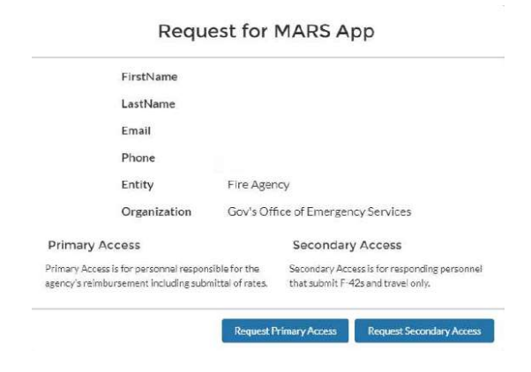
MARS Application

Slide 12
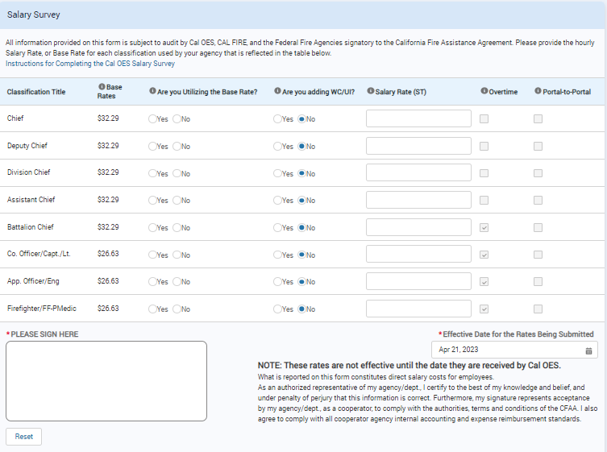
MARS Application
A sample screenshot of the web based version of the Salary Survey:

Slide 13
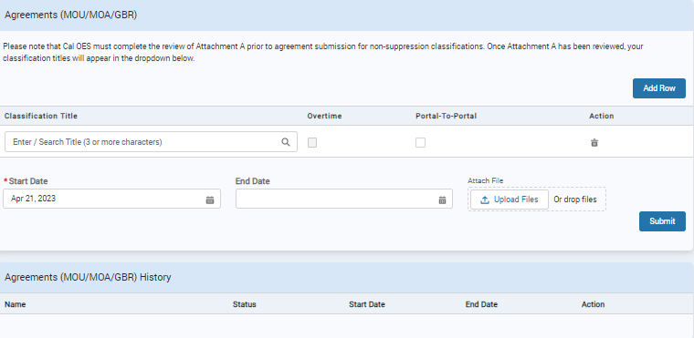
MARS Application
A sample screenshot of the web based version of the Agreements (MOU/MOA/GBR):

Slide 14
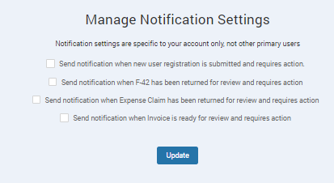
MARS Application
Fire agency primary users can manage their notification settings:

Slide 15
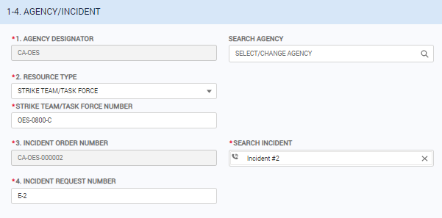
MARS Application
A sample screenshot of the web based version of the F-42 order and request information:

Slide 16
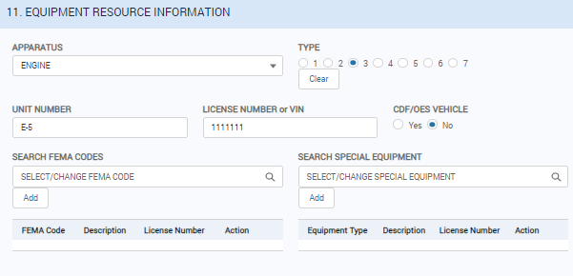
MARS Application
A sample screenshot of the web based version of the F-42 apparatus information:

Slide 17
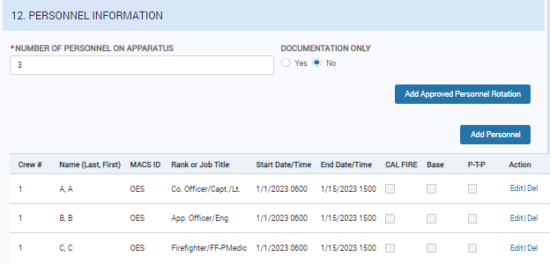
MARS Application
A sample screenshot of the web based version of the F-42 personnel information:

Slide 18
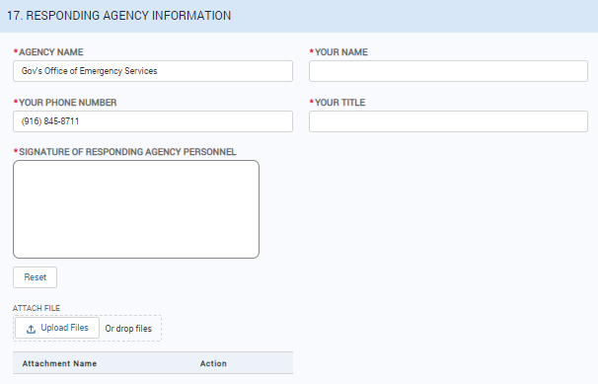
MARS Application
A sample screenshot of the web based version of the F-42 Responding Agency Information:

Slide 19
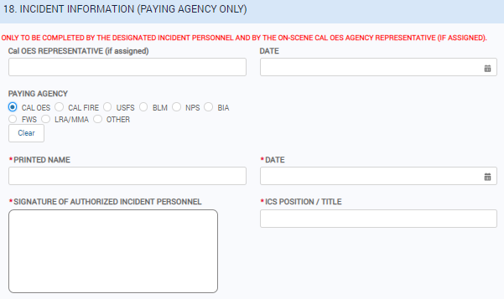
MARS Application
A sample screenshot of the web based version of the F-42 Paying Agency Incident Information:

Slide 20
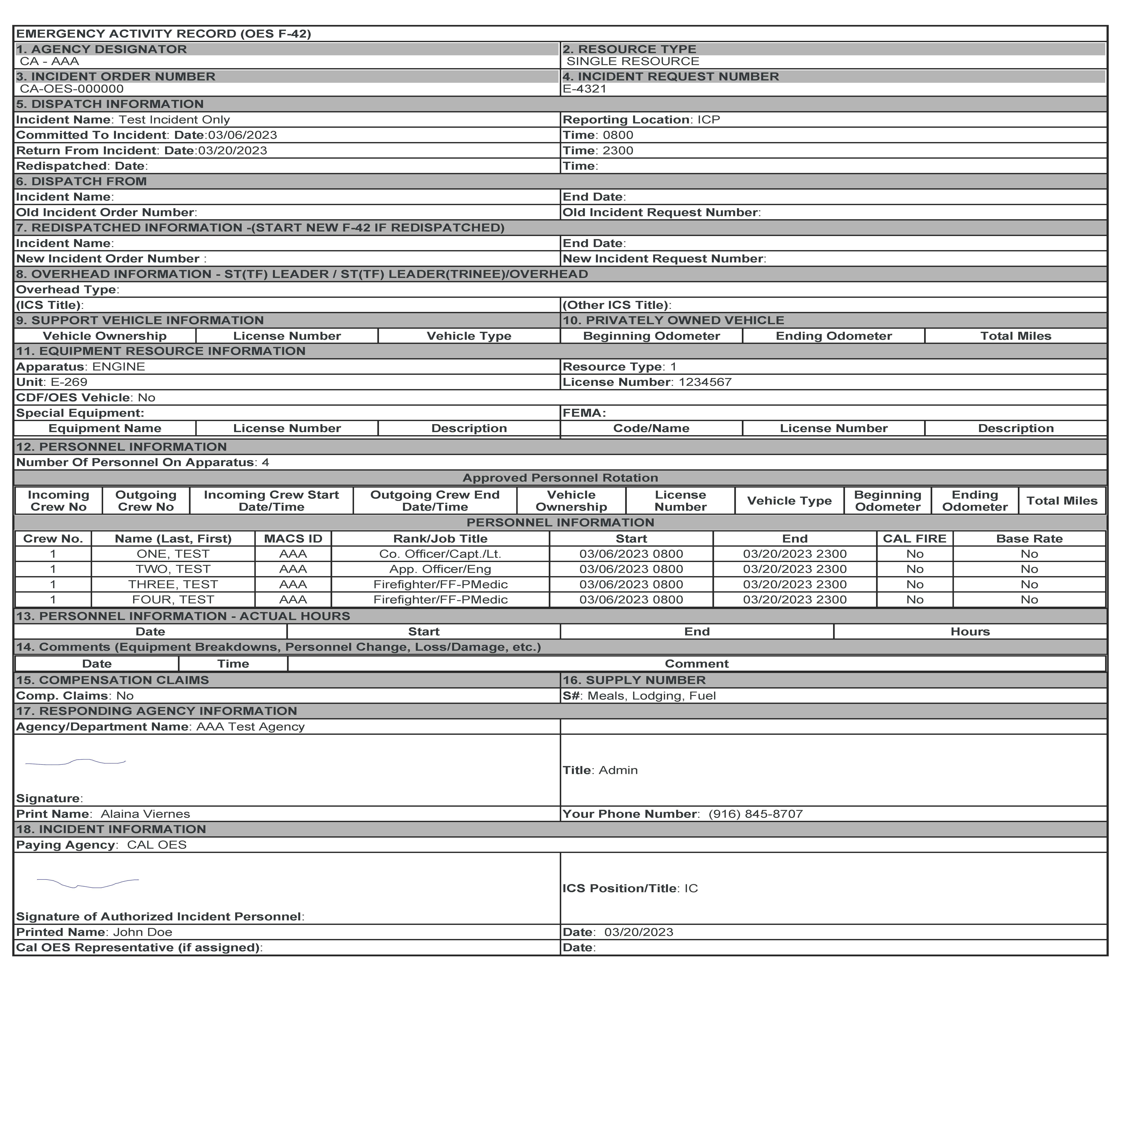
MARS Application

Slide 21
MARS Application
A sample screenshot of the web based version of the expense claim:

Slide 22
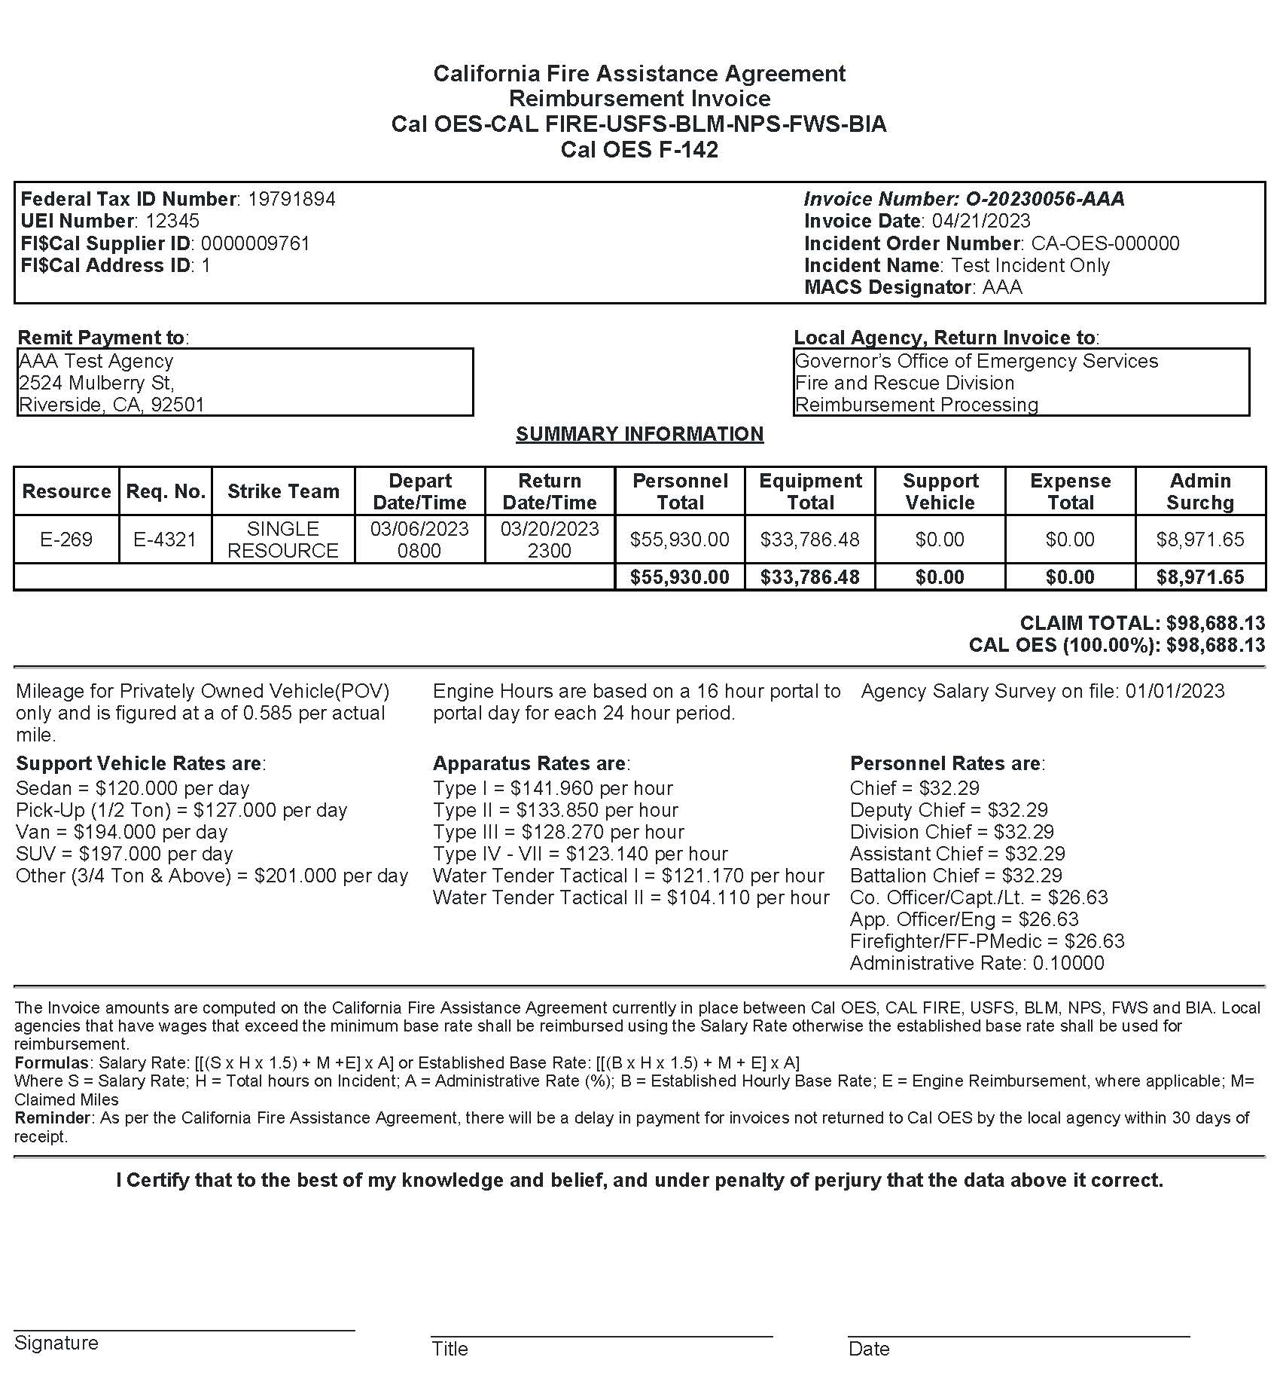
MARS Application

Slide 23
Pre-Deployment Workflow
Sign Up
Fire Agency Information
Rate Submission
Agreements
Fire Agency Personnel
Fire Agency Summary

Slide 24
Post-Deployment Workflow
OES Creates MARS Incident
F-42 and Expense Claim Entry
OES Invoice Generation
Fire Agency Review
Paying Entity Review
Invoice Payment

Slide 25
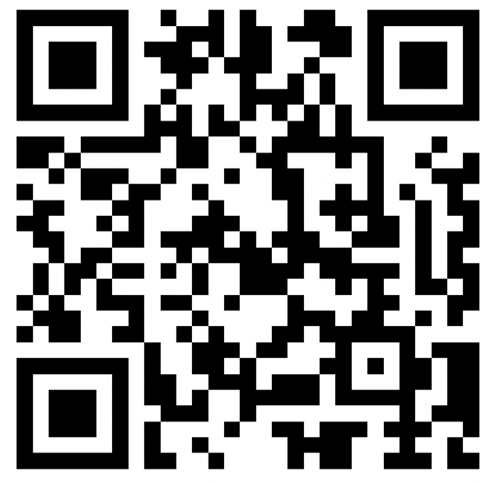
Statewide Training Implementation
Cal OES will be hosting trainings throughout the state where fire agencies will have the opportunity to access, navigate, understand how MARS will influence the workflow of reimbursements, and ask questions. These sessions will be approximately 4 hours.
We will also provide a brief out on the current status of the California Fire Assistance Agreement (CFAA).
To help us plan our statewide MARS training, please complete the survey below.

Slide 26
QUESTIONS?

Slide 27
For Help
General day-to-day questions regarding the process and how to navigate.
Monday to Friday 8:00 to 5:00 should be directed to Cal OES Reimbursement Staff or your Cal OES Region Assistant Chiefs.
On-scene incident specific questions regarding the process and how to navigate.
Should be directed to the assigned Cal OES AREP or support personnel.
If a Cal OES AREP is not on scene or after hours, questions should be directed to the Cal OES Fire Duty Chief.

Slide 28
Website
Scan to visit the Cal OES website and familiarize yourself with the application.

Slide 29
Thank You!
CONTACT US
Main Fire Phone: (916) 845-8711
General Reimbursement Inquiries: CFAAreimbursement@caloes.ca.gov
MARS Related Inquiries: MARShelpdesk@caloes.ca.gov
Cal OES Fire Duty Chief: (916) 845-8670
Cal OES Regional Assistant Chiefs

