Slide 1
California State Mutual Aid Pre-Incident Preparedness/Mobilization
Operational Area (OA) Dispatch Center

Slide 2
Intent of California State Mutual Aid Pre-Incident Preparedness/Mobilization Program
The California State Mutual Aid Pre-Incident Preparedness/Mobilization program is designed to assist the operational areas and mutual aid regions with resource augmentation for anticipated significant fire or other disaster events.
California Governor’s Office of Emergency Services (Cal OES) has the fiscal management and oversight of pre-positioning local government fire agency resources for approved qualifying event/incidents.

Slide 3
Preposition program history - Cap and Trade
Wildland fires release carbon in the air and our ability to suppress these fires early on will reduce the carbon released into the atmosphere.
The cap and trade program is one of the state’s key policies intended to reduce statewide greenhouse gas (GHG) emissions.
Therefore, in FY 17/18 budget year, California Professional Firefighters used the Cap and Trade program to obtain the initial $25 million for pre-position.
To date, the preposition program has obtained an ongoing budget of $25 million.

Slide 4
Process Overview
Local Fire Chief and Operational Area (OA) Coordinator determine there is a need to preposition resources.
Cal OES approves requests for a specified time period (occurs at OESH level).
Resources are ordered by the OA.
Resources are mobilized.
At the end of the specified time period the need is re-evaluated.
Once the pre-positioned resources are no longer needed demobilization will occur.

Slide 5
Cal OES Approval Process
Request to preposition resources will begin at the local level within the OA.
If it is determined there is a need, and meets the criteria, the OA Fire and Rescue Coordinator will contact the Cal OES Regional Fire and Rescue Coordinator and Cal OES Fire and Rescue Duty Chief to obtain approval.
If approved, the OA Fire and Rescue Coordinator will provide the OA Dispatch Center a copy of the Cal OES Preparedness/Mobilization Resource Approval Form.

Slide 6
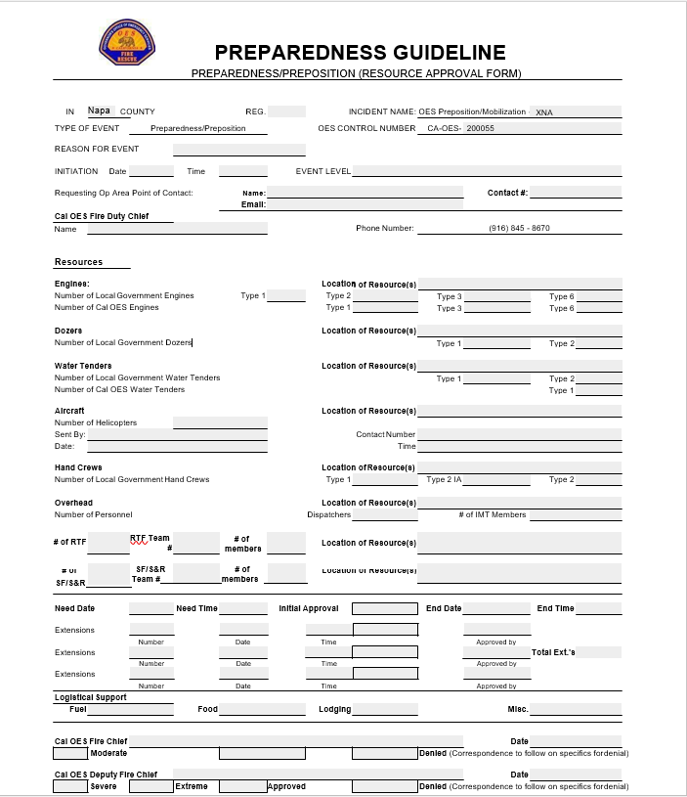

Slide 7
OA Dispatch Center - Incident Creation
Use the California IROC Business Practices to create a new incident:
For the items listed below, use the information provided on the Cal OES Preparedness/Mobilization Resource Approval Form.
Follow the below process in order as numbered:
  Protecting Unit: OA requesting Preposition
  Type: Preparedness/Preposition
  Incident Number: Use only the numbers from the Cal OES control number on the approval form (e.g. 20XXXX)
  Incident Name: As Identified on approval form
  Financial Code: Cal OES Pre-Po 2020
  Incident Location: OA Fire and Rescue Coordinator will provide location
* Only resources approved by Cal OES will be assigned to the incident.

Slide 8
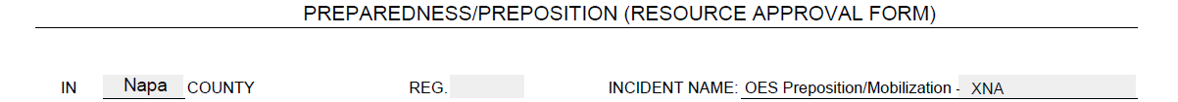
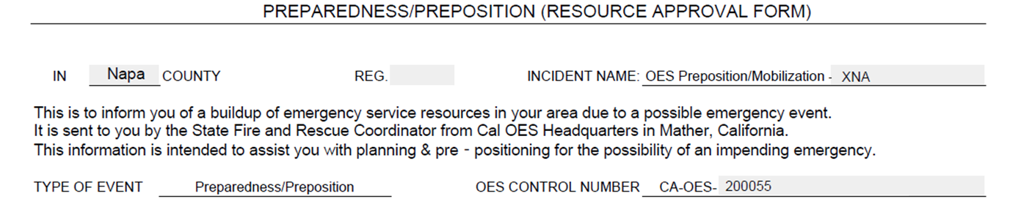
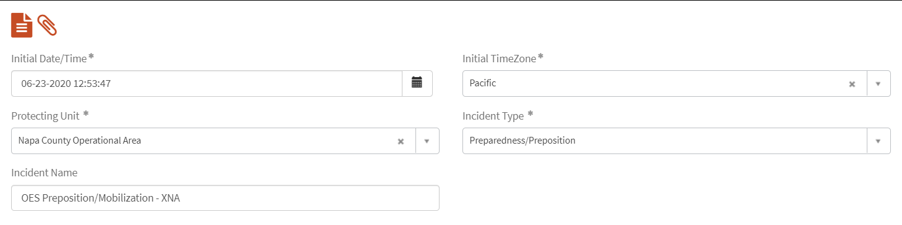
A
B
C
The ‘Protecting Unit’ will be the Operational Area requesting the preposition
The ‘Incident Name’ listed on the approval form will be the ‘Incident Name’ in IROC
The ‘Type of Event’ on the approval form will be the ‘Incident Type’ in IROC
C
A
B

Slide 9

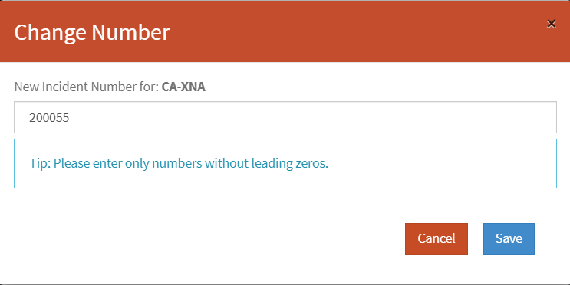
IROC Change Incident Number Screen
  For the Incident #, use only the numbers from the OES Control Number listed on the approval form.

Slide 10
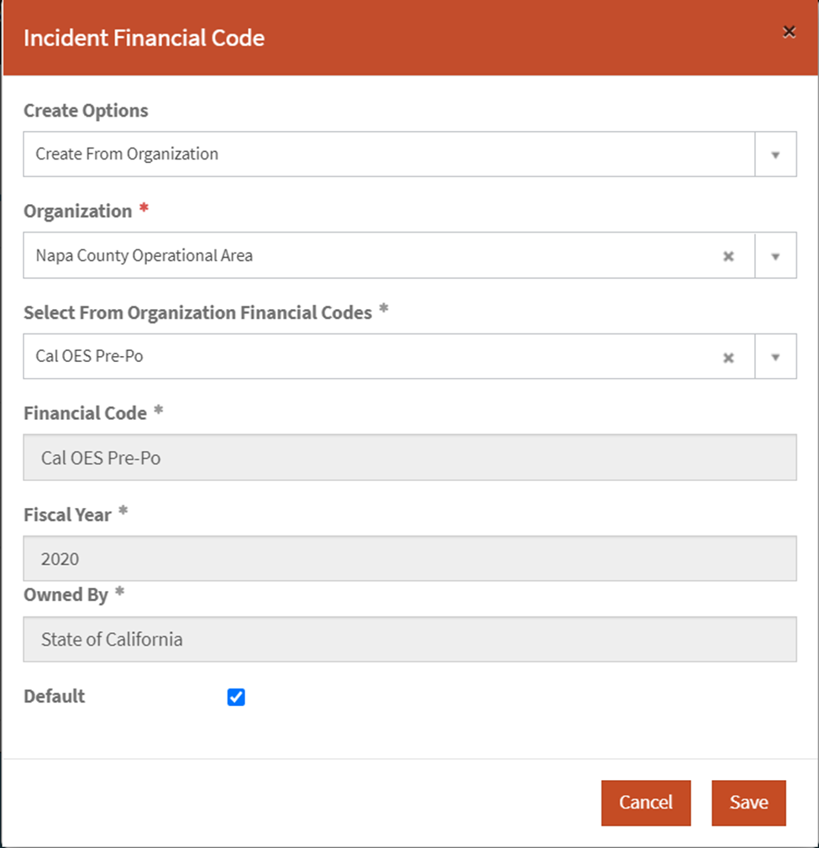

Slide 11
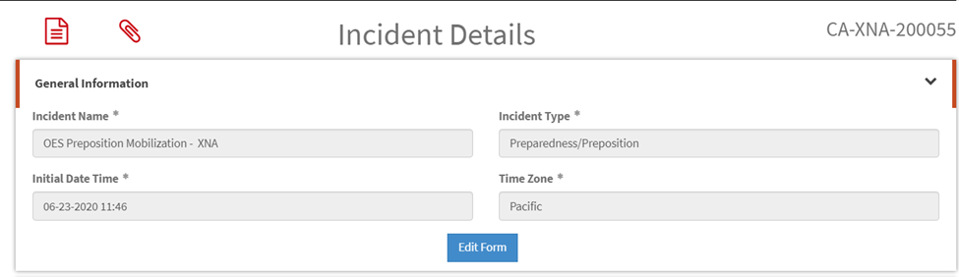
Attach Approved Cal OES Preposition/Mobilization Form to the Incident in IROC
Click on the paperclip

Slide 12
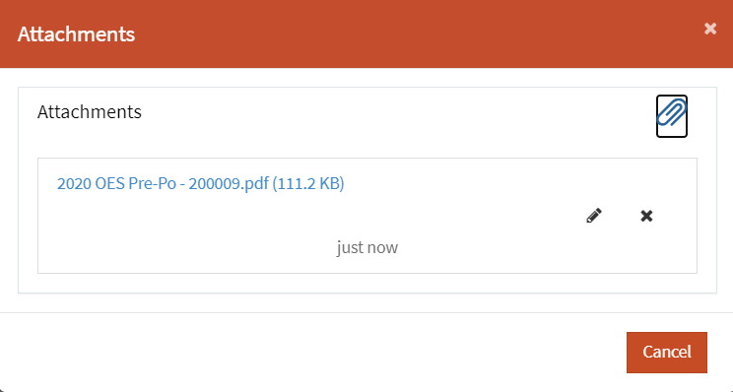

Slide 13
OA Dispatch Center - Generating Request
Use the California IROC Business Practices to generate request(s):
For the items listed below, use the information provided on the Cal OES Preparedness/Mobilization Resource Approval Form.
  Reporting Instruction: Location as listed on the approval form (Resource Specific)
  Financial Code: Cal OES Pre-Po 2020
  Ordering Contact: Requesting Op Area point of contact as listed on approval form
Cal OES may re-evaluate and approve an extension or additional resource(s).
  Resources that are extended will remain on their original request number.
  If it is determined there is a need for additional resources, a new approval form will be provided and IROC request will be generated.

Slide 14
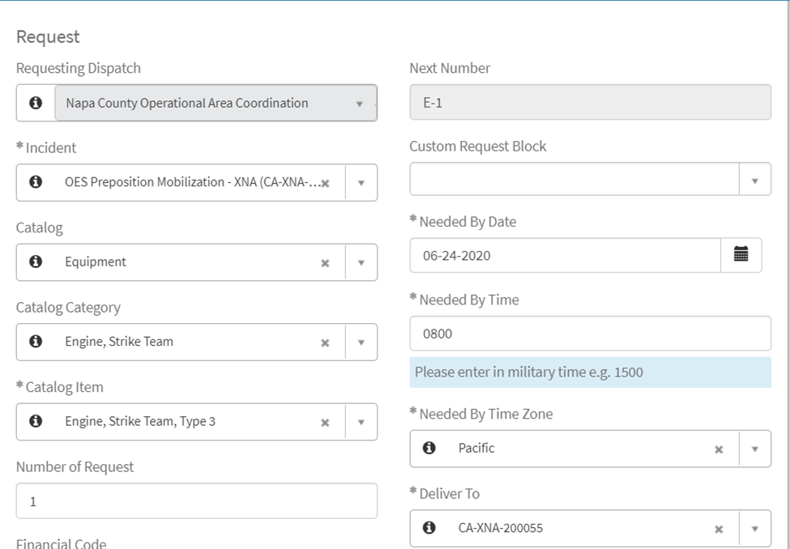
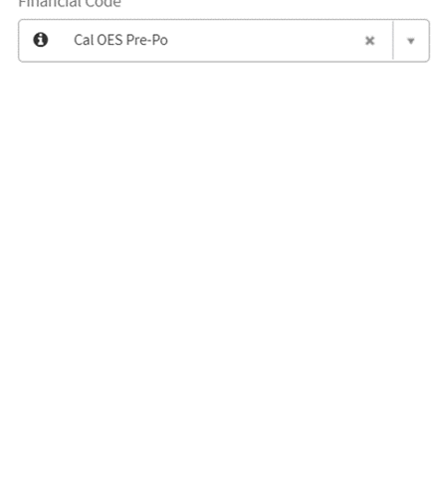
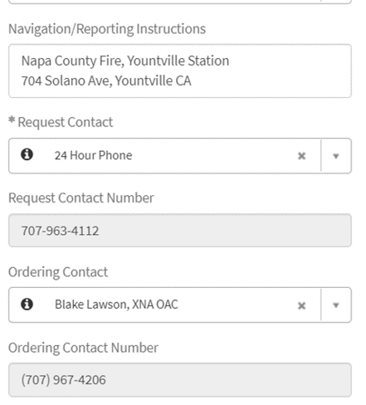

Slide 15
OA Dispatch Center - Filling the Request
Use the California IROC Business Practices to fill requests:
Fill or place request as directed by OA Fire and Rescue Coordinator.
If unable to fill within the OA, place request(s) to the respective Cal OES Fire and Rescue Mutual Aid Region.

Slide 16
Reassignment of Preparedness/Mobilization Resources
Reassignment of Preparedness/Mobilization resources require OA Fire and Rescue Coordinator approval.
Reassignment will occur in IROC.
Dispatch center will need to ensure that the appropriate financial code is selected/provided in the IROC request.
  For state or federal requests (CFAA only)
  For local requests (MMA, CFAA - only if local entity is willing to pay)
Once released, the Preparedness/Mobilization resource(s) will return to the preposition incident in IROC.

Slide 17
Demobilization of Preparedness/Mobilization Resources
OA Fire and Rescue Coordinator will notify OA Dispatch Center when resources are released and provide demobilization travel information.
OA Dispatch Center will release resource(s) as per the California IROC Business Practices.

Slide 18
For More Information:
California State Mutual Aid Pre-Incident Preparedness/Mobilization Guideline
https://www.caloes.ca.gov/FireRescueSite/Documents/California_State_Mutual_Aid_Pre-Incident_Mobilization_Preparedness_Guideline.PDF

Slide 19
Questions?

