Slide 1

Fire Management Assistance Grant Program (FMAGP)
2019

Slide 2
Purpose
The FMAG Program
Provides supplemental assistance to State, Tribal, and Local governmental entities for the mitigation, management, and control of any fire on public or private forest land or grassland that threatens such destruction as would constitute a major disaster.

Slide 3
Fire Management Assistance Grant Program
Replaced the Fire Suppression Assistance Program
Effective for all fires declared on or after October 30, 2001
Outlined in 44 CFR Part 204
Disaster Relief Funds

Slide 4
Grant Application
Before FEMA can approve the State’s grant application, all the following criteria must be satisfied:
  The fire cost threshold must be met
    Individual fire or Cumulative State
  An approved State Administrative Plan must be in place
  The FEMA-State Agreement must be executed
  An approved State Mitigation Plan must be in place

Slide 5
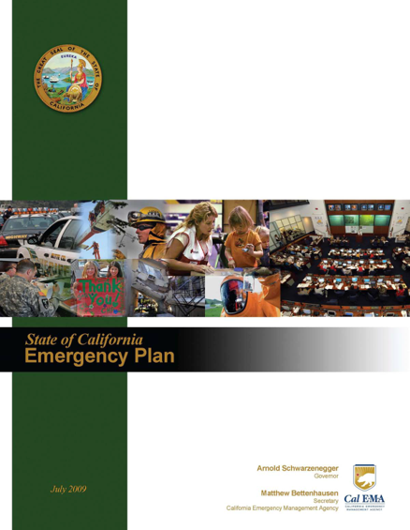
State Administrative Plan
At a minimum, the State Administrative Plan must contain the following items:
  Designation of responsible State agency
  Identification of FMAGP staffing functions
  Procedures for key FMAGP activities

Slide 6
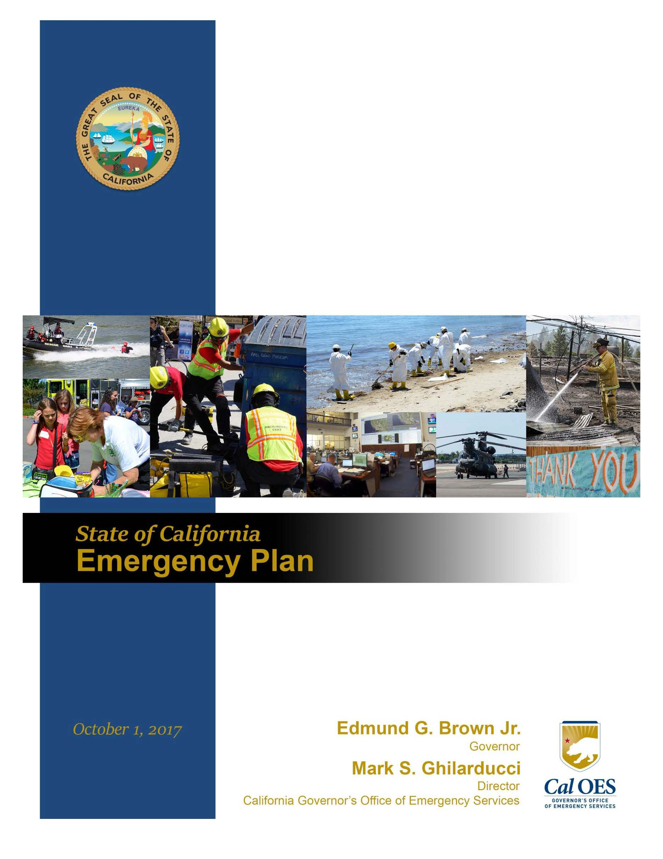
State Hazard Mitigation Plan
State Hazard Mitigation Plan (SHMP)
The SHMP represents California's primary hazard mitigation guidance document and provides an updated and comprehensive description of the state's historical and current hazard analysis, mitigation strategies, goals and objectives.

Slide 7
FMAG – Fire and Rescue
FMAG Applicant’s Eligibility
The fire suppression activities performed must be:
The legal responsibility of the applying entity
And
Required as the result of the fire
And
Located within the designated incident area

Slide 9
FMAG – Fire and Rescue
To Request an FMAG
Complete the Cal OES “A-B-C Form” (Form-158)
Create fire perimeter map
Obtain fire weather (RAWS, NWS, etc.)
Contact the Cal OES Warning Center @ 916-845-8911 and advise them of your incoming fax of the above documents or email to: warning.center@oes.ca.gov
The ICS 209 should be submitted at the next standard post time required per ICS 420-1
While the fire is burning….!!!!!

Slide 10
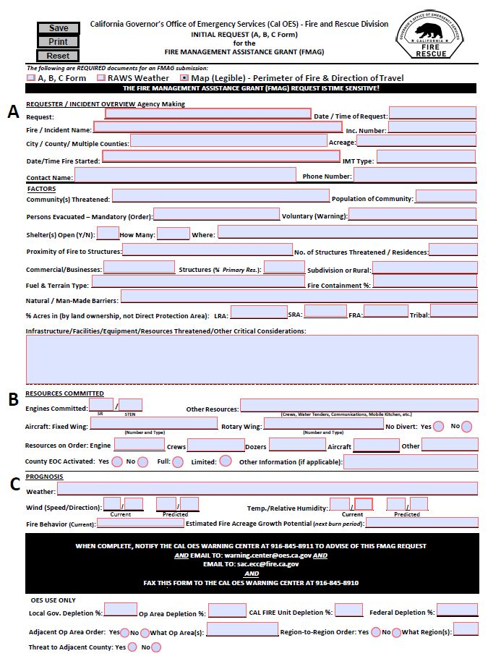
Cal OES Initial Request (ABC) Form
F-158

Slide 11

Fire Cost Threshold
The State’s eligible fire costs must meet either its individual fire cost threshold or cumulative fire cost threshold
The fire cost thresholds are adjusted annually
Costs for declared fires within a fire complex are aggregated and treated as one fire when compared to the thresholds

Slide 12
2019 FMAG Threshold
Individual Fire Cost - $2,794,047 ($2.79 mil.)
Cumulative Fire Cost - $8,382,140 ($8.38 mil.)
Major Disaster: $59,335,567* ($59.3 mil.)
*Public Assistance Per Capita Indicator: $1.50 multiplied by the 2019 state population of 39,557,045

Slide 13
Selected FY 2019 Fire Cost Thresholds
 | Individual | Cumulative
Alaska | $100,000 | $500,000
Arizona | $479,401 | $1,479,204
California | $2,794,047 | $8,382,140
Delaware | $100,000 | $500,000
Florida | $1, 410,098 | $4, 230,295
Texas | $1,885,917 | $5,657,751

Slide 14
Declarations by FEMA Region
(2001-2018)
Region I: 1
New Hampshire (1)
Region II: 1
  New Jersey (1)
Region III: 5
  Virginia (3)
  West Virginia(2)
Region IV: 41
  Alabama (1)
  Georgia (11)
  Florida (13)
  North Carolina (9)
  South Carolina (3)
  Tennessee (4)
  Region V: 2
  Kentucky (2)
Region VI: 240
  Texas (123)
  New Mexico (37)
  Oklahoma (80)
Region VII: 12
  Kansas (11)
  Nebraska (1)
Region VIII: 112
  Colorado (34)
  Montana (33)
  South Dakota (11)
  Utah (21)
  Wyoming (13)
Region IX: 272
  Arizona (37)
  California (183)
  Hawaii (13)
  Nevada (39)
Region X: 135
  Washington (71)
  Alaska (9)
  Idaho (14)
  Oregon (41)

Slide 15
FMAGP Declaration Criteria
Threat to lives and improved property, including threats to critical facilities, infrastructure, and critical watershed areas;
Availability of State and local firefighting resources;
High fire danger conditions, as indicated by nationally accepted indices such as the National Fire Danger Ratings System;
Potential major economic impact.

Slide 16
FMAGP Declaration Criteria
Remember, California’s Fire & Rescue Emergency Mutual Aid System is a tiered system from the bottom - up.
  How much of the system is committed?

Slide 17
Declaration Request
The Governor, Governors Authorized Representative (GAR), or Indian tribal government submits a request for a Fire Management Assistance Grant declaration to the Regional Administrator while the fire is:
Burning uncontrolled,
Threatens such destruction as would constitute a major disaster, and
Addresses the criteria set forth in 44 CFR §204.21 with factual data and professional estimates on the fire or fire complex.

Slide 18
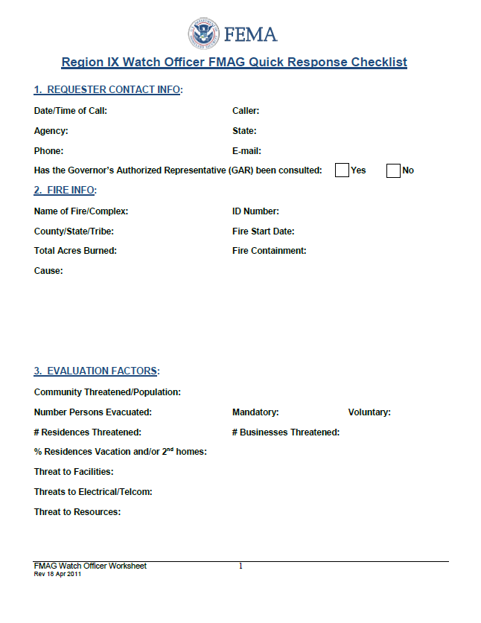
FMAG Transmission to FEMA

Slide 19
Declaration Request
While the initial request is conducted over the telephone, the request and supporting information is followed up by the official documentation
The State or Indian tribal government must complete FEMA Form 078-0-1 (90-58), Request for Fire Management Assistance Declaration, in support of the request, and transmit it to the Regional Administrator.
Accompanying the State’s request:
    Regional Summary and Recommendation
    Principal Advisor’s Report, FEMA Form 078-0-2 (90-32)
    Any additional pertinent information

Slide 20
Principal Advisor
Official of the Forest Service, U.S. Department of Agriculture, or Bureau of Land Management, U.S. Department of the Interior
Called upon by FEMA’s Regional Office to provide a technical assessment of the fire or fire complex for which a declaration request has been submitted
Completes FEMA Form 078-0-2 (90-32), the Principal Advisor’s Report and submits to the Regional Administrator for inclusion in the declaration request package

Slide 21
Requesting a Major Disaster Declaration
A request for a major disaster declaration must be based on FEMA’s determination that the situation is of such severity and magnitude to be beyond the capabilities of California and it's local governments. While other relevant information is considered, following are the primary factors when requesting Public Assistance funding under a major declaration:
Estimated cost of assistance - currently the per capita impact must exceed $3.45 or $53.3 million for an event (FEMA updates this figure annually on October 1)
Localized impacts
Insurance coverage
Disaster history within the last 12 months
Other Federal assistance requested (i.e., USFS, NRCS, FHWA)
More information is available by calling the Recovery Division at (916) 845-8200
or by visiting http://www.caloes.ca.gov/Cal-OES-Divisions/Recovery
Notes:
http://www.caloes.ca.gov/Cal-OES-Divisions/Recovery

Slide 22
Processing A Declaration Request
The FEMA Regional Fire Duty Officer compiles the data and information in the State’s request, Principal Advisor’s statement, and prepares a brief for the FEMA Regional Administrator
The FEMA Regional Administrator approves or denies the request based on:
  The conditions that existed at the time of the State’s request, and,
  Whether or not the fire or fire complex threatens such destruction as would constitute a major disaster.

Slide 23
Processing A Declaration Request
  The FMAG Representative for Cal OES is notified immediately of the success or denial of an FMAG request.
  Once a determination is made, the Declarations Unit provides an email to the Assistant Administrator detailing the declared or denied FMAG.
  The Regional Notification Memo and a White House Memo are drafted the following business day and sent to the appropriate offices.

Slide 24
Cost Share
All FMAGP grants are subject to a cost share
The federal cost share for a FMAGP grant is 75 percent
The 25 percent non-federal cost share can be provided by the grantee, sub grantee, or a combination of the two
Non-
Federal
25%
Federal
75%

Slide 25
FMAG – 2019
Fire and Rescue
FMAG Incident Period
Time interval during which the declared fire occurs.
Typically the period from when the FMAG (ABC) Application is received by OES to the point where the threat to life and property has been mitigated.
  Not necessarily tied to containment.
Cal OES, FEMA, and the agency that requested the FMAG will coordinate to establish the Incident Period.
Costs must be incurred during the incident period and must be incident-related to be considered eligible.

Slide 26
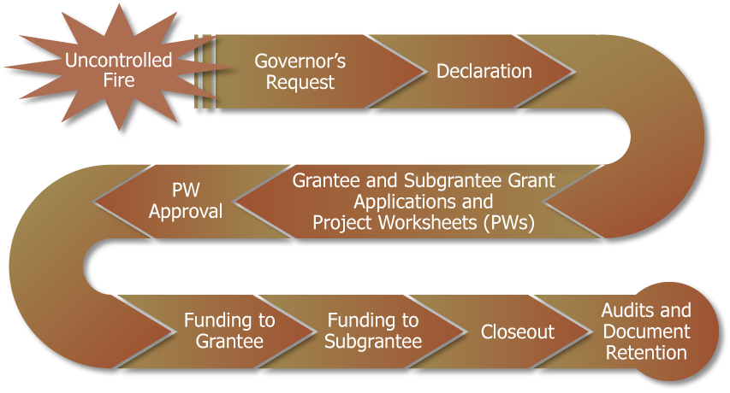
The FMAGP Process

Slide 27
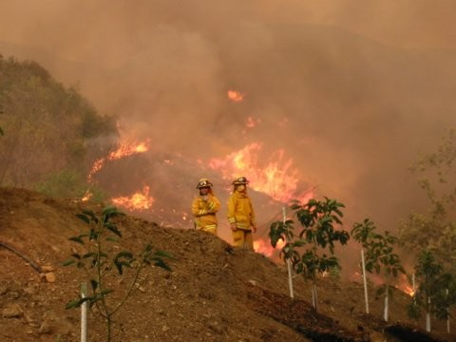
FMAG – Fire and Rescue
FMAG Written Request
The California Office of Emergency Services completes written Request for Fire Management Assistance Declaration (FEMA form 90-58)

Slide 28
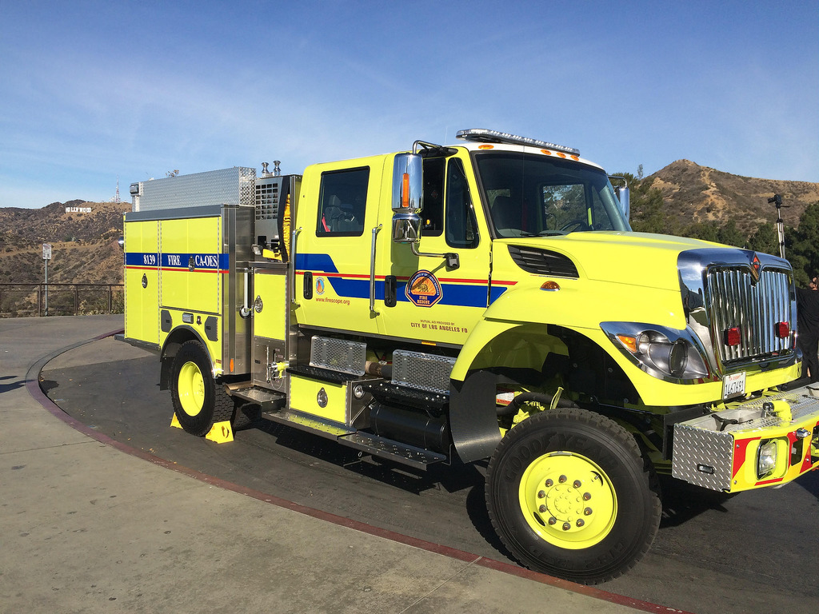
Questions
California Governor’s Office of Emergency Services
Fire and Rescue Division Website
Assistant Chief Mike Lococo
Phone Number: (916) 845-8729
Email Address: mike.lococo@caloes.ca.gov
Thank You!!!

