Slide 1
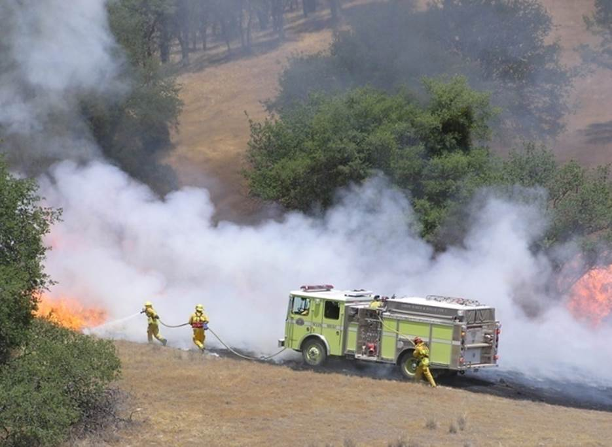









2015 California Fire Assistance Agreement Workshop

Slide 2

Introduction
Welcome
    Introduction of Cadre Members
What is the CFAA and why do we need it?
How did we get here?
    CFAA Committee
    Negotiation Process
Notes:
In 2010, the legislature requested an audit of the CA Mutual Aid System and the reimbursement process.
The audit was conducted during 2011, involving local, state, and federal agencies.
The CA State Auditor released the report findings on January 31, 2012.
Cal OES was directed through this audit to perform sample audits each year to ensure Cal OES and the committee are sharing and providing all information

Slide 3
Purpose
Provide an understanding of expectations on the different Memorandum Of Understanding (MOU’s), Memorandum of Agreement (MOA’s), Governing Body Resolution (GBR’s) or equivalent language, etc.
Assist local government fire agencies in developing accurate rates per the type of classification held.
  Support successful implementation of existing language and changes for 2015.

Slide 4
Agenda
  CFAA Intent
  No 12-Hour Free Period for DOI Agencies
  Actual Administrative Rate Due Date
  MOU/MOA/GBR or equivalent
      Due Dates
      Above straight time above a BC
      Review Process
      Supplemental Personnel exclusion

Slide 5
Agenda (cont.)
    Suppression, Non-Suppression and Supplemental Personnel definitions
    2015 Rate Letter
          Base Rates/Formula
          New OES F-42
  DOD and Tribal Fire Departments
  Reimbursement of fractional hours

Slide 6

Agenda (cont.)
  SAM Registration
  Rental Vehicle Use
  Exhibit G: Out-of-State assignments - travel, per diem and misc. approved reimbursement process
  Exhibit H: In-State assignments – travel,
  per diem and misc. approved reimbursement process

Slide 7
Agenda (cont.)
  Actual Administrative Rate Calculation
  Average Actual Rate Calculation
  Suppression & Non Suppression
  Establishing Supplemental Personnel Rates

Slide 8
The CFAA
Intent :
“It is the intent of the signatories to the CFAA to compensate California Fire and Rescue Mutual Aid System Agencies for the cost of assisting the State of California and the Federal Fire Agencies. The rates, methodologies, and formulas in the agreement are intended to provide for such costs. The compensation shall be consistent with the California Fire and Rescue Mutual Aid System Agency’s normal internal business practices and any existing memorandum of understanding (MOU)/memorandum of agreement (MOA) or governing body resolution, or equivalent which supports those business practices.” (pg. A-1)

Slide 9
Overview and Changes
12 Hour Free Period Exception:
  Department of Interior Agencies will reimburse from initial time of dispatch.
  There will be NO 12 hour free period for order and requests from BLM, NPS, FWS and BIA.
  USFS and CAL FIRE will still require a 12 hour free period.

Slide 10
Overview and Changes
Actual Administrative Rate Due Date:
  Local government fire agencies who prefer to develop an actual administrative rate, are required to develop and submit a new rate by July 1, of each year.
  Failure to submit each year before this date, will default your agency to the base administrative rate set annually each year by the committee (The rate is 10%).
Notes:
The rate will need to accompany a signed salary survey including the rate and the administrative rate calculation sheet is required and now part of the salary survey.

Slide 11
Overview and Changes
Definitions for personnel hours
PORTAL TO PORTAL shall mean the time of initial dispatch from home base to the time of return to home base.
ACTUAL HOURS WORKED shall mean the time/hours actually worked on the incident.

Slide 12
Overview and Changes
Memorandum of Understanding (MOU), Memorandum of Agreement (MOA), Governing Body Resolution (GBR) or Equivalent:
  Any agency seeking reimbursement for personnel for more than actual hours worked on an incident (PORTAL TO PORTAL) must file an MOU/MOA/GBR or equivalent with Cal OES. The MOU/MOA/GBR or equivalent shall indicate how personnel will be compensated.

Slide 13
Overview and Changes
Memorandum of Understanding (MOU), Memorandum of Agreement (MOA), Governing Body Resolution (GBR) or Equivalent (cont.):
  Due to Cal OES by May 31, 2015.
  If an F-42 is submitted and the above documentation is not on file with Cal OES, the local agency has the option to have Cal OES hold the F-42 for processing for up to 90 days to allow for the agency seeking reimbursement to submit the necessary documentation.
  Upon verification that an MOU/MOA/GBR or equivalent is not on file, Cal OES will notify the local agency in writing.

Slide 14
Overview and Changes
Memorandum of Understanding (MOU), Memorandum of Agreement (MOA), Governing Body Resolution (GBR) or Equivalent (cont.):.
  If the local agency does not submit an MOU/MOA/GBR or equivalent within the allowable 90 days, the F-42 will be processed, and the local agency will be paid for ACTUAL HOURS worked.
  This option of providing an MOU/MOA/GBR or equivalent to Cal OES will sunset December 31, 2015, and in no way changes the terms of the 2015 CFAA.

Slide 15
Overview and Changes
Memorandum of Understanding (MOU), Memorandum of Agreement (MOA), Governing Body Resolution (GBR) or Equivalent for Chief Officers:
  Personnel above the Battalion Chief level that have an MOU/MOA/GBR or equivalent that indicates they are to be paid above straight time must have the associated document on file at the time of dispatch to receive full reimbursement for associated personnel cost.

Slide 16
Overview and Changes
Memorandum of Understanding (MOU), Memorandum of Agreement (MOA), Governing Body Resolution (GBR) or Equivalent (cont.):
  Any MOU/MOA/GBR or equivalent is subject to review by the Committee.
  Local government will be formally notified by Cal OES of the determination.
  If your agency submits an MOU/MOA/GBR, only the full complete MOU /MOA/GBR will be accepted. No partial documents will be reviewed.

Slide 17
Overview and Changes
Memorandum of Understanding (MOU), Memorandum of Agreement (MOA), Governing Body Resolution (GBR) or Equivalent (cont.):
      When submitting a numerous page document for review, it’s important to point out and identify the type of language the document is intended to cover and where the language is located.

Slide 18
Overview and Changes
Memorandum of Understanding (MOU), Memorandum of Agreement (MOA), Governing Body Resolution (GBR) or Equivalent exclusion:
  Any agency seeking reimbursement for its Supplemental Personnel will accept rates as outlined in NWCG#2004-2009, Attachment D, which states that Supplemental Personnel will be reimbursed using General Schedule tables with locality pay applied for actual hours worked.

Slide 19
Overview and Changes
Documentation:
  All required documentation for rates and hours shall be based on actual costs to the responding agency, and not contingent upon reimbursement from the State of California or Federal Fire Agencies at a rate that exceeds what the agency will pay its personnel.

Slide 20
Overview and Changes
Definition for Suppression and Non- Suppression Personnel:
  Suppression Personnel shall mean personnel who routinely respond to emergencies.
  Non Suppression Personnel shall mean personnel who occupy a civilian position within a fire agency.
Notes:
Suppression formerly referred to as routine responders
Non Suppression formerly referred to as Civilian

Slide 21
Overview and Changes
Definition for Supplemental Personnel:
  Supplemental Personnel shall mean overhead tied to a local fire department/agency generally by agreement who are mobilized primarily for response to incidents/wildland fires outside of their district or mutual aid zone. They are not a permanent part of the local fire organization and are not required to attend scheduled trainings, meetings, etc. of the department staff.
Notes:
Formerly referred to as retired annuitants/employee etc

Slide 22
Overview and Changes
2015 Rate Letter and Salary Survey:
  On January 01, 2015, the annual rate letter was published.
  Actual Average and Supplemental rates have to be on file at the time of dispatch.
  You may submit rates at any time there is a change or update(s) to your MOU/MOA/GBR or equivalent.
Notes:
If document expires and they do not notify office within the 30 days of negotiations by providing a new document it will expire and you will lose the provisions for OT/Portal to Portal pay

Slide 23
Overview and Changes
Base Rates:
  A standard reimbursement formula and base rates have been established for any agency who is NOT seeking reimbursement for rates higher than what has been set forth by the Committee.

Slide 24
Overview and Changes
Base Rate Formulas:
The following base rate formulas include an overtime component. As a result, the formulas will NOT be calculated at time and one half at invoicing by Cal OES.
  Base Rate formula for Engine Company personnel and Overhead at or below Strike Team/Task Force Leader Trainee:
  (AD-F + CAL FIRE Fire Apparatus Engineer base rate) / 2 = Combined Rate, ((Combined Rate x 40 Hours Straight Time) + (Combined Rate x 128 Hours Overtime)) / 168 = Base Rate Numerical Calculation: 23.28 + 17.88 = 41.16 / 2 = 20.58, ((20.58 x 40) + (20.58 x 1.5 x 128)) = 4774.56 / 168 = $28.42

Slide 25
Overview and Changes
Base Rate Formulas (cont.):
  Base Rate formula for Overhead at or above Strike Team Leader/Task Force Leader :
  (AD-H + CAL FIRE Fire Captain base rate) / 2 = Combined Rate,((Combined Rate x 40 Hours Straight Time) + (Combined Rate x 128 Hours Overtime)) / 168 = Base Rate Numerical Calculation: 28.44 + 22.20 = 50.64 / 2 = 25.32, ((25.32 x 40) + (25.32 x 1.5 x 128)) = 5874.24 / 168 = $34.97
Notes:
The established base rate is based on the average of the CAL FIRE Fire Capt or Fire Apparatus Engineer base rates and the USDA Forest Service emergency hire rates for these positions applied to a 168 hour week, with 40 hours at straight time and 128 hours at overtime. The total amount is divided by 168 hours resulting in a blended rate.

Slide 26
Overview and Changes
Rate Letter Link

Slide 27
Overview and Changes
New Emergency Activity Record (F-42)
  The New F-42 was created to allow documentation for both portal to portal or actual hours worked dependent on your agency’s policy and what has been submitted and approved by Cal OES & or The Committee.
  The F-78 and previous version of F-42’s will be discontinued.

Slide 28
Overview and Changes
New Emergency Activity Record (F-42):
Link to sample F-42

Slide 29
Overview and Changes
Federal/Department of Defense/Tribal Fire Departments:
  Reimbursement of Federal, DOD, and Tribal Fire Departments that respond to Federal Fire Agency fires are governed by other federal agreements. In these cases Cal OES will not produce or process reimbursement invoices for DOD and Tribal Fire Departments.
  Federal and DOD Fire Departments responding under this Agreement will invoice the supported Federal Fire Agency directly in accordance with existing federal and local agreements.

Slide 30
Overview and Changes
Tribal Fire Departments:
  Tribal Fire Departments responding under this Agreement will invoice the BIA directly in accordance with existing federal or local Agreements.
  Tribal Fire Departments that have a compacted or contracted wildland fire program from BIA will respond through the Federal Dispatching System and not through the California Fire and Rescue Mutual Aid System.

Slide 31
Overview and Changes
Tribal Fire Department exception:
  HOWEVER, BIA and Cal OES have mutually agreed to informally allow tribal fire departments that would prefer Cal OES to process and generate invoices on behalf of their department to submit a request to both organizations requesting this process be documented for further billings/reimbursement.

Slide 32
Overview and Changes
Reimbursement for fractional hours:
  In the previous agreement, reimbursement for fractional hours was taken to the next whole hour. Reimbursement for fractional hours will now be taken to the next quarter hour.

Slide 33
Overview and Changes
System for Award Management (SAM):
There is NO fee to register (www.sam.gov).
Once your agency has registered, your agency is required to review and validate annually.
Your agency will receive an email at 60, 30, and 15 days prior to expiration.
Notes:
www.sam.gov

Slide 34
Overview and Changes
System for Award Management (SAM) (cont.):
If the Administrator of your agency leaves the agency without providing the log in and password to a new administrator, a notarized letter must be submitted to SAM to grant access to the new Administrator.
The Administrator can add a second contact within the registration (recommended) so that if one leaves the dept. there is still someone that can access the account (and that person can then add a new second contact).

Slide 35
Overview and Changes
Rental Vehicles:
The use and reimbursement of rental vehicles requires authorization either at the time of the initial request in ROSS, or documented by written approval at the incident.

Slide 36
Overview and Changes
Rental Vehicles (cont.):
Authorized Rental Vehicles: The dispatch/mobilization centers for the requesting State of California or Federal Fire Agencies may make arrangements for procuring rental vehicles, or may direct the California Fire and Rescue Mutual Aid System Agency to make their own arrangements.
Rental vehicles from an airport are discouraged and the use of economy cars is encouraged.

Slide 37
Overview and Changes
Rental Vehicles (cont.):
Authorized Rental Vehicles on the resource order do not need additional incident approval. The cost of the rental vehicle, if incurred by the local agency, and fuel purchased to operate the rental vehicle must be submitted on the “travel expense claim reimbursement log” with attached receipts and the ROSS order validating the approval.

Slide 38
Overview and Changes
Exhibit G – Federal Interstate Agreement:
  Procedures and reimbursement provisions of personnel and local government-owned emergency apparatus ordered for use on Federal incidents outside the State of California.
  Reimbursement of personnel, emergency apparatus, and support equipment will be consistent with Exhibit A Reimbursement Policy and Procedures with the following exceptions:

Slide 39
Overview and Changes
Exhibit G – Federal Interstate Agreement (cont.):
  Travel costs for lodging and per diem for personnel shall be reimbursed at the rates and methods established within Exhibit H, limited to the California State Standard Per Diem Rates in effect at the time of the response.
  Lodging expense will follow the “all counties/cities located in California” up to 90.00 per night, plus tax.

Slide 40
Overview and Changes
Exhibit G – Federal Interstate Agreement (cont.):
  Exceptions will be handled case by case with formal documented written approval.
  The rates and methods established by the U.S. General Services Administration (GSA) will no longer be used.

Slide 41
Overview and Changes
Exhibit H – In-State Travel and Incident Related Expenses:
  Identifies allowable costs and the process for submitting such cost.
  Primarily pertains to cost associated with fuel, food, vehicle and lodging.
Notes:
Provide handout and go over the process

Slide 42
Overview and Changes
Exhibit H – In-State Travel and Incident Related Expenses (cont.):
At no time will the California Fire and Rescue Mutual Aid System Agencies seek reimbursement for travel expenses such as fuel, food, and lodging responding to, during or returning from a State of California or Federal Fire Agency incident unless formally documented and approved in writing at the incident. The reimbursement of meals to and from the incident will be subject to the California state standard per diem and lodging rates specified in Exhibit H.
Notes:
Provide handout and go over the process

Slide 43
Overview and Changes
Exhibit H – In-State Travel and Incident Related Expenses (cont.):
Travel arrangements and reimbursement including travel for relieving personnel and backfill will only be made from the fire dept/agency location or residence whichever is closest to the incident or reporting location.
In order for agencies to be eligible for reimbursement of expenses related to the incident, the approval MUST be formally documented with an associated Supply (S) #.
Notes:
Provide handout and go over the process

Slide 44
Overview and Changes
Exhibit H – In-State Travel and Incident Related Expenses (cont.):
Exhibit H

Slide 45
Administrative Rate Effective Date
The base Administrative Rate will be set utilizing the OMB Circular A-87, appendix A methodology.
This rate (10%) will be reviewed and set annually by the committee per the annual rate letter published by Cal OES Fire and Rescue Division.
You may choose to utilize an agency specific administrative rate in accordance with the actual administrative rate process and instructions. Please submit this rate via your respective salary survey.
Notes:
Again must be submitted each year by July 1 or will default to the base 10%

Slide 46
Administrative Rate Definitions
“Expenses”
Labor – include all salaries and benefits
Services and Supplies – services and supplies include consumable items with a useful life of less than one year
Minor Equipment – items with a useful life greater than one year and less than $5,000 per unit cost
Fixed Assets – items with a per unit cost of $5,000 or more

Slide 47
Administrative Rate Definitions (cont.)
“Cost Characteristics”
Allowable – costs included in the computation of the indirect/administrative cost rate
Unallowable – costs excluded from the computation (see OMB Cir A-87 Appendix B)
http://www.whitehouse.gov/omb/circulars_default
Notes:
http://www.whitehouse.gov/omb/circulars_default

Slide 48
Administrative Rate Definitions (cont.)
“Allowable Cost Categories”
Direct – costs identified specifically with agency’s DIRECT operations or costs that can be identified specifically with a particular final cost objective
    Use Table – DO NOT DEVIATE
Indirect – expenses not identified with operations but rather administrative or supporting costs
    Use Table – DO NOT DEVIATE
Descriptions and definitions of Programs that are allocated to Direct and Indirect cost pools are included in instructions from Cal OES

Slide 49
Administrative Rate Definitions (cont.)
Cost Categories * | Indirect | Direct | Unallowable
Emergency Medical Services | x | x
General Administration | x |  | Costs of Lobbyists, City Council Members, Board of Supervisors, Board of Director
Information Technology | x
Logistics/Procurement/Supply/ Minor Fire Equipment | x
Public Information Office | x
Telecommunications | x
Arson Investigation |  | x
Community Education |  | x
Facilities |  | x
Fire Communication Center/Dispatch/Command and |  | x
Fire Hazard Reduction Program |  | x
Fleet |  | x | Costs of Fixed Asset Purchases, Replacements and Depreciation.
Hazardous Materials Response Program |  | x
Mapping |  | x
Operations |  | x
Prevention |  | x
Training |  | x
Urban Search and Rescue |  | x
* Cost categories include salaries and benefits, services and supplies and minor equipment.

Slide 50
Administrative Rate Calculations
USE TEMPLATE PROVIDED
      “Actual Administrative Rate Calculation Sheet”
Insert prior year actual departmental indirect and direct costs into Template (referred to as “prior prior actual”).
Not all categories of direct and indirect costs will follow your normal practice; however, this was an equitable, reasonable, and defendable approach and shall not be changed.

Slide 51
Administrative Rate Calculations (cont.)
Divide the sum of the allowable indirect costs into the allowable direct costs to generate indirect/administrative percentage
Indirect costs/direct costs = indirect cost rate %

Slide 52
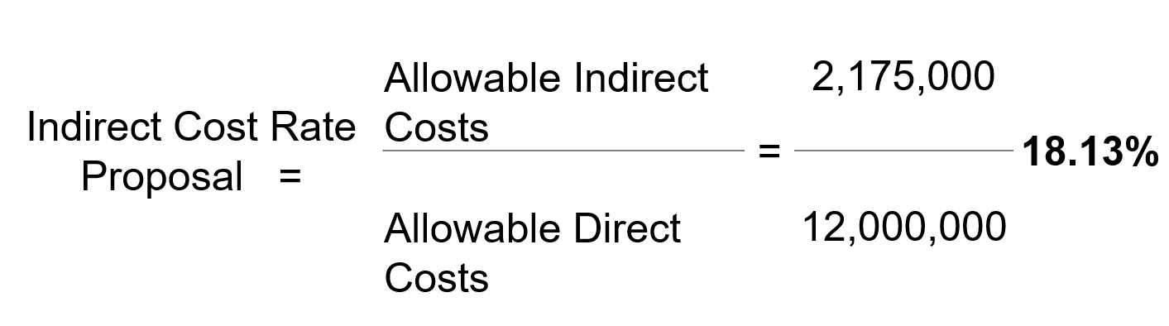
Calculating Indirect Cost Rate
Proposal

Slide 53
Average Actual Personnel Rates
Identify classifications for which you will be seeking reimbursement (including Suppression and Non Suppression)
Identify current actual base hourly rate (regular salary without benefits) for each employee within each classification
If hourly rate is not readily available from local agency system:
    Use 2,912 annual hours for 56 hour employees
    Use 2,080 annual hours for 40 hour employees
Notes:
The average actual personnel rate concept has not changed for Suppression personnel. However, we have done away with the two rate requirement for non suppression which included a ST rate for ST hours worked and an OT rate for OT hours worked. Now both Suppression and Non Suppression personnel will utilize the same process for developing their rate.
The 1.5 multiplier in the formula for non suppression represents an hourly rate which includes benefits for ST and an overtime rate for OT hours.
The 1.5 multiplier in the formula for suppression represents for all personnel costs associated with assisting the Federal and State agencies within this agreement.

Slide 54
Average Actual Personnel Rates (cont.)
Identify specialty and incentive pay that is tied to each OVERTIME hour worked. If there is no payment to the employee or no cost to the department for that benefit when an OT hour is worked, then DO NOT include.
For each employee, add hourly salary and benefit costs together.
Calculate average hourly rate for the classification.

Slide 55
Average Actual Personnel Rates Incentive/Specialty Pay and Benefits
Varies from department to department – if the incentive/specialty benefit is paid when a person works OT then it should be included
Examples: Paramedic, Hazmat, EMT, USAR, education, longevity, FICA, and Medicare – this is not an all inclusive list
Benefits typically not earned for each OT hour worked are retirement, health insurance, and merit pay

Slide 56
Average Actual Personnel Rates
Calculation Example
Job Classification – Firefighter |  | Amount
Base Salary - Current Actual Annual Salary |  | 75,924
Annual Scheduled Hours | 56-Hour Employee | 2,912
Regular Hourly Rate without benefits |  | 26.07
Incentive/Specialty Pay (Specify) | Emergency Medical Technician | 0.75
 | Education Incentive | 0.34
 | Paramedic Premium Pay | 2.00
Hourly Rate with Incentive Pays |  | 29.16
.
Benefits
FICA/Medicare | 1.45% | 0.42
Retirement | Not Applicable to overtime | -
Health Benefits / Flex Credits | Not Applicable to overtime | -
Other: (Specify) |  | -
Hourly Actual Rate (including applicable benefits) for FF/Medic 1 |  | 29.58
Notes:
Ask Abbe about this????

Slide 57
Example of Correct Classification Calculation of Average Actual Rates
Average All Firefighters
 | .
Example: | Average Actual Rate
Firefighter Paramedic 1 | 29.58
Firefighter Paramedic 2 | 29.28
Firefighter Paramedic 3 | 28.34
Firefighter 4 | 25.10
Firefighter 5 | 23.19
Firefighter 6 | 24.20
Firefighter 7 | 24.67
Average Actual Hourly Rate | 26.34

Slide 58
Incorrect Classification Calculation
DO NOT Average Steps Separately
.
FF/PM Step 2 | Average Actual Rate
Firefighter Paramedic 1 | 29.58
Firefighter Paramedic 2 | 29.28
Firefighter Paramedic 3 | 28.34
Average of FF/PM Step 2 | 29.07
FF/PM Step 1
Firefighter Paramedic 1 | 25.10
Firefighter Paramedic 2 | 23.19
Firefighter Paramedic 3 | 24.20
Firefighter Paramedic 4 Average of FF/PM Step 1 | 24.67 24.29
Average Actual Hourly Rate | 29.07+24.29 /2 = 26.68 27.71
Notes:
Do not take average all individuals in each step separately, using the average of each step to come up with a total average for the classification. This will give an equal weight to each step, regardless of the number of individuals in each step. This results in an incorrect calculation as per the CFAA Salary Survey Instructions.

Slide 59
Incorrect Classification Calculation
DO NOT Average Step Ranges
.
Example: | Average Actual Rate
FF/PM Step 1 ($20-25) | 22.50
FF/PM Step 2 ($25-30) | 27.50
FF/PM Step 3 ($30-40) | 35.00
Firefighter Step 1 ($10-15) | 12.50
Firefighter Step 2 ($15-20) | 17.50
Firefighter Step 3 ($20-25) | 22.50
Firefighter Step 4 ($25-35) | 30.00
Average Actual Hourly Rate | 26.34 23.93
Notes:
Do not average the salary range of each step, using the average to compute a total average for the classification. Each individual’s rate must be used in the calculation of the average actual rate.

Slide 60
Establishing Supplemental Personnel Rates
Rates and calculations for Supplemental Personnel:
  Determine all names of supplemental personnel attached to your agency.
  Include each qualified Incident Command System (ICS) position title the employee/personnel may hold (e.g., OSC2, DIVS, STAM,FSC1).
  http:www.nwcg.gov/general/memos/nwcg-004-2009.pdf
Notes:
Bring up website to show example
http:www.nwcg.gov/general/memos/nwcg-004-2009.pdf

Slide 61
Establishing Supplemental Personnel Rates (cont.)
Rates and calculations for Supplemental Personnel:
Go to website http://www.opm.gov/policy-data-oversight/pay-leave/salaries-wages/2015/general-schedule/.
Indicated the GS pay rate at step 5 for each position held. If the locality pay applies to the location under your agency, use the appropriate GS locality pay rate associated with your fire agency and NOT your residence.
Notes:
http://www.opm.gov/policy-data-oversight/pay-leave/salaries-wages/2015/general-schedule/

Slide 62
Establishing Supplemental Personnel Rates (cont.)
Rates and calculations for Supplemental Personnel (cont.):
  Supplemental employee’s will submit for reimbursement for the ICS position the incident ordered and requested and NOT the highest ICS position held.

Slide 63
Salary Survey(s)
Salary Survey’s
Link to Salary Survey (Suppression)
Link to Salary Survey (Non Suppression) Attach A
Link to Salary Survey (Supplemental) Attach B

Slide 64
Deadlines/Timelines
Critical Deadline Matrix
CFAA Reimbursement Timelines

Slide 65
Resources and References
California Fire Assistance Agreement (CFAA) and related documents:
http://www.caloes.ca.gov/FireRescueSite/Pages/Reimbursement.aspx
Cal OES Fire website
http://www.caloes.ca.gov/Cal-OES-Divisions/Fire-Rescue
FEMA website (equipment rates):
http://www.fema.gov/government/grant/pa/eqrates.shtm
Notes:
http://www.caloes.ca.gov/FireRescueSite/Pages/Reimbursement.aspx
http://www.caloes.ca.gov/Cal-OES-Divisions/Fire-Rescue
http://www.fema.gov/government/grant/pa/eqrates.shtm

Slide 66
Questions / Help?
Notes:
Familiarize yourself with all 8 Exhibits.
ExA-Personnel and Equipment rates, methods and formulas
ExB-Engine, Equipment, Personnel & Training Standards for Fire and Emergency Assistance
ExC-Reimbursement for Personnel Rotation
ExD-Communication Capabilities
ExE-Training Standards for Personnel and Equipment
ExF-FEMA Equipment Rate Formula for equipment not identified in the agreement or within FEMA’s schedule or Equip Rates
ExG-Reimbursement Policy and Procedures for Outside the State of California Assignments
ExH-In State Travel and Incident related expenses
ExI-Definitions

Slide 67
Contacts
Yolie Thomas, Assistant Director, Incident Administration
ythomas@fs.fed.us
707-562-8835 – United States Forest Service, Region 5
  Anjulie White, Administrative Officer
anjulie.white@bia.ca.gov
916-978-6146 – Bureau of Indian Affairs
  AnnMarie Carlson, Program Analyst
    acarlson@blm.gov
916-978-4446 – Bureau of Land Management

Slide 68
Contacts
Lori Lopez, Emergency Services Coordinator
lori.lopez@caloes.ca.gov – Local Gov’t Rep
916-845-8722 – Cal OES Fire and Rescue Division
Michelle Lawrence, Emergency Response Billing Office Manager
michelle.lawrence@fire.ca.gov
916-653-5335 – CAL FIRE
Mike Rosales, Deputy Chief, State and Federal Programs
mike.rosales@fire.ca.gov
916-653-8362 – CAL FIRE

Slide 69
CFAA Local Government Representatives
Richard H. Webb, Fire Chief
rich.webb@lindafire.org – 530-743-1553
Local Government Rep North/Volunteers
Linda Fire Protection District
Mark Lorenzen, Fire Chief
Mark.lorenzen@ventura.org – 805-389-9704
Local Government Rep South
Ventura County Fire Department
Vacant
Local Government Rep Volunteers

