Slide 1
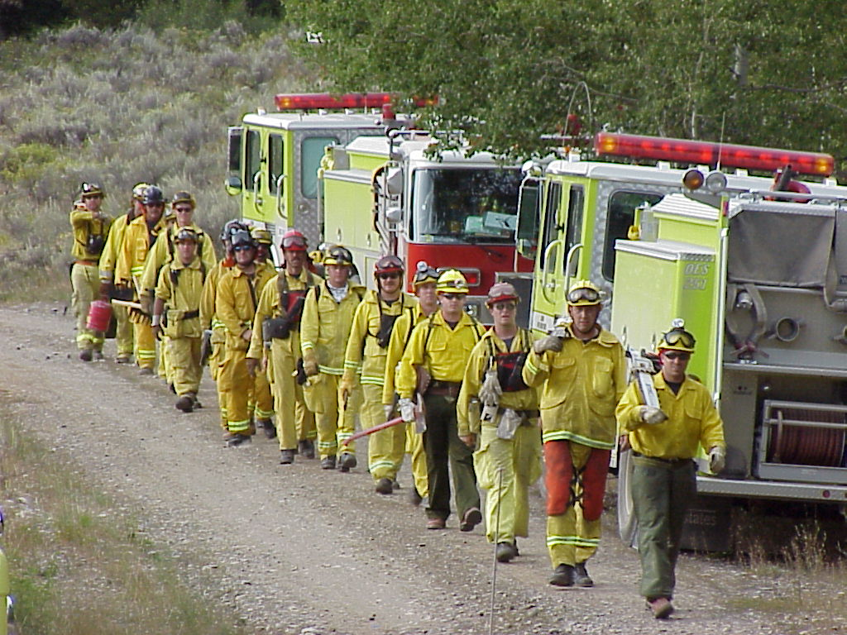


2010 CICCS REVIEW
California
Incident
Command
Certification
System
(CICCS)
Notes:
Cover slide

Slide 2
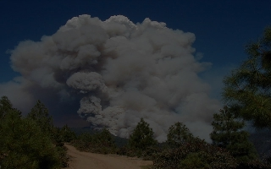
History Of CICCS
1995-Meeting between stakeholders to discuss the implementation of ICS.
1996-TaskForce developed the Calabasas Fire Report.
1997(April)-FIRESCOPE Reviewed the findings from the Calabasas Fire.
1997 (June)-Recommendation to SBFS for the development of a Task Force to develop an all-risk certification/qualification program.
1997 (October)-FIRESCOPE Board of Directors concurred with SBFS.
1998-CICCS Task Force established
Notes:
1995 - SFMO, OES & Cal Chiefs met with 230 Chiefs and Training Officers to discuss the use & implementation of ICS. The 1991 Tunnel Fire (Oakland Hills) & the 1993 California Firestorms after action reports cited ICS training deficiencies. Discussed was the creation of a system to “…..standardize certification and qualifications for ICS positions.”
1996 - After the October 1996 Calabasas fire, a task force comprised of LA County, Glendale & LA City developed the Calabasas Fire Report. A total of 56 recommendations were developed to enhance fire agencies’ capability to combat wildland fire incidents and provide for safety of personnel. There was agreement that the 12 highest priority recommendations be forwarded to FIRESCOPE for review and implementation on a statewide basis.
April 1997-OES Fire & Rescue Service Advisory Committee/FIRESCOPE Board of Directors were presented with the findings of the Calabasas Fire Report by P.Michael Freeman. Three of the recommendations involved “Development of qualifications & experience requirements for all fire fighters responding to mutual aid wildland/urban interface incidents.”
June 1997-The Training Chief, CDF/SFMO presented a recommendation to the Board that “the Board of Directors should appoint members to a working group chaired by SFMO to develop standards for all- risk incident mgt…using NWGC 310-1 as a model”
October 1997-OES Fire & Rescue Service Advisory Committee/FIRESCOPE Board of Directors “..agreed that SFMO should lead in the development of State of California Incident Management Certification and Qualification for the State….”
1998-California Incident Command Certification (CICCS) Task Force established with representatives from CDF/SFMS; CDF; OES; Chico FD; Riverside FD; LA County FD & State Board of Fire Services, CSFA.
November 2000 - CICCS Adopted by State Board of Fire Services & OES Fire & Rescue Service Advisory Committee/FIRESCOPE Board of Directors.
August 1, 2002 - Implementation by the State Fire Marshals’ Office and the Governors’ Office of Emergency Services Fire & Rescue Branch.

Slide 3
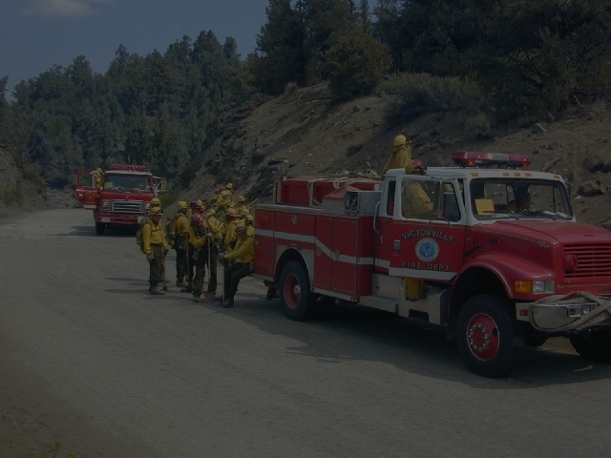
History Of CICCS
1999 - CICCS Task Force presents recommendations to the State Board of Fire Services who agreed on the following elements:
      Voluntary Fire Department Participation
      Historical Recognition of Prior Experience
      Specific System Components
      Utilizing NWCG 310-1
2000 - CICCS Adopted by SBFS and FIRESCOPE
2002 - CICCS Implemented
Notes:
History

Slide 4
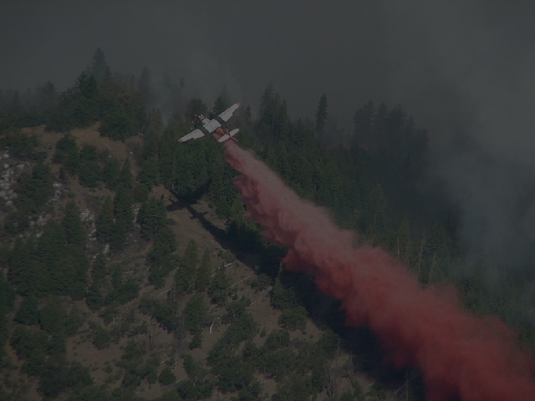
History Of CICCS
2010 - California Version of CICCS Adopted by State Board of Fire Services & OES Fire & Rescue Service Advisory Committee/FIRESCOPE Board of Directors.
JULY, 1 2010 - Implementation of California Version of CICCS
Notes:
History

Slide 5
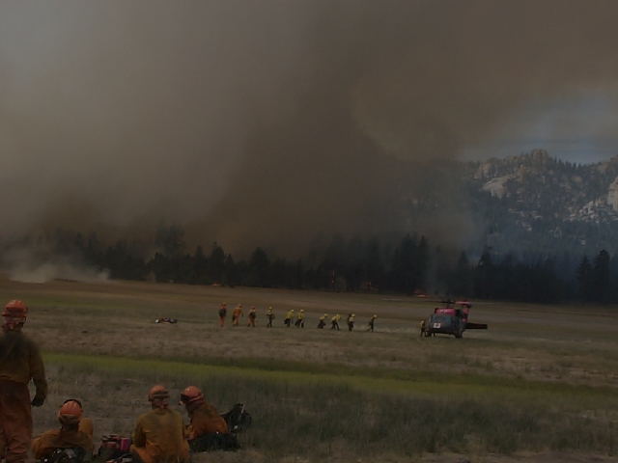
CICCS INTRODUCTION
Goal-To Enhance the abilities of our State’s firefighters to adequately prepare themselves to respond to all types of incidents by clearly identifying certification criteria.
Objective-Create a Qualification System that meets the needs of the California Fire Service.
Notes:
CICCS Incident Qualifications Guide recognizes the need to provide the California Fire Service a document that captures not only the National Wildfire Coordinating Group (NWCG) direction on wildland fire and includes components of the National Incident Management System (NIMS) all-hazard certification and qualification requirements.

Slide 6
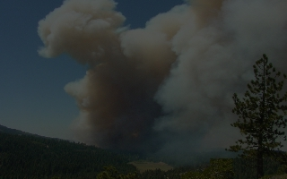
What is the California Incident Command Certification System?
CICCS Is:
A certification system for positions within the Incident Command System.
A “Performance Based System” utilizing established minimum training standards and documented experience.
Notes:
CICCS is:
A certification system for positions within the Incident Command System.
A “Performance Based System” utilizing established minimum training standards and documented experience.

Slide 7
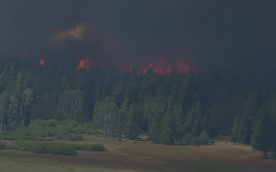
CICCS Terminology
Certification: The process whereby the State Fire Marshal’s Office confirms through the local fire chief, EMA operational area or EMA region that an individual has completed the required coursework and has obtained documented experience.
Qualification: The process whereby the fire chief affirms physical fitness and currency in the position and makes the individual available to the mutual aid system.
Notes:
Certification – Required coursework and documented experience
Qualification – Affirmation of physical fitness and currency

Slide 8
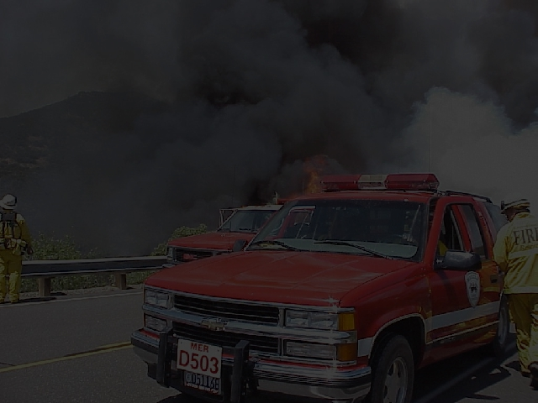
AUTHORITY
CICCS Taskforce is a sub-committee
Of the State Board of Fire Services (SBFS).
Notes:
SBFS has representation by
Labor
Fire Chiefs
Fire Districts
Volunteer Firefighters
City & County Fire Depts.
Cal Fire
Cal EMA
Insurance Industry
Chaired by the SFM

Slide 9
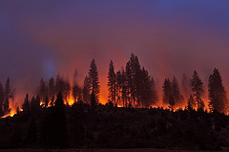
CICCS Program Responsibility
Cal EMA
Establishing both the Operational PEER Review and Regional PEER Review Committees.
Overseeing the PEER Review Process.
Providing a Statewide point of contact for CICCS
Coordination of the CICCS Taskforce
Providing Coordination of CICCS between Cal EMA and the SFM
Providing Coordination of CICCS with FIRESCOPE
Managing publications and documents of the CICCS Program.
Notes:
History

Slide 10
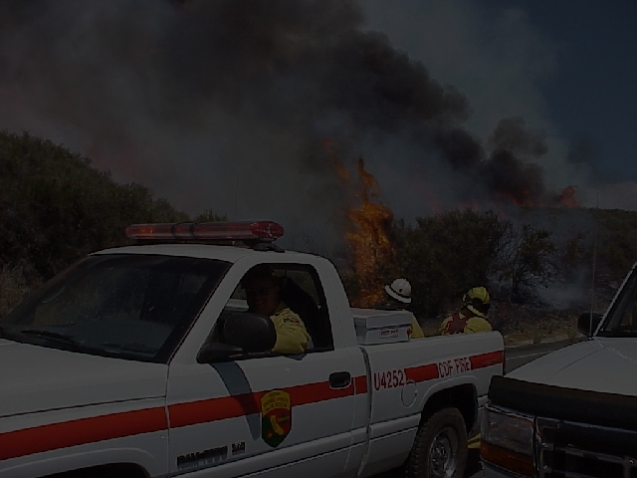
CICCS Program Responsibility
FIRESCOPE
Provides professional and technical information to the CICCS Taskforce.
Jointly developed position requirements for ICS positions.
Is responsible for operations, development and maintenance of ICS and Multi-agency Coordination.
Provides the common voice for the California Fire Service on CICCS.
Notes:
History

Slide 11
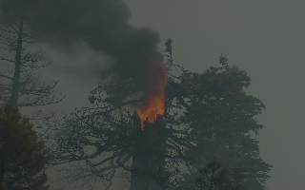
CICCS Program Responsibility
Office of the State Fire Marshal
Provides guidance to the CICCS Taskforce in matters regarding the PEER Review process.
Provides CICCS Certificates to the Operational Area, Regional Level and State Level peer review committees.
Establishes the CICCS Taskforce for the review of the Type I, Area Command and unique applications.
Ensures that the CICCS Taskforce committee meets the membership requirements as outlined in the SFT Procedures Manual.
Issues the CICCS Certificates for all positions reviewed.
Notes:
Reasons for needing CICCS

Slide 12
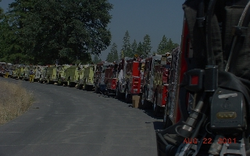
CICCS Program Responsibility
Departments and Agencies
Endorses the CICCS peer review process.
Educates their department/agency on the CICCS process.
Maintains all training records pertinent to CICCS.
Issues annual qualification cards.
Provides accurate and complete CICCS application packets to the peer review committees.
Notifies and/or provides ICS training opportunities to their members.
Provides representation to CICCS peer review committees when requested.
Provides 100 and 200 level certification certificates for the positions they are responsible for reviewing and certifying.
Notes:
Gordon Graham Risk Matrix (used with permission)
Matrix illustrates that local government use in the wildland arena is High Risk and Low Frequency.

Slide 13
CICCS Program Responsibility
Fire Chiefs and Administrators
Validates that their personnel meet all the requirements as set forth in the CICCS process.
Sets physical fitness standards.
Signs the letter of application for CICCS peer review.
Provides final review and approval for qualification of their personnel following peer review certification.
Responsible for re-certification and de-certification.
Notes:
Gordon Graham Risk Matrix (used with permission)
Matrix illustrates that local government use in the wildland arena is High Risk and Low Frequency.

Slide 14
CICCS Program Responsibility
INDIVIDUALS
Completion of all requirements outlined in the CICCS application process prior to submitting an application.
Maintain all original course completion certificates and position task books (PTB’s)
Maintain all performance evaluations for currency.
Insure qualification cards are current.
As trainee responsible for possessing initiated PTB when assigned to an incident as trainee.
Notes:
Gordon Graham Risk Matrix (used with permission)
Matrix illustrates that local government use in the wildland arena is High Risk and Low Frequency.

Slide 15
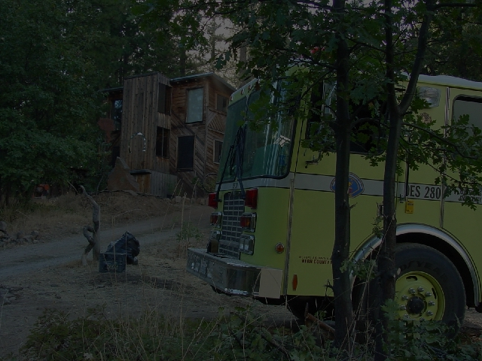
TRAINING
Several types of training that include both required and recommended.
All Training Must include
  Approved quality curriculum.
  Approved qualified instructor.
  Proper course completion certificate
It is the Host Agencies responsibility to insure the above items components are provided.
The Peer Review committee may not accept the the course certificate if these components are not provided.
Notes:
Task Force Recommendations

Slide 16
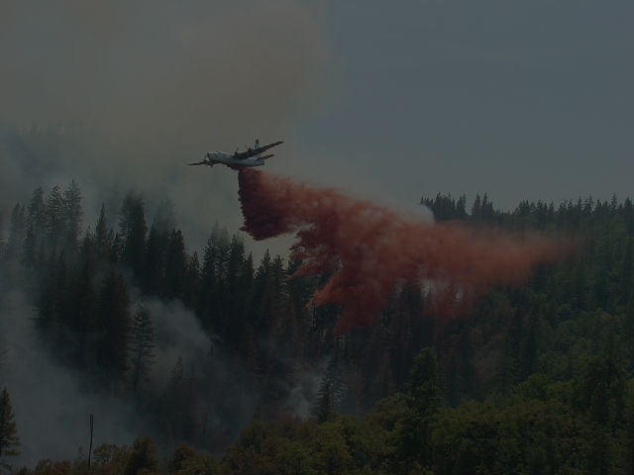
APPROVED COURSE CURRICULUM
It is recommended that Departments/Agencies provide classes that are offered through:
NWCG member agencies or their designated approved partners
California State Fire Training FSTEP classes
Approved Courses are made available through many different sources.
State Fire Training (FSTEP)
NWCG
NIMS
NFA / EMI
Notes:
Why NWCG 310-1

Slide 17
COURSE CURRICULUM
The NWCG courses are the base comparative courses used to evaluate all other courses.
A complete list of the equivalent approved courses is provided in the equivalent matrix found in the Appendix.
Approved courses have specific competency components that must be met in order to maintain the courses approved objectives and intent.
Each course must use a qualified instructor, teach to the course objectives, use the approved course materials and meet the minimum classroom hour requirements.
Notes:
Why NWCG 310-1

Slide 18
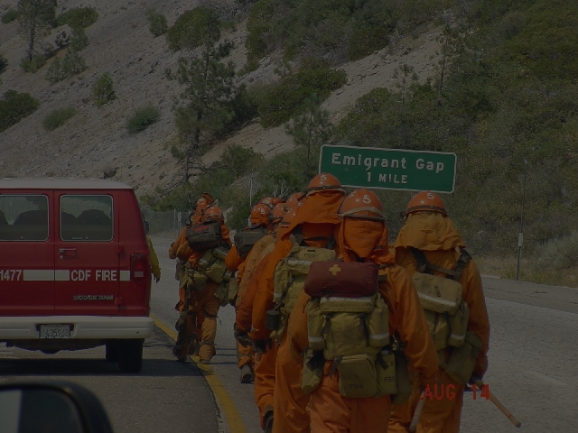
EQUIVALENCIES
CICCS recognizes that agencies may have a need to use or develop alternative courses and curriculum. An agency using alternative course curriculum must have:
A reason the alternative course was used.
A benefit gained through the use of the alternative course, such as:
  Cost Savings
  Broadened Target Audience
  Enhanced Learning Experience for the Students.
Notes:
CICCS Components

Slide 19
EQUIVALENCIES
Should an agency desire to seek course equivalency they should conduct a detailed analysis and document their findings, which should include:
All learning and performance objectives of the course are met or exceed the original course.
Same Instructor qualifications are met.
Course pre-requisites are not altered.
The equivalent course does not conflict or contradict established SFM or NWCG guidelines and standards.
Analysis should be presented to the SFM Office for consideration as outlined in the State Fire Training Procedures Manual.
Notes:
CICCS Components

Slide 20
INSTRUCTORS
Instructors for FSTEP or NWCG courses must adhere to the following:
Instructors shall meet the requirements as outlined in the State Fire Training Procedures Manual or NWCG Field Manager’s Course Guide.
Have attended and passed the course being instructed.
Meet teaching experience requirements.
Additional specific instructor requirements are outlined in the Qualifications Guide
Notes:
Instructors can only issue NWCG Certs if there is a member agency hosting the course.

Slide 21
CERTIFICATES
Certificates are the foundation of the CICCS Program. The Course completion certificate should include:
Correct name of ICS course.
Instructor name, signed and printed legibly.
Instructors Department/Agency
ICS Qualifications as it relates to the course instructed.
Notes:
CICCS Incident Qualifications Guide recognizes the need to provide the California Fire Service a document that captures not only the National Wildfire Coordinating Group (NWCG) direction on wildland fire and includes components of the National Incident Management System (NIMS) all-hazard certification and qualification requirements.

Slide 22
Required Training
Identified Required Training
Required Training can not be challenged
Required Training must be completed prior to issuing a PTB
Exception S-420, S-520, CIMC, and S-620
Refresher Training RT-130, no hour requirements
Recurrent Training, every 2-3 yrs. HRSP, HMGB
Notes:
History

Slide 23
Recommended Training
Recommended Training is not required
Departments/Agencies / Op Areas may set higher standards
Job Aids
How To booklets
Part of Required Training
Each Department/Agency needs to appoint an administrator to oversee Job Aid performance
Notes:
SBFS has representation by
Labor
Fire Chiefs
Fire Districts
Volunteer Firefighters
City & County Fire Depts.
Cal Fire
Cal EMA
Insurance Industry
Chaired by the SFM

Slide 24
NWCG Equivalencies
Notes:
California equivalencies to NWCG courses.

Slide 25
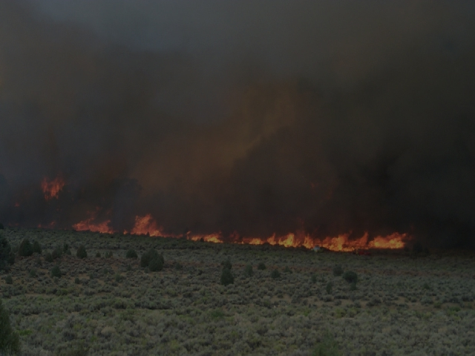
CICCS Components
Position Task Books
Contain all the identified minimal critical competencies, behaviors and tasks required to become certified for an ICS position.
An individual may have not have more than four active PTB’s open at one time.
  May not have more than two in a single function area.
Cannot have a PTB initiated while still a trainee in a pre-requisite position, except DIVS
PTB’s can only be initiated by the agency the individual is employed by.
Notes:
There is an exception to required training-the command and general staff positions that require 420, 520, and 620.
A department my require the recommended courses.

Slide 26
CICCS Components
Position Task Books
PTB must have the first required task completed within 5 years of completion of required core training.
Minimum of two (2) quality assignments.
  Must include line assignments for operations
PTB must be completed within 5 years of first required task being documented.
Notes:
There is an exception to required training-the command and general staff positions that require 420, 520, and 620.
A department my require the recommended courses.

Slide 27
CICCS Terminology
Certification: The process whereby the State Fire Marshal’s Office confirms through the local fire chief, EMA operational area or EMA region that an individual has completed the required coursework and has obtained documented experience.
Qualification: The process whereby the fire chief affirms physical fitness and currency in the position and makes the individual available to the mutual aid system.
Notes:
Certification – Required coursework and documented experience
Qualification – Affirmation of physical fitness and currency

Slide 28
Transferring Qualifications
From a non-CICCS participating Sponsoring Department/Agency (USFS, BLM, NPS, CAL FIRE, out of state agency) to a CICCS participating Sponsoring Department/Agency (Local Government)
Transferring CICCS Qualifications from Operational Area/Region to another Operational Area/Region
Notes:
Certification – Required coursework and documented experience
Qualification – Affirmation of physical fitness and currency

Slide 29
Currency
Currency can be maintained by:
By successful performance in the position qualified for within the stated timeframe.
By successful performance in a position identified in this Guide as “other position assignments that will maintain currency”.
Successfully complete a trainee assignment in the position which they were qualified. This will apply when a qualified individual falls out of currency and has reverted back to trainee status.
participating in a documented scenario based exercise or drill.
Notes:
Certification – Required coursework and documented experience
Qualification – Affirmation of physical fitness and currency

Slide 30
CICCS System Components
Decertification / Disqualification
Recertification
Physical Fitness
In an effort to ensure individual safety, CICCS recommends that all agencies consider health and fitness components that may include:
  Baseline Medical Evaluation
  A Comprehensive Wellness and Fitness Program
  Evaluation to determine that an individual can meet the physical demands of the position for which they are being qualified.
Notes:
Certification – Required coursework and documented experience
Qualification – Affirmation of physical fitness and currency

Slide 31
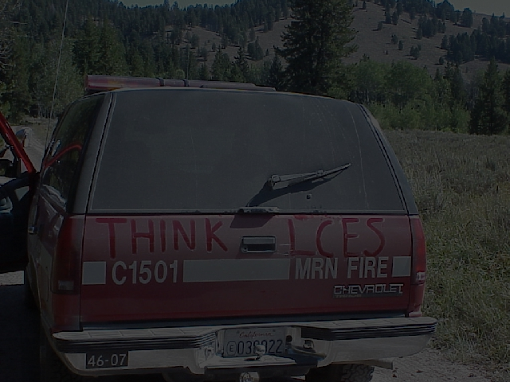
Op Area, Regional, State Peer Review Committee Membership
City Fire Department
Metro Fire Department
Fire Protection District
CAL FIRE
Cal EMA Fire & Rescue
Contract County
Federal Wildland Fire Agency
Federal Military Fire Agency
Tribal Fire Agency
Labor Organization
Independent Volunteer Fire Department
Qualified ICS Training Specialist (From any fire agency)
Community College
Notes:
Peer review committee membership. Not all positions need to be filled. The idea is that if an agency borders one of these jurisdictions, then they may have a seat on the committee.

Slide 32
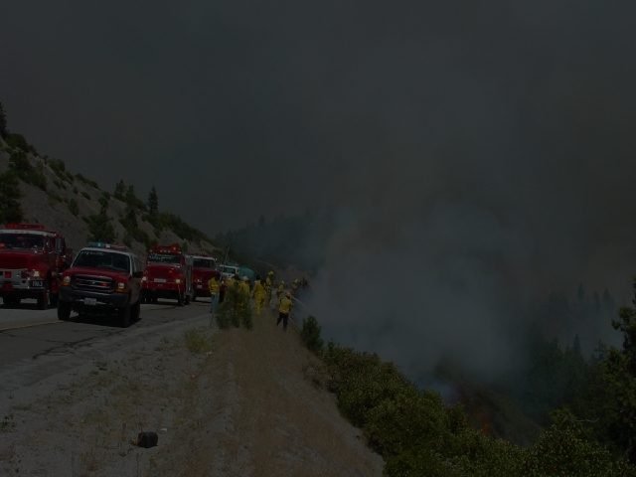
PEER REVIEW LEVELS
Local-Department/Agency
Fire Chief Authorization
FFT2, FFT1, ENGB, CRWB, ICT4, ICT5, FEMT, EMTP, AREP
Operational Area
ICS 200 and 300 Level Positions
Regions
ICS 300 and 400 Level Positions
CICCS Task Force - (PACE V)
500, 600, and unique positions
Notes:
Peer Review Committee Structure
ICS “Leader” Level Positions
ICS Command & General Staff Level

Slide 33
Peer Review Comm. Responsibilities
Each Committee will meet at least annually
Committee can not be less restrictive than this document.
Operational Area Chiefs can require additional training and experience.
Can require trainee applications to be reviewed prior to entry into ROSS
Committee shall conduct an annual audit of ROSS
Each Peer Review Committee shall submit their membership roster to the CICCS TF through their EMA Regional Chief
Notes:
History

Slide 34
Sponsoring Department/Agency
Peer Review
The sponsoring Department/Agency will be responsible for the review, Certification and Qualification of the following positions:
Crew Boss (CRWB) | Incident Commander Type 4 (ICT4)
Engine Boss (ENGB) | Incident Commander Type 5 (ICT5)
Firefighter 1 (FFT1)
Notes:
SBFS has representation by
Labor
Fire Chiefs
Fire Districts
Volunteer Firefighters
City & County Fire Depts.
Cal Fire
Cal EMA
Insurance Industry
Chaired by the SFM

Slide 35
Operational Area Peer Review
Agency Representative (AREP)
Aircraft Base Radio Operator (ABRO)
Aircraft Dispatcher (ACDP)
Aircraft Time Recorder (ATIM)
Base/Camp Manager (BCMG)
Claims Specialist (CLMS)
Communications Unit Leader (COML)
Communications Tech (COMT)
Claims Unit Leader (COMP)
Cost Unit Leader (COST)
Deck Coordinator (DECK)
Demobilization U.L. (DMOB)
Display Processor (DPRO)
Documentation Unit Leader (DOCL)
Dozer Boss (DOZB)
Equipment Manager (EQPM)
Equipment Time Recorder (EQTR)
Expanded Dispatch Recorder (EDRC)
Expanded Dispatch Specialist (EDSP)
Expanded Dispatch Support Dspr. (EDSD)
Facility U. L. (FACL)
Felling Boss (FELB)
Field Observer (FOBS)
Fireline EMT (FEMT)
Fireline Paramedic (FEMP)
Firing Boss (FIRB)
Food U.L. (FUDL)
Geographic Info. System Specialist (GISS)
Ground Support U. L. (GSUL)
Helibase Radio Operator (HERO)
Helibase Manager 1 (HE
Resources Unit Leader (RESL)
Security Manager (SECM)
Single Engine Air Tanker (SEMG)
Situation U.L. (SITL)
Staging Area Mgr (STAM)
Status/Check-In Recorder (SCKN)
Strike Team Leader Crew (STCR)
Strike Team Dozer (STDZ)
Strike Team Engine (STEN)
Supply Unit Leader (SPUL)
Take-off and Landing Coord. (TOLC)
Task Force Leader (TFLD)
Time Unit Leader (TIME)
Notes:
Certification – Required coursework and documented experience
Qualification – Affirmation of physical fitness and currency

Slide 36
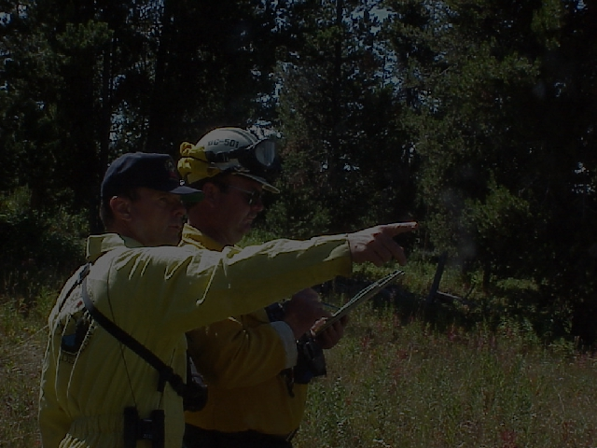
Regional Peer Review
Air Operations Branch Director (AOBD)
Air Support Group Supervisor (ASGS)
Air Tactical Group Supervisor (ATGS)
Division/Group Supervisor (DIVS)
Expanded Dispatch Coord. (CORD)
Finance/Administration (FSC2)
Helicopter Coordinator (HLCO)
Incident Business Advisor 2 (IBA2)
Incident Commander Type 2 (ICT2)
Information Officer Type 2
Liaison Officer (LOFR)
Logistics Chief Type 2 (LSC2)
Operations Branch Director (OPBD)
Op’s Section Chief Type 2 (OSC2)
Planning Section Chief Type 2 (PSC1)
Rx Burn Boss Type 1 (RXB1)
Rx Burn Boss Type 2 (RXB2)
Rx Fire Manager Type 1 (RXM1)
Rx Fire Manager Type 2 (RXM2)
Safety Officer Type 2 (SOF2)
Service Branch Director (SVBD)
Structure Protect. Specialist (STPS)
Support Branch Director (SUBD)
Training Specialist (TNSP)
Notes:
100 and 200 level review

Slide 37
State Peer Review
CICCS TF
Area Command (ACDR)
Area Command Aviation Coord.(ACAC)
Area Command Logistics-Chief (ACLC)
Area Command Planning-Chief (ACPC)
Finance/Admin-Section Chief Type 1 (FSC1)
Fire Behavior Analyst (FBAN)
Incident Business Advisor 1 (IBA1)
Incident Commander Type 1 (ICT1)
Information Officer Type 1
Long Term Fire Analyst (LTAN)
Logistics Section Chief (LSC1)
Op’s Section Chief Type 1 (OSC1)
Planning Section Chief Type 1 (PSC2)
Safety Officer Type 1 (SOF1)
Notes:
100 and 200 level review

Slide 38
APPLICATION SUBMITAL
PROCESS
Type Written Application
with appropriate applicant and verifying official original signatures.
Chiefs Authorization Letter
Record of Experience (past 5 years)
Record of training courses required for the position
Complete copy of the PTB
Copies of performance evaluations (ICS-225) for the position applied for.
Copies of lower level CICCS certificates documenting required experience.
Copies of all “Required Course” certificates for the position.
Any other documentation that supports knowledge and experience
Notes:
100 and 200 level review

Slide 39
APPLICATION SUBMITAL
PROCESS
Application Package shall be submitted to the appropriate level (Local, Operational, Regional or State) peer review committee chairperson.
Committees shall review application in order to verify that all CICCS requirements for certification have been met.
Committee Chair shall notify applicant, Agency/Department Chief or designee of the results of the peer review.
Upon successful committee evaluation and approval a CICCS certificate will be issued for the ICS position
Department/Agencies are responsible for the issuance of certificates at their review level
Notes:
100 and 200 level review

Slide 40

http://www.vdatasys.com/
Notes:
IQS software is suggested for tracking purposes. IQS will also produce a card for the individual.
http://www.vdatasys.com/

Slide 41
Internal
Department/Agency Review Committee

Slide 42
CICCS Record Keeping
Chairperson is required to maintain all written documentation pertaining to the peer review committee including
  electronic messages and notes
  hardcopies of notes, letters, other correspondence
  meeting minutes
  original signed applications
  other pertinent documentation
(all records may be digitized and maintained electronically)

Slide 43
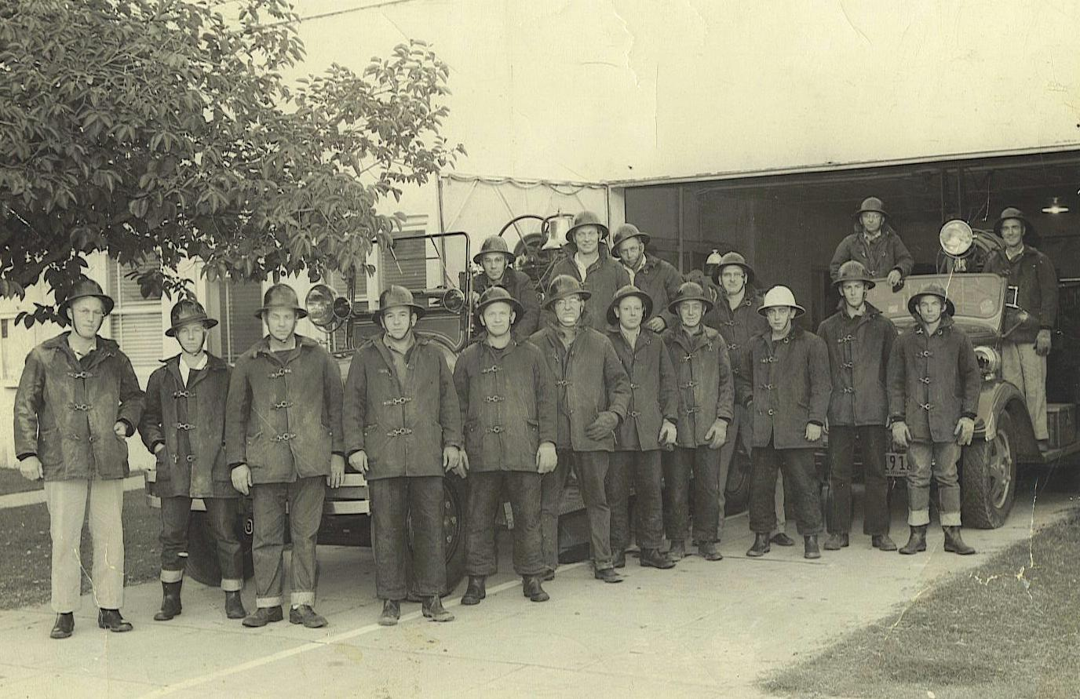
Historical Recognition

Slide 44
www.calema.ca.gov/fire/onlinedocuments or www.firescope.org
Notes:
www.calema.ca.gov/fire/onlinedocuments
www.firescope.org

Slide 45
STATEWIDE
POINT OF CONTACT
www.calema.ca.gov/fire/onlinedocuments
Deputy Chief Scott Vail
916-832-4229
  scott.vail@calema.ca.gov

