Slide 1
Fire Asset Status Tracker An Introduction to All-Hazard Resource Status Reporting

Slide 2
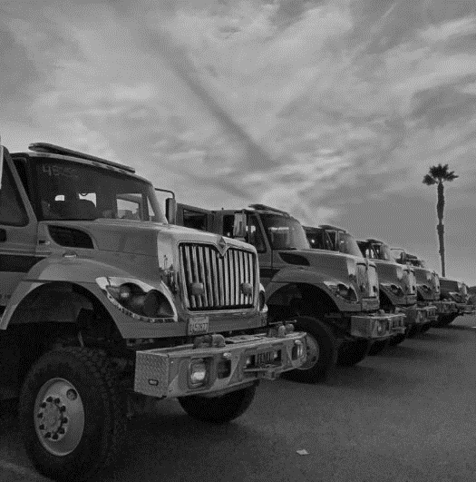
Discussion Topics
Project Objectives
Impact on the Fire Service
Mobile Application User Experience
Cal OES Management Features
Go Live Next Steps
Q/A

Slide 3
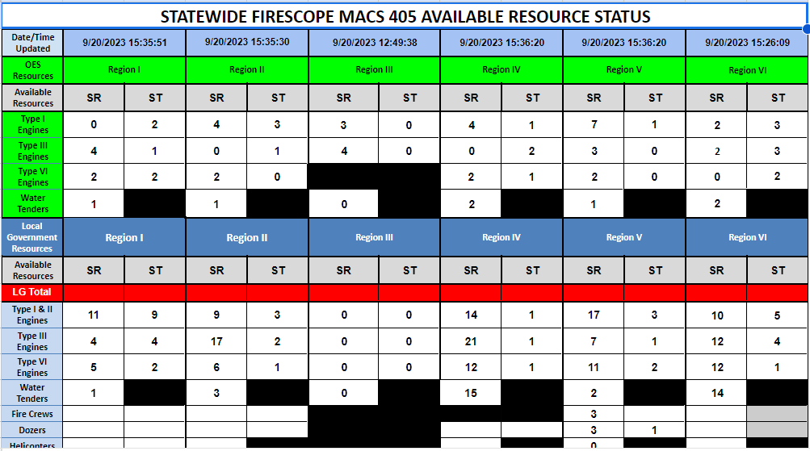
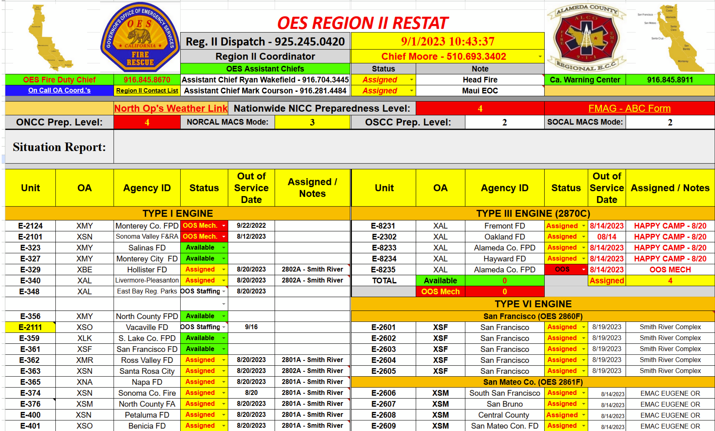
Project Objectives
Replace existing status reporting framework
Improve mutual aid efficiency and response times
Enable real-time local resource status updates
Inform strategic resource decision-making
Simplify the firefighter user experience
Increase transparency and information access

Slide 4
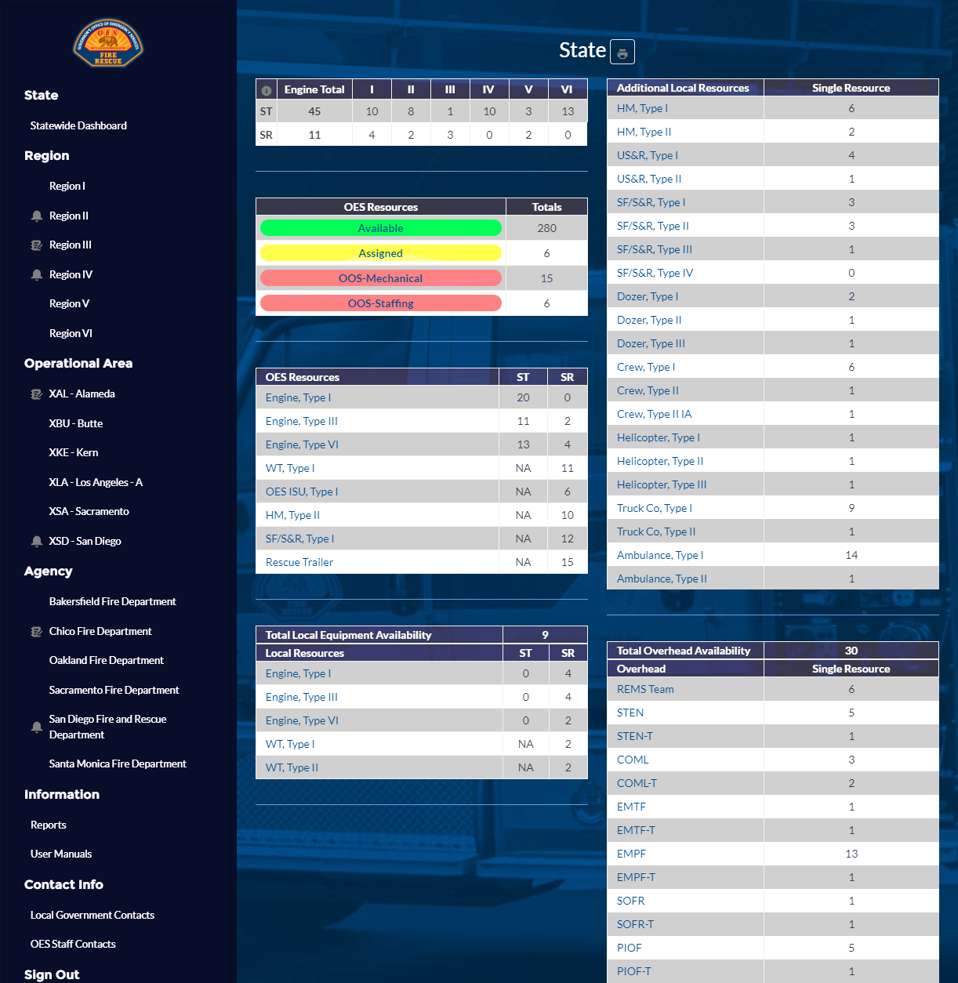
Impact on the Fire Service
Provide a primarily mobile application
Simplify the user experience
Allow real-time status updates
Track statewide all-hazard fire resources
Cal OES Fire & Rescue assignments
Local government apparatus and overhead
Rapidly onboard agencies via MARS
Primary and secondary user access
Provide intel with robust data collection
Inventory Tracker survey
Fleet management & Out of Service process
Statewide all-hazard resource availability
Enable integration capabilities
Slack
Esri / ArcGIS

Slide 5
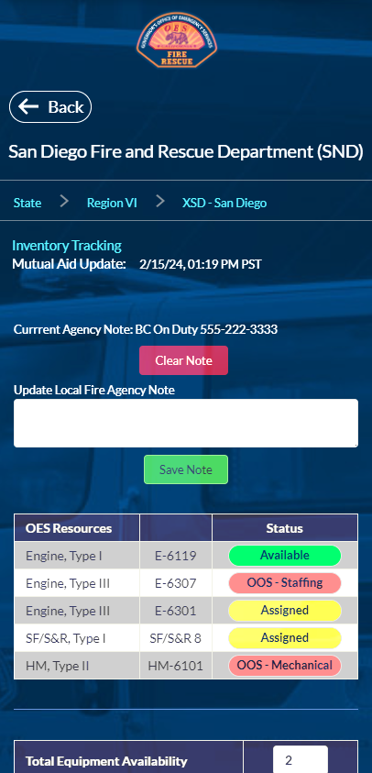
Local Agency Mutual Aid and Inventory Tracking
Collect Complete Inventory Data from all Local Fire Agencies
Quickly Input Status Updates for OES Resources and Local Equipment / Overhead
Integrated Error-Checking for Total Availability and Inventory Tracker data

Slide 6
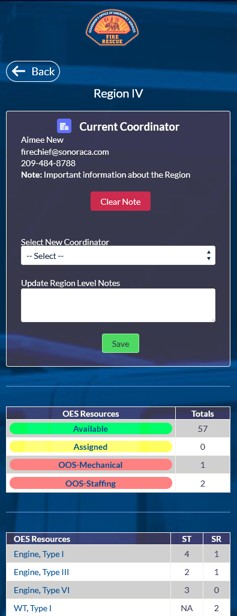
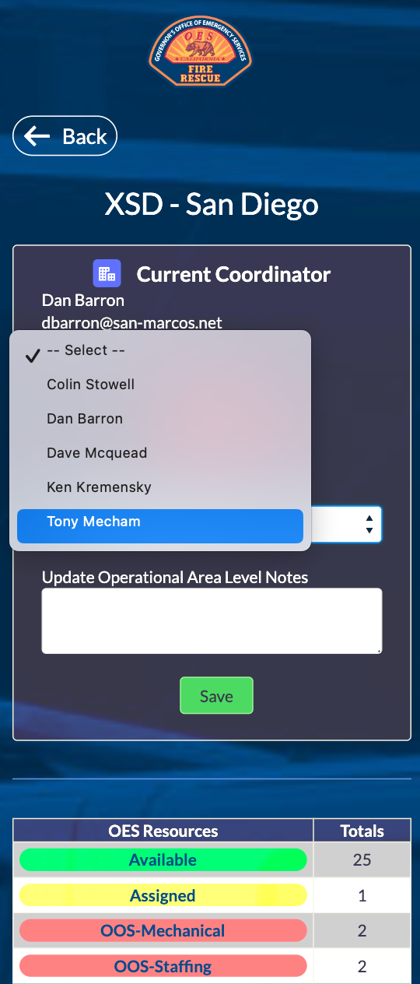
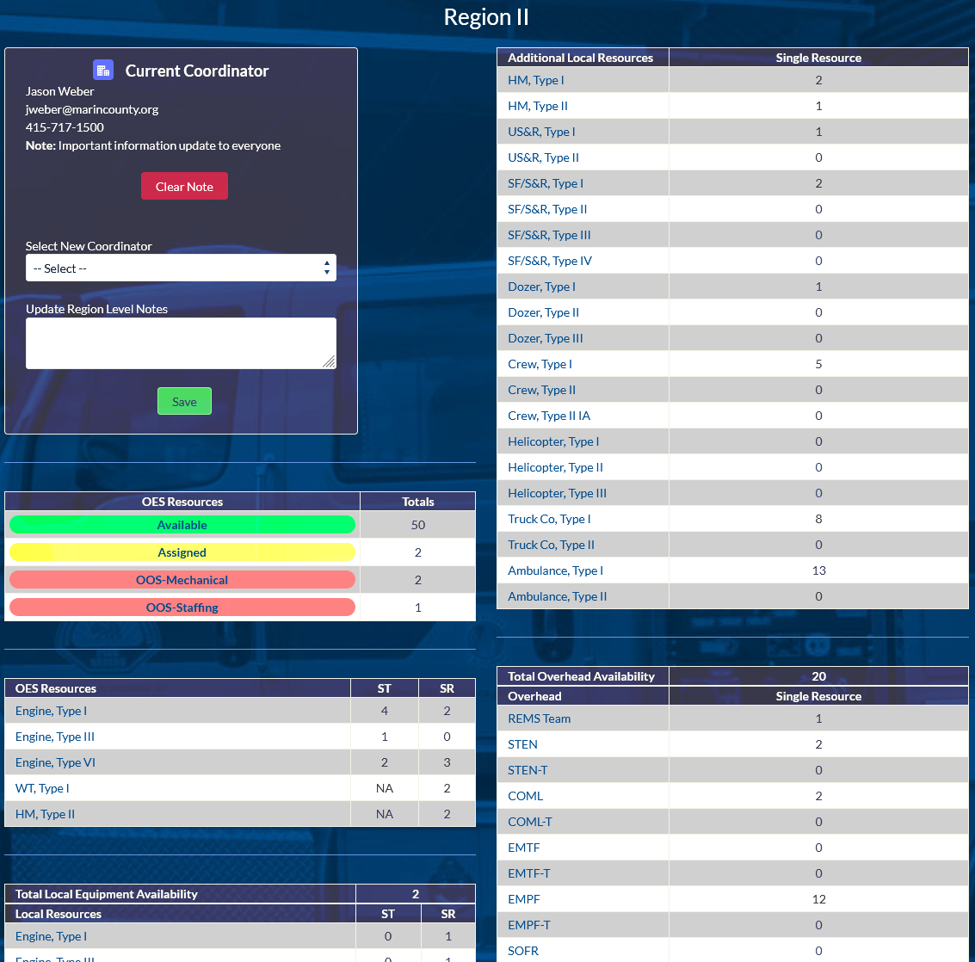
Region and Op Area Status Pages
Manage On-Duty Coordinators
View Coordinator Point of Contact Info
Add Notes for Information Sharing

Slide 7
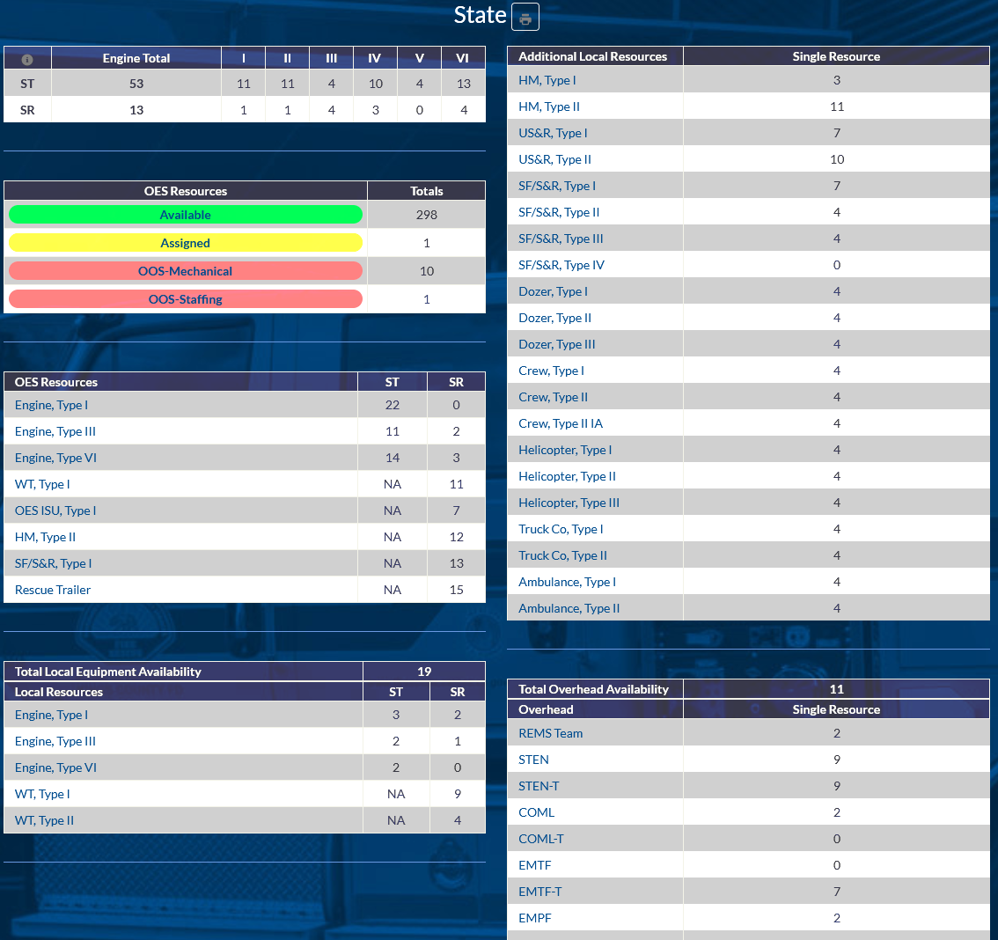
Statewide Dashboard
Comprehensive view of all-hazard resources across the State
Quickly access summarized data by Region or Type
Easily dive into detailed views through top-to-bottom navigation links

Slide 8
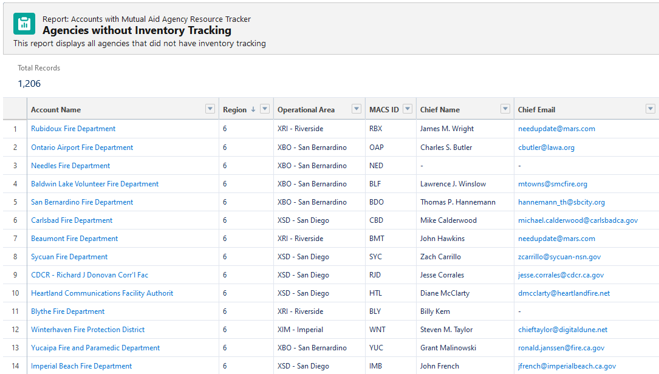
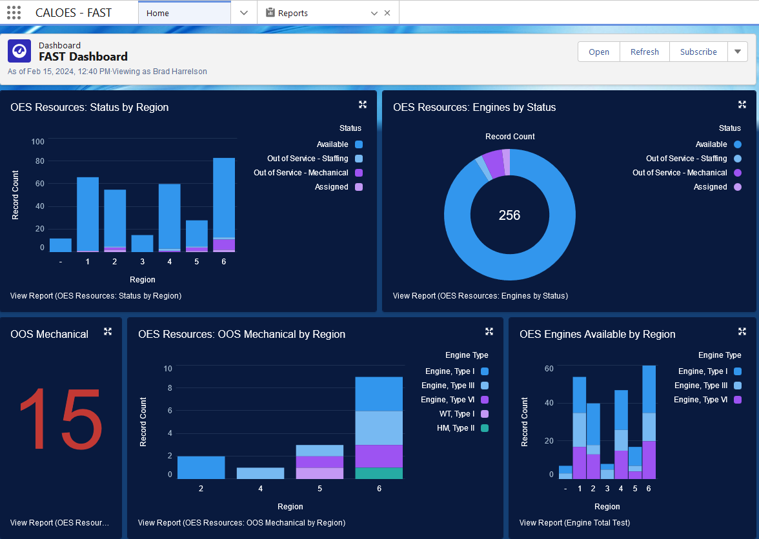
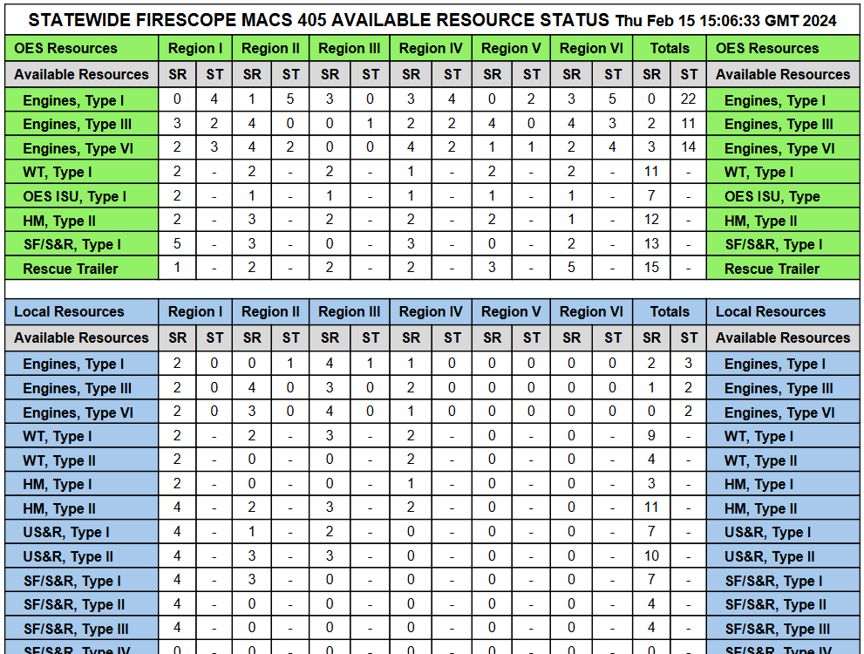
Generate Reports and Dashboards
Identify Agencies that…
Have never submitted an inventory survey
Have not updated mutual aid status in last 7 days
Have OES Resources OOS Mechanical
Statewide PDF MACS 405 report

Slide 9
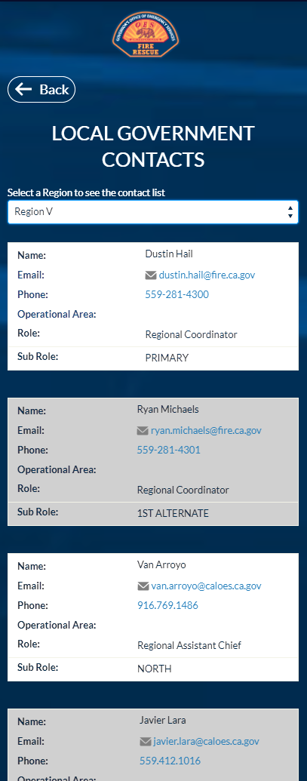
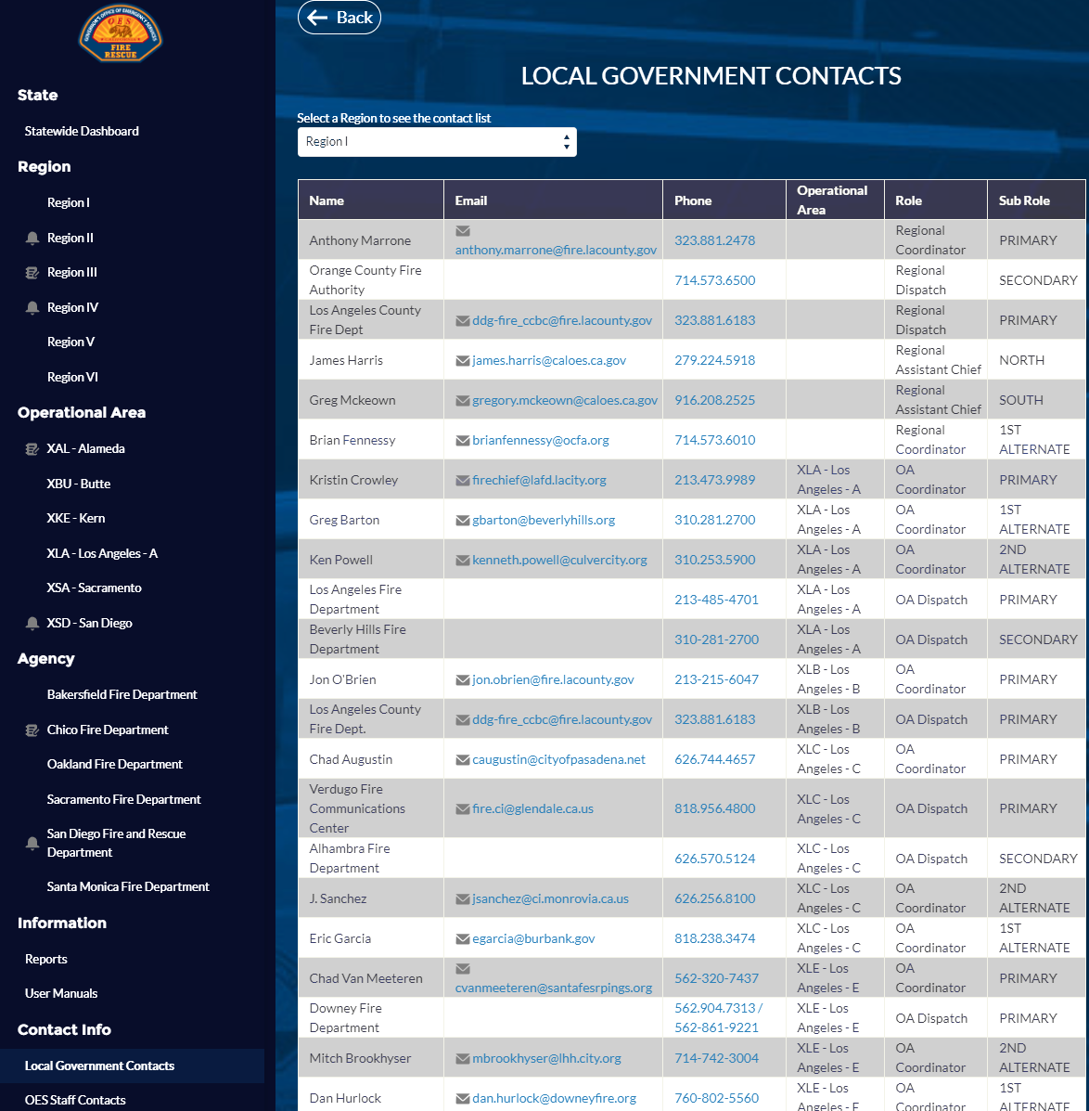
Access OES and Local Government Contacts
Quickly access complete lists of Region and OES contacts
Easily click to send an email or place a call on mobile

Slide 10
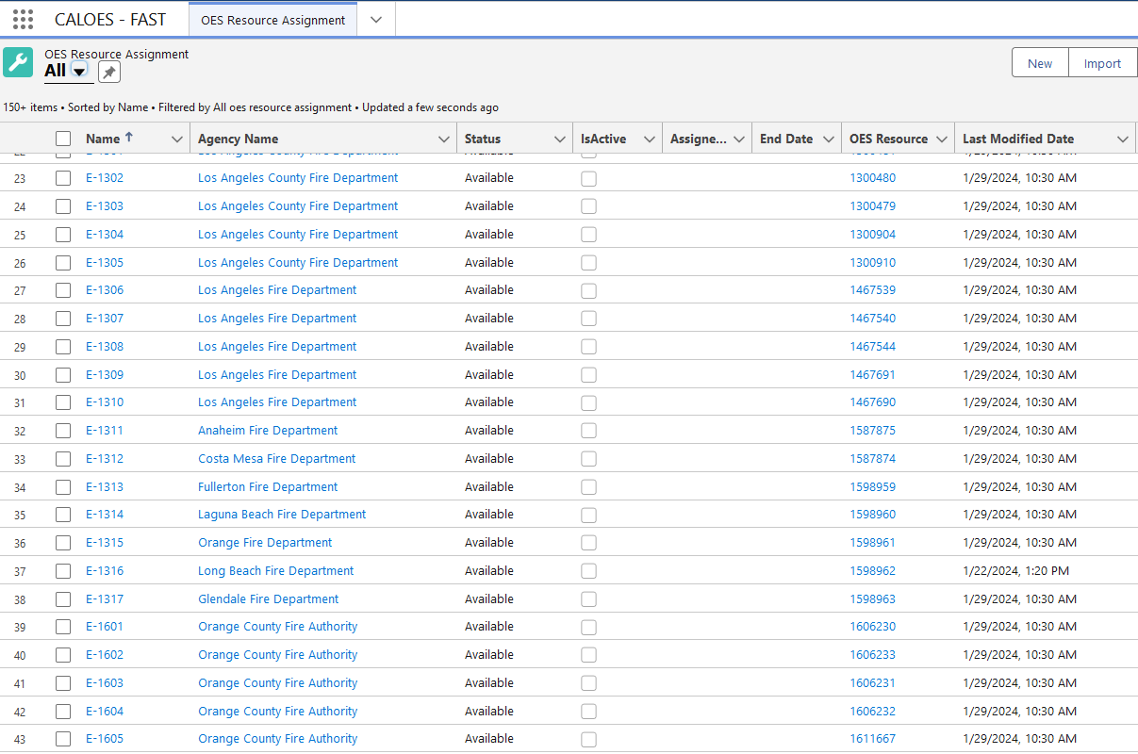
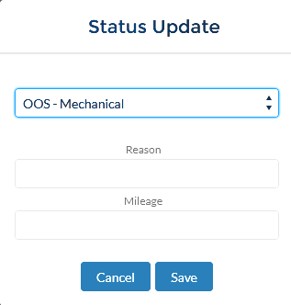
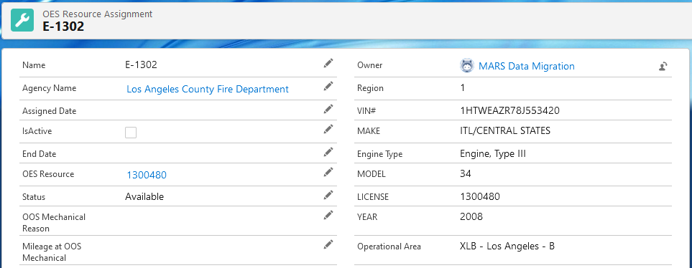
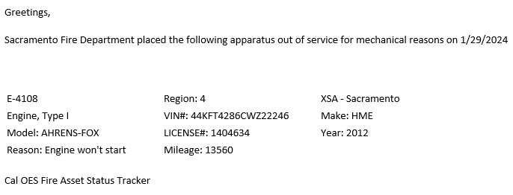
Administer OES Fleet Assignments
Track OES Resource Assignments
Begin OES Fleet Maintenance Request
Trigger Out of Services Notifications

Slide 11
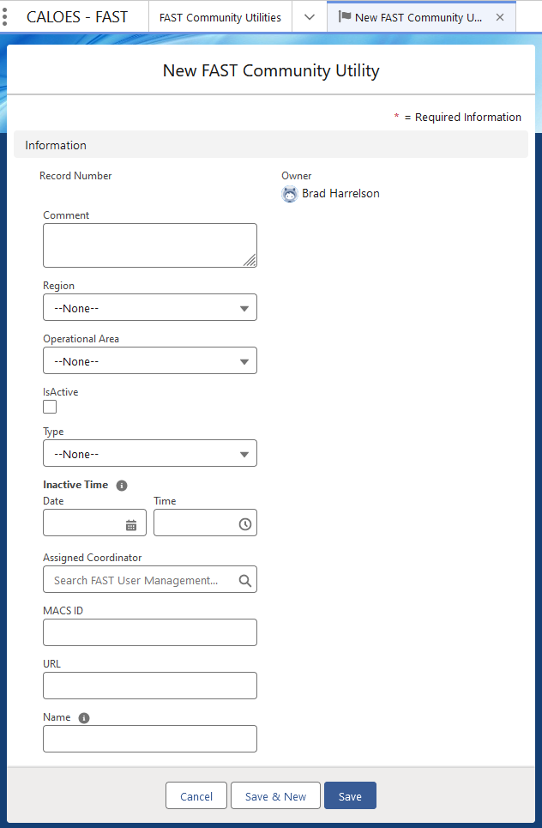
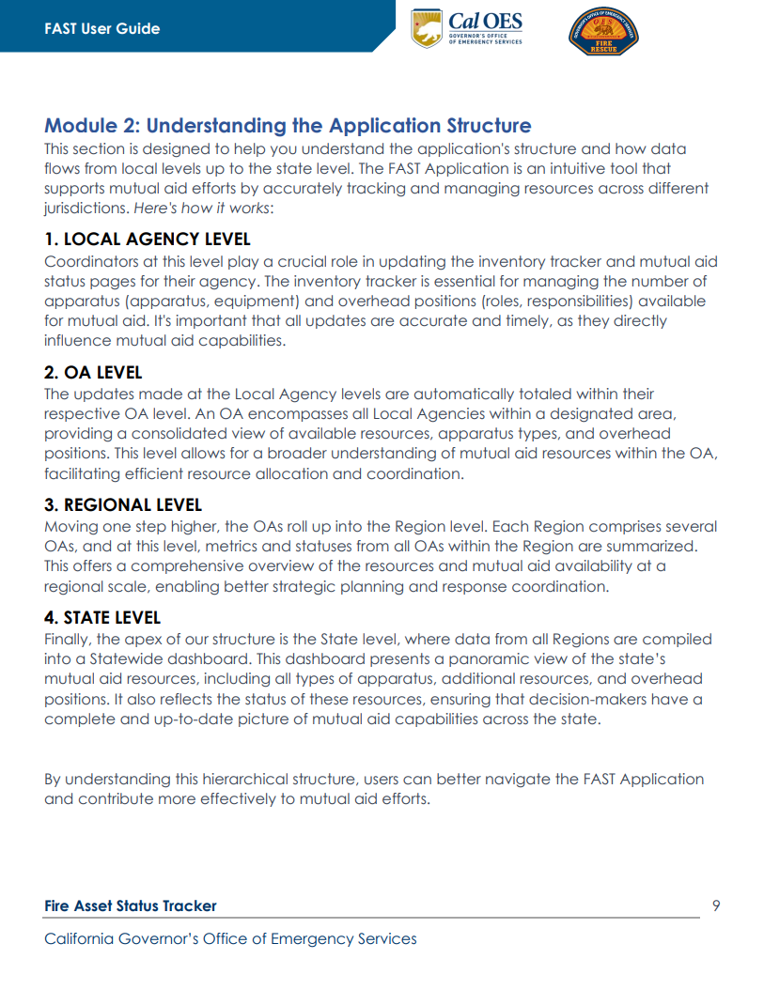
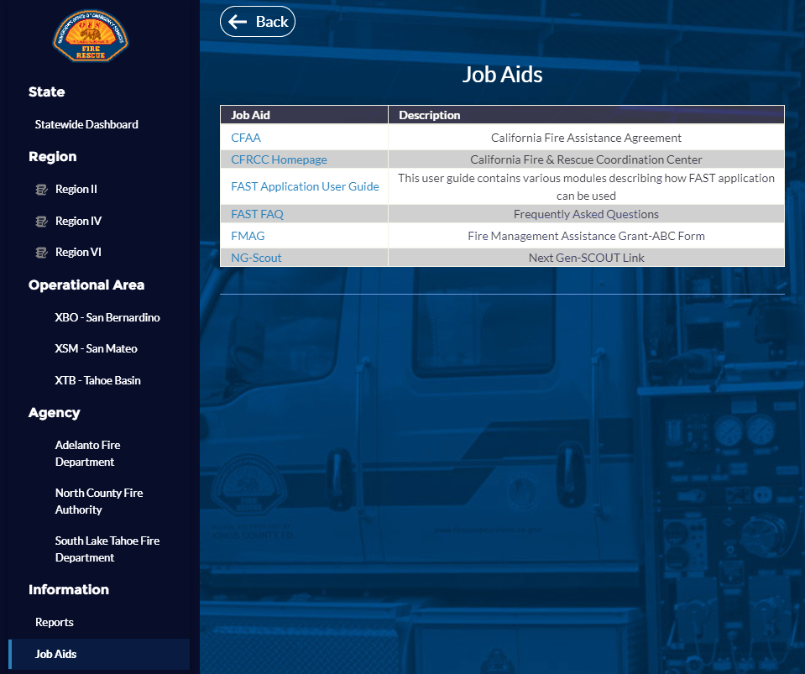
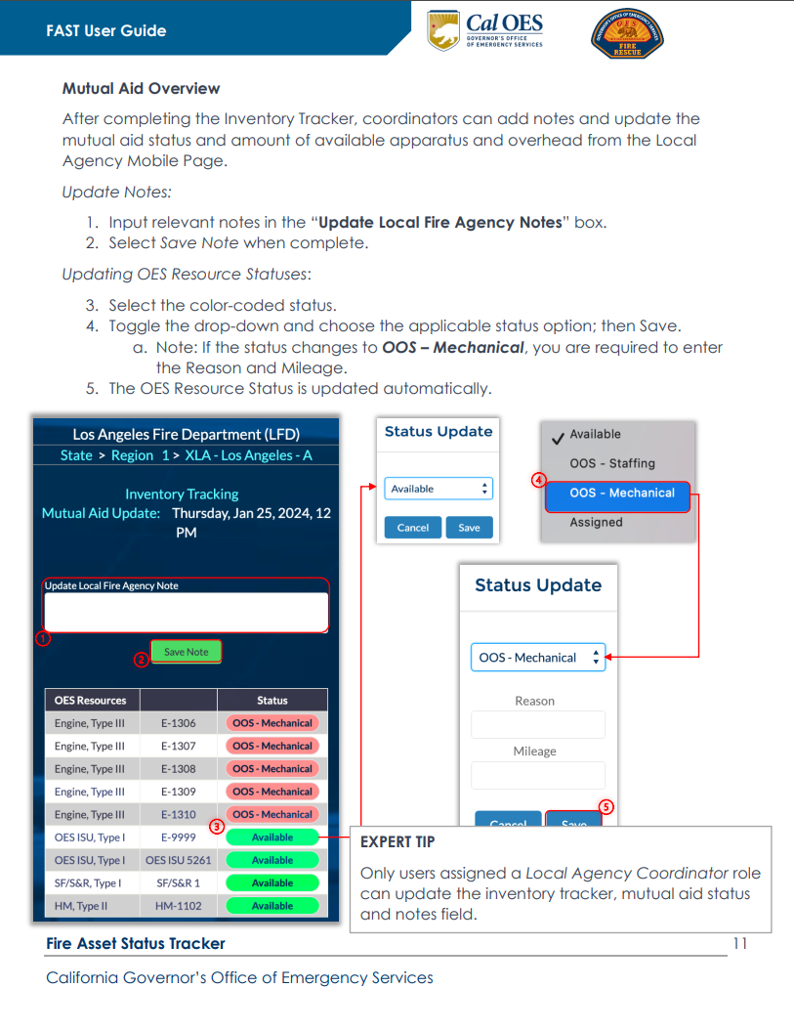
Share Critical Information

Slide 12
Go Live Next Steps
Rollout
Cal OES Fire & Rescue / CFRCC
FIRESCOPE / Mutual Aid Summit Group
Region and OA Coordinators
Local Fire Agencies
Training
User Guides & PPT
FAQ
Agency User Access Management Guides
In-Person
Support
Fast@caloes.ca.gov
CFRCC
Supports all users
Provides program support and assistance
CFRCC@CalOES.ca.gov
Cal OES Enterprise Support
Supports all users
Receives and triages Help Desk cases
Investigates and resolve application technical issues

