Slide 1
Fire Asset Status Tracker Local Fire Agency Training Guide

Slide 2
Discussion Topics
Importance of FAST
Getting Started with FAST
Navigating the FAST Application
Job Aid and Support Resources
Interactive Demo
Q/A

Slide 3
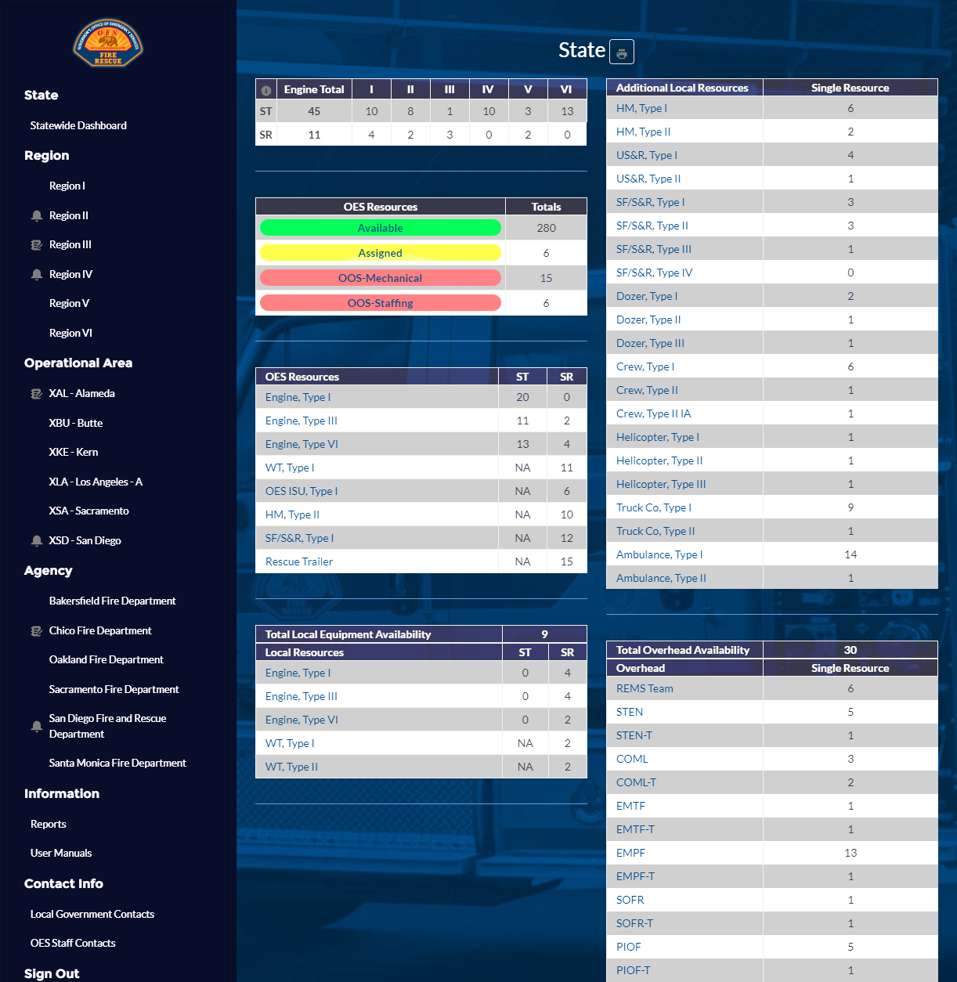
Impact on the Fire Service
Provide a primarily mobile application
Simplify the user experience
Allow real-time status updates
Track statewide all-hazard fire resources
Cal OES Fire & Rescue assignments
Local government apparatus and overhead
Rapidly onboard agencies via MARS
Primary and secondary user access
Provide intel with robust data collection
Inventory Tracker survey
Fleet management & Out of Service process
Statewide all-hazard resource availability
Enable integration capabilities
Slack
Esri / ArcGIS

Slide 4
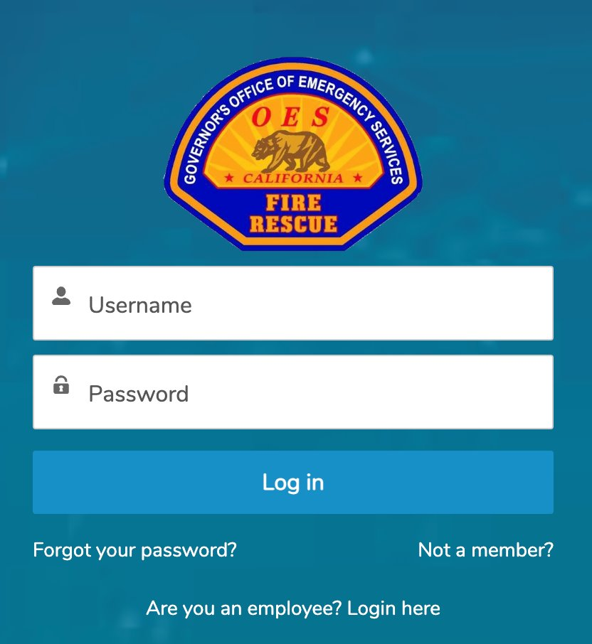
Getting Started: Sign Up & Login
New User Sign Up (NO MARS):
Visit the Engage Community Portal: https://engage.caloes.ca.gov.
Register as “Entity Type” = “Fire Agency”
Validate your email
Request access to the Fire & Rescue app
Ensure you know your MACS ID!
Existing User Login (With MARS):
Direct Access: Go to https://engage.caloes.ca.gov/fast/s/ and enter your login credentials.
Via MARS: After logging into MARS, navigate to the FAST application link provided within the platform.
Supported browsers include Chrome, Edge, & Safari for optimal performance.

Slide 5
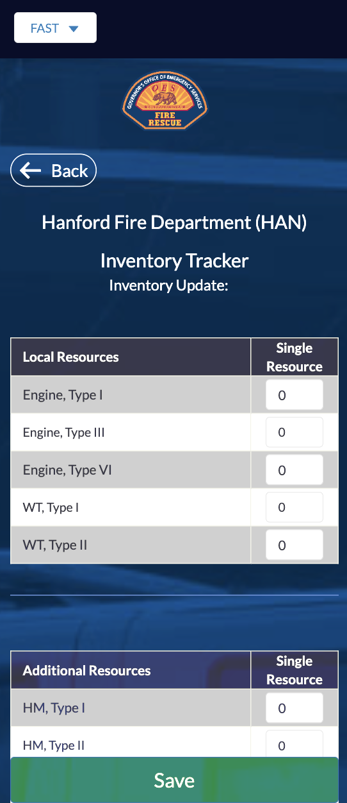
Configure Your Agency
The Inventory Tracker must be completed before updating your mutual aid status
First-Time Fire Department Setup:
Navigate to your Local Fire Agency Dashboard
Click the Inventory Tracking link
Enter details for Local / Additional Resources (“How many you own”) and Overhead (“How many are trained”)
Save changes to complete the setup process
Navigate back to your Local Fire Agency Dashboard

Slide 6
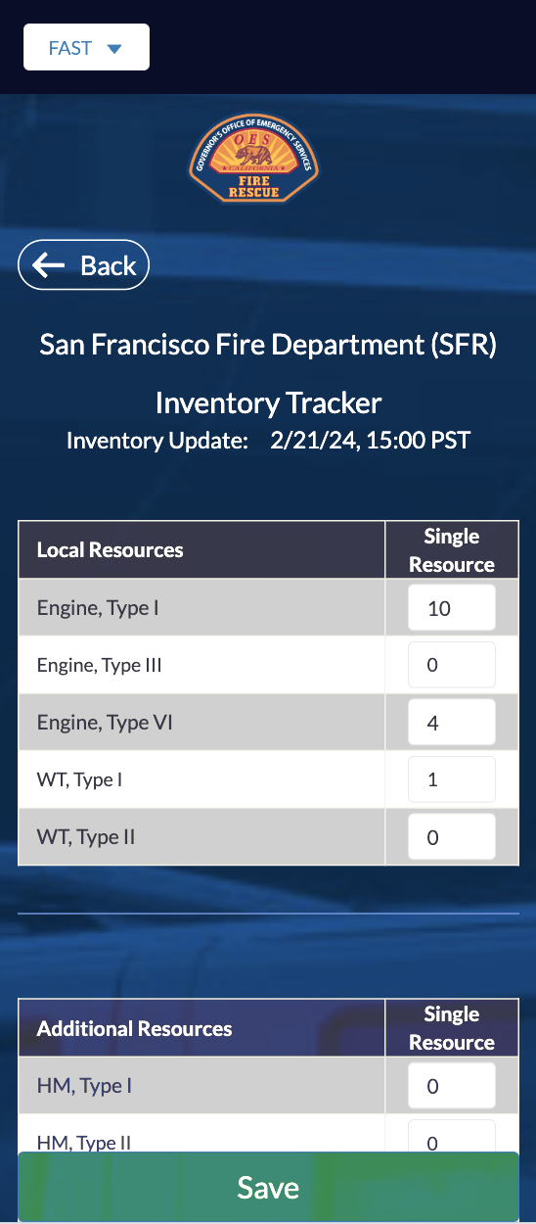
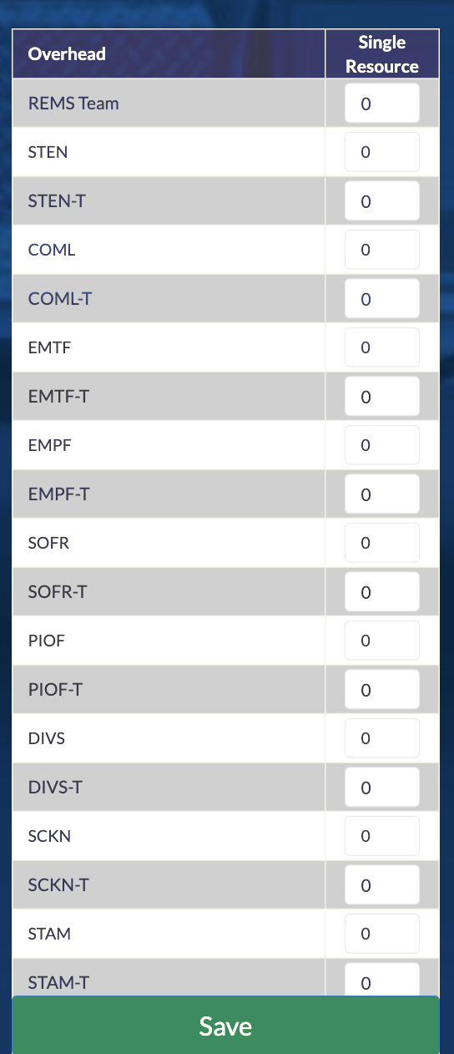
Inventory Tracker Essentials
Recommended Updates:
Regularly update the Inventory Tracker maintain accuracy.
Example: Your agency bought a new Type I Engine
Regular Reviews:
Review and update your agency's resources as needed.
Confirm or amend details for all resource categories.
Example: Update FAST when updating MARS Salary Survey
Expert Tip:
Keeping your Inventory Tracker updated is vital for the accuracy of state-wide mutual aid resource availability and efficient emergency response coordination.

Slide 7
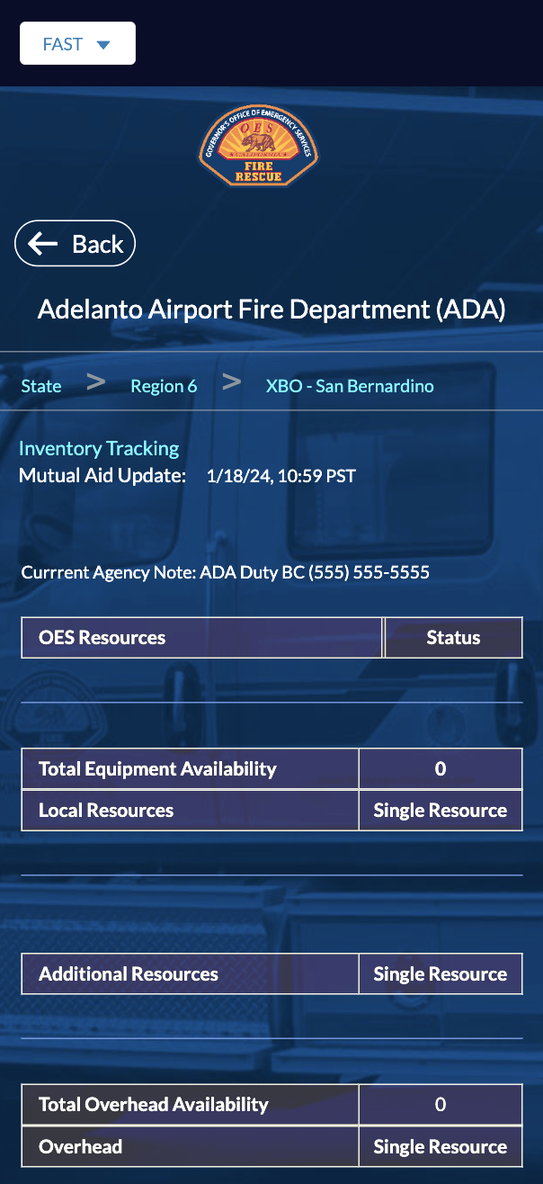
Viewing Local Agency Dashboards
Capabilities:
Secondary users can view real-time data and updates.
Monitor status updates and notes from local agencies.
See Total Equipment/Overhead Availability figures.
Expert Tip:
Your Local Agency Dashboard will appear blank if a primary user has not completed the Inventory Tracker

Slide 8
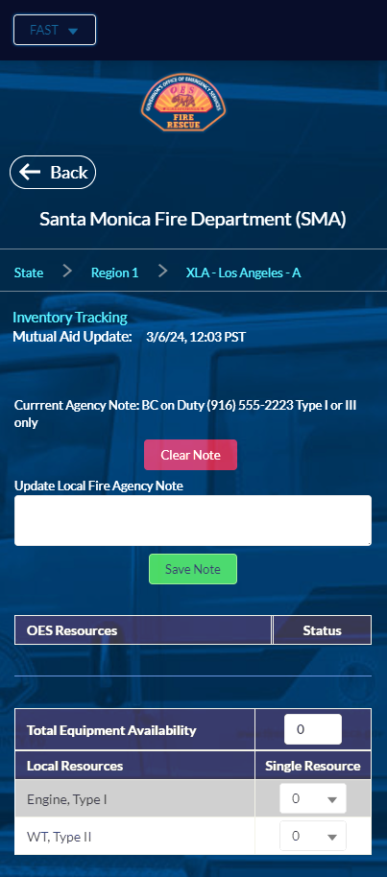
Managing Local Agency Dashboards for Mutual Aid
Capabilities:
Primary users can edit their Local Fire Agency Dashboard
Update mutual aid status and resource availability.
Input Local Fire Agency Notes.
Examples: “Type I or Type III” or “One engine of any type”
Expert Tips:
OES Resources will be blank if you are not an Assignee
Total Equipment/Overhead Availability influences OA, Region, and State resource totals and mutual aid decision-making
Error message displays if your Total Equipment/Overhead Availability input conflicts with your mutual aid status numbers

Slide 9
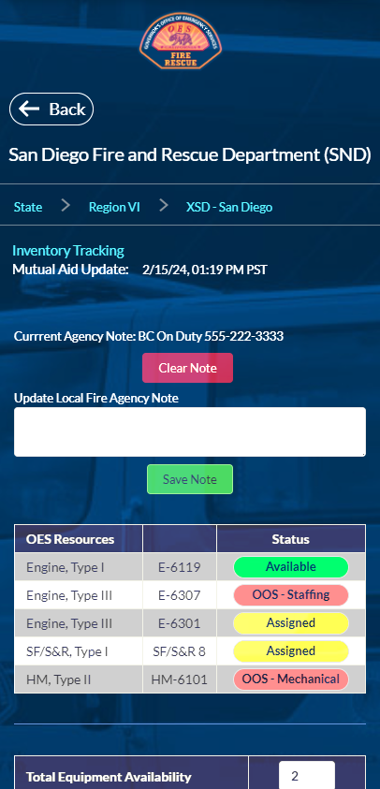
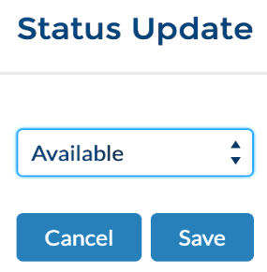
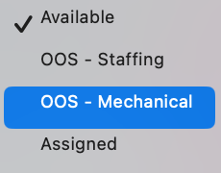
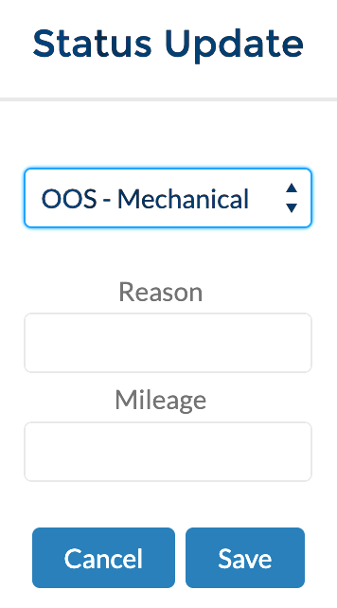
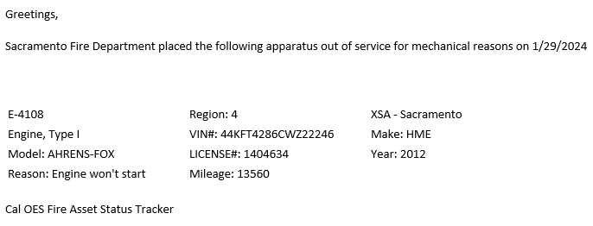
OES Assignees Guidance
Capabilities:
Primary users can update your assigned OES Resources:
Available = Ready for Mutual Aid Assignment
Assigned = On an Incident
Out of Service (OOS)
Staffing = Unable to staff the resource
Mechanical = Maintenance needed
Expert Tip:
Selecting OOS Mechanical triggers an email notification to OES Fleet with your resource details.

Slide 10
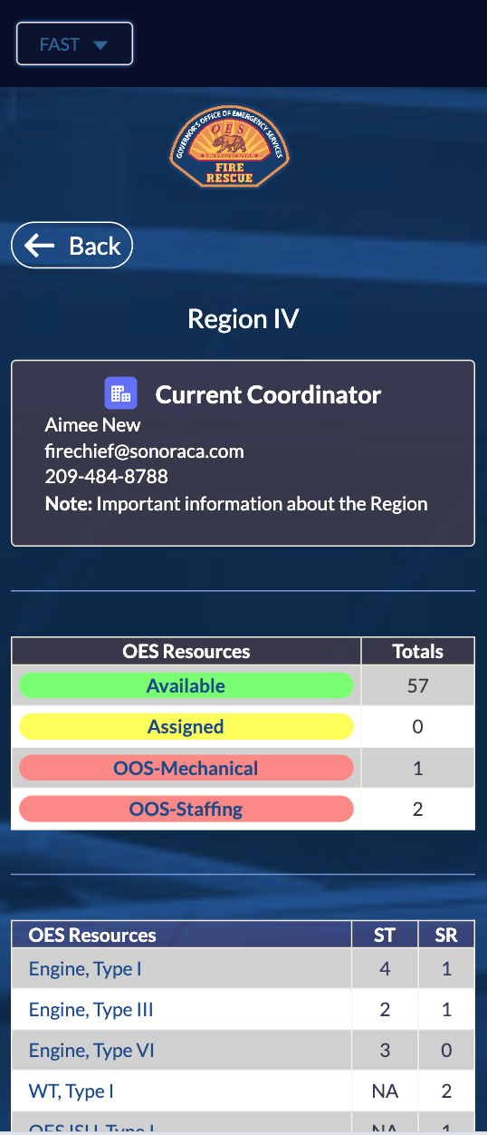
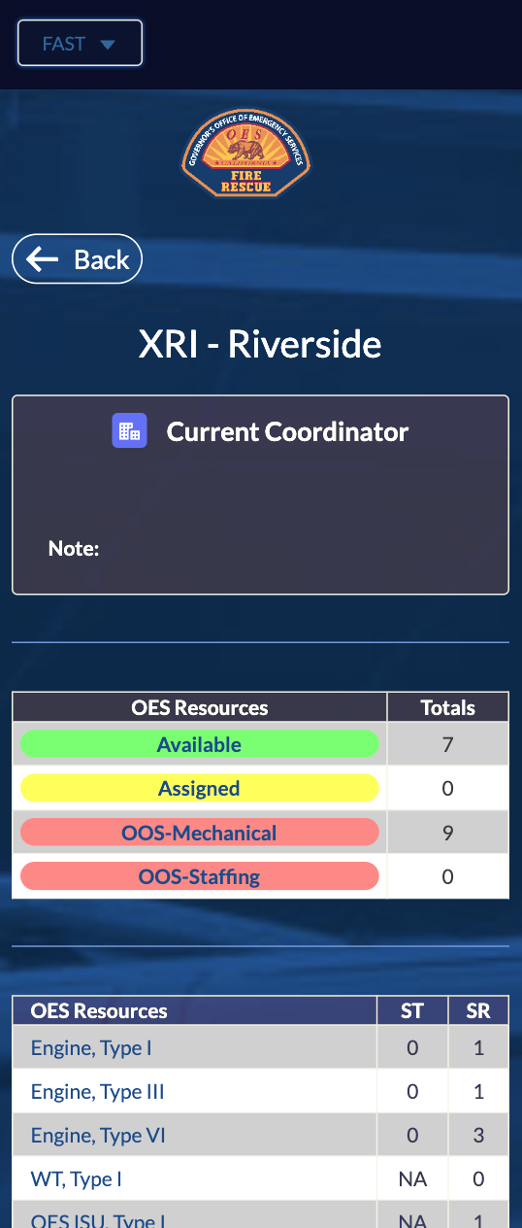
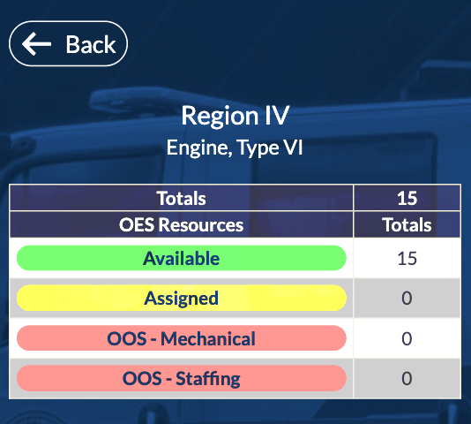
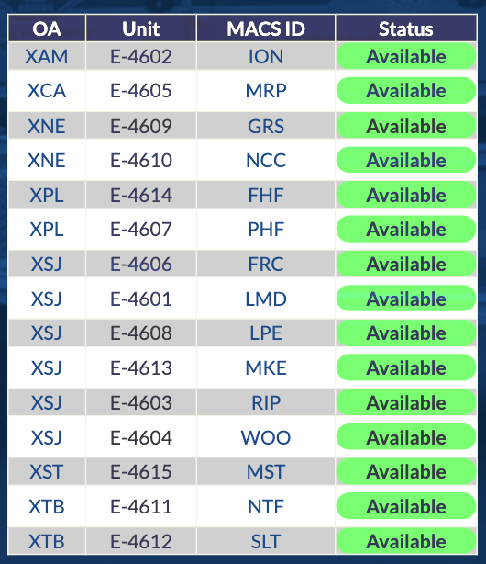
Viewing OA & Region Dashboards
Capabilities:
Users with view-only access can see real-time updates and statuses across OA and Region Dashboards.
Review On Duty Coordinator contact information
Review important Notes about the OA/Region
Access specific resource status summary pages.
Example: View all OES Type VI Engines in Region IV
Easily navigate to Local Fire Agency Dashboards
All blue text is a hyperlink!
Notes:
These dashboards allow for efficient allocation and strategic planning at broader operational and regional scales, ensuring a cohesive response to emergencies.

Slide 11
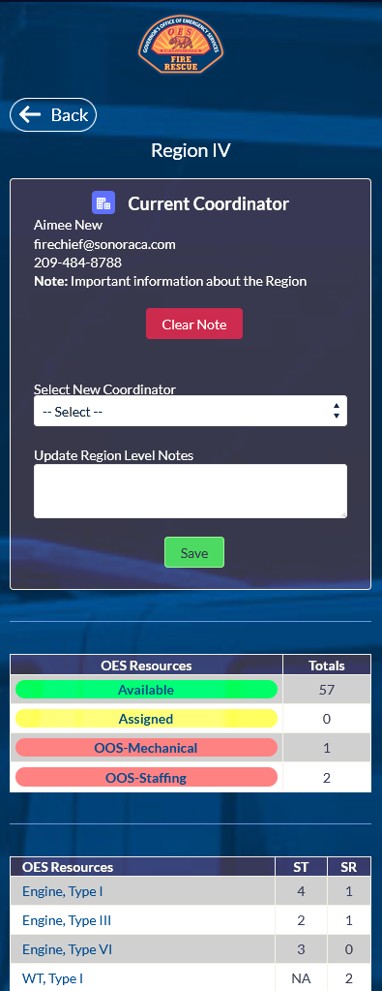
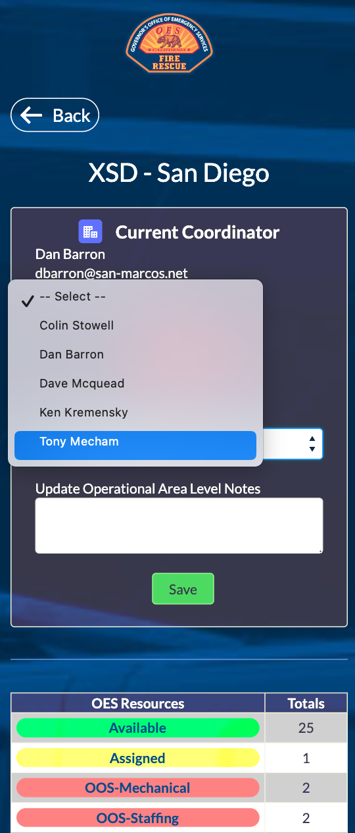
OA & Region Coordinator Guidance
Capabilities:
OA/Region Coordinators have exclusive edit privileges for their assigned geographic area.
Update the On Duty Coordinator.
Add OA/Region Notes.
Note: This is a new feature compared to Google Sheets

Slide 12
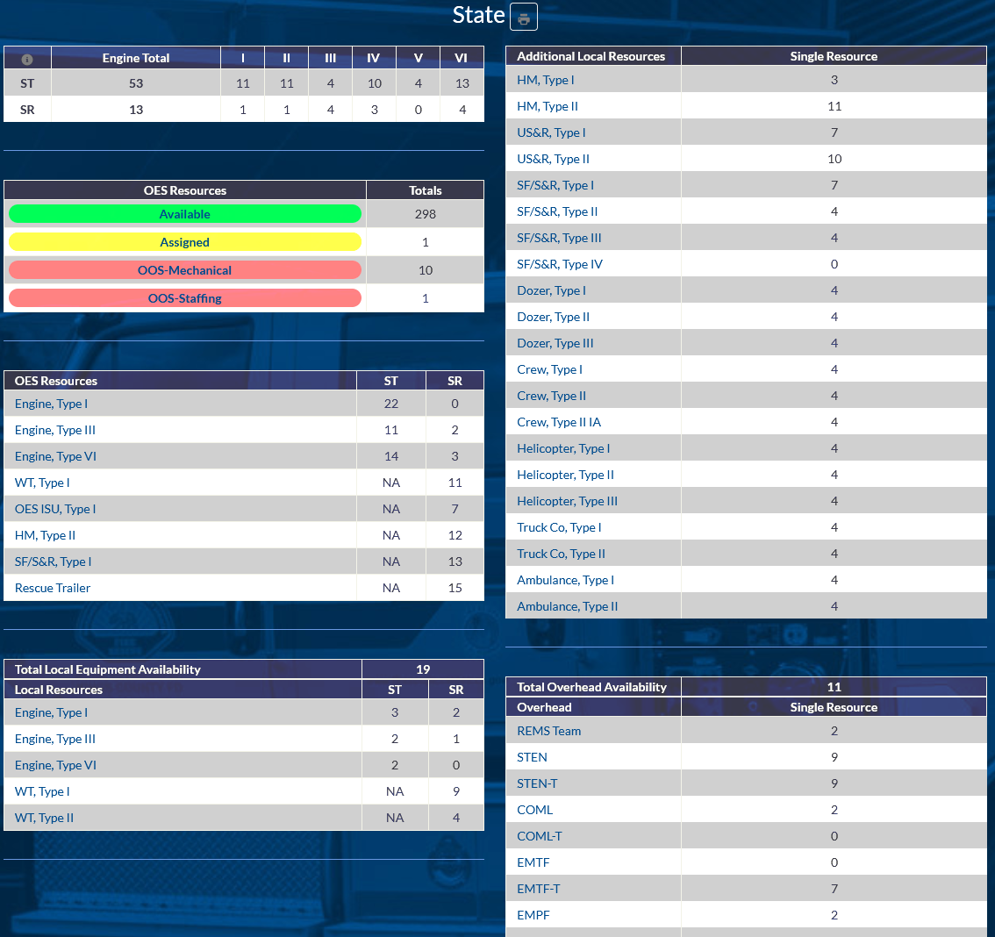
Statewide Dashboard
See real-time, statewide resource availability!
Capabilities:
Print PDF – MACS 405:
Primary statewide report for all resources.
Includes Region subtotal breakdown
Engine Totals:
Combined Type I, III, & VI availability by Strike Teams and Single Resources per Region.
OES Resource Status Table:
Summary of resources by current status.
Note: Click “Available” to see all available assets
OES/Local/Overhead Resource Tables:
Statewide totals of each resource
Note: Click to see Region breakdowns

Slide 13
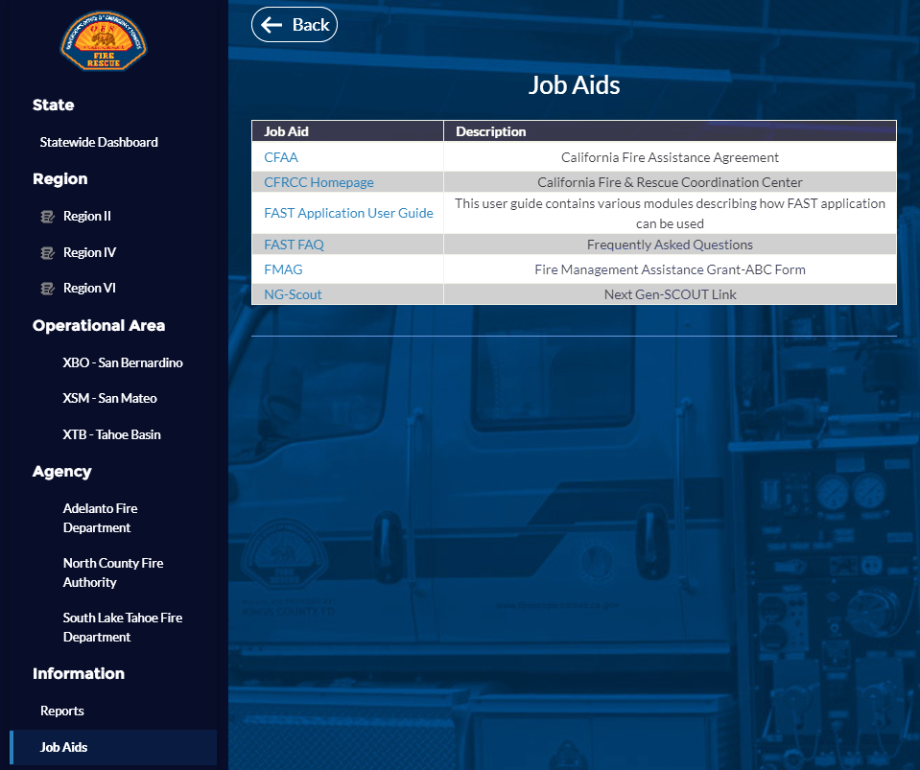
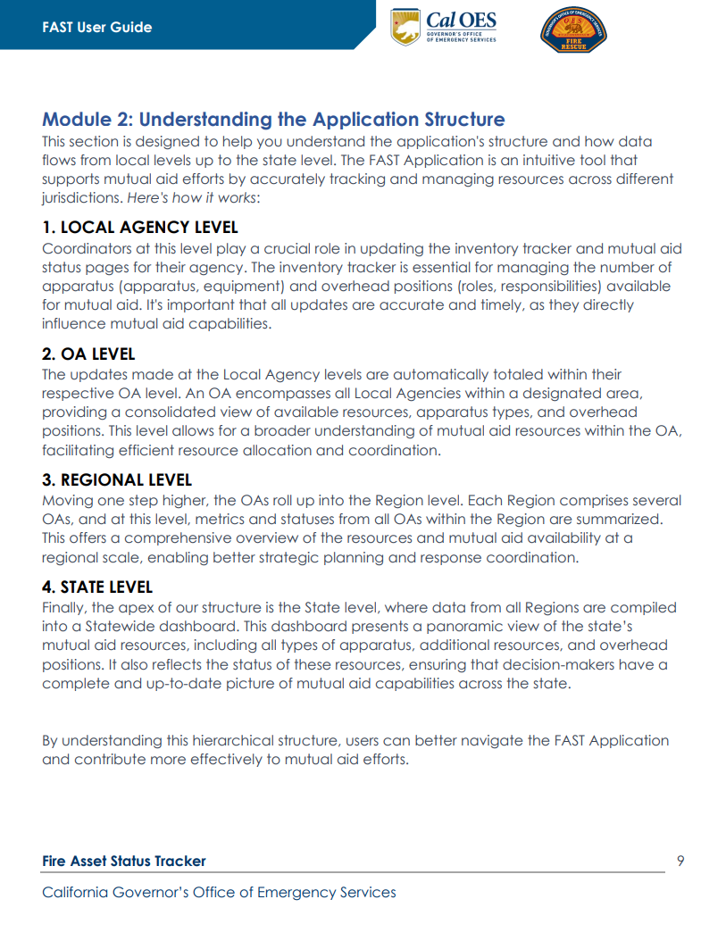
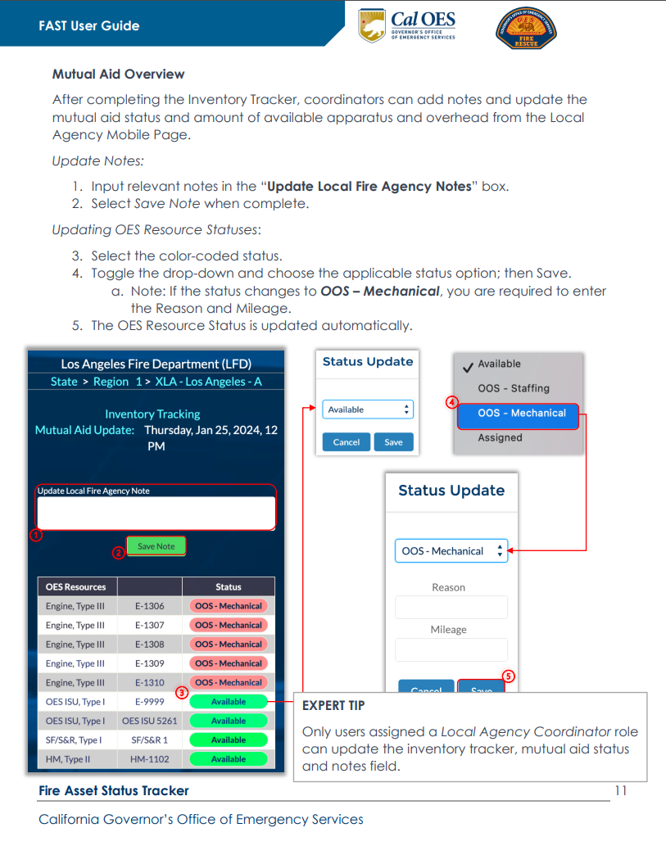
Access Critical Information

Slide 14
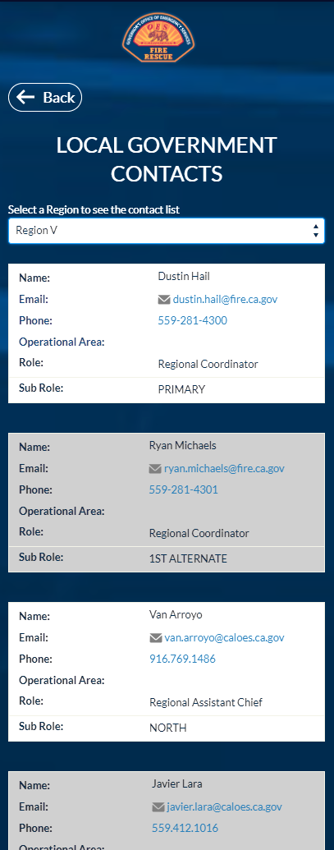
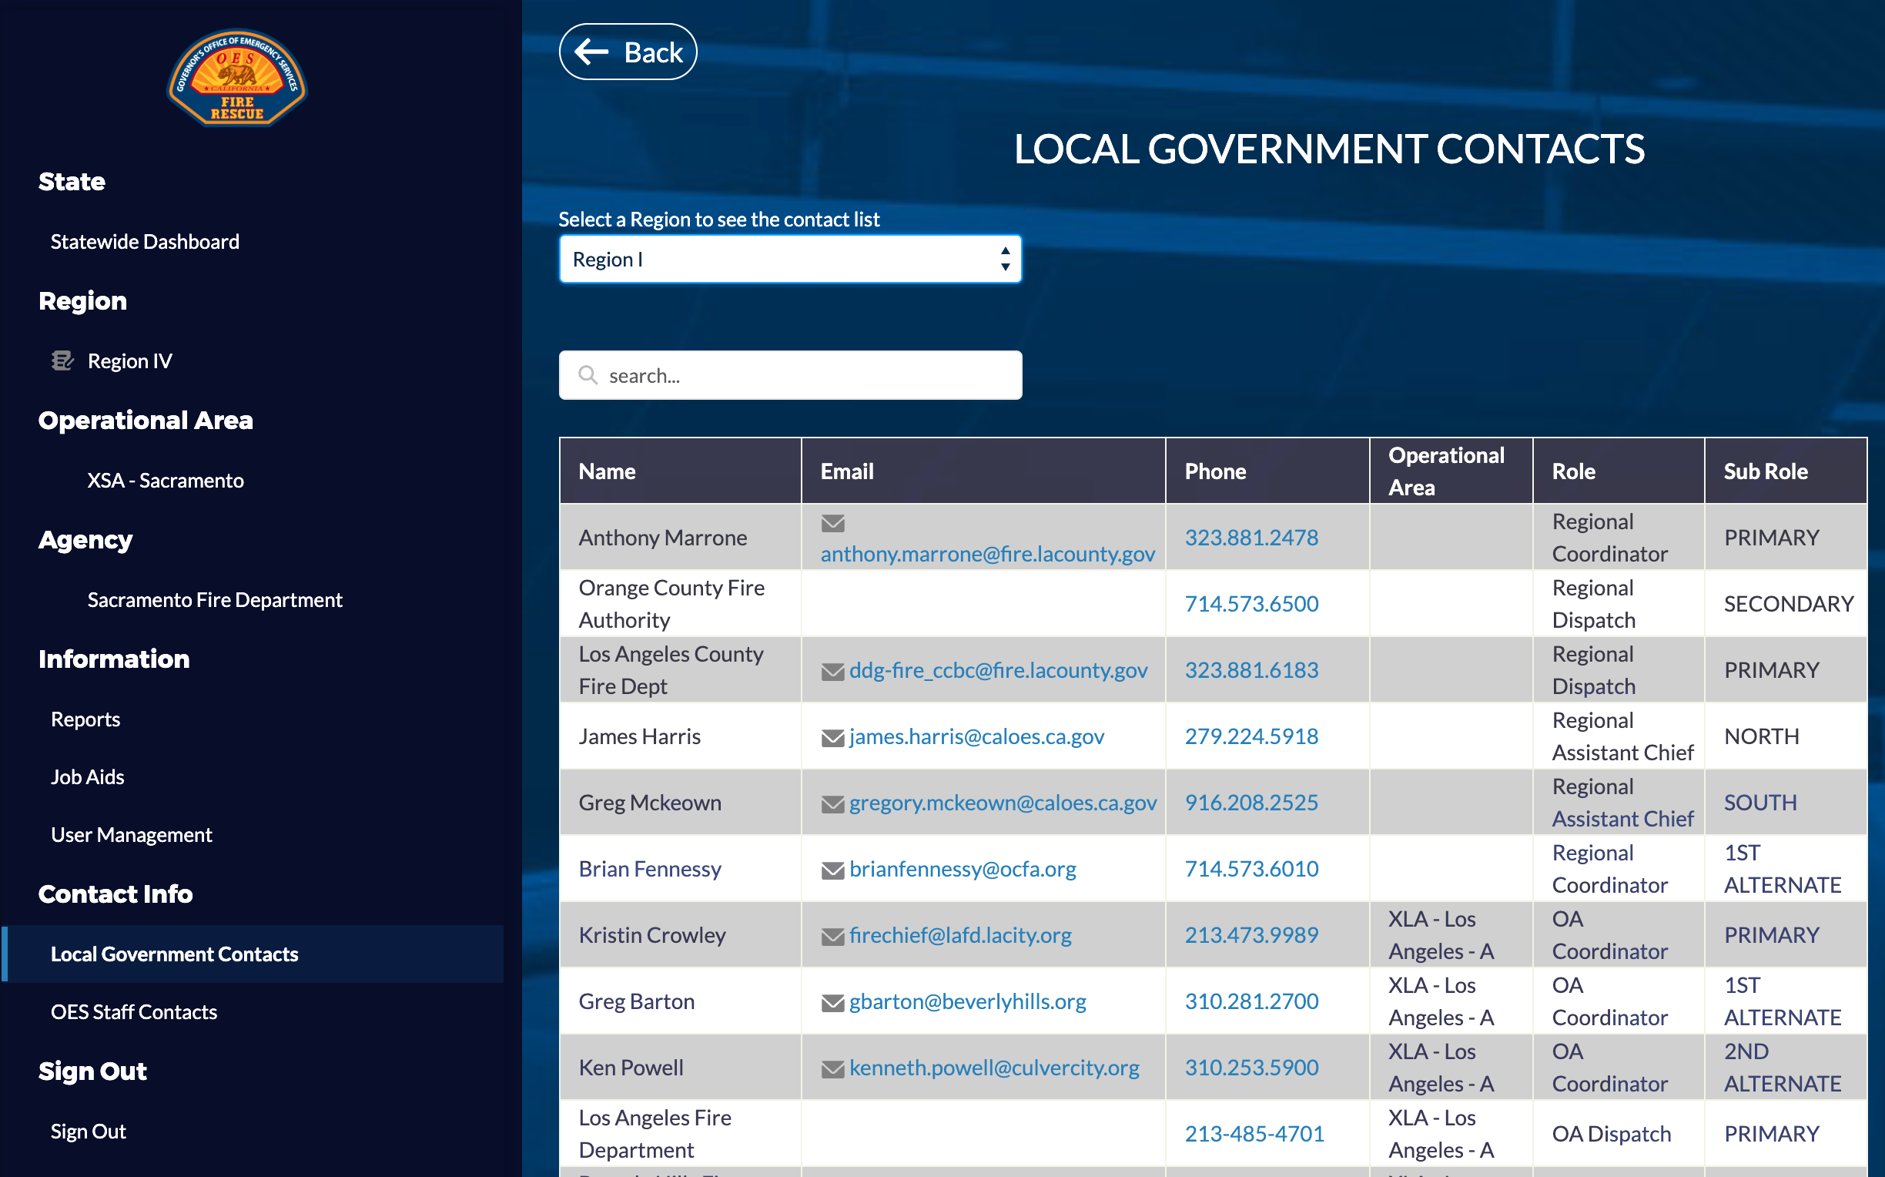
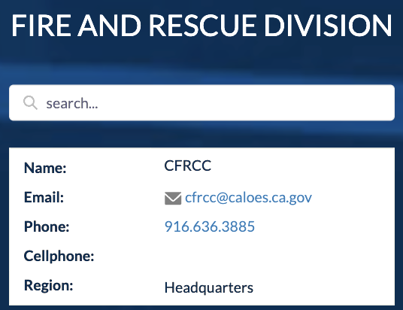
Access OES and Local Government Contacts
Capabilities:
Quickly access complete lists of Region and OES contacts
Easily click to send an email or place a call on mobile
Contact California Fire Rescue Coordination Center (CFRCC) for FAST support!

Slide 15
Interactive Demo
Notes:
- Login; access bite-sized training videos

Slide 16
Q/A
?
Questions

Slide 17
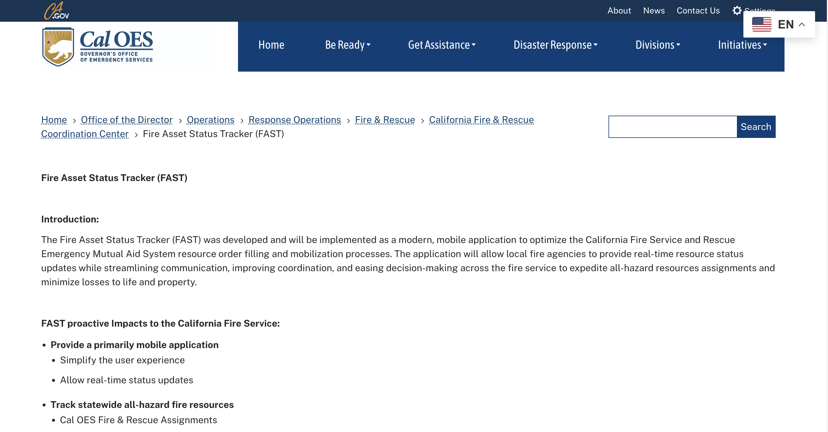
Post Training Support
For program guidance, contact CFRCC@CalOES.CA.gov.
For technical issues, reach out to Engage.Support@CalOES.CA.gov.
Scan the QR code to learn more!

Slide 18
Backup Slides
Notes:
- Login; access bite-sized training videos

Slide 19
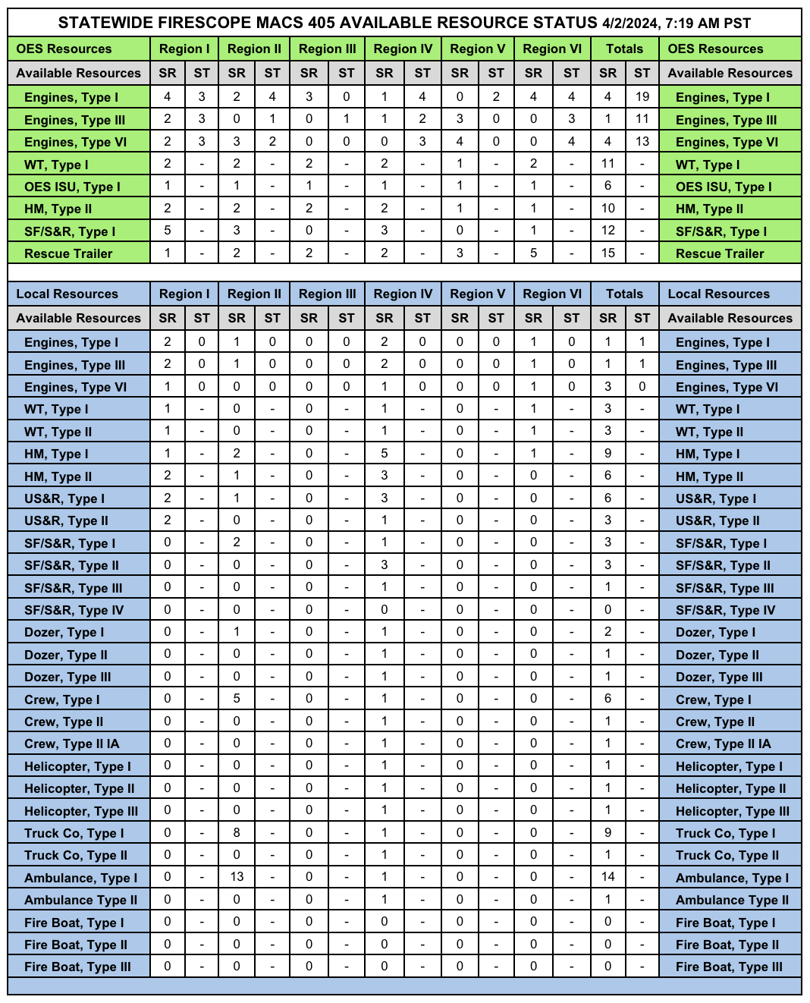
MACS-405

Slide 20
Fire Asset Status Tracker (FAST) Application
Provide a primarily mobile application
Simplify the user experience
Allow real-time status updates
Track statewide all-hazard fire resources
Cal OES Fire & Rescue assignments
Local government apparatus and overhead
Rapidly onboard agencies via MARS
Primary and secondary user access
Provide intel with robust data collection
Inventory Tracker survey
Fleet management & Out of Service process
Statewide all-hazard resource availability
Enable integration capabilities
Slack
Esri / ArcGIS
Mobile view of Local Agency
Desktop view of Statewide Dashboard

