Slide 1
Incident Cost Reporting
Disaster Financial Recovery and Reconciliation (DFRR) and Public Assistance (PA)

Slide 2
Presentation Outline
We will cover these Topics
What is Smartsheet?
Incident Cost Reporting Process – DFRR (Response Cost) and Public Assistance (Permanent Work)
Setting Up A Smartsheet Account

Slide 3
Purpose of Smartsheet Reporting
Why are we tracking Response Cost?
DREOA or Other Supplemental Funding Needs for State Agency (SA) unabsorbable costs.
Fiscal Impact to California State Budget.
Major Presidential Declaration.
Governor’s Office, Department of Finance (DOF), or other stakeholders request for transparency
Smartsheet Triggers?
Incident Cost Reporting Process
Setting Up A Smartsheet Account
Conclusion

Slide 4
Smartsheet Reporting Triggers
Outreach from DFRR team.
State Operation Center (SOC) activation, State of Emergency (SOE) proclamation, Federal Declaration and/or SA communicate to DFRR that they are incurring cost.
Cal OES Mission Tasking through Resource Request System (RRS).
DFRR may log into RRS on weekly basis to see if SA are Mission Task (MT) and then can send outreach.
DFRR– Incident Cost Estimates for response activities towards the incident.
Public Assistance – Cost Estimates for Preliminary Damage Assessments (PDA) that can be utilized to request major Presidential Declaration.
Smartsheet Triggers?
Incident Cost Reporting Process
Setting Up A Smartsheet Account
Conclusion

Slide 5
What is a Smartsheet?
Web-based software that provides a user-friendly hub to report and store data with collaboration in mind.
What is Smartsheet?
Incident Cost Reporting Process
Setting Up A Smartsheet Account
Conclusion

Slide 6
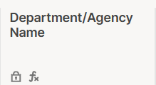
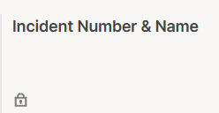
Incident Cost Reporting Process- Phase 1- Estimated Response Cost
Fiscal Year
(Completed by DFRR Analyst)
Auto populates the current Fiscal Year (FY)
*Hidden column
Department/Agency Name
(Completed by DFRR Analyst)
Auto populates the Department/Agency Name
*Hidden column
Incident Number & Name
(Completed by DFRR Analyst)
Auto populates Incident Number and Name.
*Hidden column
Incident Cost Reporting Process
What is Smartsheet?
Setting Up A Smartsheet Account
Conclusion

Slide 7
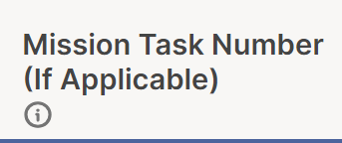
Incident Cost Reporting Process- Phase 1- Estimated Response Cost
Mission Task Number
(Completed by SA)
This is the Task Number assigned to your agency by SOC Operations via Cal OES RRS. If no mission task, put N/A.
County
(Completed by SA)
Counties for which the activities were performed.
Activity Start Date
(Completed by SA)
The initial date of the line item.
Anticipated End Date
(Completed by SA)
When the agency believes the work related to this line item will be completed.
Incident Cost Reporting Process
What is Smartsheet?
Setting Up A Smartsheet Account
Conclusion

Slide 8
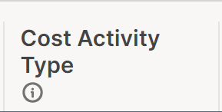
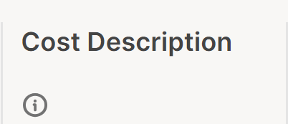
Incident Cost Reporting Process- Phase 1- Estimated Response Cost
Category of Work
(Completed by SA)
FEMA's standard categories of emergency response work.
Cat A: Debris Removal
Cat B: Emergency Protective Measures
Cat H: Fire (CalFire for FMAG only)
Cost Activity Type
(Completed by SA)
Cost Activity such as Personnel Services and OE&E related to the Cost Category.
* Contracts & Procurements should be one per row
* Personnel & Travel should be rolled up according to same criteria (ex: county, date range and category of work)
Cost Description
(Completed by SA)
Brief explanation of what was being done and why.
Incident Cost Reporting Process
What is Smartsheet?
Setting Up A Smartsheet Account
Conclusion

Slide 9
Incident Cost Reporting Process- Phase 1- Estimated Response Cost
Estimated To-Date Costs
(Completed by SA)
A rough calculation of incurred expenses between the Start Date and the most recently completed date.
Projected Remaining Costs
(Completed by SA)
A rough calculation of outstanding expenses from today through the Anticipated End Date.
Total Anticipated Costs
(Auto populated)
The total of the line items Estimated To-Date Costs and Projected Remaining Costs.
Incident Cost Reporting Process
What is Smartsheet?
Setting Up A Smartsheet Account
Conclusion

Slide 10
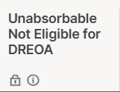
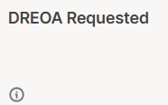
Incident Cost Reporting Process- Phase 1- Estimated Response Cost
Costs Absorbable
(Completed by SA)
Are Anticipated Costs absorbable within your agency's budget? Verify this with your budget/admin office.
* Yes or No
DREOA Need
(Completed by SA)
DREOA-eligible costs which an agency cannot absorb within its budget. Use $ amount.
Unabsorbable Not Eligible for DREOA
(Completed by SA)
Costs not eligible for DREOA, that are not absorbed within an agency’s budget
*Confirm with SA budget/admin office.
DREOA Requested
(Completed by DFRR Analyst)
Agency's requested amount submitted to DOF for their review.
Incident Cost Reporting Process
What is Smartsheet?
Setting Up A Smartsheet Account
Conclusion

Slide 11
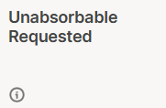
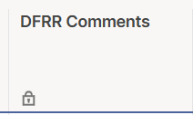
Incident Cost Reporting Process- Phase 1- Estimated Response Cost
Unabsorbable Requested
(Completed by DFRR Analyst)
Costs not eligible for DREOA that are submitted to DOF.
Department Notes/Comments
(Completed by SA)
Additional explanation, projection methodology, and/or questions related to the cost in this row.
DFRR Comments
(Completed by DFRR Analyst)
Any comments made by DFRR Analyst.
Incident Cost Reporting Process
What is Smartsheet?
Setting Up A Smartsheet Account
Conclusion

Slide 12
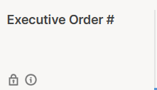
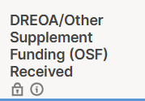
Incident Cost Reporting Process- Phase 1- Estimated Response Cost
Executive Order #
(Completed by DFRR Analyst)
Executive Order (EO)# of the DOF approved supplemental funding.
DREOA/Other Supplement Funding (OSF) Received
(Completed by DFRR Analyst)
DOF's allocated amount of DREOA/OSF to a State Agency.
Incident Cost Reporting Process
What is Smartsheet?
Setting Up A Smartsheet Account
Conclusion

Slide 13
Incident Cost Reporting – Phase 1 - Public Assistance: Permanent Work
Permanent work costs reported by State Agencies are collected as Initial Damage Estimates (IDEs) to inform potential requests for a Major Disaster Declaration (MDD).
Outreach for the reporting of permanent work costs will be distributed concurrently with DFRR’s Incident Cost Reporting outreach.
Notes:
DFRR & Cal OES Recovery would previously conduct separate outreach for the collection of emergency work cost estimates and permanent work cost estimates (for potential MDD requests). To streamline the cost collection process, PA is now utilizing a Smartsheet format to collect permanent work cost estimates.
The request to complete Cal OES Recovery PA’s Permanent Work Smartsheet will be distributed at the same time as that of DFRR.

Slide 14
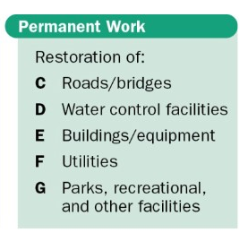
Incident Cost Reporting Process: Permanent Work
Detailed cost reporting of permanent work demonstrates the extent of damage, and the scope of repairs needed. This helps justify the request for federal assistance to repair or replace damaged public infrastructure through FEMA’s Public Assistance (PA) program.
Notes:
California must show that the disaster's damage is significant enough, both statewide and in affected counties, to qualify for federal assistance.
The permanent work scope & cost should capture the necessary work to repair a facility to pre-disaster design & condition.

Slide 15
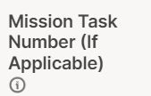
Incident Cost Reporting of Permanent Work
Facility Name
Enter an identifiable name for the damaged site.
EXAMPLE: CalOES Bldg E Roof Damage
Mission Task Number
(If Applicable) This is the Task Number related to the mission provided to your agency by SOC Operations via CalEOC that this line item pertains to.
County
The County the line item relates to. All Counties are available to select, along with SOC when applicable.
Incident Cost Reporting Process
What is Smartsheet?
Setting Up A Smartsheet Account
Conclusion

Slide 16
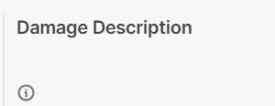
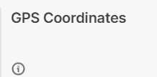
Incident Cost Reporting: Process Permanent Work
Category of Work
Report only permanent work here (Cat C, D, E, F, or G). Category A and B should be reported in Emergency Work Tracker..
Damage Description
Must include dimensions (sizes, quantities, dimensions, volumes, etc.) of the facility. Dimensions of the work that has been completed including materials and work to be completed.
GPS Coordinates
Latitude and Longitude of the Damaged Facility.
Start Date of Facility Damage
The initial damage date of the line item.
Incident Cost Reporting Process
What is Smartsheet?
Setting Up A Smartsheet Account
Conclusion

Slide 17
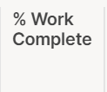
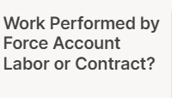
Incident Cost Reporting: Process Permanent Work
Anticipated Work Start Date
When the agency believes the work related to this line item will begin.
Anticipated Work End Date
When the agency believes the work related to this line item will be completed.
% Work Complete
Percentage of Work completed to date.
Work Performed by Force Account Labor or Contract?
Incident Cost Reporting Process
What is Smartsheet?
Setting Up A Smartsheet Account
Conclusion

Slide 18
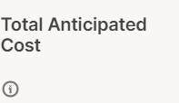
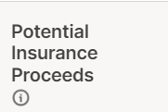
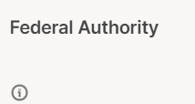
Incident Cost Reporting Process: Permanent Work
Total Anticipated Cost
The total of all Estimated To-Date Costs and Projected Remaining Costs.
Potential Insurance Proceeds
Please indicate if any insurance proceeds are anticipated.
Federal Authority
Is the facility under the authority of another Federal Agency? Select all that apply.
Incident Cost Reporting Process
What is Smartsheet?
Setting Up A Smartsheet Account
Conclusion

Slide 19
Incident Cost Reporting Process: Permanent Work
Teresa Valadez, PM I
Teresa.Valadez@caloes.ca.gov
Silvestre Guerrero-Maya, DAPS I
Silvestre.Guerrero-Maya@caloes.ca.gov
For questions as you complete the Permanent Work Smartsheet, please contact the following members of the PA State Agencies Team.
Notes:
Once initial information is received in the Permanent Work Tracker, PA will be in touch with any clarifying questions or if additional information is needed.

Slide 20
Phase 2 of Cost Reporting
DFRR will request actuals after the incident has been closed for roughly 6-9 months. Actuals include total actual cost, the amount of DREOA/OSF used (if SA received DREOA/OSF), and the dollar amount submitted to FEMA Grants Portal (GP). The columns are highlighted in yellow and are unhidden once DFRR sends the request.
What is Smartsheet?
Incident Cost Reporting Process
Setting Up A Smartsheet Account
Conclusion

Slide 21
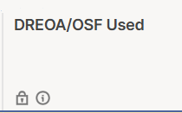
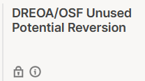
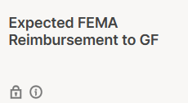
Incident Cost Reporting Process Phase 2 – (Actual Response Cost)
Total Actual Cost
(Completed by SA)
Actual incurred expenses.
DREOA/OSF Funding Used
(Completed by SA)
The DREOA/OSF funding that was used for this cost.
DREOA/OSF Unused Potential Reversion
(Completed by SA)
The DREOA/OSF unused funding that needs to be returned via manual or automatic reversion.
Expected FEMA Reimbursement to GF (Completed by DFRR Analyst)
Expected FEMA Reimbursement to GF.
Incident Cost Reporting Process
What is Smartsheet?
Setting Up A Smartsheet Account
Conclusion

Slide 22
Incident Cost Reporting Process Phase 3 – (FEMA Submission and Reimbursement)
FEMA Project #, PW #, Category of Work
(Completed by DFRR Analyst)
The project#, PW#, and Category of Work assigned by FEMA to a project in Grants Portal.
Project Amount
(Completed by DFRR Analyst)
Total Project Amount submitted to FEMA.
Federal Cost Share Percentage
(Completed by DFRR Analyst)
Percentage of the project amount to be reimbursed with Federal Funds.
Incident Cost Reporting Process
What is Smartsheet?
Setting Up A Smartsheet Account
Conclusion

Slide 23
Returned to General Fund (GF)
(Completed by DFRR Analyst)
The amount of the Federal Obligation that was returned to the GF to offset the DREOA/OSF received.
Paid to State Agency (SA)
(Completed by DFRR Analyst)
The amount of the Federal Obligation returned to the agency.
Notes/Comments
(Completed by DFRR Analyst)
Additional explanation of any other comments.
Obligated Federal Share
(Completed by DFRR Analyst)
Federal Funds that FEMA has awarded for this project.
Incident Cost Reporting Process
What is Smartsheet?
Setting Up A Smartsheet Account
Conclusion

Slide 24
Setting Up A Smartsheet Account
Check your emails for the invite to the Smartsheet
Click on the link in your email
Follow the Job-Aid attached to the email
If additional staff in your agency need access, please contact DFRR at disastercostrecovery@caloes.ca.gov.
Note:
The free account is all you need to work on your Incident Cost Tracker within Smartsheets
There is no need for a license to edit existing sheets you are invited to.
Setting Up A Smartsheet Account
What is Smartsheet?
Incident Cost Reporting Process
Conclusion

Slide 25
Disaster Cost Tracking Summary
Here is what we learned.
Incident Cost Reporting:
What is a Smartsheet?
How are incident costs reported?
Emergency work category A and B (DFRR).
Perm work trackers for cost category C-G (PA).
How do I get access?
Conclusion
What is Smartsheet?
Incident Cost Reporting Process
Setting Up A Smartsheet Account

Slide 26
Glossary
DFRR- Disaster Financial Recovery and Reconciliation
DR- Disaster Response
DREOA- Disaster Emergency Operations Account
FMAG-Fire Management Assistance Grant
FY- Fiscal Year
GP- Grants Portal
IDEs- Initial Damage Estimates
MDD- Major Disaster Declaration
MT- Mission Task
OSF- Other Supplemental Funding
PA- Public Assistance
PDA- Preliminary Damage Assessments
RRS- Resource Request System
SA- State Agency
SOC- State Operation Center
SOE- State of Emergency
Smartsheet Triggers?
Incident Cost Reporting Process
Setting Up A Smartsheet Account
Conclusion

Slide 27
Questions?

