Slide 1
California Wildfire Mitigation Program Authority
January 20, 2026
Home Hardening Initiative
CWMPA Board of Directors Public Meeting

Slide 2
CWMPA Board of Directors Public Meeting
Call To Order and Roll Call
Consent Agenda Items
Welcome Message
Approval of October 21, 2025, Meeting Minutes

Slide 3
California Wildfire Mitigation Program Authority
Home Hardening Initiative
CWMPA Board of Directors Public Meeting
Discussion and Action Items

Slide 4
CWMP Pilot Program Update:
Cal OES Hazard Mitigation Assistance
CWMP Grant Expenditures

Slide 5
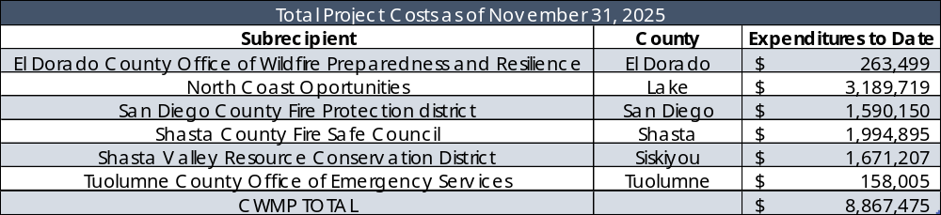
CWMP Grant Expenditures – November 30, 2025
Notes:
Updated to August 31 2024.

Slide 6
CWMP Pilot Program Update:
CAL FIRE
Review the home hardening assessment reports and provide technical recommendations for defensible space and home hardening retrofits
Creating a 2025, California Wildfire Urban Interface Code, Title 24, Part 7 for CWMP subrecipient communities
Update CAL FIRE and CWMP MQS, documents, and websites from Chapter 7A to the new 2025, CWUIC, Title 24, Part 7 language

Slide 7
CWMP Pilot Program Update:
San Diego County Fire Protection District in San Diego County
Site-Work Updates –
Fourteen homes complete
FEMA EHP Update -
Record of Environmental Consideration (REC) for the additional “No-Issue” properties in the expanded area (Batch 1)
Three additional construction complete, pending closeout documents
Four homes in progress
Three homes commencing work in January
Four homes awarded contracts
Six new no-issue applicants in Campo
Submitted nine Phase II reports for “Issue Properties”
Batch 2 (4 properties) have cleared EHP and are pending DHS approval
Has cleared EHP and is Pending Large Project Notification
Batch 3 (5 properties) are in EHP Review

Slide 8
CWMP Pilot Program Update:
Shasta Valley Resource Conservation District in Siskiyou County
Site Work Updates – Batch One – 8 Homes
All site work is complete
Site Work Updates – Batch Two – 7 Homes
All site work is complete
Site Work Updates – Batch Four – 9 Homes
All site work is complete
Site Work Updates – Batch Three – 11 Homes
All site work is complete
Site Work Updates – Batch Five – 7 Homes
Work is in progress

Slide 9
CWMP Pilot Program Update:
Shasta County FireSafe Council in Shasta County
Site Work
Project Area
EHP
25 Homes have been completed
4 Homes in active construction
First Issue property has been submitted to FEMA for phase II Review
Community meetings have been scheduled in each of the project areas
7 SOW In development
In the process prioritizing and creating batches for future submissions
Whitmore: 2/2, 6:00–8:00 PM — Whitmore Community Center
Lakehead: 2/10, 6:00–8:00 PM — Lakehead Lions Club
Oak Run: 2/3, 6:00–8:00 PM — Oak Run VFD (Volunteer Fire Company)
Developed a Fire Safety Workshop that will be covering Defensible Space, Home Hardening, the CWMP, and the local Defensible Space ordinance. There will also be a display table with home hardening materials for homeowners to view and discuss.
Provide paper applications and a space for in-person help
Planned attendees: local CAL FIRE units, CWMP staff, contractors, and an IBHS representative
Outreach: USPS postcard mailers to all addresses in the three communities’ ZIP codes, SCFSFC, RCD and local CAL FIRE Social media posts

Slide 10
CWMP Pilot Program Update:
North Coast Opportunities in Lake County
Site Work
Staff
Entire team has been fully trained and certified to complete home assessments
50 Homes have been completed
6 going out to bid
Project Area
Homeowner cost-share cap limit
8 SOW in progress
12 homes in active construction
Environmental SME/contract
Working on annual botanist contract
Improved coordinators’ ability to clearly explain the program and since its implementation, there have been no homeowners who have backed out.

Slide 11
CWMP Pilot Program Update:
Tuolumne County Office of Emergency Services
Project Updates
The county is actively working on properties and beginning to develop their scopes of work.
Staff
Outreach/Applications
One part time Assessor and Project Manager.
Increasing number of calls from homeowners and contractors who are interested in applying for the program
78 applications in queue waiting to be assessed.
6 applications in SOW Development stage.
An additional 7 applications in draft stage.
Revolving QA meetings have begun with CAL FIRE regarding the assessment to scope of work development process.

Slide 12
CWMP Pilot Program Update:
El Dorado County Office of Wildfire Preparedness and Resilience
Project/EHP Update
Staff
74 No Issue Properties
Community Outreach
Full time construction manager and 4 assessors have been hired.
Increasing number of calls from homeowners who are interested in applying for the program
Revolving QA meetings have begun with CAL FIRE regarding the assessment to scope of work development process.
Three additional construction managers have been brought on.
30 Applications with 4 completed assessments ready for review/SOW

Slide 13
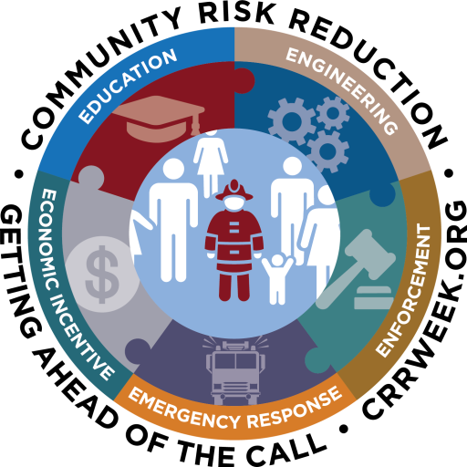
CWMP Authority - Executive Director Report
  Community Risk Reduction (CRR) Week is January 19–26, 2026
  CRR Week | CRR Week
  CRR Week is a grass-roots effort by an informal group of fire safety professionals from across the nation. The idea is to help promote the awareness of Community Risk Reduction within the fire service by having a week where everyone can do CRR programs and demonstrate its importance to the fire service.

Slide 14
CWMP Authority - Executive Director Report
CWMP Monthly Status Report
Support to Local and State Wildfire Home Hardening Efforts
  Oregon State Fire Marshals Office
  Ventura Regional Fire Safe Council
  Altadena & Palisades damaged and undamaged homes retrofits
  LA County Incidents: Historic Structures Hardening Guidance
  LA County Incidents: Recovery Support Strategy or Rebuild Support Strategy Rebuild & Long-Term Recovery Task Force - County/State/Fed
Wildfire Home Hardening and CWMP Program Presentation to:
  Long-Term Housing Recovery Meeting
  California Climate and Energy Collaborative (CCEC), Local Energy Resources Network (LERN) Meeting
  Metropolitan Transportation Commission (MTC) and the Association of Bay Area Government's (ABAG's), Wildfire and Housing - What's New?
2025 Form 700
General Liability Insurance Acquisition: Golden State Risk Management Authority

Slide 15
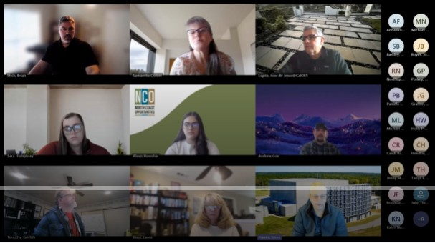
CWMP Authority - Executive Director Report
  Partnerships
  IBHS Wildfire Prepared Home Training for CWMP Pilot Sub-applicants
  Neighborhood Partnership Housing Services (NPHS)
  Coordination to enhance project productivity
  California Local Conservation Corps (CLCC)
  Team Rubicon
  Senate Bill 254: The California Legislature passed and Governor Gavin Newsom signed SB254, which requires a comprehensive assessment to analyze and develop long-term reforms that protect access to insurance, reduce litigation costs, provide fair and expeditious compensation to claimants, support wildfire mitigation, safety, and community resilience, and ensure large electrical corporations are accountable for safety and also have the financial health to attract low-cost capital on behalf of ratepayers.
  As directed by SB 254 (2025), the California Earthquake Authority (CEA), in its role as Administrator of the California Wildfire Fund, is responsible for preparing and delivering a report (Study) that includes findings and recommendations.

Slide 16
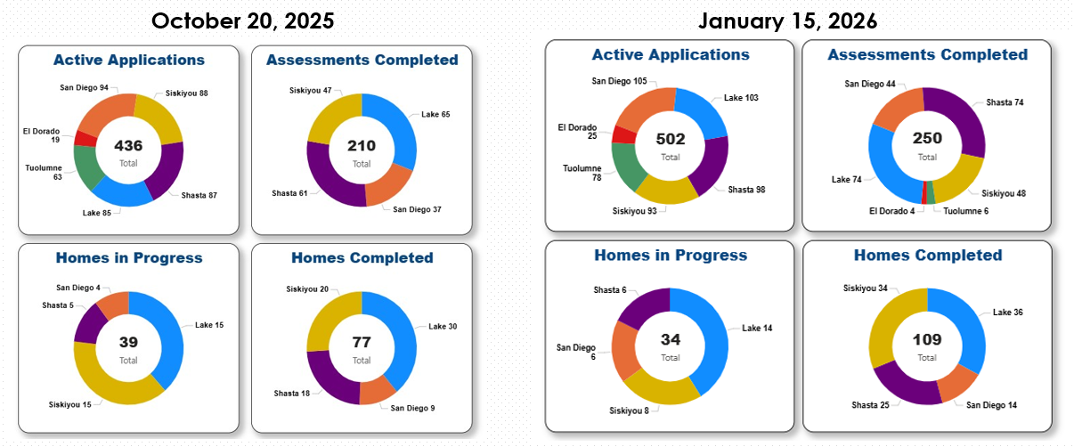
CWMP Authority - Executive Director Report

Slide 17
CWMP Pilot Program Next Steps
CWMP Funding Budget Act 2022 (AB-179) Funding $13 Million
  ~$6 Million Committed to Siskiyou County for HMGP Grant ~$24 million
  ~$7 Million Committed to Riverside County for HMGP Grant ~$26 million
  Both Projects submitted to FEMA on 11/21/2024 utilizing funding opportunity DR-4699-CA (California Severe Winter Storms, Straight-line Winds, Flooding, Landslides, and Mudslides) FEMA Review will take ~7-12 months.
  Update: 13 million reverted per 2025-26 State budget
SB-946 Personal Income Tax Law: Corporation Tax Law: exclusions: wildfire mitigation payments.(2023-2024)
Proposition 4
  Grants under the Home Hardening Program to retrofit, harden, or create defensible space for homes at high risk of wildfire to protect California communities

Slide 18
CWMP Pilot Program Next Steps
SECTION 1. Section 91510 of the Public Resources Code is amended to read:
  91510. (a) Of the funds made available by Section 91500, $135,000,000 shall be available, upon appropriation by the Legislature, to the Office of Emergency Services for a wildfire mitigation grant program. The Office of Emergency Services shall coordinate with the Department of Forestry and Fire Protection in administering these moneys. The grant program shall assist local and state agencies to leverage additional funds, including matching grants from federal agencies. Funds may be used to provide loans, rebates, direct assistance, and matching funds for projects that prevent wildfires, increase resilience, maintain existing wildfire risk reduction projects, reduce the risk of wildfires to communities, or increase home or community hardening. Projects shall benefit disadvantaged communities, severely disadvantaged communities, or vulnerable populations.

Slide 19
CWMP Authority - Executive Director Report
Assembly Bill No. 38:
Prescribed Disclosure Notice
This bill, on or after January 1, 2021, would require the seller of any real property located in a high or very high fire hazard severity zone to provide a prescribed disclosure notice to the buyer, if the home was constructed before January 1, 2020, of information relating to fire hardening improvements on the property and a list of specified features that may make the home vulnerable to wildfire and flying embers and which features, if any, that exist on the home of which the seller is aware.
The bill, on or after July 1, 2025, would require the disclosure notice to also include the State Fire Marshal’s list of low-cost retrofits. The bill would also require a seller who has obtained a specified final inspection report to provide to the buyer a copy of that report or information on where a copy may be obtained.
Bill Text - AB-38 Fire safety: low-cost retrofits: regional capacity review: wildfire mitigation.

Slide 20
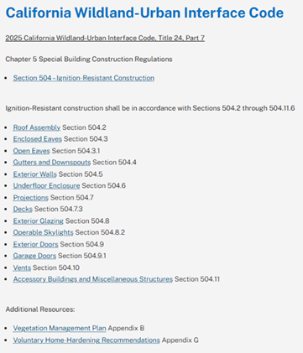
CWMP Authority - Executive Director Report
2026 Online Updates
CWMPA Staff has implemented the following updates to our OES Hosted CWMP Resource Center
New 2026 Low-Cost Retrofit List
MQS 2.1
Dedicated section for CWUIC with links to respective ICC pages (shown to right)
Reviewed all Resource Center links to ensure desired navigation

Slide 21
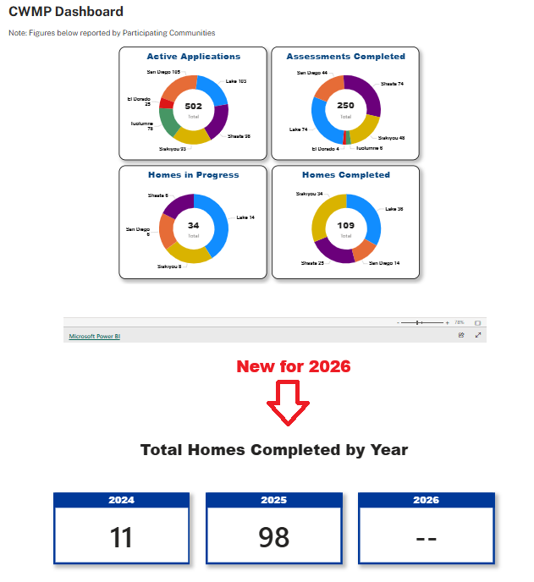
CWMP Authority - Executive Director Report
2026 Online Updates
CWMPA Staff has implemented the following updates to our OES Hosted CWMP About Page
Addition of Total Homes Completed by Year, which will auto generate daily as respective records are updated by Participating Communities (image shown to right as of January 15, 2025)

Slide 22
CWMP Authority - Executive Director Report
  Assembly Bill 2469: No later than July 1, 2028, the joint powers authority shall submit a report to the Legislature, in compliance with Section 9795, regarding the implementation of the wildfire mitigation financial assistance program administered pursuant to this article.

Slide 23
Resolution No. 2026-01: A Resolution of the California Wildfire Mitigation Program Authority to add the Department of Insurance as an Ex Officio Nonvoting Member to the California Wildfire Mitigation Program Authority Board of Directors
Recommendation: Adopt Resolution 2026-1
CWMPA Member Agencies to amend CWMP Joint Exercise of Powers Agreement
Discussion regarding AB 1531. Adoption of Resolution No. 2026-01

Slide 24
CWMPA Staff Recommendation: For current HMGP Funded CWMP Projects, at the conclusion of their respective period of performance, continue with State Only home hardening projects with balance of previously committed SB-85 dollars until all dollars are utilized, or the SB-85 liquidation period is reached.
Discussion and Action regarding future utilization of SB 85 funds

Slide 25
CWMP Board of Directors Public Meeting
Board Member Comments
Public Comment
Adjournment
Meeting Schedule
Next meeting is February 17, 2026
715 P Street, 2nd Floor Conference Room 2-221, Sacramento, CA 95814
CWMPA Monthly Meeting Schedule

Slide 26
California Wildfire Mitigation Program Authority
Home Hardening Initiative
CWMP Board of Directors Public Meeting

