Slide 1


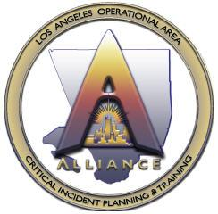
Los Angeles
Regional Alliance

Slide 2

Los Angeles Regional Alliance
  The Alliance Concept
    Ryan Rockabrand, Los Angeles County OEM/The Alliance
  Mass Evacuation Overview
    Sergeant Eric Fox, Los Angeles County Sheriff’s Department

Slide 3

A Whole Community Approach
A Holistic Planning Methodology
“We need to move away from the mindset that Federal and State governments are always in the lead, and build upon the strengths of our local communities and, more importantly, our citizens. We must treat individuals and communities as key assets rather than liabilities.”
- W. Craig Fugate, FEMA Administrator

Slide 4
Who is the Whole Community?…
VOLUNTEER, FAITH, NON-PROFIT AND COMMUNITY-BASED ORGANIZATIONS, THE PRIVATE SECTOR, AND THE PUBLIC, INCLUDING SURVIVORS THEMSELVES
Who is that to me?…

Slide 5
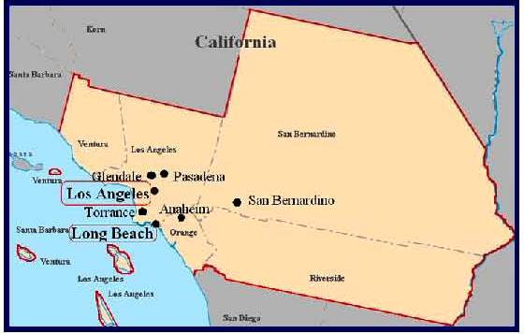
Combined Statistical Area
5 counties
35,000 square miles
18 million people
Over 1 million tourists
Over 150 countries & languages represented

Slide 6
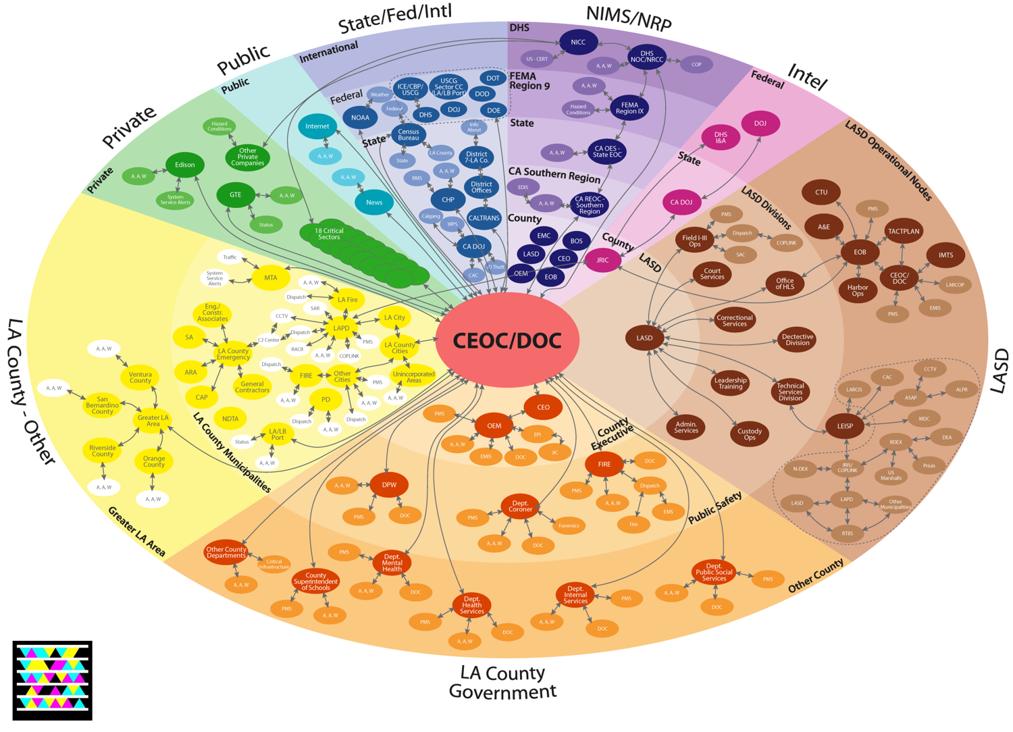
My LA County Stakeholders

Slide 7
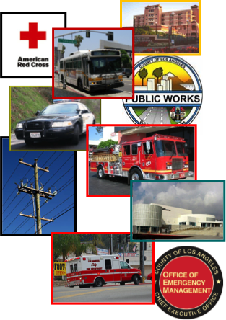

The Alliance
  Multi-Jurisdiction
  Multi-Agency
    All 5 Counties
    Police & Fire
    Emergency Managers
    Public Safety Officials
    First Responder Agencies
    Public Works
    Parks & Recreation
    Transportation (Public & Private)
    Volunteer Agencies
    Hospitals
    Schools and Colleges
    Utilities and Infrastructure Operators
    Private Sector Partner Stakeholders

Slide 8
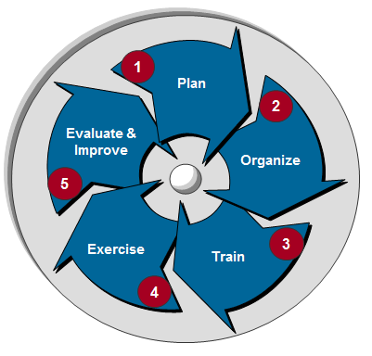
Plan, Train, Exercise
Organize and Staff - Develop plans to organize and staff catastrophic plans to ensure adequate support to review, develop, implement, and revise plans as needed.
Train - Develop and implement plans to effectively train newly developed regional catastrophic plans with communities, States, nonprofit organizations, and the private sector, as well as other regional partners.
Exercise - Develop and implement plans to exercise regional catastrophic plans to test capabilities and interdependencies between jurisdictions based on regional threats.
Evaluate and Improve - Assess ability of plans to address regional catastrophic needs, evaluate findings, and develop corrective action plans to improve plans based on lessons learned.

Slide 9

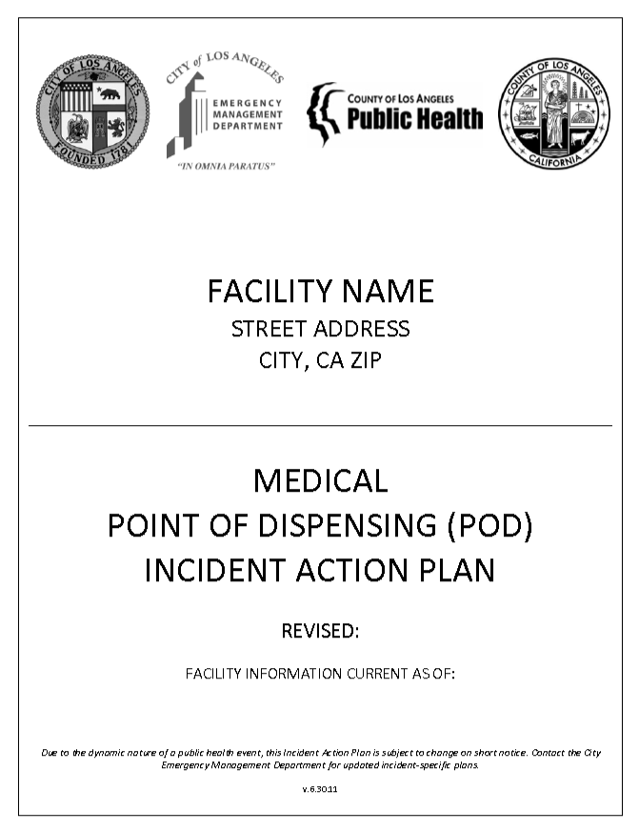
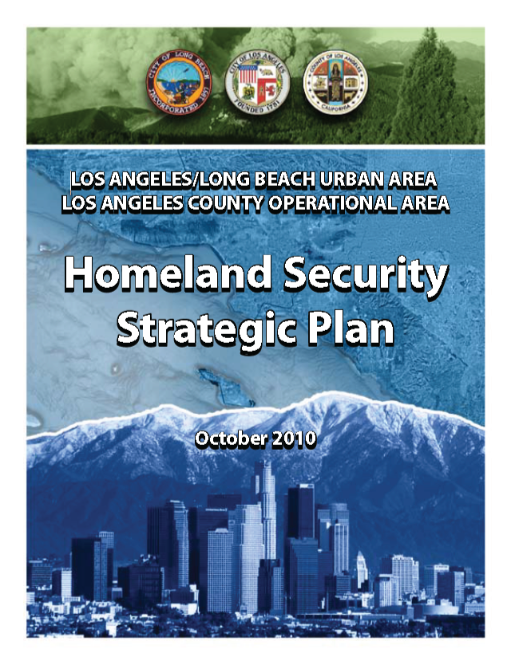
What To Do
Support mechanism to member organizations
Address specific objectives defined by leadership, grant guidance and gaps identified in the Homeland Security Strategic Plan
Serve as the liaison between locals and the beltway
Empower stakeholders
Offer ‘White-label’ solutions

Slide 10
How To Operate/Sustain
Funding Mechanisms:
  Grants
  501c3’s
    NGOs
    Foundations
  COGs
  Private Sector
Offer assistance via:
  Fiscal year end spending
  Match requirements

Slide 11
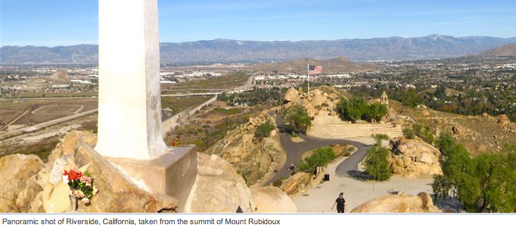
Governance
Regional Catastrophic Planning Team (RCPT)
  Membership includes direct or indirect representation of all jurisdictions from CSA for regional planning
  Coordinates the development & implementation of grant initiatives
  Develops & maintains the Charter (working groups)
  Cultivates sustainment strategies

Slide 12
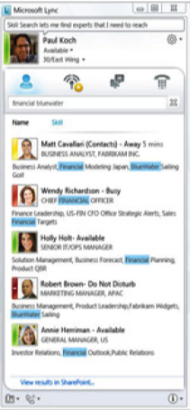
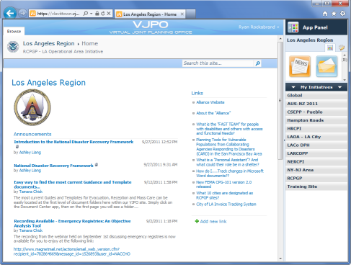
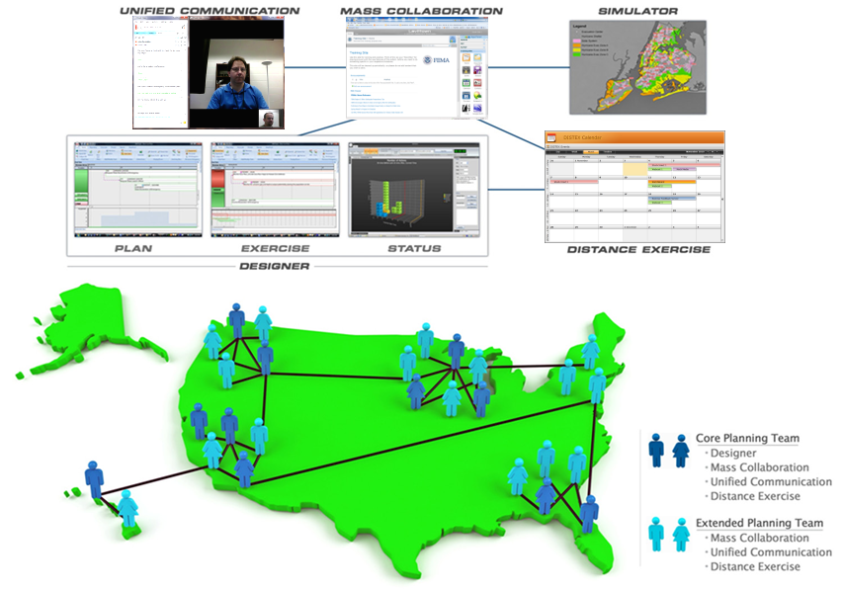
VJPO / Lync

Slide 13
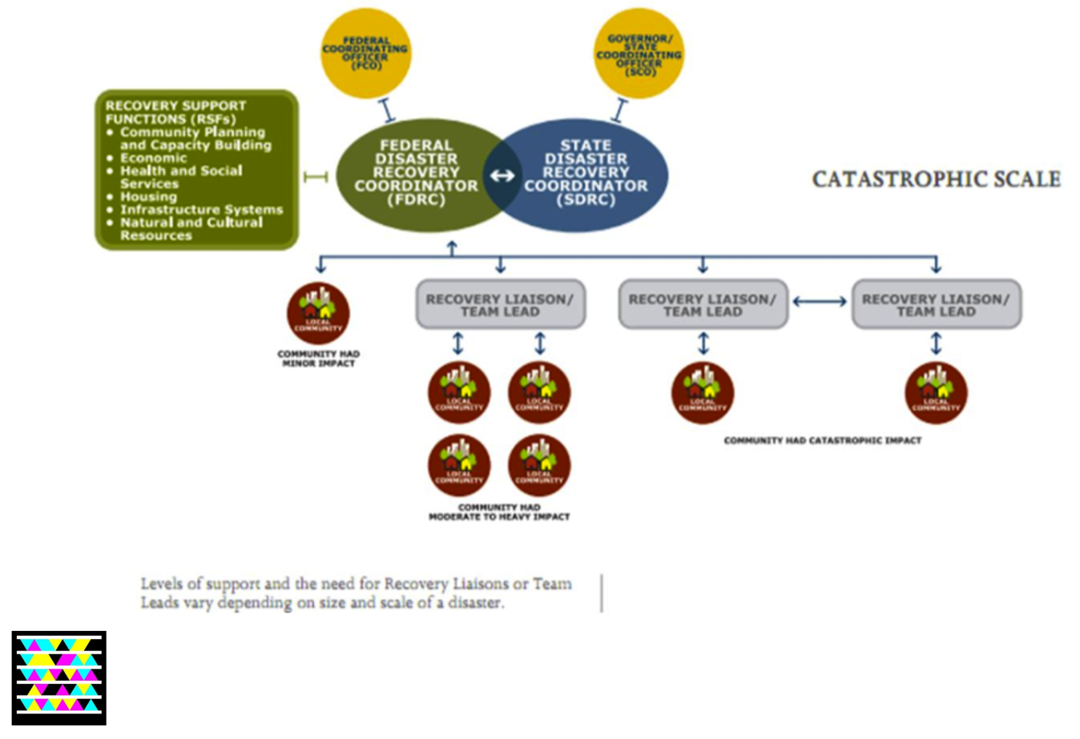
Federal, State, Local Integration

Slide 14

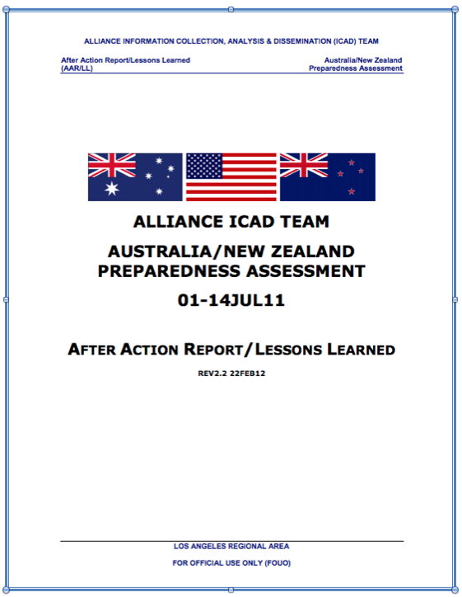
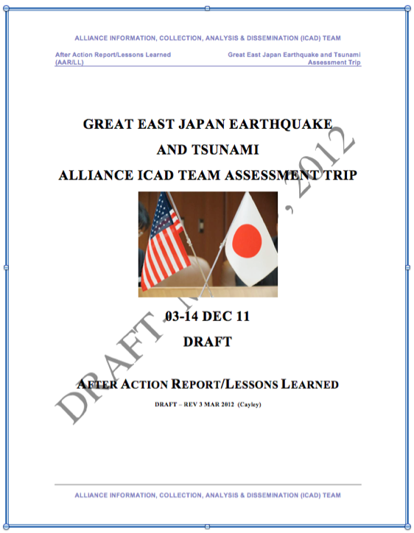
Alliance ICAD Missions
Information Collection, Analysis & Dissemination Teams
  Domestic: Houston, Miami, Mississippi, Seattle, Atlanta, San Francisco, New Orleans, New York
  International: Chile, Australia/New Zealand, Japan

Slide 15
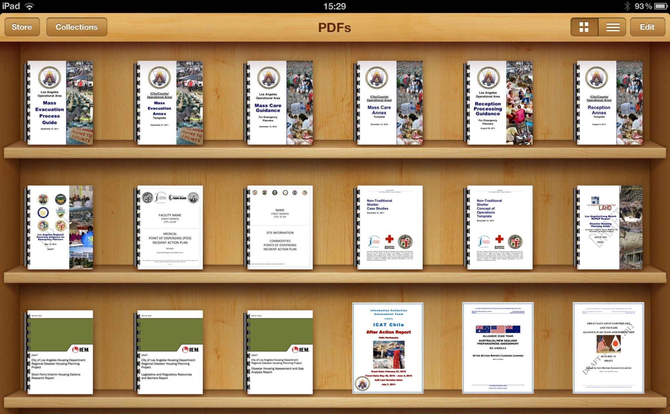
Alliance Projects In Detail

Slide 16


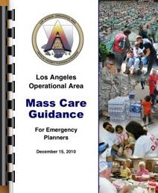
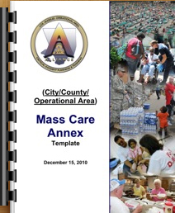
Mass Care & Shelter
Addresses Planning Processes for Mass Care Functions:
Services: Sheltering, Feeding, Bulk Distribution, Basic First Aid, and Disaster Welfare Information
Four Associated Annexes: Household Pet Sheltering, Medical and Health, Non-Traditional Sheltering, and Transportation Management

Slide 17

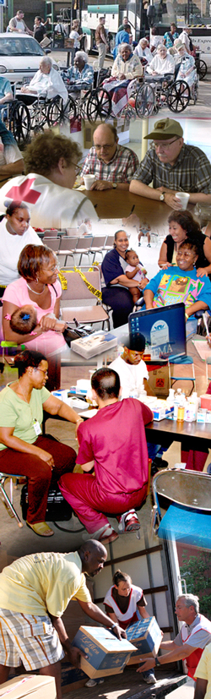
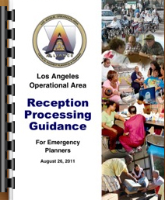
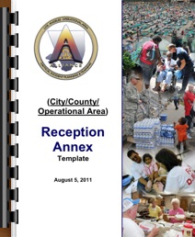
Reception Processing
Guide Addresses Processes:
Types of Reception Sites: Pickup, Evacuation, Transfer, Info Points
Reception Processing Sites vs Shelter Reception Area
Critical Coordination Points: Decon, Medical Triage, FAC, LAC, VRC
Concept of Operations, Planning Considerations & Strategies
Reception Site Locations, Services, Scalability Operational Design
Reception Logistics, Admin & Finance, Return & Re-Entry

Slide 18
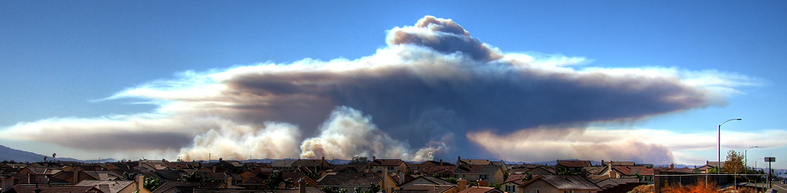
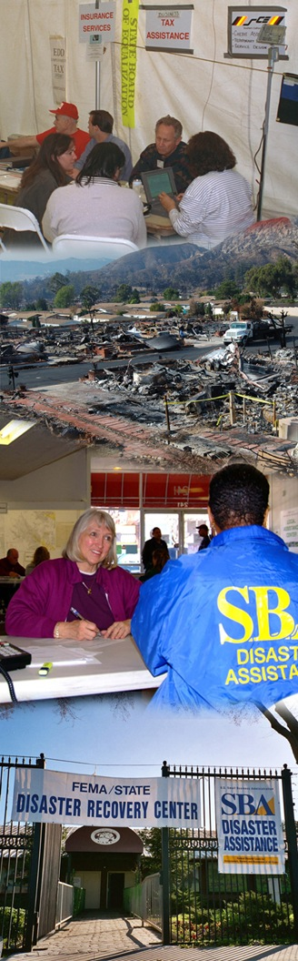
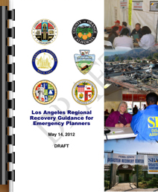
Regional Recovery
Identifies planning principles when developing recovery plans, emphasizing consistency with the recently released National Disaster Recovery Framework
Identifies functional roles and responsibilities to manage recovery operations
Explains the relationships between Emergency Functions (EF) used during response and Recovery Support Functions (RSF) and the transition to recovery
Emphasizes a ‘Whole-of-Community’ approach to recovery planning and recommendations for incorporating community-based organizations and private-sector partnerships in the process
Provides detailed planning guidance for each of the six RSFs necessary for successful recovery following a catastrophic event:
    Community Planning and Capacity Building RSF
    Economic RSF
    Health and Social RSF
    Housing Recovery RSF
    Infrastructure Systems RSF
    Natural and Cultural Resources RSF

Slide 19

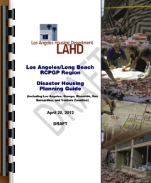
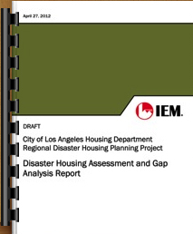
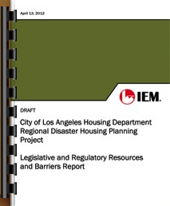
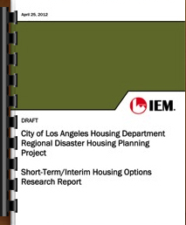
Disaster Housing
Disaster Housing Working Group - Disaster awareness and preparation by the region’s housing industry; Includes private and public sector participants
Assessment & Gap Analysis Report
Conduct an assessment and gap analysis of disaster housing preparations within the five county region
Short-Term/Interim Housing Options Report
Create an inventory of all short-term housing options in the Region
Safety Assessment Module (SAM) Software
Web application for conducting damage assessments
Disaster Housing Planning Guide
Guide for local jurisdictions which includes checklists of critical information needed for planning purposes and resources for information gathering
Legislative & Regulatory Resources Report
Research legislative and regulatory resources to identify legal authorities that can facilitate or prevent pre and post-disaster residential recovery and reconstruction

Slide 20
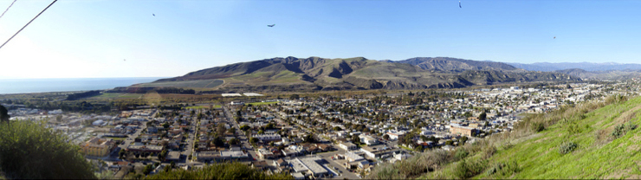
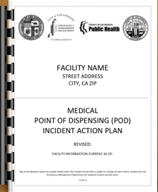
Medical Points of Dispensing (M-PODs)
Direct support of Federal Emergency Support Function #8 - Public Health and Medical Services
Expand upon each jurisdiction’s capability to provide mass prophylaxis
Each jurisdiction has developed and maintain site-specific POD plans by:
  Conducting facility assessments
  Writing facility use plans, and
  Developing security and traffic management strategies
To regionalize these plans, the working group and counties established a regional POD planning process and identified minimum plan components. Each member of the group included project colleagues in POD exercises and plan peer review.

Slide 21
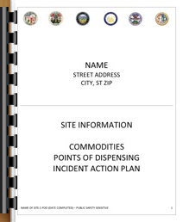
Commodities Distribution
(C-PODs)
There are two major project components:
1) Develop a site-specific CD Plan for 20 independent sites (identified below), located in all five counties, using a prescribed CD Plan Template and guidelines. A site is defined as an open area that is paved, concrete, or gravel hard-stand, typically ranging from one to three acres (e.g. a large parking lot).
2) Identify and log commodity-based businesses in the five counties using the provided Business Database Template, and generate a map with that data in ArcGIS.
Number of Sites Per Jurisdiction for Site-Specific Planning Project
    •Los Angeles City - 5
    •Los Angeles County - 6 (for areas excluding LA City)
    •Orange County - 3
    •Riverside County - 2
    •San Bernardino County - 2
    •Ventura County – 2

Slide 22
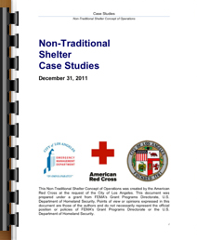
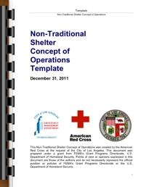
Non-Traditional Sheltering

Slide 23

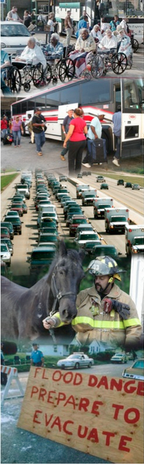
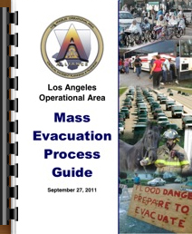
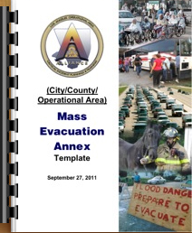
Mass Evacuation
Guide Addresses Processes:
Rapid reference guide for Pre/Post-Incident Planning and Direction
Evacuation Management
Continuity of Operations/Government (COOP/COG)
Access and Functional Needs Populations
Communications
Private and Non-Governmental Organization (NGO) Cooperation

Slide 24

Tag Us For More Information
www.catastrophicplanning.org
Notes:
www.catastrophicplanning.org

